Slide 1
On-Demand Dynamic
Software Analysis
Joseph L. Greathouse
Ph.D. Candidate
Advanced Computer Architecture Laboratory
University of Michigan
December 12, 2011
Notes:
This talk was given for the AMD Tech Topics series on December 12, 2011. (Thanks to Matthew Stringer and Martin Pohlack). This is basically a mix of my ISCA2011 talk along with some very preliminary slides from my ASPLOS 2012 talk. See the ISCA slides for detailed notes of what all the animations mean.

Slide 2


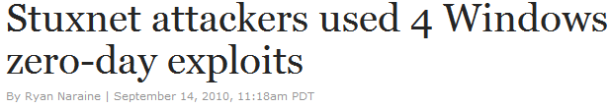
Software Errors Abound
NIST: SW errors cost U.S. ~$60 billion/year as of 2002
FBI CCS: Security Issues $67 billion/year as of 2005
  >⅓ from viruses, network intrusion, etc.
Cataloged Software Vulnerabilities

Slide 3
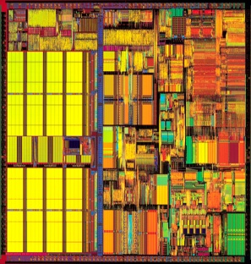
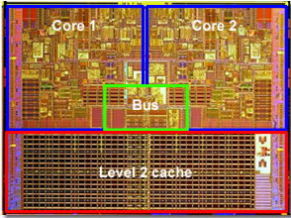
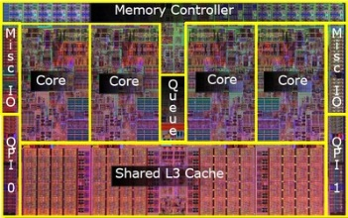
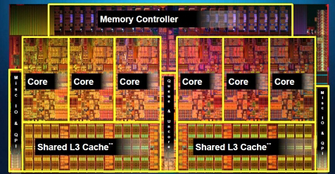
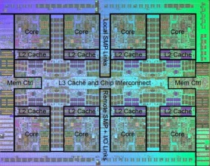

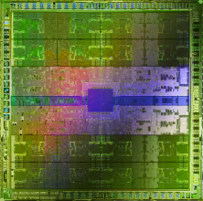



Hardware Plays a Role
In spite of proposed solutions
Bulk Memory Commits
Hardware Data Race Recording
Deterministic Execution/Replay
TRANSACTIONAL
MEMORY
Bug-Free Memory Models
Atomicity Violation Detectors
AMD ASF?
IBM BG/Q

Slide 4
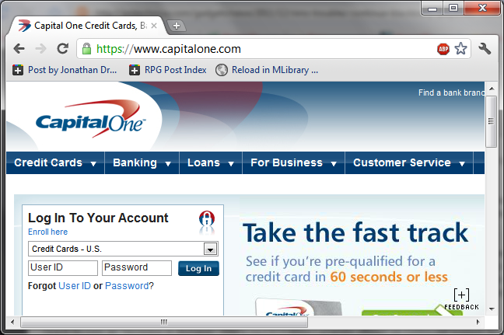
Example of a Modern Bug
Thread 1
Thread 2
mylen=small
mylen=large
Nov. 2010 OpenSSL Security Flaw
if(ptr == NULL) {
len=thread_local->mylen;
ptr=malloc(len);
memcpy(ptr, data, len);
}
ptr
∅

Slide 5
Example of a Modern Bug
Thread 1
Thread 2
mylen=small
mylen=large
TIME
if(ptr==NULL)
if(ptr==NULL)
len2=thread_local->mylen;
ptr=malloc(len2);
len1=thread_local->mylen;
ptr=malloc(len1);
memcpy(ptr, data1, len1)
memcpy(ptr, data2, len2)
ptr
LEAKED
∅

Slide 6




Dynamic Software Analysis
Analyze the program as it runs
  System state, find errors on any executed path
  LARGE runtime overheads, only test one path
Analysis Instrumentation
Program
Instrumented Program
In-House
Test Machine(s)
Developer
Analysis Results
LONG run time

Slide 7
Runtime Overheads: How Large?
Data Race Detection
(e.g. Inspector XE)
Memory Checking
(e.g. MemCheck)
Taint Analysis
(e.g.TaintCheck)
Dynamic Bounds Checking
2-300x
2-200x
5-50x
10-80x
Symbolic Execution
10-200x

Slide 8
Could use Hardware
Data Race Detection: HARD, CORD, etc.
Taint Analysis: Raksha, FlexiTaint, etc.
Bounds Checking: HardBound
None Currently Exist; Bugs Are Here Now
Single-Use Specialization
  Won’t be built due to HW, power, verification costs
  Unchangeable algorithms locked in HW

Slide 9
Goals of this Talk
Accelerate SW Analyses Using Existing HW
Run Tests On Demand: Only When Needed
Explore Future Generic HW Additions

Slide 10
Outline
Problem Statement
Background Information
  Demand-Driven Dynamic Dataflow Analysis
Proposed Solutions
  Demand-Driven Data Race Detection
  Unlimited Hardware Watchpoints

Slide 11
Example Dynamic Dataflow Analysis
Data
Input
Meta-data
Associate
x = read_input()
x = read_input()
validate(x)
Clear
Propagate
y = x * 1024
y = x * 1024
w = x + 42
Check w
Check w
a += y
z = y * 75
Check z
a += y
z = y * 75
Check z
Check a
Check a

Slide 12




Demand-Driven Dataflow Analysis
Only Analyze Shadowed Data
Instrumented
Application
Instrumented
Application
Native
Application
No meta-data
Shadowed Data
Non-Shadowed Data
Meta-Data Detection

Slide 13
Finding Meta-Data
No additional overhead when no meta-data
  Needs hardware support
Take a fault when touching shadowed data
Solution: Virtual Memory Watchpoints
FAULT
V→P
V→P

Slide 14
Results by Ho et al.
From “Practical Taint-Based Protection using Demand Emulation”
System | Slowdown (normalized)
Taint Analysis | 101.7x
On-Demand Taint Analysis | 1.98x

Slide 15
Outline
Problem Statement
Background Information
  Demand-Driven Dynamic Dataflow Analysis
Proposed Solutions
  Demand-Driven Data Race Detection
  Unlimited Hardware Watchpoints

Slide 16
Software Data Race Detection
Add checks around every memory access
Find inter-thread sharing events
Synchronization between write-shared accesses?
  No? Data race.

Slide 17



Data Race Detection
Thread 1
Thread 2
mylen=small
mylen=large
TIME
if(ptr==NULL)
len1=thread_local->mylen;
Shared?
ptr=malloc(len1);
Synchronized?
memcpy(ptr, data1, len1)
if(ptr==NULL)
len2=thread_local->mylen;
ptr=malloc(len2);
memcpy(ptr, data2, len2)

Slide 18
SW Race Detection is Slow
Phoenix
PARSEC

Slide 19
Inter-thread Sharing is What’s Important
“Data races ... are failures in programs that access and update shared data in critical sections” – Netzer & Miller, 1992
Thread-local data
NO SHARING
TIME
if(ptr==NULL)
len1=thread_local->mylen;
ptr=malloc(len1);
Shared data
NO INTER-THREAD SHARING EVENTS
memcpy(ptr, data1, len1)
if(ptr==NULL)
len2=thread_local->mylen;
ptr=malloc(len2);
memcpy(ptr, data2, len2)

Slide 20
Very Little Inter-Thread Sharing
Phoenix
PARSEC

Slide 21

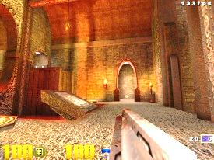

Use Demand-Driven Analysis!
Software
Race Detector
Software
Race Detector
Multi-threaded
Application
Inter-thread sharing
Local Access
Inter-thread Sharing Monitor

Slide 22
Finding Inter-thread Sharing
Virtual Memory Watchpoints?
  ~100% of accesses cause page faults
Granularity Gap
Per-process not per-thread
Must go through the kernel on faults
Syscalls for setting/removing meta-data
Inter-Thread Sharing
FAULT
FAULT

Slide 23
Hardware Sharing Detector
HITM in Cache: W→R Data Sharing
Hardware Performance Counters
Core 1
Core 2
S
S
HITM
Write Y=5
M
Y=5
I
Read Y
I
Perf. Ctrs
PEBS
Debug Store
Pipeline
1
0
-
EFLAGS
EIP
RegVals
MemInfo
FAULT
0
-1
Armed
-
Cache
0
1
-
Precise
Fault
0
-

Slide 24
Potential Accuracy & Perf. Problems
Limitations of Performance Counters
  HITM only finds W→R Data Sharing
  Hardware prefetcher events aren’t counted
Limitations of Cache Events
  SMT sharing can’t be counted
  Cache eviction causes missed events
  False sharing, etc…
PEBS events still go through the kernel

Slide 25
On-Demand Analysis on Real HW
> 97%
Execute Instruction
NO
HITM
Interrupt?
NO
Analysis
Enabled?
Disable Analysis
YES
YES
NO
< 3%
Enable Analysis
SW Race Detection
Sharing Recently?
YES

Slide 26
Performance Difference
Phoenix
PARSEC

Slide 27
Performance Increases
Phoenix
PARSEC
51x

Slide 28
Demand-Driven Analysis Accuracy
1/1
2/4
2/4
2/4
3/3
4/4
4/4
3/3
4/4
4/4
4/4
Accuracy vs. Continuous Analysis: 97%

Slide 29
Outline
Problem Statement
Background Information
  Demand-Driven Dynamic Dataflow Analysis
Proposed Solutions
  Demand-Driven Data Race Detection
  Unlimited Hardware Watchpoints

Slide 30
Watchpoints Globally Useful
Byte/Word Accurate and Per-Thread

Slide 31
Watchpoint-Based Software Analyses
Taint Analysis
Data Race Detection
Deterministic Execution
Canary-Based Bounds Checking
Speculative Program Optimization
Hybrid Transactional Memory

Slide 32
Challenges
Some analyses require watchpoint ranges
  Better stored as base + length
Some need large # of small watchpoints
  Better stored as bitmaps
Need a large number

Slide 33
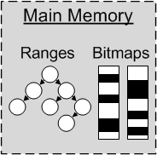
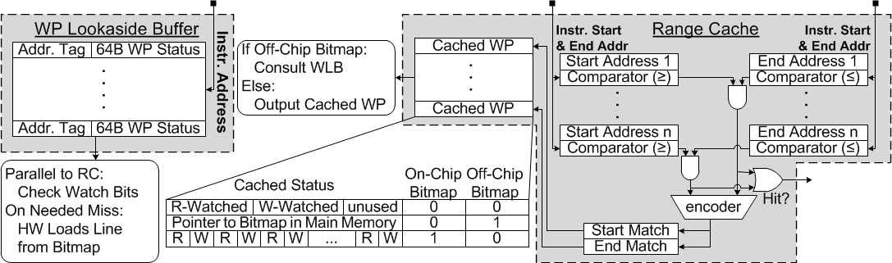
The Best of Both Worlds
Store Watchpoints in Main Memory
Cache watchpoints on-chip

Slide 34
Demand-Driven Taint Analysis

Slide 35
Watchpoint-Based Data Race Detection
Phoenix
PARSEC

Slide 36
Watchpoint Deterministic Execution
Phoenix
SPEC OMP2001

Slide 37
BACKUP SLIDES

