Slide 1
DVFS Space Exploration in Power-Constrained Processing-in-Memory Systems
Marko Scrbak and Krishna M. Kavi
Computer Systems Research Laboratory
Department of Computer Science & Engineering
University of North Texas, USA
Joseph Greathouse and Nuwan Jayasena
AMD Research - Advanced Micro Devices, Inc., USA

Slide 2
Introduction
End of Dennard scaling
Power and thermal challenges for modern processor design
Heterogeneous computing and sophisticated DVFS techniques can increase computational efficiency
Memory bandwidth becomes a bottleneck
3D-stacked memory, e.g. HMC (Micron), HBM (JEDEC standard)
Offer high-bandwidth, lower latency, lower energy/access
Place compute logic within 3D-stack: Processing-in-Memory (PIM)
Relax off-chip bandwidth requirements
Minimize power consumption by reducing excess data movement
We show that compute intensive kernels should execute on host
bandwidth intensive applications should execute on PIMs.
Even for compute intensive kernels, PIMs are preferred in power constrained environments
Notes:
Dennard scaling says that power density stays constant with decreasing transistor size because power goes down proportionally with area.
This is not true anymore as the power doesn’t decrease proportionally with area -> Increasing processor compute efficiency can’t be done by shoving more transistors on running high frequency (complex cores).
Instead, we went to multicore. To further tackle the problem we went to heterogeneity -> GPUs and CPUs on same silicon (APUs), to increase compute efficiency.
This only solves part of the problem; now the cores can’t run at their maximum operating frequencies (because of power density cap) -> DARK SILICON.
DVFS tackles this problem -> run at lower frequencies and lower voltage if you want to use all cores, and run at higher frequency and voltage when you are using fewer cores.
So now we can use all cores (or many of them), but to support multiple threads of execution we need to have available bandwidth and MLP in the system to feed the threads with the data they need.
This creates pressure on the memory system, mostly in the form of high bandwidth requirement.

Slide 3
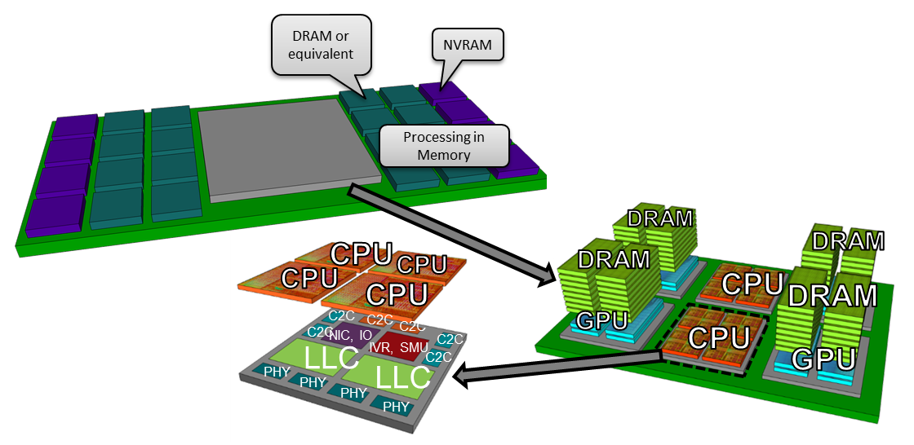
Introduction
Possible HPC Node Architecture
On-package stacked memory with GPUs (APUs)
Off-package board-level memory with PIM
Off-package memory accesses are more expensive in terms of latency and energy
Notes:
This is the vision as seen by AMD. Future HPC nodes will consist of a high performance APU (CPU and GPU capabilities) with possible on-chip 3D stacked DRAM limited in capacity.
Higher capacity 3D-DRAM will be available off-stack, at the expense of higher latency and lower bandwidth.
One proposed solution to tackle expensive off-chip memory accesses is to have PIMs. They are advocating GPUs as PIMs for number of reasons (programmability and high throughput mostly).
So we focused on GPUs as PIMs and compare them to running kernels on the host GPUs (inside the APU). The data is always assumed off-chip – it is uncertain will on-chip 3D-DRAM be feasible in near future due to thermal and power constraints. Also the capacity will be limited.

Slide 4
Introduction
PIMs can be implemented using a low leakage processes
No need for high performance (high frequency) as the performance improvement would be compensated by exploiting high in-stack bandwidth
What type of architecture to use for PIMs?
Previously (ARCS-2015) we evaluated 16 ARM cores per stack. Here we evaluate GPUs as PIMs
GPUs as PIM
Energy efficient, high compute and memory throughput, mature programming models, uniform power dissipation
PIMs target memory intensive applications
Locality based computing
Bandwidth constrained applications
Performance gain from high bandwidth and data locality
Less compute intensive than the host APU
No need for high CU count and high engine frequency
More energy efficient than host
In this work we evaluate optimal choice between PIMs and Host APUs-- for application kernels
Notes:
Other alternatives for PIM are possible.
ARM cores, Dataflow, FPGA, fixed-function PIMs, ASICs targeting only specific domains (graph processing, machine learning, etc.).
We evaluated ARM cores, and one problem is the low bandwidth utilization. So we also explore GPUs for the reasons listed above. Also, AMD is favoring GPUs for the same reasons and this research, which was done as a part of an internship, aligns with their research requirements.
Other alternatives have their pros and cons, and there is no general consensus what is best. But GPUs are favored by the industry.

Slide 5
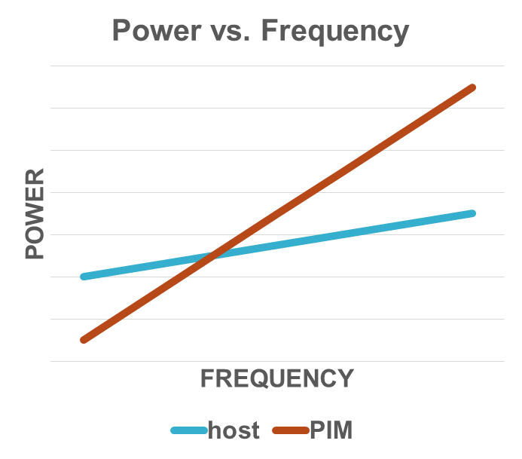
Motivation
Cartoon Example
Different power and performance characteristics for PIM and host
PIM can compensate for low frequency by exploiting high memory bandwidth
Host can run at high frequencies, maximizing performance for compute intensive applications
Host has higher leakage
PIM consumes more power at higher frequencies
Notes:
Compute intensive kernels can rely on high core count, larger LLC, high frequency -> host.
Memory intensive kernels can rely on high bandwidth, lower latency (no need or high freq. and core count) -> PIM.
Different requirements -> different process technology -> different power/performance characteristics -> interesting tradeoffs -> OUR RESEARCH.

Slide 6
DVFS optimization - example
Optimizing for maximum performance, minimum power and minimum ED²
An Example: miniFE
 | dotprod | matvec | waxby
HOST |  | 1GHz | 1GHz
PIM | 600MHz
 | dotprod | matvec | waxby
HOST
PIM | 400MHz | 400MHz | 400MHz
MAX PERFORMANCE
MIN POWER
 | dotprod | matvec | waxby
HOST
PIM | 500MHz | 400MHz | 500MHz
We use AMD in-house simulator to gather performance statistics for host and PIM
We developed power model for PIM based on host and technology roadmaps
Dynamic power – DVFS characteristics for host and PIM
Leakage power – relative difference in leakage power between host and PIM
MIN ED2
Notes:
This may not be a great example since for Min Power and ED2, we are indicating PIMs are better than host.
This is not always the case as we will show later (absolutely right). It is just an illustrative example. Here the best performance varies between PIM and host, and best ED2 has different DVFS states (but for PIM). In some cases the best ED2 moves to the host, running at different DVFS states, as we will see later.
This all depends on the performance characteristics of the kernels and power characteristics of the hardware.
The performance characteristics of the kernels depend on the algorithm implementation. In this case we are looking at linear algebra algorithms (dot product, mat-vector multiply and w=ax + by).
IN THIS SPECIFIC CASE: dotprod kernel has low arithmetic intensity and needs lot of data per FLOP. Its performance scales with available memory bandwidth (PIM). Matvec relies on a form of register/cache blocking (optimized AMD library) and relaxes the BW requirement making it compute intensive (runs better on host). (Ref. Last Slide in Backup slides – ARITHMETIC INTENSITY)

Slide 7
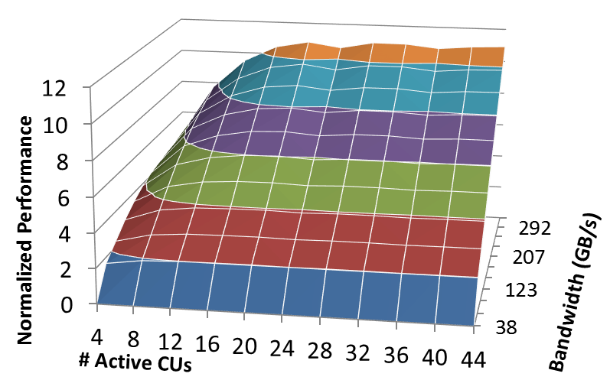
Performance model
How do we estimate GPU kernel performance for some future hardware configuration?
If we know how the performance scales with (current) HW resources (CUs, memory bandwidth, frequency) then we can estimate the performance using performance scaling curves for a target HW configuration
We can create a performance scaling curve by running the kernel on a GPU and change HW configurations (CUs, Mem. Bandwidth, Frequency).
The plot is generated by running each kernel on 720 different hardware configurations
Using these plots we can obtain performance for other hardware configurations
Notes:
The curve is created by running the kernel on 720 different HW configurations.
If we were to simulate any of those HW configurations, it would be trivial.
But if we want to know something in between, then we can interpolate between 2 known points.
The same is true if we want to know what happens outside the curve.
We can extrapolate to a future HW configuration, like we do for host/PIM.
The only thing is that we have to use 2 points which have THE SAME CU/BW RATIO, as the main assumption is that the performance improvement stays constant on the same CU/BW curve.
Example: to know the performance at 120CU, 600 GB/s we need 2 points: these would be 12 CU and 60 GB/s and say 24 CU and 120 GB/s. If we know by how much the performance changes between those two points we can extrapolate to 120CU, 600GB/s because the performance improvement we get each time by incrementing by 12 CU will remain the same (as we keep increasing the Bwidth at the same time).

Slide 8
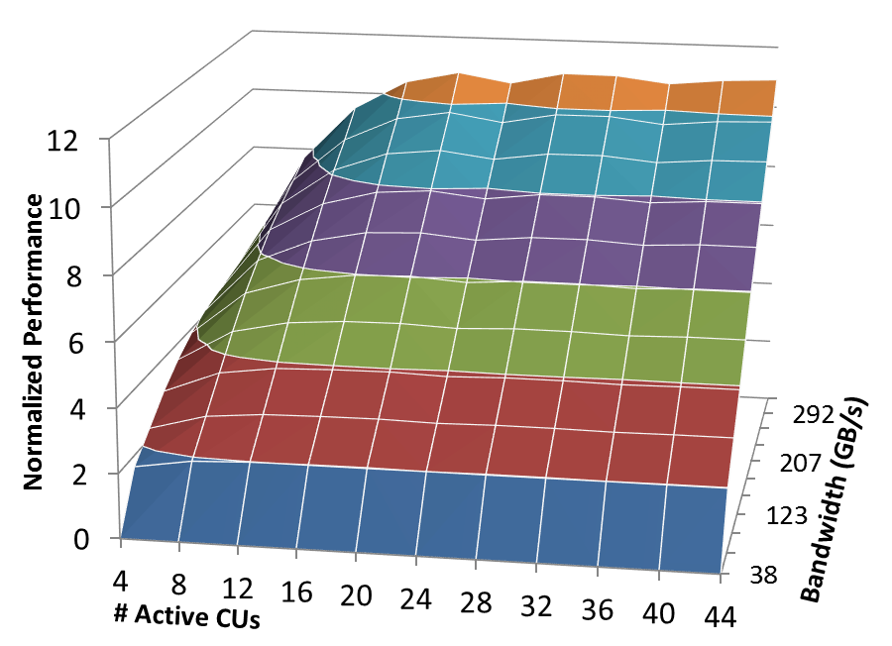
GPU Performance SCALING
If we want to know the performance at 40 CUs and 200 GB/s, we can gather performance data on a Base Hardware Configuration (e.g. 20 CUs, 120 GB/s)
Start from a Base Hardware Configuration and predict performance for a Target Hardware Configuration (e.g. 40 CUs, 200 GB/s) by following the performance scaling curve for that particular kernel
How do we get a performance scaling curve?
Run the kernel at all possible HW configurations -> tedious process
Use a ML model, trained on known kernel scaling curves
Notes:
Base HW configuration is some number of Cus and BW we can set on the GPU and get the data
Target HW configuration is not something we can measure directly but it will be interpolated/extrapolated using the measured points in the scaling curve.
Also, our PIM/host points lie way outside the curve so we will extrapolate instead of interpolating between two known points.
BackupSlide Performance Model BACKUP (num.45) shows how we would estimate something outside the performance scaling curve using extrapolation.

Slide 9
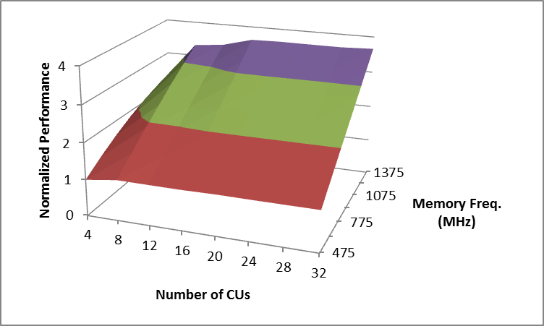
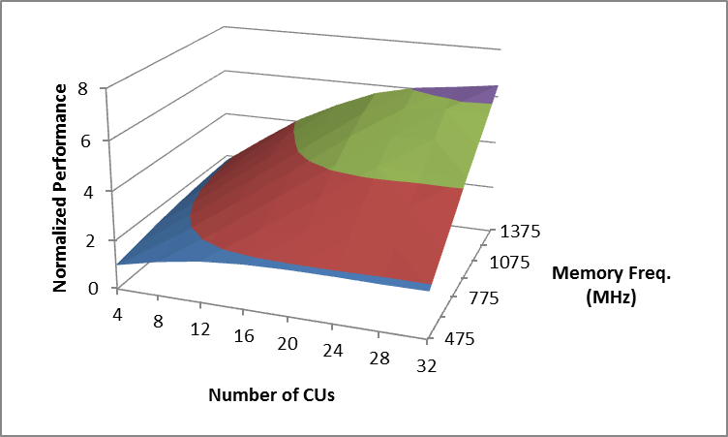
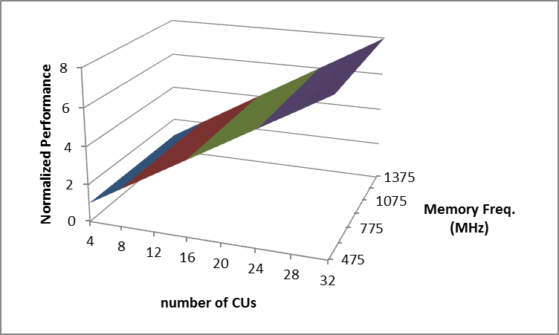
Performance model
Training Set
Kernel 1
Kernel 2
Kernel 3
Collect performance scaling curves for many kernels running on an AMD Workstation class GPU
Group similar kernels into clusters using machine learning techniques
We can then classify new applications into known clusters
And predict performance for new applications
Kernel 4
Kernel 5
Kernel 6
Cluster 1
Cluster 2
Cluster 3
Notes:
Scaling curves were collected on AMD W9100 (Hawaii) GPU. Frequency ranges from 400MHz-1000MHz, memory bandwidth from 32 GB/s – 320GB/s, CU count from 8-44. Total of 720 configurations.
We run these configurations for 200 kernels.
Specific names are not important.
But for instance cluster 1 would be memory bound kernels (example kmeans and miniFE). Cluster 2 balanced kernels (B+tree and backprop). Cluster 3 is compute bound kernels (MaxFlops example).
There are more than 3 clusters, this is just for illustration. For more details readers can refer to HPCA 2015 “GPGPU Performance and Power Estimation Using Machine Learning” by Gene Wu.

Slide 10
Performance model
Cluster 1
?
Performance Counter Values
(from base configuration)
Machine Learning Classifier
Cluster 2
?
?
Train a ML Classifier
Use that ML Classifier to match a new kernel to a cluster and get the performance scaling curve for that cluster -> fast compared to running the kernel through 720 different HW configurations!
Estimate the performance as explained previously (slide 8)
Cluster 3
Notes:
There are multiple clusters, for each of the CU configurations. It gets a bit complicated to explain. It took me a month to completely understand the details and the purpose of such design.
You can refer them to Gene Wu’s paper from HPCA 2015 “GPGPU Performance and Power Estimation Using Machine Learning”

Slide 11
Power model
Total Power = Dynamic Power + Leakage Power
Predicting power is more complex
Dynamic power depends on switching activity, which in turn depends on capacitance, threshold voltage and frequency
The capacitance depends on
V/f scaling factors
Technology scaling (14nm or smaller)
process – high voltage or low voltage threshold devices
We use kernels that produce 100% switching activity and then scale for others
Static (or leakage power) is primarily based on
technology scaling
technology processes (high voltage or low voltage threshold devices)
We use AMD internal simulations and models for this purpose

Slide 12
Power model
DYNAMIC POWER
Start with a known dynamic power
Maximum dynamic power at 100% cac on Hawaii (1000MHz/1.2V)
Scale by number of CUs
Scale by frequency and voltage (technology dependent)
Scale capacitance (technology dependent, going from Hawaii 28nm – 14nm = 0.65)
Scale by the relative switching activity
$cac_{rel}= \frac{P_{dynamic}}{Pmax_{dynamic}}$ at a specific hardware point
$P_{dynamic}=Max.Dyn.P_{Hawaii}∗\frac{CU_{target}}{CU_{base}}∗\frac{f_{target}}{f_{base}}∗{\left(\frac{V_{target}}{V_{base}}\right)}^{2}∗Cap.Scaling∗cac_{rel}$
Notes:
Max.Dyn.P hawaii = maximum dynamic power consumed by a standalone high-end GPU. Something known we can measure and then scale. For Hawaii that’s 125W.
So we start with 125 W and scale it using these 5 factors.
CU target = target number of CUs (say 192 CUs); CU base = Hawaii total CUs: 44
f target = target frequency (say 800 MHz); f base = Hawai frequency: 1000MHz
V target = target Voltage (say 0.8 V), this will depend on the V/f curve; V base = Hawaii voltage at 1GHz (1.2 V)
Cap.Scaling = how much does the power change only because of feature size scaling (going from 28nm to 14nm) – magic number derived from AMDs spreadsheets: 0.65
- that means the power will be lowered by 35% by reducing the feature size from 28nm to 14nm FinFET (only because of capacitance scaling; it will be lower because we can also lower voltage/freq etc.).
CACrel = relative switching activity. Relative switching activity is how much does the switching activity change because we change the HW configuration.

Slide 13
Power model – V/f characteristics
The V/f characteristics of PIM and host will depend on the process technology and variation
A chip design is built using multiple types of transistors to target different tradeoffs (high-performance vs. low power)
HVT – High Threshold Voltage causes less power consumption and timing to switch is not optimized. Used to minimize power consumption for power critical functions.
LVT – Low Threshold Voltage causes more power consumption and switching timing is optimized. Used on the critical path
SVT (MVT) – Standard Threshold Voltage offers trade-off between HVT and LVT i.e., moderate delay and moderate power consumption.

Slide 14
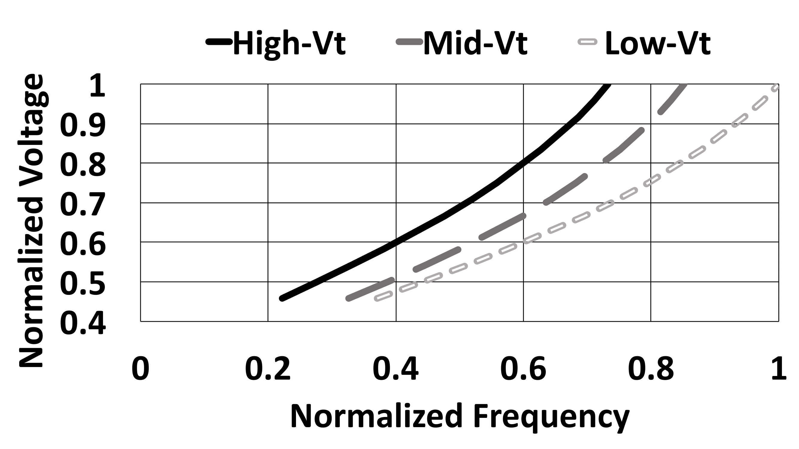
Power model – v/f characteristics
Typical V/f characteristics of HVT, MVT and LVT transistors

Slide 15
Power model
We use AMD internal tool/database to get:
V/f curves for a 14nm chip similar to Hawaii GPU (high-performance process)
Relative difference in leakage power between host and PIM for different VT distributions (HVT/MVT/LVT)
We assume same V/f curve for PIM and host but limit the operating frequency of PIM to a lower frequency range
PIM will deviate from that curve at higher frequencies
Since we can’t determine what is the “cutoff” frequency for PIM we examine the leakage power for different VT distributions
Notes:
To more accurately model dynamic power for host and PIM we need to know what they V/f curves will look like. The previous slide shows what the V/f curves look like for threee different types of transistors.
The host device will be like a modern GPU today. Mostly consisting of MVT and HVT devices.
The V/f curve will be the one of MVT up to a certain point, after which the curve will start looking like the HVT curve (that is we can’t get higher frequencies because HVT transistors now limit the clock speed). For host, since it will be like Hawaii GPU, this will happen much later than for PIM (after 1GHz).
When will it happen for PIM? Well it is hard to say because of factors like process variation, exact mix of devices, etc.
Since we can’t know the exact frequency when will that happen and for which mix of devices, we limit our operating frequency at a lower range (400-600 MHz) and look how leakage power changes with different mixes.
We argue that with a higher ratio of low leakage devices PIMs should be able to operate around 500MHz.

Slide 16
Power model – v/f characteristics
We pick a V/f curve for a 14nm chip similar to Hawaii for a specific type of transistors
And limit the operating frequencies
Host frequency: 600MHz-1000MHz
PIM frequency: 400MHz-600MHz
Notes:
What is the exact V/f curve for host and PIM? It is hard to know that because of process variation, exact mix of devices, technology improvement, etc.
Instead, we know what the V/f curves are for three different types of devices – we get this from AMD internal tools.
We know that the host GPU will be a high-end GPU like Hawaii and will have similar transistor mix – 50/50 HVT/MVT. And it will be able to operate easily up to a GHz.
So we pick the Mid-Vt curve for Hawaii. We limit the operating frequency up to a 1 GHz because after that the curve will start looking like High-Vt curve.
When will it happen for PIM (certainly not up to a GHz because they will have more High-Vt transistors)? Well it is hard to say because of factors like process variation, exact mix of devices, etc.
Since we can’t know the exact frequency when will that happen and for which mix of devices, we limit our operating frequency at a lower range (400-600 MHz) and look how leakage power changes with different mixes.
We argue that with a higher ratio of low leakage devices PIMs should be able to operate around 500MHz.

Slide 17
Leakage power
We use AMD internal tool/database to get:
Relative difference in leakage power between host and PIM for different VT distributions
We get leakage for a given type of transistors
We use this information to model the relative difference in leakage power and use this as leakage scaling factor between PIM and host
Notes:
We can’t get the leakage power directly but we can get the leakage values for circuits built out of different types of transistors.
We can use this info to get the relative leakage between different types of transistor mixes.
We can then use this information to get the actual leakage of host and PIM (that is if we have at least one known total leakage – next couple of slides explain how we do it)

Slide 18
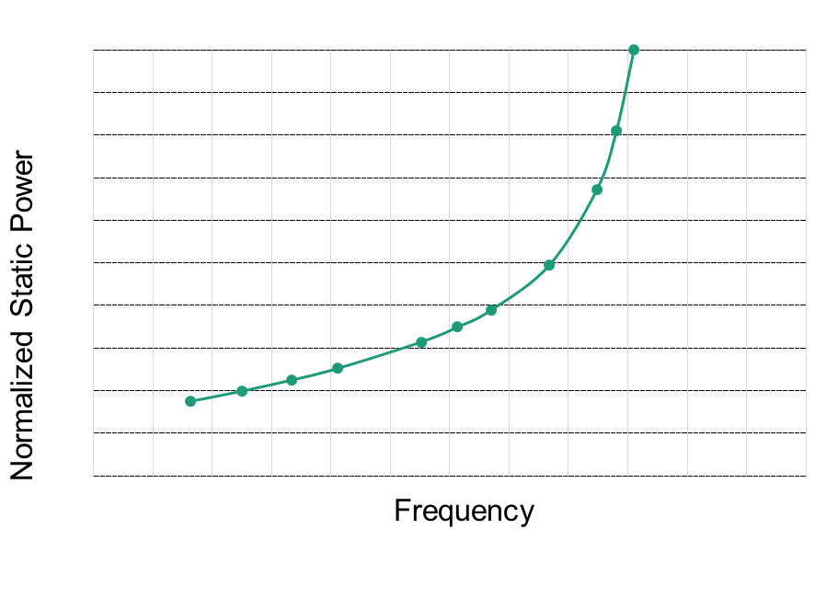
Power model – Leakage power
The curve represents how static power changes with frequency for a circuit built of 50/50 HVT/MVT devices
Obtained from AMD tools
All the data points are relative leakage power normalized to the highest leakage power (right-most point)
So how do we get the leakage?
Notes:
This is the data we get from AMD internal tool. The tool can give the leakage of a small circuit built out of HVT/MVT transistors.
That data is useless to us in terms of absolute values (couple nW). But we can use that information to get how does the leakage change relatively to the right-most point.
We can also know how does it change relatively to diferent HVT/MVT mixes.
We only need to calculate the rightmost point.

Slide 19
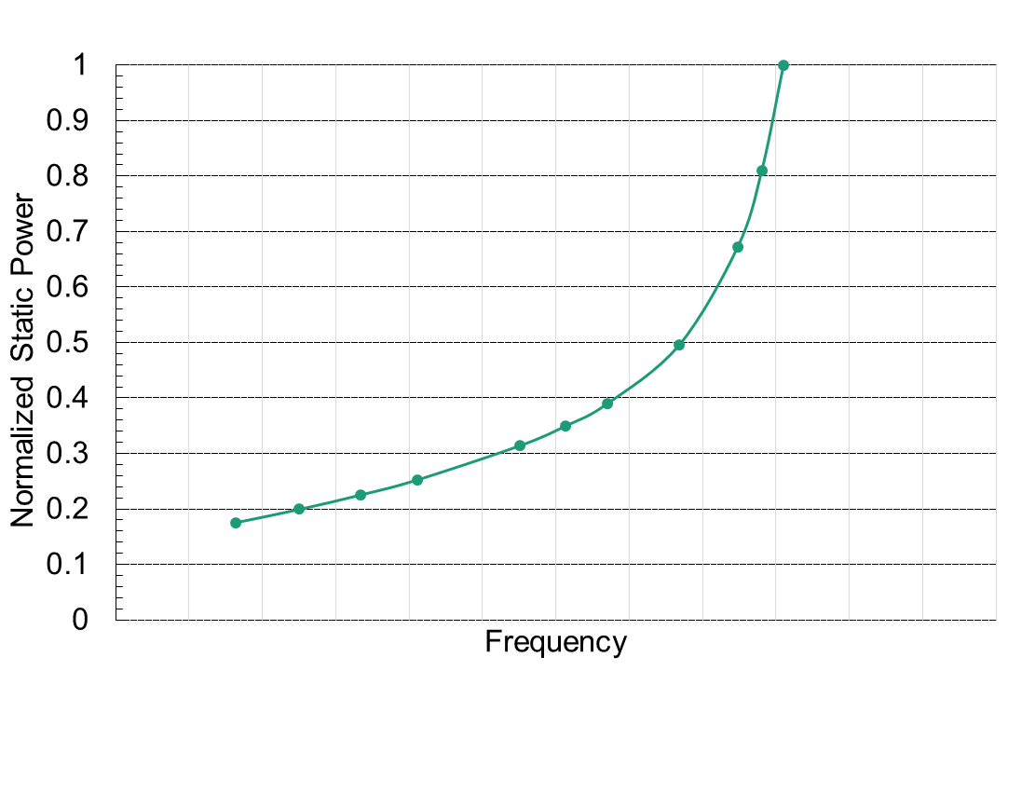
Power model – Leakage power
Pick a baseline point and estimate the leakage power at this particular V/f point
In our case the baseline point is at 1.2V (at 1200MHz)
We need to know the actual leakage power for that V/f point[watts]
We will estimate leakage power using well established estimates – 30% of the TDP
So, we first estimate Dynamic power at maximum switching activity

Slide 20
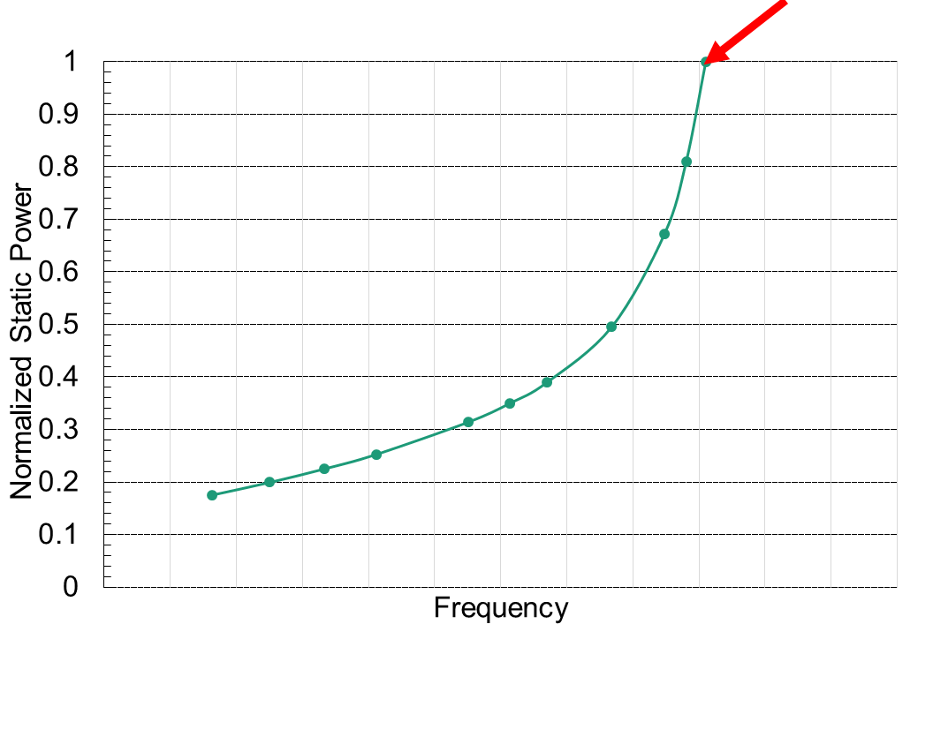
Power model – Leakage power
Previous designs (and models) show that 30% of TDP as leakage is a good estimate
TDP = Max.Dyn.Power + Leakage
Calculate Max.Dyn.Power for host at 1.2V/1200MHz
$$P_{leak}=MAX.DYN.POWER∗\frac{0.3}{1−0.3}$$
We can calculate the maximum dynamic power by using the formula for 100% switching activity
(Max.Dyn.Power Hawaii is at 1V/1GHz/32nm;
we need 1.2V/1.2GHZ/14nm)
$P_{dynamic}=MAX.DYN.POWER_{Hawaii}∗\frac{CU_{target}}{CU_{base}}∗\frac{f_{target}}{f_{base}}∗{\left(\frac{V_{target}}{V_{base}}\right)}^{2}∗Cap.Scaling∗cac_{rel}$
Notes:
Once we know the dynamic power of the right-most point (at 100% switching activity) we can get estimate the leakage power number.
A good estimate, shown by Borkhar in some of his talks, and Nuwan in TOP-PIM paper, and some other papers, is 30% if TDP.
Now we have a number calculated for the rightmost point.
Since this line represents 50/50 mix (host), the total is estimated at 250W (14nm host – 256 CUs at 1GHz/1V).

Slide 21
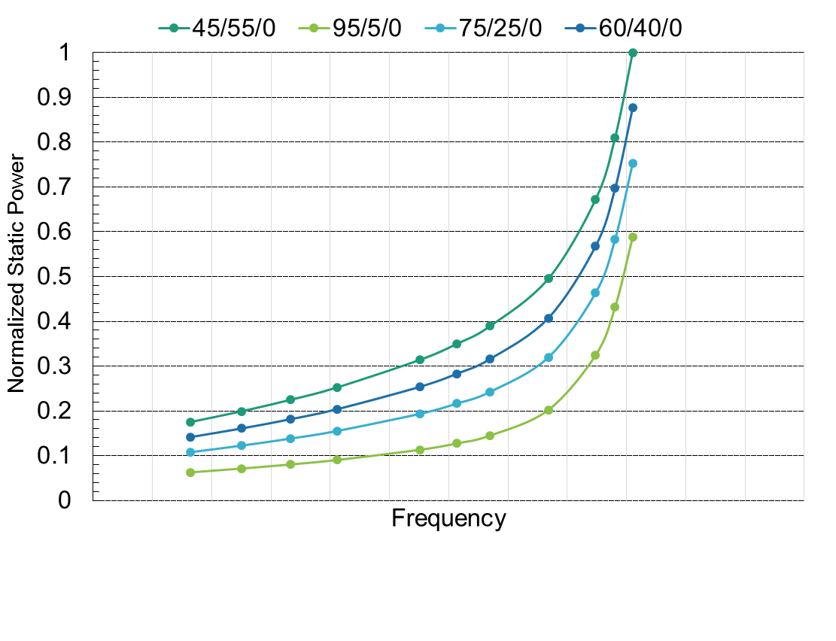
Power model – Leakage power
250W
Baseline point in our case is 250W
Scale leakage power relative to the base point for different VT breakdowns
105W
35W
Based on the leakage power, we can decide on the processing mix we need to achieve that power goal and the DVFS state to operate
Notes:
So in order to find out the leakage power at some lower frequency, we can simply scale the 250W number down to whatever frequency we are looking at (just follow the curve).
If we want to know the leakage for a differetn mix, we can just calculate it from the relative differences between two curves, say bottom blue and top green.
These are the leakage numbers for diferent frequencies and mixes calculated by scaling the starting number of 250 W.
We use this method to calculate host and PIM leakage in the next slides.

Slide 22
Experiments and Results Baseline System
PIM +
DRAM
PIM +
DRAM
HOST
256 CUs
1 TB/s aggregate bandwidth
600MHz – 1000MHz
PIM
8 x 24CUs = 192 CUs
2 TB/s aggregate bandwidth
400MHz – 600MHz
The number of CUs and BW are somewhat constrained by the capabilities of AMD’s HLSim
Host APU
PIM +
DRAM
PIM +
DRAM
PIM +
DRAM
PIM +
DRAM
PIM +
DRAM
PIM +
DRAM
Notes:
If anyone asks, these are indeed large number of compute units and this is certainly an aggressive design, but according to people at AMD it is definitely something possible.
The main reason we sticked to these numbers is the simulator capabilities.
In order to estimate the performance based on the performance scaling curves, our design (compute to bandwidth capabilities) has to fall within the curves.
Since we are simulating high total bandwidth (1TB/s and 2TB/s) we need a high number of CUs to match the current compute-to-bandwidth capabilities.
Example. A state-of-the-art AMD gpu has 44CUs and 320GB/s BW. We are simulating 2 TB/s. That would be equivalent of compute-to-bandwidth 280 CUs - 2048GB/s.
Also, refer to backup slide 44. Performance Model. Our compute to bandwidth ration has to fall within that curve. Whether it is 8CU/320GB/s or 44CU/40GB/s.

Slide 23
Baseline System
PIM +
DRAM
PIM +
DRAM
Host and PIM in 14 nm process
Host HVT/MVT/LVT – 45/55/0
PIM: 95/5/0, 75/25/0, 60/40/0
All of our leakage is assumed to be at some fixed temperature (e.g.100°C)
Performance counters collected on Hawaii (28nm) 1000MHz, 1.2V, 1250MHz memory frequency
Host APU
PIM +
DRAM
PIM +
DRAM
PIM +
DRAM
PIM +
DRAM
PIM +
DRAM
PIM +
DRAM

Slide 24
Leakage power comparison
Minimizing leakage power is important as it is the most significant power contributor for bandwidth intensive applications
We can rely on HTV implementation of PIM devices as they will compensate any performance losses by exploiting high bandwidth
HVT/MVT/LVT
Notes:
192 CUs in 8 stacks = 24 per stack (slide 26 – Baseline System: PIM)

Slide 25
DVFS optimization
Adjusting engine frequency (and voltage) to maximize energy efficiency
Trying to find optimal placement of kernels (PIM/host) such that we maximize energy efficiency
Comparing execution time with power constraints
All results are normalized to the best case for each kernel

Slide 26
Target = Minimum ED²
Addition of PIMs to a heterogeneous node architecture can yield high energy efficiency even compared to applications running on host running at lower DVFS states
Power will be significantly reduced, at the expense of small performance loss leading to great energy efficiency
PIMs aren't necessarily the most energy-efficient choice for computation in all cases
Compute intensive applications like MaxFLops and Nbody favor host (at lower DVFS state) over PIM
Notes:
ED2 optimal may involve some kernels on host and some on PIMs (while trying to minimize total ED2)
while host and PIM bars indicate host only and PIM only – all kernels run only on host or only on PIM.
The bars are normalized to the worst case out of 3. So CoMD is normalized to the PIM bar of CoMD. Meaning the host bar is 45% better, and optimal bar is 48% better.
Since many of the benchmarks have only 1 or 2 kernels in many cases the optimal bar is the same as host/PIM bar. Indicating that all kernels (1 or 2 of them) should all run on host or all on PIM.
Only few have a mix of PIM/host execution. E.g. CoMD, MaxFlops, miniFE, DevMem. The problem in miniFE and DevMem is that the couple of kernels that favor host over PIM are very short so they don’t contribute to the overall energy consumed and their performance doesn’t have big impact on total runtime.

Slide 27
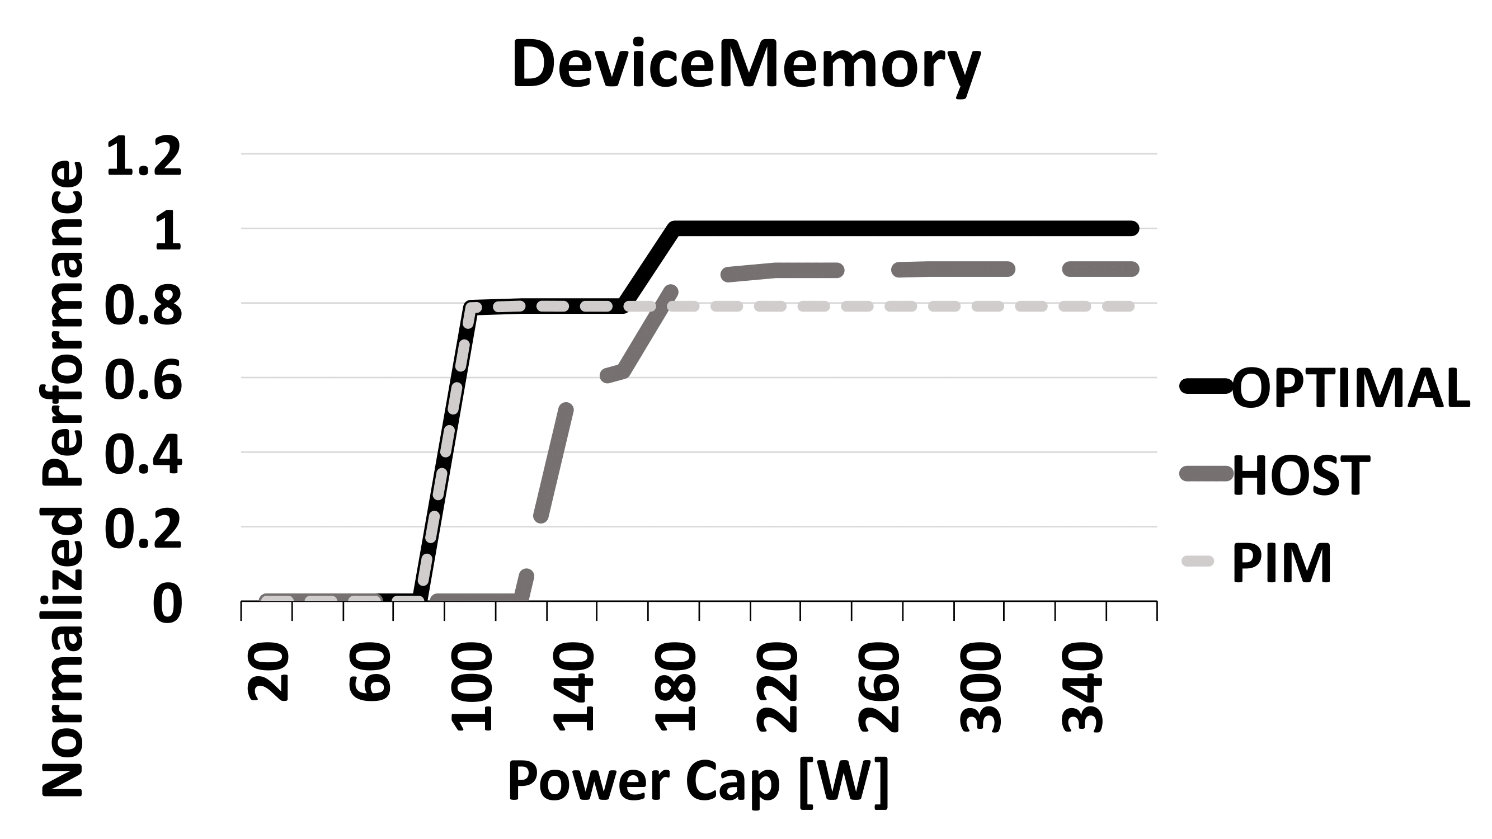
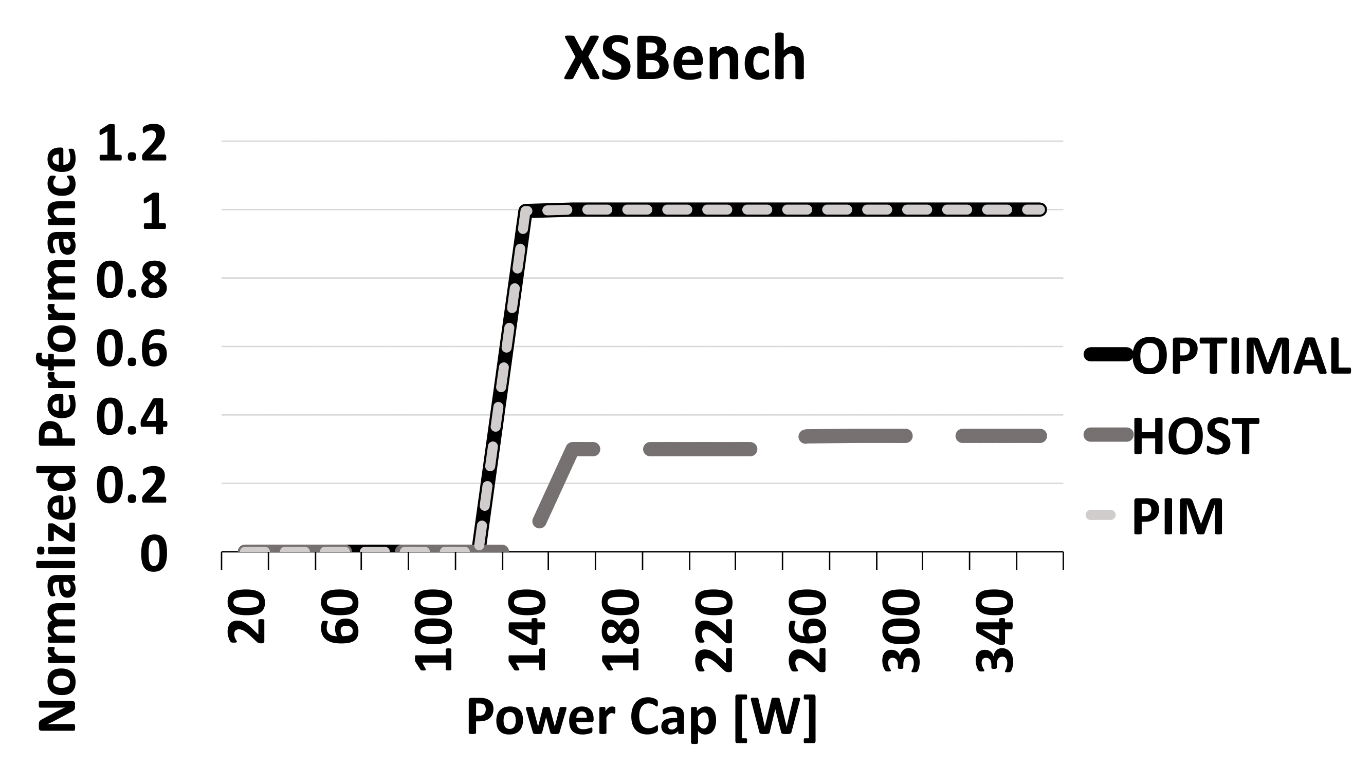
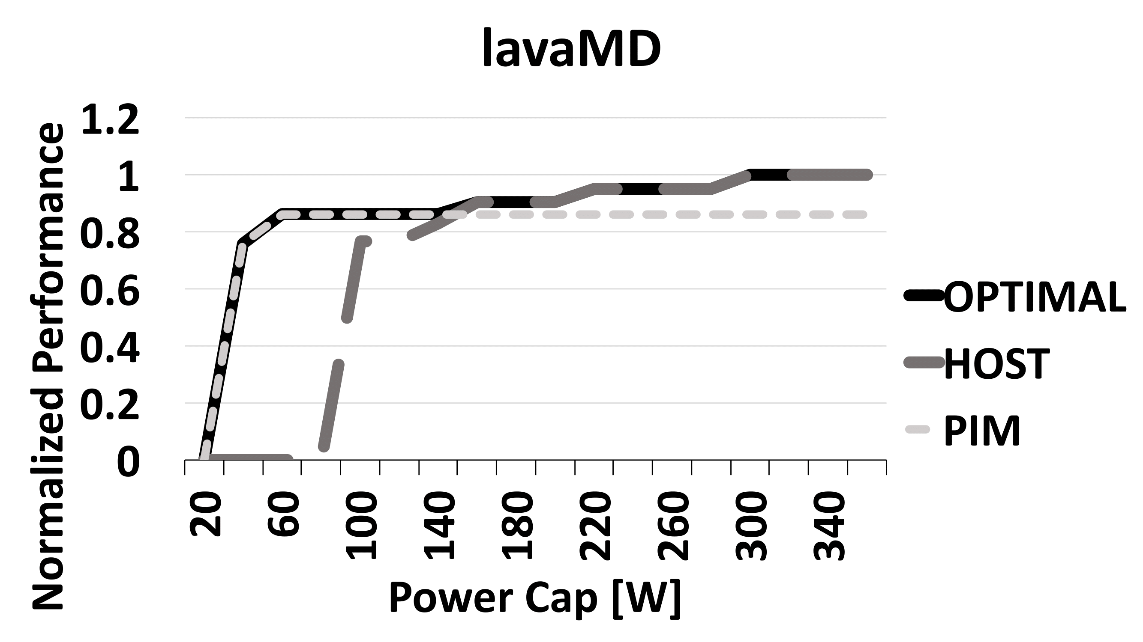
Maximum performance under power constraint
A high performance host always consumes 100W and for lower power constraints PIMs can deliver good performance
lavaMD – PIMs outperform host for even at higher power budgets (130W) by running on intermediate DVFS states
PIMs are often a better choice even when host runs at lower DVFS states
Application compensate the performance difference by exploiting higher memory bandwidth
Notes:
In a nutshell, higher power cap favors host. Except in the case of memory bound kernels -> XSBench. Then, even with high available power it is better to run on PIM due to higher available bandwidth. So why waste power on the host if can save huge amounts by running on PIM, AND get better performance.
Everything is normalized to the best achieved performance at 340W. As we go to the left (lower power available), we will switch to lower DVFS states and get lower performance as compared to the best possible. Or in XSBench case, host has 60% lower performance on PIM than on host (2x more bandwidth, better splits on 192 cores than on 256, plus errors in performance estimates).

Slide 28
Co-optimization and DVFS
Minimum achievable ED² on a hybrid host/PIMsystem with DVFS to a host/PIM system without DVFS (running on highest DVFS state) and host/PIM co-optimization
By picking the right DVFS state and right hardware to run the kernel we can on average improve energy efficiency by 7x
Our findings strengthen the hypothesis of PIMs being a useful heterogeneous platform and show the importance of DVFS as a mean to maximize performance and energy efficiency in HPC systems with PIM
Notes:
If we run the kernels only on PIM or only on host, at some fixed frequency (say host 1GHz, PIM 600MHz), then we get some performance X and energy efficiency Y. This is what TOP-PIM paper shows.
However, what we show is that if we use DVFS and don’t look only at fixed frequencies, and also can decide whether it is better to run kernels on host/PIM we can improve the energy efficiency of the system by 7x on average.
In some cases we will have to sacrifice a fraction of the maximum achievable performance but this comes with great gains in energy efficiency which is important for future HPC systems (recall 200W per node in 100 000 node HPC cluster running with 20 MW power budget). Also in many cases we will have to run on lower power constraints to meet such targets, and that’s were PIMs can significantly boost performance for many kernels (NOT ALL).

Slide 29
CONCLUSION
PIM can offer both high performance and low power for memory intensive applications
Host maximizes performance for compute bound applications but consumes more power than PIMs
Additional power savings can be obtained with lower DVFS states
PIMs are more energy efficient compared to host in most cases, even when the host runs at low power DVFS states
PIMs can deliver significantly better performance under tight power budgets by exploiting high in-stack bandwidth and compensating performance loss from low power DVFS states

Slide 30
Thank you

Slide 31
BACKUP SLIDES
Notes:
Even though we may not need backup, can you provide more notes for these slides also?

Slide 32
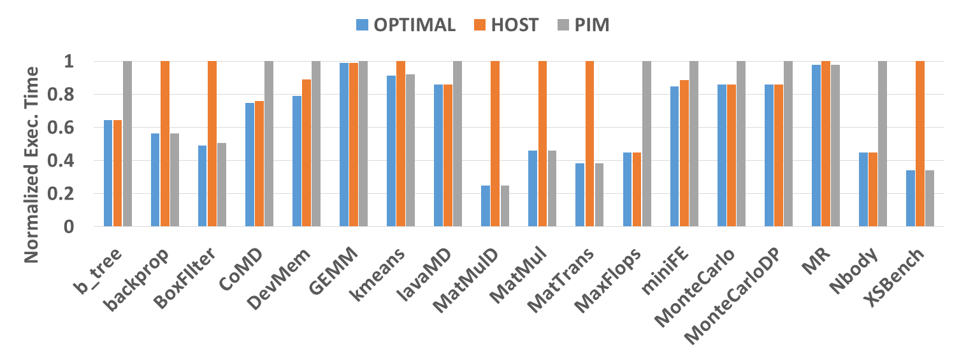
TARGET = minimum execution TIME
B+tree, MaxFlops, MonteCarlo, Nbody – all compute bound kernels which tend to favor execution only on host
Backprop, MatrixMultiplication, MatrixTranspose, XSBench – all bandwidth bound kernels which favor PIM
CoMD, GEMM, miniFE – dominated by one type of kernel, other kernels may prefer PIM over host or vice versa
Always picking the highest DVFS state – maximizing performance

Slide 33
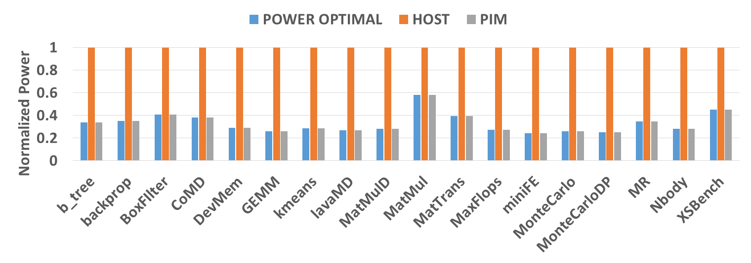
TARGET: MINIMUM POWER
Always picking PIM and the lowest DVFS states – minimum power
Even though we get significant power savings when running kernels on PIM, performance will be significantly lower for compute intensive kernels

Slide 34
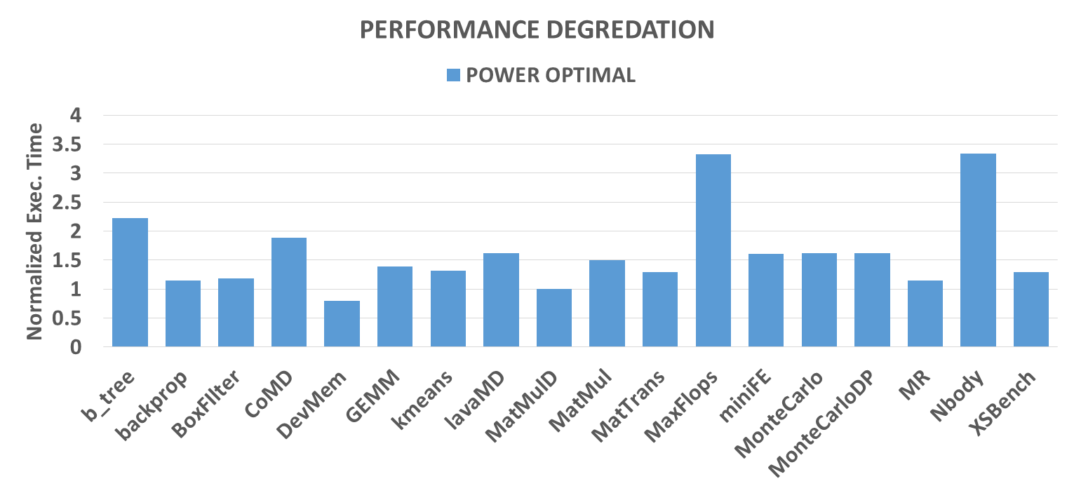
Performance degradation, Target = Minimum POWER

Slide 35
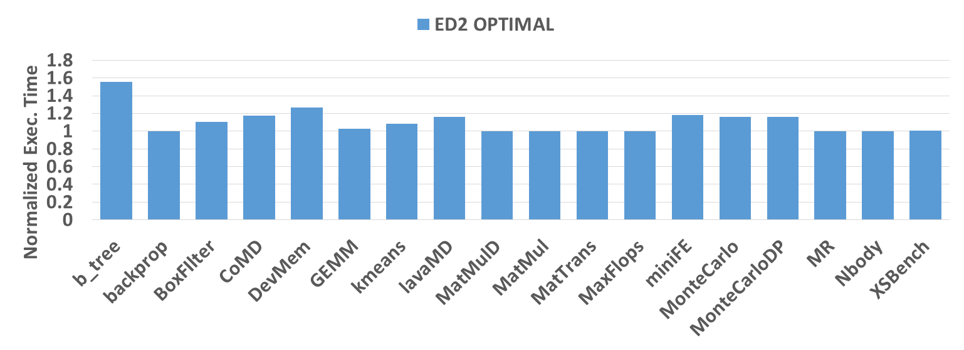
Performance degradation, target=min. ed2

Slide 36
Performance model BACKUP
60 CUs 360GB/s
How do we estimate performance at 164 CUs and 360 GB/s bandwidth?
Find 2 points which have the same compute/bandwidth ratio as the target HW
Find the slope on which these 2 points lie
Extrapolate (follow the slope) to target HW (60 CUs)
Assumption: Performance change across the same CU/BW ratio remains the same
40 CUs 240GB/s
20 CUs 120GB/s

Slide 37
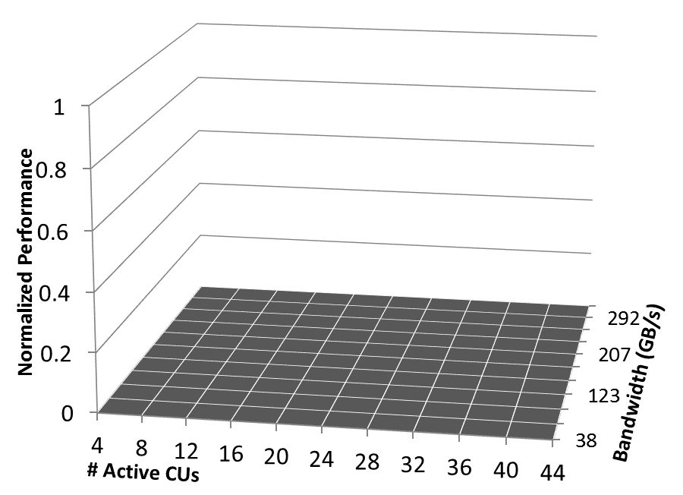
GPU Performance SCALING
Gather performance & power data at Base Hardware Configuration
Start from a Base Hardware Configuration and predict performance for a Target Hardware Configuration
How does the kernel scale? Ask the ML model!
Notes:
Base Hardware Configuration execution time/power measured on real hardware and then predict the Target Hardware Configuration execution time by using the model to scale the measure time.
Base Hardware Configuration, i.e. the starting point, is always the same for a model. A new model needs to be built to use a different Base Hardware Configuration.

Slide 38
Arithmetic Intensity

