Slide 1
A Power Characterization and Management of GPU Graph Traversal
ADAM MCLAUGHLIN*, INDRANI PAUL†, JOSEPH GREATHOUSE†, SRILATHA MANNE†, AND SUDHKAHAR YALAMANCHILI*
*GEORGIA INSTITUTE OF TECHNOLOGY
†AMD RESEARCH
Notes:
Brad will update the title slide

Slide 2
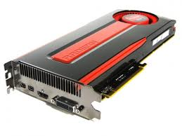
Motivation
Future machines may not be able to run at full power
Expensive
Installations consume tens of Megawatts
Dark Silicon
Current SoCs prevent damaging hotspots and maintain thermal limits
All of the Top 10 machines from the Green 500 leverage GPUs
Practical applications are constrained by power or thermal limitations
The HPC community does not want to sacrifice performance for power
It’s critical to develop power management techniques for emergent irregular applications on GPUs
Notes:
Adam: Not enough room on this slide to mention the focus on graph algorithms, hence use of the term “irregular applications” instead for the last bullet. Slides 3-4 clarify what that term means (i.e. graph algorithms and how they’re used to solve real-world problems).

Slide 3
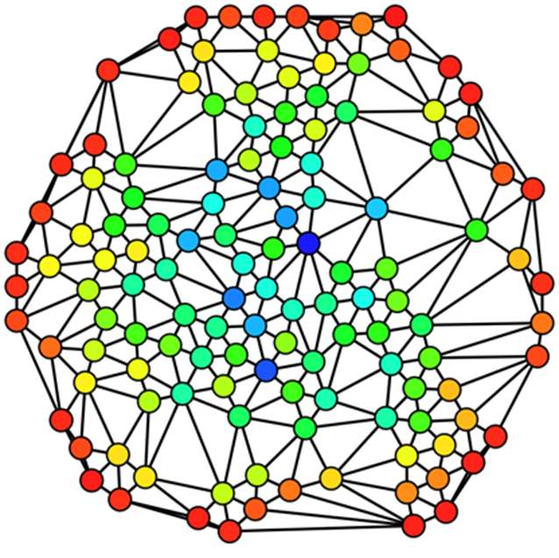
Graph Algorithms
Irregular Applications
Typically memory bound
Inconsistent memory access patterns
Characteristics unknown at compile time
Interesting data sets are massive
Graph structures – Not a one size fits all problem
Scale-free
Small world
Road networks
Meshes
Notes:
Scale-free the degree of the vertices follow a power-law distribution. Seen in social networks and the internet.
Small world is where a graph is highly connected so the diameter of graph is logarithmic to the number of vertices.

Slide 4
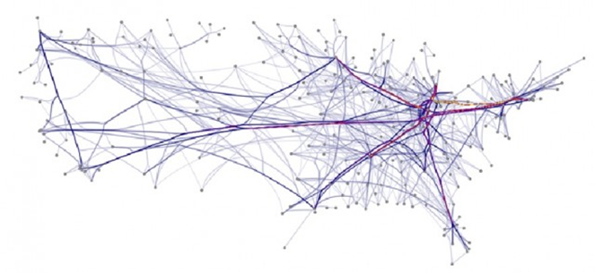
Applications of Graph Algorithms
Machine Learning
Compiler Optimization
Register allocation
Points-to Analysis
Social Network Analysis
Computational Biology
Computational Fluid Dynamics
Urban Planning
Path finding
Notes:
Points-to analysis is alises analysis

Slide 5
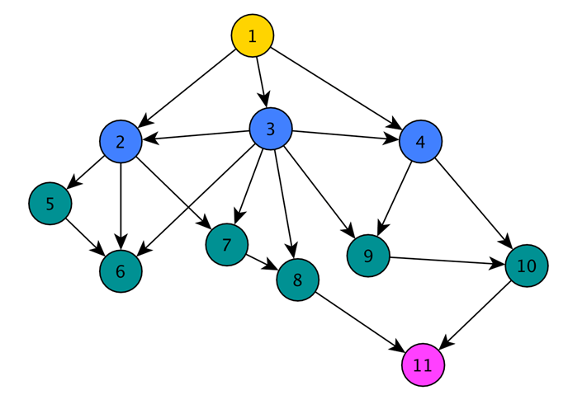
Breadth-First Search
Choose a source node $s$ to start from
Explore neighbors of $s$
Explore neighbors of neighbors, and so on
Building block to more complicated problems
Betweenness Centrality
All-pairs Shortest Paths
Strongly Connected Components
“Bricks and Mortar” of classical graph algorithms
Especially useful for parallel graph algorithms
Depth-First Search is P-Complete
Notes:
P-complete algorithms are known to be hard to parallelize

Slide 6
Recent work on BFS
SHOC Benchmark Suite
Quadratic [Harish and Narayanan HiPC ‘07]
Naively assign a thread to every vertex on every iteration
Lots of unnecessary memory fetches and branch overhead
Linear with atomics [Luo, Wong, and Hwu DAC ‘10]
Asymptotically Optimal O(m + n) work
For graphs with n vertices and m edges
Fastest publicly available OpenCL implementation
Used for the experiments in this paper
Linear with prefix sums [Merrill, Garland, and Grimshaw PPoPP ‘12]
Fastest GPU implementation
Direction-Optimizing [Beamer, Asanović, and Patterson SC’12]
Notes:
May not need to cover each bullet in detail.

Slide 7
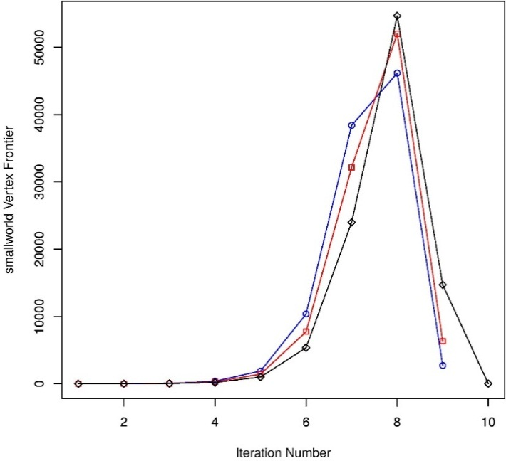
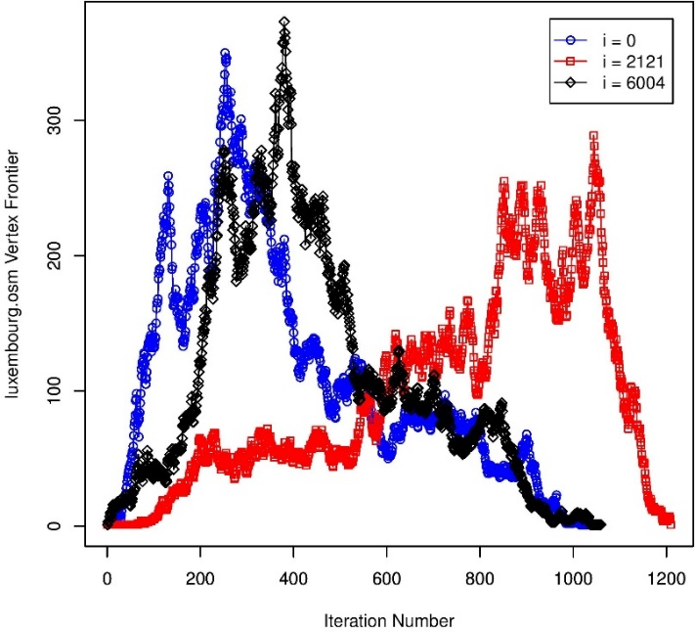
Change in Parallelism Over Time
Two trends
Few BFS iterations that process many nodes each
Scale-free, small world
Many BFS iterations that process few nodes each
Road networks, sparse meshes
Notes:
Time can vary between ms and 100s of ms. It depends the on the critical path of the traversal.
In_2004 input and copaper_citeseer are an examples of small world and/or scale free. The line between the two is blurry, but slightly more scale free.
The black read and blue are just different starting vertex.

Slide 8
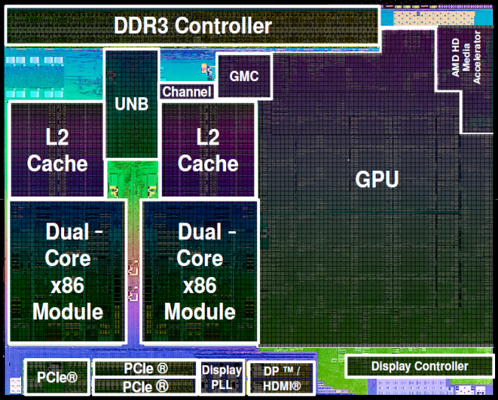
Experimental Setup
How do we leverage this information to manage power?
Two “knobs” of control
DVFS state
Number of active Compute Units (CUs)
A10-5800K Trinity APU
384 Radeon Cores
6 SIMD Units
16 Lanes with 4-way VLIW
3 DVFS States
High: 800 MHz, 1.275V
Medium: 633 MHz, 1.2V
Low: 304 MHz, 0.9375V
18 Manageable Power States
Up to 6 Active SIMDs (Compute Units)
3 DVFS States

Slide 9
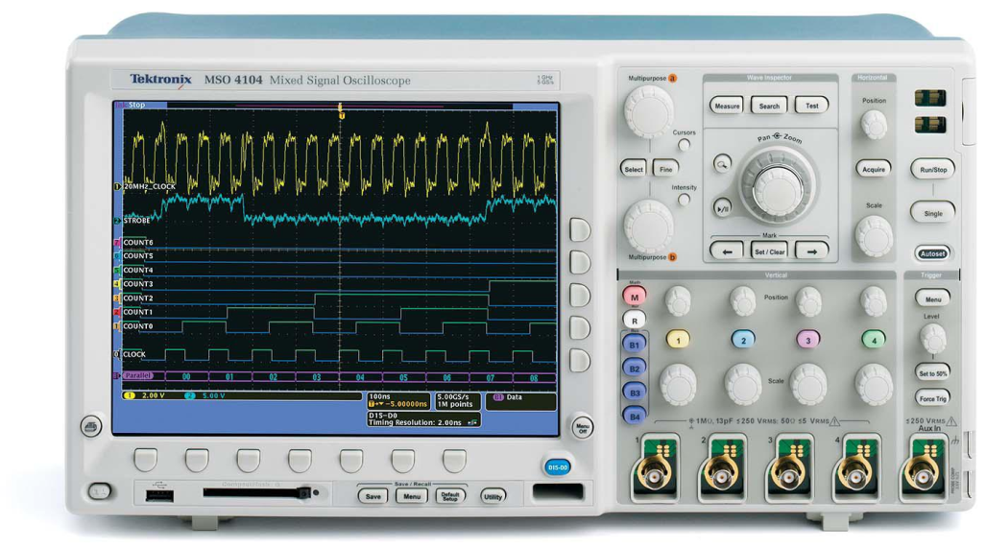
Power Measurements
Measure GPU power directly
Receive estimates from power management firmware
Sample power every millisecond
Overhead of changing DVFS state ~ microseconds
Analyze power configurations offline
Limitations in changing power states during execution
Throughput Baseline
Low Frequency
4 Active CUs
Latency Baseline
Medium Frequency
2 Active CUs

Slide 10
Distinguishing Power and Energy
Our goal is to maximize performance in a power-constrained environment
Our goal is NOT to minimize energy
“Race to idle” is not a valid solution
Notes:
National lab LINPACK – Call from the power company

Slide 11
Benchmark Graphs
Name | Vertices | Edges | Significance
coPapersCiteseer | 434,102 | 16,036,720 | Social Network
delaunay_n23 | 8,388,608 | 25,165,784 | Random Triangluation
asia.osm | 11,950,757 | 12,711,603 | Street Network
ldoor | 952,203 | 22,785,136 | Sparse Matrix
af_shell10 | 1,508,065 | 25,582,130 | Sheet Metal Forming
kkt_power | 2,063,494 | 6,482,320 | Nonlinear Optimization
rgg_n_2_22_s0 | 4,194,304 | 30,359,198 | Random Geometric Graph
G3_circuit | 1,585,478 | 3,037,674 | AMD Circuit Simulation
hugebubbles_00020 | 21,198,119 | 31,790,179 | 2D Dynamic Simulations
in-2004 | 1,382,908 | 13,591,473 | Web Crawl
packing_500x100x100-b050 | 2,145,852 | 17,488,243 | Fluid Mechanics
Notes:
Training set: hugebubbles and copapers
These input sets come from many different areas
Delauanay and rgg are synthetic, the rest are real

Slide 12
Static Oracle
Given a graph and power cap, determine the best power state
Exhaustively run all settings
Pick the setting that has…
…the least execution time
…instantaneous power within the cap at all times
Refer to this setting as the static oracle
“Static” because the same power setting is used throughout the traversal

Slide 13
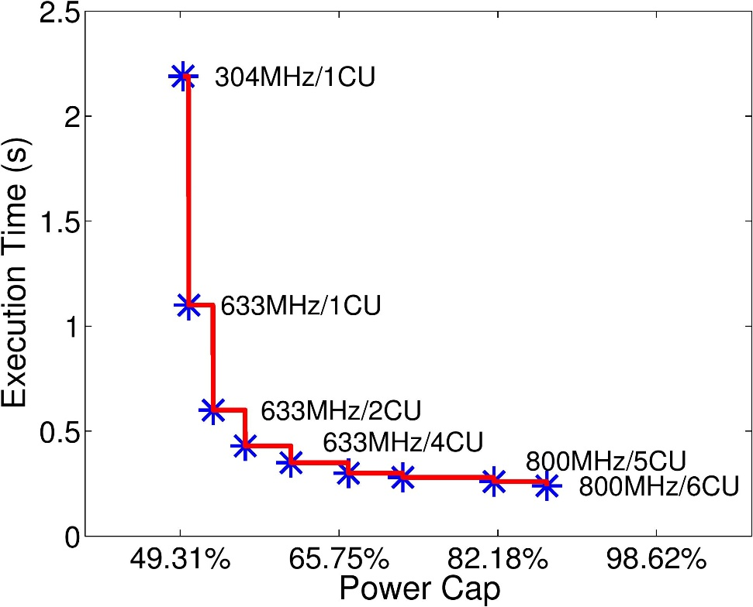
Best Configuration Varies with Graph Input
Consider an 82.18% Power Cap
Left (delaunay_n23): Medium Frequency and 6 CUs
Right (G3_Circuit): High Frequency and 5 CUs

Slide 14
Leveraging Both Degrees of Freedom
Sometimes it is better to boost frequency than CUs (af)
Sometimes it is better to boost CUs than frequency (del)
Boost both degrees somewhat rather than boosting one maximally (in)
Reduce one degree to be able to boost the other (pack)
Notes:
These 4 represent the four different types of behaviors.

Slide 15
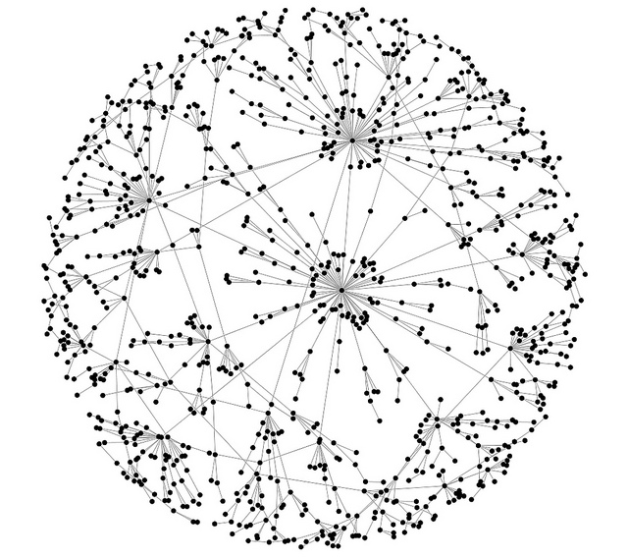
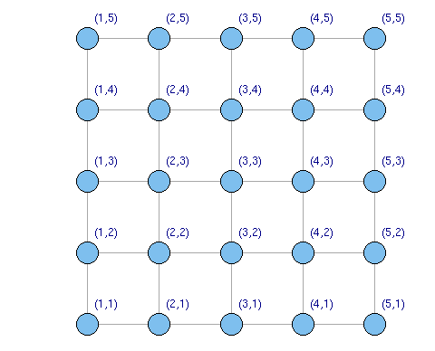
An Algorithmic Approach
How to determine the best configuration for a given graph and power cap?
Intuition: Graphs tend to be more sensitive to either latency or parallelism
Use simple, offline, graph metrics to determine this sensitivity
Number of nodes
Average degree
Diameter would be ideal, but that requires too much preprocessing
Notes:
Standard deviation requires too much preprocessing as well

Slide 16
Clustering
Red circles: training set
Blue x’s: Classified via K-means clustering
High average degree implies a high potential for load imbalances
Scale-free, small world graphs
Low average degree means more uniform work
Meshes, Road networks

Slide 17
Static Results
Algorithm matches the oracle for 8/9 graphs
CU scaling less helpful
Baseline already has 4 active CUs
Matter of perspective

Slide 18
Conclusions
Power optimizations depends heavily on graph structure
Frequency boosting is a useful technique
Already implemented in contemporary HW
We show that CU boosting is also useful
…and that combining Frequency and CU boosting is even better
Simple graph metadata suffices for making power management decisions
No preprocessing required
HW needs to support finer granularities of power management

Slide 19
Questions
We would like to thank the NSF and AMD for their support

Slide 20
Improvements: Dynamic Algorithm
Choose the best configuration at each iteration of the search
Exhaustively test all iterations at all power configurations
Choose the fastest of the ones that do not exceed the power cap
Refer to this setting as the Dynamic Oracle
Two ways to improve over the static algorithm
If the static algorithm classifies a graph incorrectly
If the vertex frontiers change significantly in size
Scale CUs when frontiers are small
Scale frequency when frontiers are large

Slide 21
Dynamic Results
Modest improvements
~5% overall
More variation in structure than available power states
Need finer-grained methods of power management
Small number of iterations dominate
Static case can optimize for these iterations

