Slide 1

Highly Scalable Distributed Dataflow Analysis
Joseph L. Greathouse
Chelsea LeBlanc
Todd Austin
Valeria Bertacco
Advanced Computer Architecture Laboratory
University of Michigan
CGO, Chamonix, France
April 6, 2011
Notes:
Transition to next: So, why am I here?

Slide 2
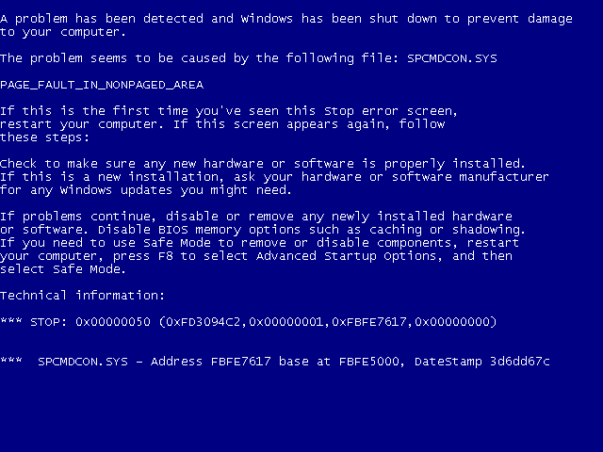
Software Errors Abound
NIST: SW errors cost U.S. ~$60 billion/year as of 2002
FBI CCS: Security Issues $67 billion/year as of 2005
  >⅓ from viruses, network intrusion, etc.
Notes:
Because bad software is everywhere. Unfortunately, software bugs have real costs associated with them. In 2002, for instance, NIST reported that software problems cost the U.S. economy almost $60 billion per year.
Beyond the monetary costs *click* Well, beyond the monetary costs you can run into problems that cause embarrassment. *click* both for presenters and for companies. I’m sure a number of you in the audience associate that blue screen with a particular piece of software. That is bad marketing.
Bugs can lead to more insidious problems, such as security flaws. The FBI estimated that computer security issues cost US companies upwards of $67 billion in 2005; more than a third of that cost resulted from viruses, network intrusions, and other issues whose root causes often come down to software bugs.

Slide 3
Goals of this Work
High quality dynamic software analysis
  Find difficult bugs that other analyses miss
Distribute Tests to Large Populations
  Low overhead or users get angry
Accomplished by sampling the analyses
  Each user only tests part of the program
Notes:
Therefore, the goal of this work is to enable high quality dynamic correctness and security analyses.
*We focus on dynamic analyses because they are useful for finding errors that other mechanisms can’t.
*Some powerful static analyses, for instance, attain high error coverage at the cost of small scope. Some, for instance, run into a state explosion problem as they attempt to work their way through all possible paths to find errors.
We wish to *distribute* dynamic analyses to large populations of users because this type of analysis gains power from seeing a multitude of different dynamic states. The more you test, the stronger your analysis.
However, if we wish to distribute these to users, they must have low overhead. Otherwise, users will (1) get angry at your slow software, and (2) probably stop using it.
We plan to accomplish *this* by sampling analyses, allowing users test *parts* of the program. This means that each user will see much less overhead, as their analysis system is only enabled a small portion of the time.
While you may have heard of other sampling works: they don’t work. They don’t work for the type of analysis we want to look at: dynamic dataflow analyses.
Transition: What do I mean by dynamic dataflow analyses

Slide 4
Dynamic Dataflow Analysis
Associate meta-data with program values
Propagate/Clear meta-data while executing
Check meta-data for safety & correctness
Forms dataflows of meta/shadow information
Notes:
Make sure we’re on the same page, since some audience members may be static analysis people where dataflow means something already.
*Associate meta-data with the regular values of the program
**Example: Is this variable initialized?
*As the program executes, you propagate this meta-data to new variables in the program, or clear it from old ones.
**Example: I’m copying an initialized variable into a location; that variable is now initialized.
*Check meta-data values on certain actions to verify integrity of system
**Example: Is this pointer I am about to dereference initialized?
Meta-data flows represent the movement of important testing information from source to checks.

Slide 5
Example Dynamic Dataflow Analysis
Data
Input
Meta-data
Associate
x = read_input()
x = read_input()
validate(x)
Clear
Propagate
y = x * 1024
y = x * 1024
w = x + 42
Check w
Check w
a += y
z = y * 75
Check z
a += y
z = y * 75
Check z
Check a
Check a
Notes:
Let’s go through an example. Overview of what the rules of this simple taint analysis system are:
*Don’t trust data from outside the program
*Associated meta-data bit means “not trusted”
*Error if you check non-trusted data.
{go through example}
Transition: Dynamic analyses can only perform these tests on control paths seen by the program. Therefore, we wish to see as many paths and dynamic inputs as possible.

Slide 6
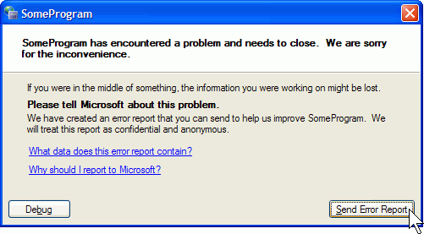





Distributed Dynamic Dataflow Analysis
Split analysis across large populations
  Observe more runtime states
  Report problems developer never thought to test
Instrumented Program
Potential problems
Notes:
To maximize the number of dynamic situations observed: distribute the tests to end users.
*click*
A developer can send an instrumented version of his program to his users.
Large populations will then see many more runtime states than the developer could test alone.
*click*
Because of that, the analyses some users run may find potential errors.
It’s important to note that different users MIGHT FIND DIFFERENT BUGS. The more users the better.
*click*
These potential problems can then be reported back to the developer
*click*
much like how program crashes are reported today. Software updated (iPhone, cloud sw, auto-update)

Slide 7
Problem: DDAs are Slow
Symbolic Execution
Data Race Detection
(e.g. Helgrind)
Memory Checking
(e.g. Dr. Memory)
Taint Analysis
(e.g.TaintCheck)
Dynamic Bounds Checking
FP Accuracy Verification
10-200x
2-200x
2-300x
10-80x
100-500x
5-50x
Notes:
Unfortunately, distributing these analyses to end-users is well nigh impossible because DDAs are *slow*.
This is a list of example DDAs and the ranges of overheads reported in the literature.
Even the _relatively_ low 5x of something like Dr. Memory may be too much for most users. And it can get much higher in some dynamic situations.
NOTE for readers: Data race detection sampling has been done before (LiteRace, PACER, etc.), but these mechanisms only work because the dataflows in a happens-before race detection system are simple. Synchronization points cause clocks to increment; the first time a variable is touched after a synchro point propagates the clock into it, and no more propagation happens; checks are only done when data is shared between two threads.
NOTE: This symbolic execution specifically refers to the work by Larson & Austin, “High Coverage Detection of Input-Related Security Faults”
NOTE: The floating-point accuracy thing is in reference to some work out of UMD by Michael Lam et al. See: http://blog.freearrow.com/software/fried

Slide 8
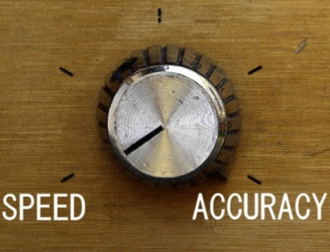
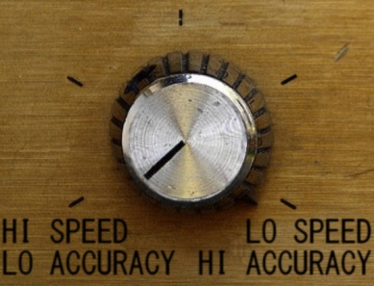
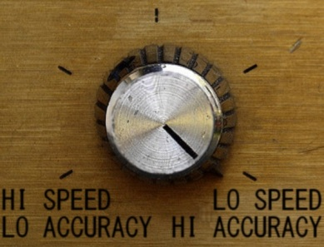
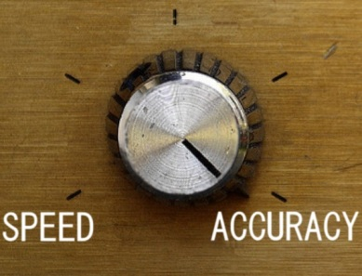
Our Solution: Sampling
Lower overheads by skipping some analyses
No
Analysis
Complete
Analysis
Notes:
Our solution to this overhead problem is sampling. In other words, we desire to analyze a random part of the program’s dynamic state during each execution, where the amount of analysis is controlled by our desired maximum overhead.
This graph represents the desired results of an ideal sampling system. On the far left side, the system would see zero overhead, but have no chance of detecting errors; this is where we are right now, never performing analysis. Current analysis systems lie on the right, where our overhead is high but we detect every observable error.
We want to fill in the middle through sampling techniques, where our probability of finding an error is proportional to the observed overhead.
*click* In essence, this would give users (or developers) a knob that allows them to choose their individual accuracy versus speed tradeoff.

Slide 9
Sampling Allows Distribution
End Users
Beta Testers
Many users testing at little overhead see more errors than one user at high overhead.
Developer
Notes:
For example, developers may be OK with running at high overheads for some tests (devs currently do this for Valgrind, for example.) However, by turning the knob lower, *click* we can allow our larger population beta testers to catch errors at much less overhead.
If we can continue to lower the overhead, it could even be possible to send these analyses off to our very large population of end users *cllick*. And while they would have a low probability of finding any individual error, our hope for this work is that *click* many users testing at little overhead see more errors than one user at high overhead because of their sheer numbers.

Slide 10
Cannot Naïvely Sample Code
Input
x = read_input()
validate(x)
Skip Instr.
x = read_input()
Validate(x)
False Positive
y = x * 1024
w = x + 42
Check w
y = x * 1024
w = x + 42
Check w
a += y
Skip Instr.
a += y
z = y * 75
Check z
Check a
Check z
False Negative
Check a
Notes:
Unfortunately, previous sampling mechanisms do not work for dynamic dataflow analyses. These systems (e.g. Liblit et al.) operate by skipping random instructions throughout the program, which does not work when you must follow long meta dataflows from source to check.
In this example, we will skip some instructions, as a code-based sampling system would. When we skip these instructions, the meta data at the destination will stay the same, as the meta-data system is disabled.
{Go through example}
Therefore you can get both false negatives and false positives. We cannot trust any answer that this analysis gives us, as it may be wrong in either direction.

Slide 11
Our Solution: Sample Data, not Code
Sampling must be aware of meta-data
Remove meta-data from skipped dataflows
  Prevents false positives
Notes:
So our solution is to sample _the meta dataflows_, not the code of the program.
Let’s look at this example dynamic dataflow. Rather than skipping any individual instruction that forms it, we wish to non-deterministically choose, at runtime, some subset of the dataflows *click*
To ensure that you don’t get the false positives that we showed on the previous slide, you *must* clear the meta-data from any value if you touch it while avoiding its dataflow.
Transition: Let’s show an example.

Slide 12
Dataflow Sampling Example
Input
x = read_input()
x = read_input()
validate(x)
Skip Dataflow
y = x * 1024
Check w
y = x * 1024
w = x + 42
Check w
Skip Dataflow
a += y
a += y
z = y * 75
Check z
Check a
Check z
False Negative
Check a
Notes:
In this slide, rather than skipping instructions, we’ll skip dataflow operations. And, as mentioned, we will clear the meta-data from any variable on a dataflow we’re “skipping”.
{Example here}

Slide 13


Mechanisms for Dataflow Sampling (1)
Start with demand analysis
Demand Analysis Tool
Instrumented
Application
(e.g. Valgrind)
Instrumented
Application
(e.g. Valgrind)
Native
Application
No meta-data
Meta-data
Operating System
Notes:
How to build our system. Start w/ demand analysis tool.
Run slow tests only when touching data of interest to the analysis.
*click*Run full speed on native hardware otherwise.
Mark pages w/ meta-data unavailable
*click* Page fault on access
*click*Handler signals to move program into analysis tool
Slow execution
*click* Tool releases program when no meta-data seen for a period of time
-------
NOTE for readers: This is described in “Practical Taint-Based Protection using Demand Emulation” by Alex Ho, Michael Fetterman, Christopher Clark, Andrew Warfield, and Steven Hand in EuroSys06.

Slide 14



Mechanisms for Dataflow Sampling (2)
Remove dataflows if execution is too slow
Sampling Analysis Tool
Instrumented
Application
Instrumented
Application
Native
Application
OH Threshold
Clear meta-data
Meta-data
Operating System
Notes:
In this system, you will have some maximum observable slowdown. If you cross it, you will begin attempting to sample the dataflows.
*click to start animations* In this case, you start playing your games as normal, hit meta-data, and start the slow analysis
*click* but what if that analysis continues unabated? Your system will slow further and eventually
*click* cross an overhead threshold. At this point, the system will attempt to start removing meta-data from the system
*click* in a probabilistic manner. If you win the coin toss, you *click* signal the virtual memory system to remove all the shadow values from the page you’re working on. This means that the system will transition to native execution *click* as it begins operating on data with no meta-data.

Slide 15
Prototype Setup
Taint analysis sampling system
  Network packets untrusted
Xen-based demand analysis
  Whole-system analysis with modified QEMU
Overhead Manager (OHM) is user-controlled
Xen Hypervisor
ShadowPage Table
Admin VM
OS and Applications
Net Stack
Taint Analysis QEMU
OHM
App
App
…
App
Linux
Notes:
We built a prototype system to test our dataflow sampling methods for both performance and accuracy. We used “taint analysis” as our dynamic dataflow test, where network packets are untrusted. An error is raised if untrusted values are, for instance, used as the destination of a jump.
This was built on top of a Xen & Linux system, and also uses a version of the emulator QEMU that was modified to perform taint analysis on x86 code. A shadow page table is used to cause a fault when a guest virtual machine touches a tainted value, at which point the entire guest VM is moved into QEMU.
An overhead manager sits next to QEMU, and keeps track of the amount of time a domain spends in analysis versus on the bare hardware. If the domain passes some user-controlled threshold, it can perform dataflow sampling by telling the emulator and shadow page system to stochastically remove meta-data associated with that domain.

Slide 16
Benchmarks
Performance – Network Throughput
  Example: ssh_receive
Accuracy of Sampling Analysis
  Real-world Security Exploits
Name | Error Description
Apache | Stack overflow in Apache Tomcat JK Connector
Eggdrop | Stack overflow in Eggdrop IRC bot
Lynx | Stack overflow in Lynx web browser
ProFTPD | Heap smashing attack on ProFTPD Server
Squid | Heap smashing attack on Squid proxy server
Notes:
Our tests for this prototype are in two domains. The first, performance, test the network throughput of the system. Because all the meta-data in the system is derived from I/O, network throughput benchmarks constantly try to operate on meta-data. In the interests of time, I’ll just show one example from the paper. Ssh_receive attempts to receive a constant stream of encrypted packets, , perform decryption calculations within the emulator, and throw away the decoded packets. This yields very poor performance in a classical demand-analysis system, as nearly every calculation in the system is within the emulator.
Our second set of tests are to verify the accuracy of the analysis system when we begin sampling. For this, we test a number of real-world security errors that our full taint analysis system can observe at runtime. This is a collection of remote-code-running exploits on network-facing applications obtained from online exploit databases.

Slide 17
Performance of Dataflow Sampling
ssh_receive
Throughput with no analysis
Notes:
Error bars 95% confidence interval. Blue dashed line is the throughput of the system when the analysis emulator is not enabled, never attempt to run analysis (this is different than always turning sampling on, as you don’t ever taint anything in the virtual memory system.)
When no analysis, about 19.72 MB/s
When analysis is always running: 178 kB/s
Can effectively control overheads using dataflow removal. Get to 19.67 MB/s at “always sampling”.

Slide 18
Accuracy at Very Low Overhead
Max time in analysis: 1% every 10 seconds
Always stop analysis after threshold
  Lowest probability of detecting exploits
Name | Chance of Detecting Exploit
Apache | 100%
Eggdrop | 100%
Lynx | 100%
ProFTPD | 100%
Squid | 100%
Notes:
1% of the time (overhead) in any 10 second window
Always stop the analysis after the threshold
(yields lowest probability)
*Nothing else is happening on the system; no other work at all*
Transition: This is true for a system nothing else happening on it, which is unlikely to be the case on a busy server. Therefore, our next set of tests were run with one of the ssh_receive throughput benchmark also running, simulating a large amount of benign traffic.

Slide 19
Accuracy with Background Tasks
ssh_receive running in background
Notes:
At some random point in time after beginning this test, we sent in the exploit for each particular accuracy benchmark and observed the probability of detecting the exploit within the torrent of dataflows that led to no error.
Ran each test multiple times (95% confidence interval). This shows that even with a large amount of benign dataflows in the system, we can still find most errors a percentage of the time ~close to the overhead percentage. *click*
Only need 1000 test runs to find the bug in Apache, which is difficult to find because its dataflows are very large and go through a number of different Apache modules.
Note for readers: the blue bar that comes up on the click is for illustrative purposes only. It shows that we’re basically on the overhead/accuracy line from slides 8 + 9. (honestly, it should be a step function for 10%, 25%, 50%, 75%, 90%, but whatever.

Slide 20

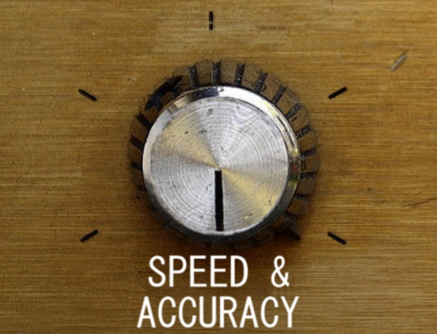
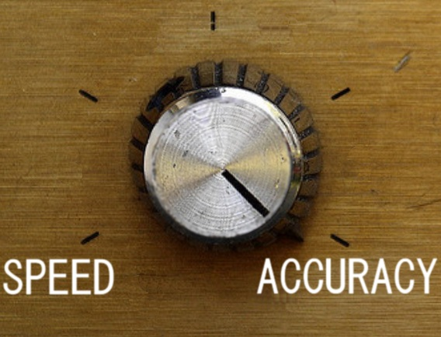
Conclusion & Future Work
Dynamic dataflow sampling gives users a
knob to control accuracy vs. performance
Better methods of sample choices
Combine static information
New types of sampling analysis
Notes:
Our previous knob settings were either high speed or high analysis accuracy, but with this system *click* you can get high speed on individual users and high accuracy across a whole population.

Slide 21
BACKUP SLIDES

Slide 22
Outline
Software Errors and Security
Dynamic Dataflow Analysis
Sampling and Distributed Analysis
Prototype System
Performance and Accuracy

Slide 23

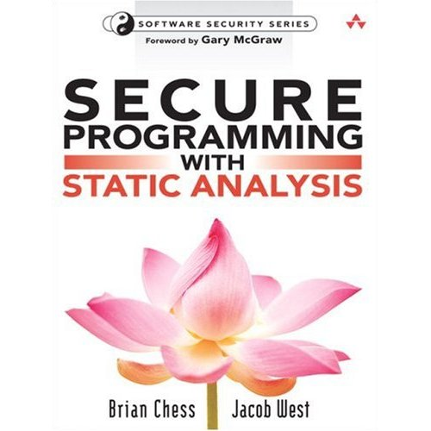




Detecting Security Errors
Static Analysis
  Analyze source, formal reasoning
  Find all reachable, defined errors
  Intractable, requires expert input,
  no system state
Dynamic Analysis
  Observe and test runtime state
  Find deep errors as they happen
  Only along traversed path,
  very slow
Notes:
Benefits of static analysis: Fully understand the code you see
Dynamic: much larger scope

Slide 24
Security Vulnerability Example
Buffer overflows a large class of security vulnerabilities
Return address
void foo()
{
int local_variables;
int buffer[256];
…
buffer = read_input();
…
return;
}
New Return address
Local variables
Bad Local variables
buffer
Buffer Fill
buffer
If read_input() reads 200 ints
If read_input() reads >256 ints

Slide 25
Performance of Dataflow Sampling (2)
netcat_receive
Throughput with no analysis
Notes:
Error bars 95% confidence interval.
Netcat_receive sent a bunch of data from a remote computer into the DUT through a TCP connection. The DUT then took these packets and immediately dumped them into /dev/null

Slide 26
Performance of Dataflow Sampling (3)
ssh_transmit
Throughput with no analysis
Notes:
Error bars 95% confidence interval.
Ssh_transmit sent a bunch of data over an SSH tunnel into a remove machine. The ACKs etc were returned over SSH and required decrypting, but less-so than ssh_receive, so the throughput here is higher.

Slide 27
Accuracy with Background Tasks
netcat_receive running with benchmark
Notes:
Much higher values because netcat_receive doesn’t hammer QEMU as badly, so more dataflows make their way through the sampling system to catch errors.

Slide 28
Width Test
Notes:
In case the projector is clipping.

