Slide 1
Dynamic Buffer Overflow detection for gpgpus
Chris Erb, Mike Collins, Joe Greathouse,
February 6, 2017
Notes:
Hello everyone, thanks for coming.
I’m Chris Erb from AMD Research.
I’m here today to present a paper by Mike, Joe and myself called Dynamic Buffer Overflow Detection for GPGPUs.
In it we describe our design of our buffer overflow detection tool.

Slide 2

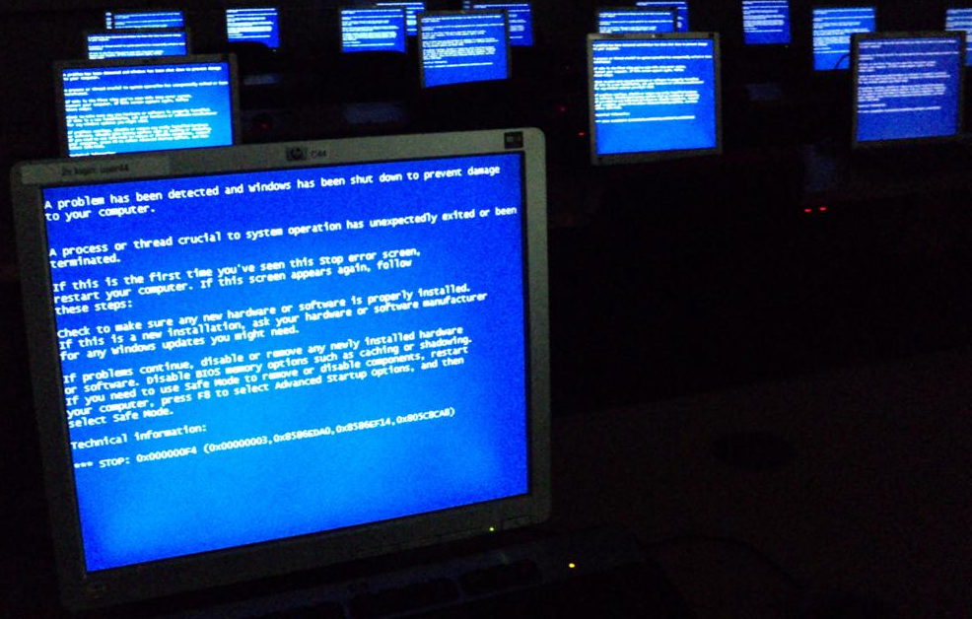
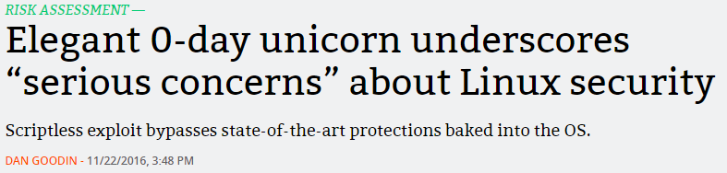
Consequences of Buffer overflows
Degrading user experience, and security risks
Data Corruption
Segmentation Faults
Altered Control Flow
(Security Subversion)
Notes:
Data corruption image taken from https://commons.wikimedia.org/wiki/File:Data_loss_of_image_file.JPG
Per that page (accessed on 1/17/2017):
“I, the copyright holder of this work, release this work into the public domain. This applies worldwide.”
“I grant anyone the right to use this work for any purpose, without any conditions, unless such conditions are required by law.”
Blue-screen image obtained from https://commons.wikimedia.org/wiki/File:Windows_Blue_Screen_on_room_full_of_computers.JPG
Per that page (accessed on 1/17/2017), this image was licensed at Creative Commons CC0 1.0:
“The person who associated a work with this deed has dedicated the work to the public domain by waiving all of his or her rights to the work worldwide under copyright law, including all related and neighboring rights, to the extent allowed by law. You can copy, modify, distribute and perform the work, even for commercial purposes, all without asking permission.”
Why should you care about buffer overflows?
Here are a few reasons.
The first is data corruption.
A buffer overflow may result in a write that destroys files or invalidates program results.
Next are segmentation faults.
A buffer overflow can cause program to end prematurely, this ranging from application crashes to the infamous blue screen of death.
A third consequence is vulnerability to execution redirection.
This last one is often exploited to subvert system security.

Slide 3
Background: Normal Buffer Fill
buf[n+1]
memcpy(buf, src, n+1)
src[0]
src[1]
src[2]
…
src[n]
return addr
buf
buf+1
buf+2
…
buf+n
Notes:
We’ll use this mem copy example a couple times to illustrate a buffer overflow.
Here we have a buffer of size n+1 and a mem copy that will write to n+5 indexes
<click through>
After the mem copy the return address adjacent to the buffer has been replaced with some other data.

Slide 4
Background: Buffer Overflow
buf[n+1]
memcpy(buf, src, n+5)
overflow
src[0]
src[1]
src[2]
…
src[n]
return addr src[n+1] – [n+4]
return addr
buf
buf+1
buf+2
…
buf+n
Notes:
We’ll use this mem copy example a couple times to illustrate a buffer overflow.
Here we have a buffer of size n+1 and a mem copy that will write to n+5 indexes
<click through>
After the mem copy the return address adjacent to the buffer has been replaced with some other data.

Slide 5

GPU Buffers Also Overflow
Remote Code Execution on GPU
Overflows on GPU can cause remote GPU code execution
  A. Miele. Buffer Overflow Vulnerabilities in CUDA: A Preliminary Analysis.
  B. Di, J. Sun, and H. Chen. A Study of Overflow Vulnerabilities on GPUs.
GPU
MEM
MEM
memcpy(buf, src, n+5)
0
CORE
Buffer
4
Normal exec
…
n-3
Func Addr
Redirected exec
Notes:
There is prior work discussing how buffer overflows can be used to affect remote code exectution.
<click through>
GPU is just as vulnerable to this kind of exploit
Spend more time
Clipart of bomb from https://openclipart.org/detail/131257/black-bomb
Relevant license text from https://openclipart.org/unlimited-commercial-use-clipart: “All Clipart on Openclipart are available for unlimited commercial use.”
Further, from https://openclipart.org/share: “All Clipart are Released into the Public Domain.”
Sites visited on 1/16/2017.

Slide 6
Gpu Buffers also overflow
Shared memory corruption
  GPU can overflow buffers in system memory
  Over Interconnects like PCIe®
SYSTEM MEMORY
GPU
memcpy(buf, src, n+5)
0
assert(x == y + z)
x = y + z
CPU
GPU Buffer
4
…
PCIe
n-3
x
GPU MEMORY
CPU Data
y
z
Notes:
Also happens in systems that allow the GPU to access data in system memory over interconnects such as PCIe®.
<click through>

Slide 7
Gpu Buffers also overflow
Shared memory corruption
CPU and GPU as part of the same package
  Every GPU buffer overflow may affect CPU data
assert(x == y + z)
x = y + z
CPU
MEMORY
CPU
0
GPU Buffer
4
…
GPU
n-3
GPU
memcpy(buf, src, n+5)
x
CPU Data
y
z
Notes:
GPU based buffer overflows will also affect Host execution in case of shared memory environments.
This happens today in APUs or other processors with shared memory (such as those that follow the HSA standard)
In these environments the cpu and gpu share the same physical and virtual memory space.
It’s a given that one affects the other.
<click through>

Slide 8
Goals
Building clarmor
Software tool to detect buffer overflows caused by GPU
  clARMOR found 13 GPU buffer overflows in 7 programs
Runnable with most OpenCL™ applications
  Tested for GPU and CPU device types from multiple vendors
Low runtime overhead
  14% overhead across 175 applications in 16 GPU benchmark suites
Notes:
We wanted to make a tool that would detect these overflows with a low overhead,
and one that could be usable across many OpenCL™ applications
<click through>
We found
We ran
We tested

Slide 9
Goals
Building clarmor
Software tool to detect buffer overflows caused by GPU
  clARMOR found 13 GPU buffer overflows in 7 programs
Runnable with most OpenCL™ applications
  Tested for GPU and CPU device types from multiple vendors
Low runtime overhead
  14% overhead across 175 applications in 16 GPU benchmark suites
Notes:
We wanted to make a tool that would detect these overflows with a low overhead,
and one that could be usable across many OpenCL™ applications
<click through>
We found
We ran
We tested

Slide 10
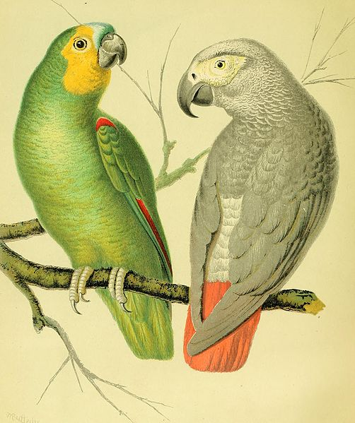
Buffer overflow Detection Methodology
Canary-Based Detection
Inserting known values around a protected region.
buf[n+1]
memcpy(buf, src, n+1)
src[0]
src[1]
src[2]
…
src[n]
canary
return addr
buf
buf+1
buf+2
…
buf+n
verify
Notes:
We are using a canary based detection scheme
Canary based detection schemes add a known or calculable set of values to protected regions to detect changes there in.
Here is an example of a mem copy that won’t write past our buffer allocation
<click through>
After the copy operation completes, and during the canary check, the canary remains intact.
This operation is verified ok.
Canary image from
https://commons.wikimedia.org/wiki/File:The_illustrated_book_of_canaries_and_cage-birds,_British_and_foreign_(1878)_(14748666991).jpg
Per that page (accessed on 1/19/2017):
“This image was originally posted to Flickr by Internet Archive Book Images at https://flickr.com/photos/126377022@N07/14748666991. It was reviewed on 25 September 2015 by the FlickreviewR robot and was confirmed to be licensed under the terms of the No known copyright restrictions.”

Slide 11
Buffer overflow Detection Methodology
Canary-Based Detection
Inserting known values around a protected region.
buf[n+1]
memcpy(buf, src, n+5)
Absence of known canary values alerts to invalid writes.
overflow src[n+1] – [n+4]
src[0]
src[1]
src[2]
…
src[n]
canary
return addr
buf
buf+1
buf+2
…
buf+n
verify
Notes:
Here is a mem copy that will write past the buffer allocation again
<click through>
This time the canary check will fail, and an overflow will be detected.

Slide 12
Goals
Building clarmor
Software tool to detect buffer overflows caused by GPU
  clARMOR found 13 GPU buffer overflows in 7 programs
Runnable with most OpenCL™ applications
  Tested for GPU and CPU device types from multiple vendors
Low runtime overhead
  14% overhead across 175 applications in 16 GPU benchmark suites
Notes:
We wanted to make a tool that would detect these overflows with a low overhead,
and one that could be usable across many OpenCL™ applications
<click through>
We found
We ran
We tested

Slide 13
Launching an Opencl™ kernel
Buffer Create
Buffer
Notes:
Now we will talk about what clARMOR adds to OpenCL™.
When OpenCL creates a buffer, clARMOR artificially extends it with a canary region.

Slide 14
Launching an Opencl™ kernel
Buffer Create
Set Arguments
Buffer
Kernel
Buffer
Notes:
clARMOR then makes a record of relevant information to that buffer: memory pointer, creation flags,
anything the detector might need later.
clARMOR also keeps lists of kernel information
When OpenCL™ is setting arguments to kernels, clARMOR simultaneously associates the buffer metadata it creates with this kernel information structure.

Slide 15

Launching an Opencl™ kernel
Set Arguments
Launch Kernel
Kernel
Buffer
Unrelated Memory
Notes:
It’s then time for OpenCL™ to launch a kernel.
The kernel executes.

Slide 16
Launching an Opencl™ WiTH clArmor
Buffer Create
Buffer Metadata
Buffer Metadata
Buffer
Canary
Canary
Notes:
Now we will talk about what clARMOR adds to OpenCL™.
When OpenCL creates a buffer, clARMOR artificially extends it with a canary region.

Slide 17
Launching an Opencl™ WiTH clArmor
Kernel Information
Buffer Create
Set Arguments
Buffer Metadata
Buffer Metadata
Buffer
Canary
Kernel
Buffer
Canary
Notes:
clARMOR then makes a record of relevant information to that buffer: memory pointer, creation flags,
anything the detector might need later.
clARMOR also keeps lists of kernel information
When OpenCL™ is setting arguments to kernels, clARMOR simultaneously associates the buffer metadata it creates with this kernel information structure.

Slide 18
Launching an Opencl™ WiTH clArmor
Kernel Information
Set Arguments
Buffer Metadata
Launch Kernel
Kernel
Buffer
Canary
Notes:
It’s then time for OpenCL™ to launch a kernel.
The kernel executes.

Slide 19
Launching an Opencl™ WiTH clArmor
Kernel Information
Buffer Metadata
Canary Verification
Kernel
Buffer
Canary
Notes:
After kernel execution completes, the kernel information structure is used to discover what buffers the kernel operated on.
Potentially affected canary regions are then scanned for overflows.

Slide 20
Wrapping Opencl™
Clarmor between your application and opencl
clARMOR is a Linux® library that uses LD_PRELOAD to wrap OpenCL™ library calls
Call Wrapping
  Buffer and Image creates
  Argument setters
  Kernel launches
  Information functions
User App
clARMOR
OpenCL
Notes:
clARMOR is a Linux® LD_PRELOAD library that executes over top of OpenCL™.

Slide 21
Wrapping the Opencl™ api
Buffer and image Creation
Attach canaries to memory objects
Buffer Creation
  Calls to clCreateBuffer, clCreateSubBuffer or clSVMAlloc
  Increase space requested, fill end with canary
Image Creation
  Calls to clCreateImage, clCreateImage2D, or clCreateImage3D
  Potential for multi dimensional overflow
  Add canary regions to each dimension
Buffer
Canary
Image Row0
Canary
Image Row1
Image Row0
Canary
Canary
Image Row1
Canary Slice
Image Row2
Canary
Canary
Image Row2
Canary
Canary Row
Canary Row
Notes:
clARMOR wraps buffer creation APIs in order to add canary regions to created buffers.
For a normal buffer, this is a simple process of increasing the allocation size and filling the extra space with canaries.
Images complicate this by allowing the buffers to be addressed in multiple dimensions.
To compensate for this, clARMOR adds canaries at the end of each addressable dimension.
OpenCL™ allows programmers to create buffers using existing memory allocations.
It’s not possible for clARMOR to update all references to these allocations, so instead it uses copies of them with canaries at kernel enqueue time.

Slide 22
Wrapping the Opencl™ api
Buffer creation from existing allocations
OpenCL allows buffer creation using an existing memory allocation
  Cannot extend buffer
  Cannot move buffer
  Work around by using a temporary copy at run time
References
Make this a buffer.
Adjacent Memory
Data Array
Buffer
Adjacent Memory
Buffer
Buffer Copy
Canary
Notes:
clARMOR wraps buffer creation APIs in order to add canary regions to created buffers.
For a normal buffer, this is a simple process of increasing the allocation size and filling the extra space with canaries.
Images complicate this by allowing the buffers to be addressed in multiple dimensions.
To compensate for this, clARMOR adds canaries at the end of each addressable dimension.
OpenCL™ allows programmers to create buffers using existing memory allocations.
It’s not possible for clARMOR to update all references to these allocations, so instead it uses copies of them with canaries at kernel enqueue time.

Slide 23
Wrapping the Opencl™ api
Set arguments
clARMOR needs to know which buffers/images to check for overflows
Kernel information object
  map kernel argument number to buffer information
Update on call to clSetKernelArg or clSetKernelArgSVMPointer
Kernel Information
ARG1
ARG2
ARG3
Constant
Buffer Metadata
Buffer Metadata
Notes:
clARMOR wraps set argument calls to gain information about what buffers to check after an OpenCL™ kernel.
These calls are augmented to populate references to kernel argument indexes in the kernel information structure.
At kernel launch time the kernel information structure will then have an up to date mapping of argument indexes to constants and buffers used.

Slide 24
Wrapping the Opencl™ api
Kernel launch
Do the work of detecting buffer overflows
On call to clEnqueueNDRangeKernel
  Enqueue the kernel
  Retrieve affected buffers
  Run the canary check
  Report errors
Kernel Information
Buffer Metadata
Kernel
Canary
Buffer
Canary
Buffer
Canary
Notes:
The heavy lifting of clARMOR is done in the kernel enqueue wrapper.
clARMOR passes the kernel launch to OpenCL™.
While OpenCL begins work on the kernel, clARMOR assembles the list of potentially affected buffers, and enqueues work to assemble and check their canary regions for overflows.

Slide 25
Goals
Building clarmor
Software tool to detect buffer overflows caused by GPU
  clARMOR found 13 GPU buffer overflows in 7 programs
Runnable with most OpenCL™ applications
  Tested for GPU and CPU device types from multiple vendors
Low runtime overhead
  14% overhead across 175 applications in 16 GPU benchmark suites
Notes:
We wanted to make a tool that would detect these overflows with a low overhead,
and one that could be usable across many OpenCL™ applications
<click through>
We found
We ran
We tested

Slide 26
Acceleration
Selecting a device for performing canary verification
CPU is faster
  small / few canary regions (latency advantage)
GPU is faster
  large / many canary regions (throughput advantage with embarrassingly parallel workload)
  reduced transfers over PCIe® by keeping on GPU
CPU
GPU
Canary
Canary
Canary
Canary
Canary
Canary
Notes:
clARMOR has execution paths for verification on CPU and GPU.
It attempts to select the best performing path for the workload at hand.
For larger workloads, the GPU path often has throughput advantage due to the embarrassingly parallel nature of the canary check.
This is coupled with a reduction in PCIe® transfers, from keeping work local to the GPU.
More details in the paper

Slide 27
Acceleration
Using Opencl™ events to increase throughput
Maximizing asynchrony
  Event-based programming wherever possible
  GPU check kernels enqueue behind work kernels and wait on completion
  Evaluation of check kernel results is done with call-backs
synchronous
asynchronous
CPU
clARMOR Prelaunch
clARMOR Postlaunch
clARMOR Prelaunch
clARMOR Postlaunch
GPU
User Kernel
Canary Check
User Kernel
Canary Check
Notes:
We take advantage of OpenCL™ event based programming.
This is a method for managing CPU & GPU work asynchronously.
If we did all work synchronously we would have to wait for the user kernel to finish before we could enqueue our GPU based canary check and continue with postlaunch work.
However using events, we can enqueue the work and immediately continue with host side execution.
More details in the paper

Slide 28
Test Setup
Hardware Specifications and Benchmarks suites
Suite | Num Benchmarks
AMDAPP | 46
FINANCEBENCH | 2
GPUSTREAM | 1
HETEROMARK | 14
MANTEVO | 4
NPB_OCL | 8
OPENDWARFS | 7
PANNOTIA | 6
PARBOIL | 9
PHORONIX | 4
POLYBENCH | 21
PROXYAPPS | 6
RODINIA | 21
SHOC | 14
STREAMMR | 4
VIENNACL | 8
3.7 GHz AMD A10-7850K CPU
  32 GB of DDR3-1866
AMD FirePro™ W9100 discrete GPU
  930 MHz core frequency
  320 GB/s of memory bandwidth
  16 GB of GDDR5 memory
3rd Generation PCIe® x8 CPU–GPU connection
175 benchmarks in 16 benchmark suites
Detect GPU Buffer Overflows
Compatible With Most OpenCL™
Low Runtime Overhead
Notes:
Paper later in the program tells how normally a paper has less than 17 benchmarks.
We have 16 benchmark suites

Slide 29
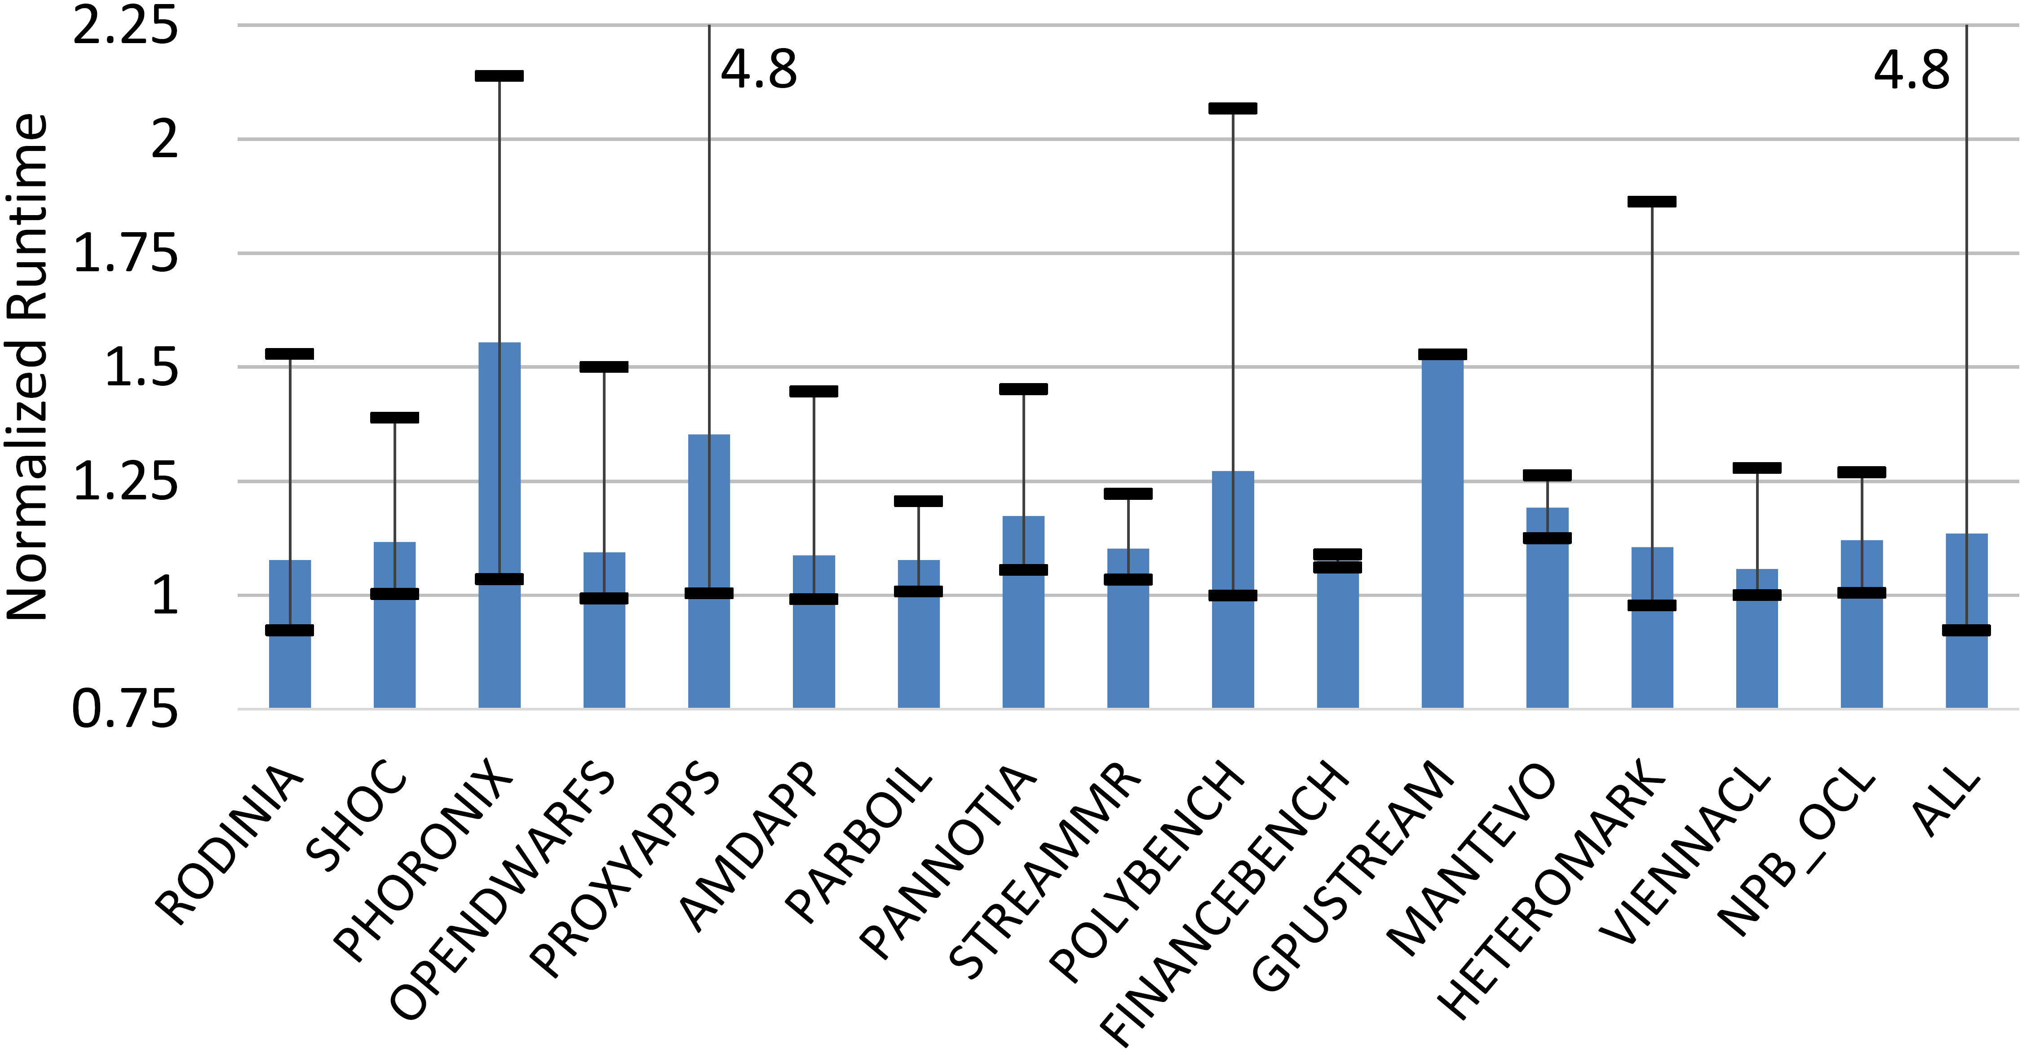
Performance Evaluation
Detect GPU Buffer Overflows
Compatible With Most OpenCL™
Low Runtime Overhead
Application runtime: with / without tool
Lower is better
14%
Notes:
This chart shows mean normalized runtime for each benchmark suite.
Times are normalized to runtime without detector.
Upper and lower black bars are the max and min normalized runtime within the suite.
<click>
Most applications stay below 1.5 normalized runtime.
<click>
The mean across all benchmarks is 14% overhead.
Proxyapps high - snap_mpi, tiny kernels & constant synchronization

Slide 30
Analysis of tool overhead with SNAP_MPI
Example SNAP_MPI kernel launch
CPU
Application Prelaunch
clARMOR Prelaunch
clARMOR
Postlaunch
Application Postlaunch
GPU
User Kernel
Canary Check
Launch Delay
SNAP_MPI Synchronization
Possible improvement for SNAP_MPI kernel launch
CPU
Application Prelaunch
clARMOR Prelaunch
clARMOR
Postlaunch
Application Postlaunch
Application Prelaunch
GPU
User Kernel
Canary Check
User Kernel
Launch Delay
Launch Delay

Slide 31
Clarmor detection results
List of benchmarks with buffer overflows
Parboil
  mri-gridding
StreamMR
  kmeans
  wordcount
Hetero-Mark
  OpenCL™ 1.2 kmeans
  OpenCL 2.0 kmeans
  OpenCL 1.2 sw, 4 errors
  OpenCL 2.0 sw, 4 errors
Detect GPU Buffer Overflows
Compatible With Most OpenCL™
Low Runtime Overhead
Notes:
Eye chart of benchmarks with overflows detected
We found 13

Slide 32
  Hetero-Mark OpenCL™ 1.2 SW Overflow Error
Kernel
Host
__kernel void sw_compute0( …
const unsigned M_LEN, …
__global double *cu,
… ) {
int x = get_global_id(0);
int y = get_global_id(1);
cu[(y + 1) * M_LEN + x] = <input_equation>
…
}
size_t sizeInBytes = sizeof(double) * m_len_ * n_len_;
…
cu_ = clCreateBuffer(context_, CL_MEM_READ_WRITE, sizeInBytes, NULL, &err);
…
const size_t globalSize[2] = {m_len_, n_len_};
…
err |= clSetKernelArg(kernel_sw_compute0_, 6, sizeof(cl_mem),
reinterpret_cast<void *>(&cu_));
…
err = clEnqueueNDRangeKernel(cmdQueue_, kernel_sw_compute0_, 2, NULL, globalSize, localSize, 0, NULL, NULL);
(y + 1) * M_LEN + x
x = m - 1
(y + 1) * m + x
y = n - 1
(n) * m + x
m == M_LEN
n * m + m - 1
m*n – 1 + m > m*n - 1
m > 0
Notes:
A detailed example of an overflow in the cl 1.2 implementation of sw within hetero-mark.
The kernel is sw_compute0, the buffer is cu.
A size of m x n is declared and this is used to initialize the cu buffer.
Global worksize is declared as m x n.
The cu buffer is set to sw_compute0 as an argument
Sw_compute0 is launched with globalsize m x n
X and y represent the work dimensions
Lets take these to some logical extremes
x will max out at m – 1 and y will max out at n - 1 as defined by globalsize.
Lets put this into the indexing equation for cu
M is m_len so we’ll remove that first
Y is n – 1
X is m – 1
Notice that this is greater than the allocated space for cu

Slide 33
Conclusion
Clarmor is ready for you to use
Canary-based detection scheme finds GPU write overflows
  13 GPU buffer overflows in 7 programs
Works for most OpenCL™ applications
  Running on GPU or CPU, not vendor specific
Near real time detection
  14% overhead across 175 applications in 16 GPU benchmark suites
Open Sourced
  https://github.com/GPUOpen-ProfessionalCompute-Tools/clARMOR
  Branch available for reproducing paper measurements

Slide 34
Disclaimer & Attribution
The information presented in this document is for informational purposes only and may contain technical inaccuracies, omissions and typographical errors.
The information contained herein is subject to change and may be rendered inaccurate for many reasons, including but not limited to product and roadmap changes, component and motherboard version changes, new model and/or product releases, product differences between differing manufacturers, software changes, BIOS flashes, firmware upgrades, or the like. AMD assumes no obligation to update or otherwise correct or revise this information. However, AMD reserves the right to revise this information and to make changes from time to time to the content hereof without obligation of AMD to notify any person of such revisions or changes.
AMD MAKES NO REPRESENTATIONS OR WARRANTIES WITH RESPECT TO THE CONTENTS HEREOF AND ASSUMES NO RESPONSIBILITY FOR ANY INACCURACIES, ERRORS OR OMISSIONS THAT MAY APPEAR IN THIS INFORMATION.
AMD SPECIFICALLY DISCLAIMS ANY IMPLIED WARRANTIES OF MERCHANTABILITY OR FITNESS FOR ANY PARTICULAR PURPOSE. IN NO EVENT WILL AMD BE LIABLE TO ANY PERSON FOR ANY DIRECT, INDIRECT, SPECIAL OR OTHER CONSEQUENTIAL DAMAGES ARISING FROM THE USE OF ANY INFORMATION CONTAINED HEREIN, EVEN IF AMD IS EXPRESSLY ADVISED OF THE POSSIBILITY OF SUCH DAMAGES.
ATTRIBUTION
© 2017 Advanced Micro Devices, Inc. All rights reserved. AMD, the AMD Arrow logo, AMD FirePro, and combinations thereof are trademarks of Advanced Micro Devices, Inc. in the United States and/or other jurisdictions. OpenCL is a trademark of Apple Inc. used by permission by Khronos. PCIe is a registered trademark of PCI-SIG Corporation. Linux is a registered trademark of Linus Torvalds. Other names are for informational purposes only and may be trademarks of their respective owners.

Slide 36
Memory Overhead

Slide 38
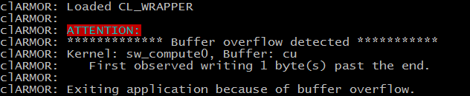
Example Error

