Slide 1
Summary Presentation of Cortical Computing with Memrisitve Nanodevices
Authored by Greg S. Snider
Hewlett-Packard Laboratories
Published Winter 2008, SciDAC Review
Presented by: Joseph Lee Greathouse

Slide 2
Overview of Topics
Quick refresher on real neurons
Reminder of artificial neural networks
Memristors
Memristor-based neural circuits
“Cortical Computing”

Slide 3
Neurons are nervous system cells
Neuron body receives signals from other neurons
Synapse is connection point between neurons
Synapse can be electrical or chemical
“All-or-none” principle

Slide 4
More detailed makeup of a neuron

Slide 5
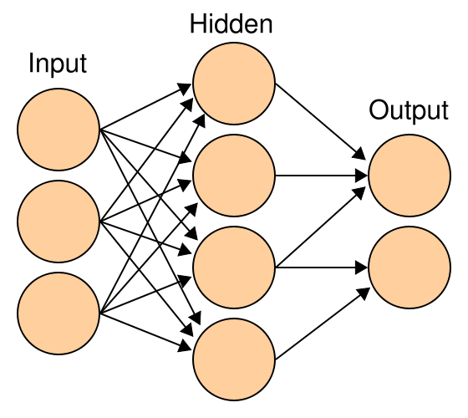
Artificial Neural Networks
Computational model that simulates real neurons
Inputs send signals through hidden layer
Hidden layer weighs inputs and gives outputs based on those inputs
This yields actions akin to neurons

Slide 6
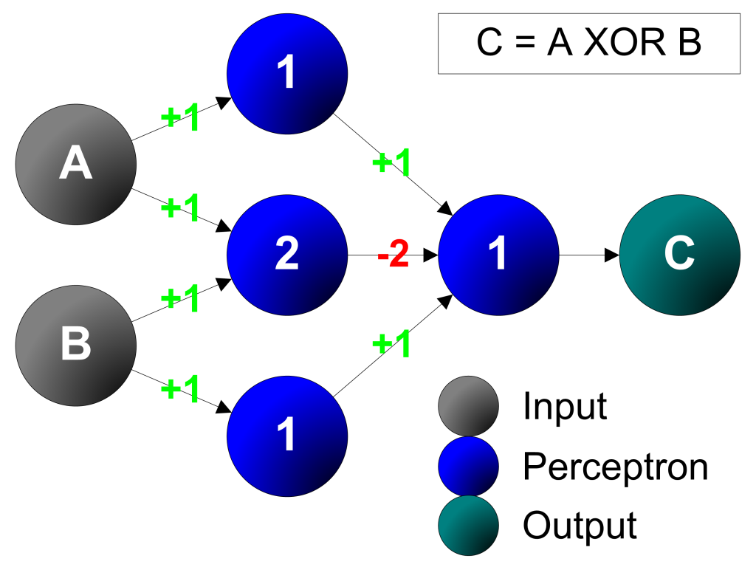
Artificial Neural Net Example
Artificial Neural Networks can be used to do full-fledged computations
This perceptron example requires designer to know a truth table.
Would like to have a circuit that trains itself based on examples

Slide 7
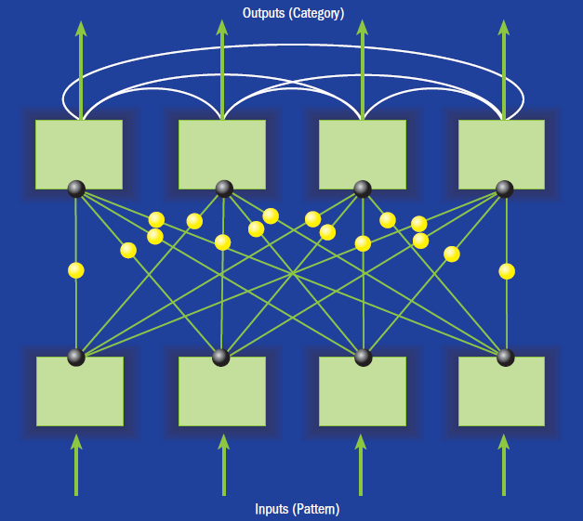
Pattern Recognition ANN
“Neurons”
“Synapses”
Pattern
Excitatory inputs
Inhibitory inputs
Categorization

Slide 8
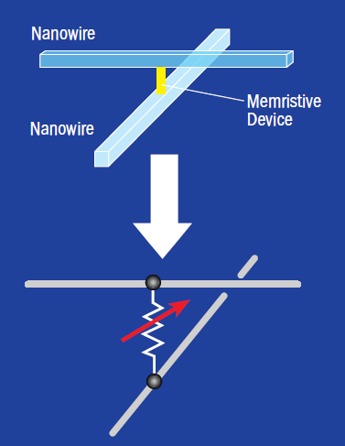
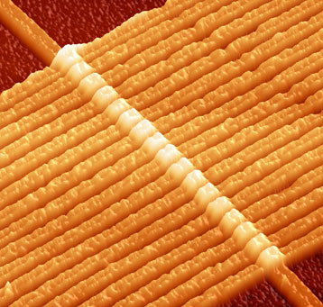
Memristors
Passive two-terminal devices
Basically: Variable resistance as a function of voltage previously applied

Slide 9
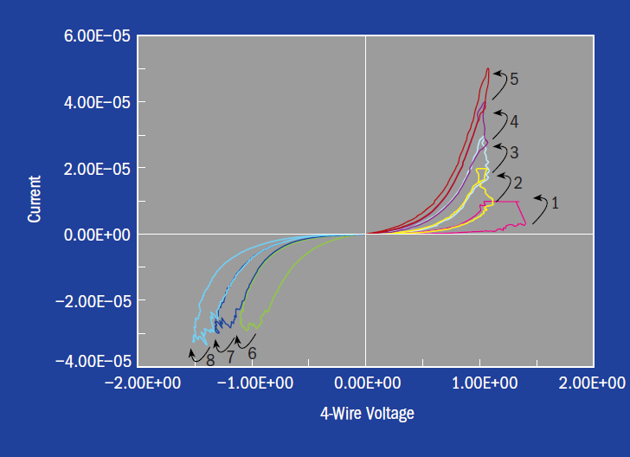
Memristor Learning Behavior

Slide 10
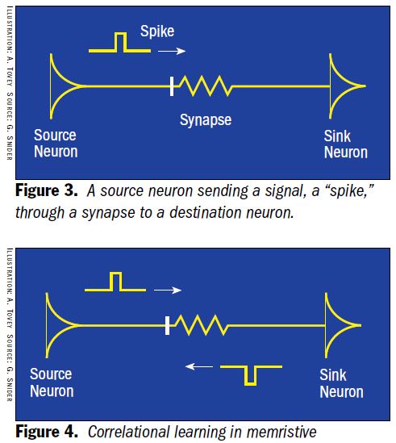
Utilizing Memristors for ANN Synapses
ANNs can use memristors as artificial synapses
Resistance changes signal strength between input & output neurons
Memristors allow learning to take place utilizing only two terminals

Slide 11
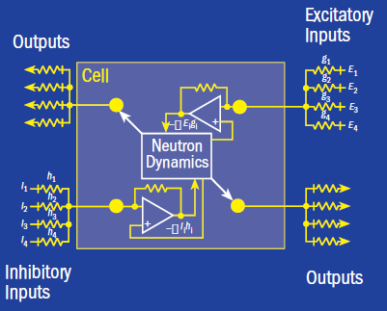
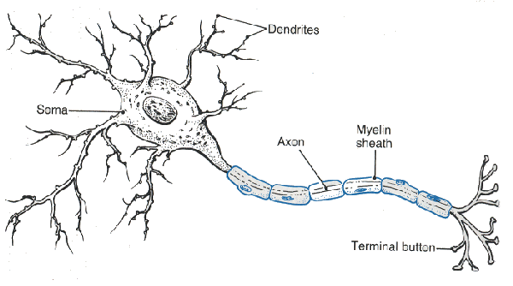
Artificial neurons as a circuit
Two inputs (inhibitory/excitatory)
Two outputs (inhibitory/excitatory)
Some calculation core
Example of this as a computational neuron with memristors

Slide 12
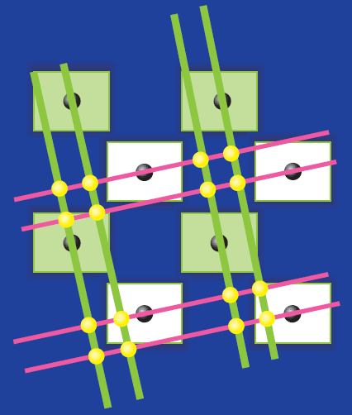
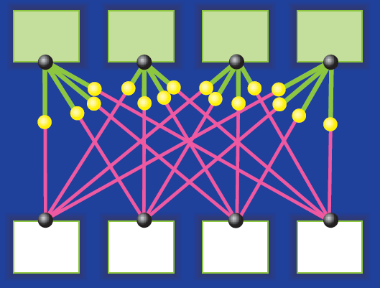
Building circuit on silicon
Lay out circuit to use multiple metal layers
Each neuron circuit fabbed in regular CMOS

Slide 13
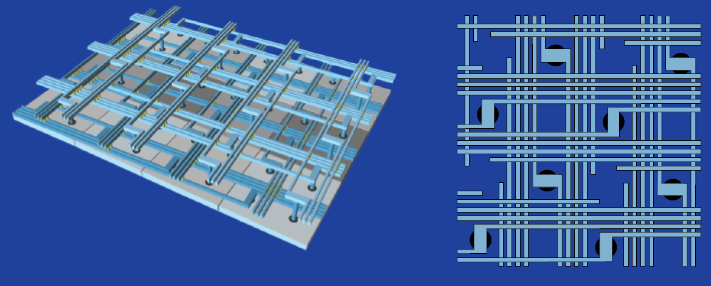
Layout of an entire neural network
Build entire cortex structure using Neurons (boxes/circuits), axons & dendrites (wires), and synapses (memristors/wire crossings).

Slide 14
Neural circuitry doing pattern recognition

Slide 15
Cortical Computing
"People confuse these kinds of networks with neural networks," … But neural networks - the previous best hope for creating an artificial brain - are software working on standard computing hardware. "What we're aiming for is actually a change in architecture," -- from “Memristor minds: The future of artificial intelligence”

