Slide 1
Hardware Support for
On-Demand Software Analysis
Joseph L. Greathouse
Advanced Computer Architecture Laboratory
University of Michigan
December 8, 2011
Notes:
This talk was given on December 8, 2011, for the University of Michigan Computer Science and Engineering Graduate Student Honors competition. I was lucky enough to win 1st place. It’s a shortened version of the ISCA talk (primarily), and makes an argument that hardware should help make software better.

Slide 2
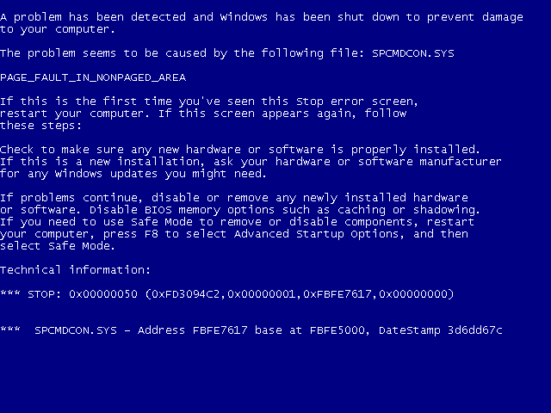
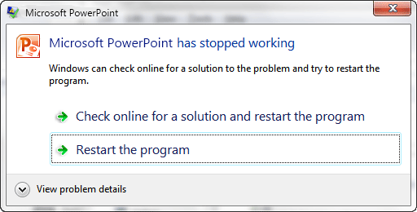


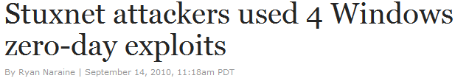
Software Errors Abound
NIST: Software errors cost U.S. ~$60 billion/year
FBI: Security Issues cost U.S. $67 billion/year
  >⅓ from viruses, network intrusion, etc.

Slide 3
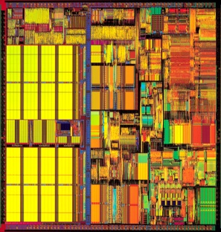
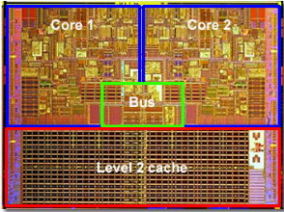
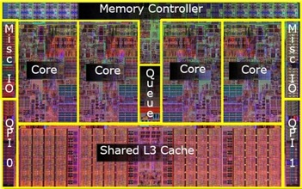
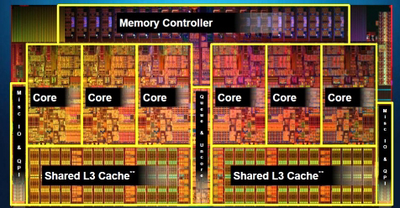
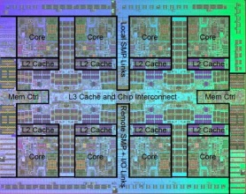
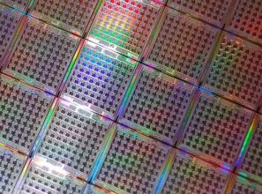
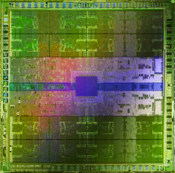

Hardware Plays a Role
Parallel Programming is Here – And it’s Hard!
x + y = 10
y + z = 20
5
10
10
10
X = 5
Y =
Z =
X = 0
Y=10
10
Y=10

Slide 4

Example of a Modern Bug
Thread 1
Thread 2
mylen=small
mylen=large
Nov. 2010 OpenSSL Security Flaw
if(ptr == NULL) {
len=thread_local->mylen;
ptr=malloc(len);
memcpy(ptr, data, len);
}
ptr
∅

Slide 5
Example of a Modern Bug
Thread 1
Thread 2
mylen=small
mylen=large
TIME
if(ptr==NULL)
if(ptr==NULL)
len2=thread_local->mylen;
ptr=malloc(len2);
len1=thread_local->mylen;
ptr=malloc(len1);
memcpy(ptr, data1, len1)
memcpy(ptr, data2, len2)
ptr
LEAKED
∅

Slide 6



Data Race Detection
Thread 1
Thread 2
mylen=small
mylen=large
TIME
if(ptr==NULL)
len1=thread_local->mylen;
Shared?
ptr=malloc(len1);
Synchronized?
memcpy(ptr, data1, len1)
if(ptr==NULL)
len2=thread_local->mylen;
ptr=malloc(len2);
memcpy(ptr, data2, len2)

Slide 7
Data Race Detection is Slow
Phoenix
PARSEC

Slide 8
Inter-thread Sharing is What’s Important
Thread-local data
NO SHARING
TIME
if(ptr==NULL)
len1=thread_local->mylen;
ptr=malloc(len1);
Shared data, but
NO DYNAMIC SHARING
memcpy(ptr, data1, len1)
if(ptr==NULL)
len2=thread_local->mylen;
ptr=malloc(len2);
memcpy(ptr, data2, len2)

Slide 9
Very Little Dynamic Sharing
Phoenix
PARSEC

Slide 10



Little Sharing Means Wasted Work
Software
Race Detector
Software
Race Detector
Inter-thread sharing
Local Access
Multi-threaded
Application

Slide 11


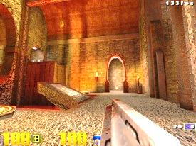
Do Analysis On-Demand!
Software
Race Detector
Software
Race Detector
Multi-threaded
Application
Inter-thread sharing
Local Access
Inter-thread Sharing Monitor

Slide 12
Hardware Sharing Detector
HITM in Cache Memory: W→R Data Sharing
Hardware Performance Counters
Core 1
Core 2
S
S
HITM
Write Y=5
M
Y=5
I
Read Y
I
Perf. Ctrs
Pipeline
2
1
0
FAULT
0
-1
Cache
0
1
0

Slide 13
On-Demand Analysis on Real HW
> 97%
Execute Instruction
NO
HITM
Interrupt?
NO
Analysis
Enabled?
Disable Analysis
YES
YES
NO
< 3%
Enable Analysis
SW Race Detection
Sharing Recently?
YES

Slide 14
Performance Difference
Phoenix
PARSEC

Slide 15
Performance Increases
Phoenix
PARSEC
51x
Accuracy vs. Continuous Analysis: 97%

Slide 16
In Summary
Hardware makes constructing software difficult.
Tools make software better.
Hardware can (and should!) help these tools.

Slide 17
BACKUP SLIDES

Slide 18
Width Test
Notes:
In case the projector is clipping.

