Slide 1
Hardware Mechanisms for Distributed Dynamic
Software Analysis
Joseph L. Greathouse
Advisor: Prof. Todd Austin
May 10, 2012

Slide 2
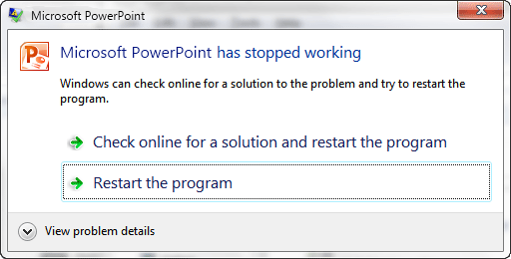


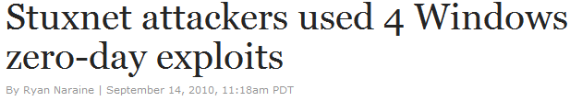
Software Errors Abound
NIST: Software errors cost U.S. ~$60 billion/year
FBI: Security Issues cost U.S. $67 billion/year
  >⅓ from viruses, network intrusion, etc.

Slide 3

Example of a Modern Bug
Thread 1
Thread 2
mylen=small
mylen=large
Nov. 2010 OpenSSL Security Flaw
if(ptr == NULL) {
len=thread_local->mylen;
ptr=malloc(len);
memcpy(ptr, data, len);
}
ptr
∅

Slide 4
Example of a Modern Bug
Thread 1
Thread 2
mylen=small
mylen=large
TIME
if(ptr==NULL)
if(ptr==NULL)
len2=thread_local->mylen;
ptr=malloc(len2);
len1=thread_local->mylen;
ptr=malloc(len1);
memcpy(ptr, data1, len1)
memcpy(ptr, data2, len2)
ptr
LEAKED
∅

Slide 5
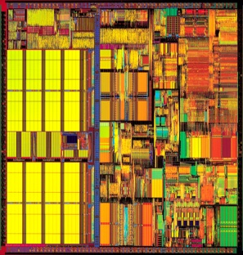
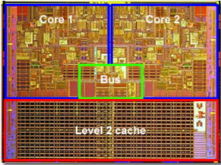
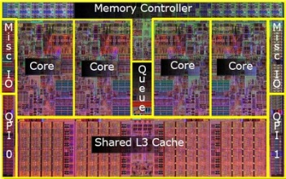
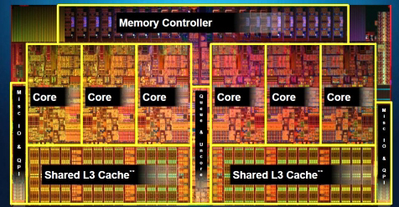
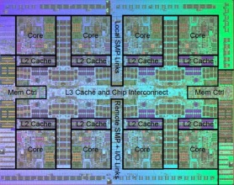

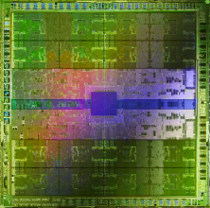



Hardware Plays a Role in this Problem
In spite of proposed hardware solutions
Bulk Memory Commits
Hardware Data Race Recording
Deterministic Execution/Replay
TRANSACTIONAL
MEMORY
Bug-Free Memory Models
Atomicity Violation Detectors
Notes:
All of those may be true, but I would also like to make the case that hardware plays a role in this problem.
For example, the move to chip multiprocessors has pushed parallel processing into the mainstream. Computer performance used to hinge on increasing the processor’s operating frequency and adding more complicated microarchitectural features. Technically, software developers could gain performance by doing nothing at all.
However, since the move to CMPs, software developers must work for their performance. As processors have moved from *click* 1 to 2 to …, performance gains now come from changing your code to work efficiently in parallel. This, unfortunately, leads to new kinds of bugs, and architects have done little to help solve this problem.
This is in spite of *proposed* solutions, such as …
So while hardware helps create the problem, there is little the hardware does to help solve it. One of the most important arguments of this thesis is that hardware should make it easier to eliminate bugs.

Slide 6
Dynamic Software Analyses
Data Race Detection
(e.g. Inspector XE)
Memory Checking
(e.g. MemCheck)
Taint Analysis
Dynamic Bounds Checking
Analyze the program as it runs
  Find errors on any executed path
  LARGE overheads, only test one path at a time
2-300x
2-200x
5-50x
2-80x

Slide 7
Goals of this Thesis
Allow high quality dynamic software analyses
  Find difficult bugs that weaker analyses miss
Distribute the tests to large populations
  Must be low overhead or users will get angry
Sampling + Hardware to accomplished this
  Each user only tests a small part of the program
  Each test should be helped by hardware
Notes:
Therefore, the goal of this work is to enable high quality dynamic correctness and security analyses.
*We focus on dynamic analyses because they are useful for finding errors that other mechanisms can’t.
*Some powerful static analyses, for instance, attain high error coverage at the cost of small scope. Some, for instance, run into a state explosion problem as they attempt to work their way through all possible paths to find errors.
We wish to *distribute* dynamic analyses to large populations of users because this type of analysis gains power from seeing a multitude of different dynamic states. The more you test, the stronger your analysis.
However, if we wish to distribute these to users, they must have low overhead. Otherwise, users will (1) get angry at your slow software, and (2) probably stop using it.
We plan to accomplish *this* by sampling analyses, allowing users test *parts* of the program. This means that each user will see much less overhead, as their analysis system is only enabled a small portion of the time.
While you may have heard of other sampling works: they don’t work. They don’t work for the type of analysis we want to look at: dynamic dataflow analyses.
Transition: What do I mean by dynamic dataflow analyses

Slide 8
Meeting These Goals - Thesis Overview
Software Support
Hardware Support
Dataflow
Analysis
Dataflow
Analysis
Allow high quality dynamic software analyses
Data Race Detection
Data Race Detection

Slide 9
Meeting These Goals - Thesis Overview
Software Support
Hardware Support
Dataflow Analysis Sampling (CGO’11)
Unlimited Watchpoint System (ASPLOS’12)
Dataflow Analysis Sampling
(MICRO’08)
Dataflow
Analysis
Tests must be
low overhead
Distribute the tests + Sample the analyses
Hardware-Assisted Demand-Driven
Race Detection (ISCA’11)
Data Race Detection

Slide 10
Outline
Problem Statement
Distributed Dynamic Dataflow Analysis
Demand-Driven Data Race Detection
Unlimited Watchpoints

Slide 11
Outline
Problem Statement
Distributed Dynamic Dataflow Analysis
Demand-Driven Data Race Detection
Unlimited Watchpoints
SW
Dataflow
Sampling
Watch
points
HW Dataflow Sampling
Demand-Driven Race Detection

Slide 12
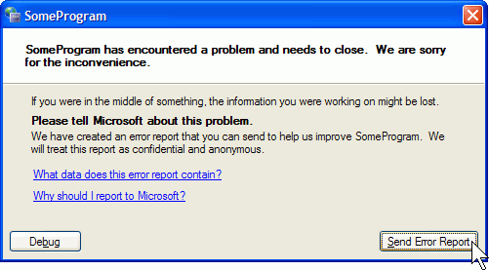





Distributed Dynamic Dataflow Analysis
Split analysis across large populations
  Observe more runtime states
  Report problems developer never thought to test
Instrumented Program
Potential problems
Notes:
To maximize the number of dynamic situations observed: distribute the tests to end users.
*click*
A developer can send an instrumented version of his program to his users.
Large populations will then see many more runtime states than the developer could test alone.
*click*
Because of that, the analyses some users run may find potential errors.
It’s important to note that different users MIGHT FIND DIFFERENT BUGS. The more users the better.
*click*
These potential problems can then be reported back to the developer
*click*
much like how program crashes are reported today. Software updated (iPhone, cloud sw, auto-update)

Slide 13
The Problem: OVERHEADS
Data Race Detection
(e.g. Thread Analyzer)
Memory Checking
(e.g. MemCheck)
Taint Analysis
(e.g.TaintCheck)
Dynamic Bounds Checking
Analyze the program as it runs
  System state, find errors on any executed path
  LARGE runtime overheads, only test one path
2-300x
2-200x
5-50x
2-80x

Slide 14
Current Options Limited
No
Analysis
Complete
Analysis
Notes:
Our solution to this overhead problem is sampling. In other words, we desire to analyze a random part of the program’s dynamic state during each execution, where the amount of analysis is controlled by our desired maximum overhead.
This graph represents the desired results of an ideal sampling system. On the far left side, the system would see zero overhead, but have no chance of detecting errors; this is where we are right now, never performing analysis. Current analysis systems lie on the right, where our overhead is high but we detect every observable error.
We want to fill in the middle through sampling techniques, where our probability of finding an error is proportional to the observed overhead.
*click* In essence, this would give users (or developers) a knob that allows them to choose their individual accuracy versus speed tradeoff.

Slide 15
Solution: Sampling
Lower overheads by skipping some analyses
No
Analysis
Complete
Analysis
Notes:
Our solution to this overhead problem is sampling. In other words, we desire to analyze a random part of the program’s dynamic state during each execution, where the amount of analysis is controlled by our desired maximum overhead.
This graph represents the desired results of an ideal sampling system. On the far left side, the system would see zero overhead, but have no chance of detecting errors; this is where we are right now, never performing analysis. Current analysis systems lie on the right, where our overhead is high but we detect every observable error.
We want to fill in the middle through sampling techniques, where our probability of finding an error is proportional to the observed overhead.
*click* In essence, this would give users (or developers) a knob that allows them to choose their individual accuracy versus speed tradeoff.

Slide 16
Sampling Allows Distribution
Lower overheads mean more users
End Users
Many Users
Many users testing at little overhead see more errors than one user at high overhead.
Beta Testers
Developers
Few Users
No
Analysis
Complete
Analysis
Notes:
For example, developers may be OK with running at high overheads for some tests (devs currently do this for Valgrind, for example.) However, by turning the knob lower, *click* we can allow our larger population beta testers to catch errors at much less overhead.
If we can continue to lower the overhead, it could even be possible to send these analyses off to our very large population of end users *cllick*. And while they would have a low probability of finding any individual error, our hope for this work is that *click* many users testing at little overhead see more errors than one user at high overhead because of their sheer numbers.

Slide 17
Example Dynamic Dataflow Analysis
Data
Input
Meta-data
Associate
x = read_input()
x = read_input()
validate(x)
Clear
Propagate
y = x * 1024
y = x * 1024
w = x + 42
Check w
Check w
a += y
z = y * 75
Check z
a += y
z = y * 75
Check z
Check a
Check a
Notes:
Let’s go through an example. Overview of what the rules of this simple taint analysis system are:
*Don’t trust data from outside the program
*Associated meta-data bit means “not trusted”
*Error if you check non-trusted data.
{go through example}
Transition: Dynamic analyses can only perform these tests on control paths seen by the program. Therefore, we wish to see as many paths and dynamic inputs as possible.

Slide 18
Sampling Dataflows
Sampling must be aware of meta-data
Remove meta-data from skipped dataflows
Notes:
So our solution is to sample _the meta dataflows_, not the code of the program.
Let’s look at this example dynamic dataflow. Rather than skipping any individual instruction that forms it, we wish to non-deterministically choose, at runtime, some subset of the dataflows *click*
To ensure that you don’t get the false positives that we showed on the previous slide, you *must* clear the meta-data from any value if you touch it while avoiding its dataflow.
Transition: Let’s show an example.

Slide 19
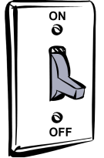
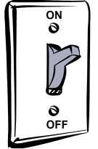




Dataflow Sampling
Sampling Tool
Analysis Tool
Analysis Tool
Application
OH Threshold
Clear meta-data
Meta-data
Meta-Data Detection

Slide 20
Finding Meta-Data
No additional overhead when no meta-data
  Needs hardware support
Take a fault when touching shadowed data
Solution: Virtual Memory Watchpoints
FAULT
V→P
V→P

Slide 21
Prototype Setup
Xen+QEMU Taint analysis sampling system
  Network packets untrusted
Performance Tests – Network Throughput
  Example: ssh_receive
Sampling Accuracy Tests
  Real-world Security Exploits
Xen Hypervisor
ShadowPage Table
Admin VM
OS and Applications
Net Stack
Taint Analysis QEMU
OHM
App
App
…
App
Linux
Notes:
We built a prototype system to test our dataflow sampling methods for both performance and accuracy. We used “taint analysis” as our dynamic dataflow test, where network packets are untrusted. An error is raised if untrusted values are, for instance, used as the destination of a jump.
This was built on top of a Xen & Linux system, and also uses a version of the emulator QEMU that was modified to perform taint analysis on x86 code. A shadow page table is used to cause a fault when a guest virtual machine touches a tainted value, at which point the entire guest VM is moved into QEMU.
An overhead manager sits next to QEMU, and keeps track of the amount of time a domain spends in analysis versus on the bare hardware. If the domain passes some user-controlled threshold, it can perform dataflow sampling by telling the emulator and shadow page system to stochastically remove meta-data associated with that domain.

Slide 22
Performance of Dataflow Sampling
ssh_receive
Throughput with no analysis
Notes:
Error bars 95% confidence interval. Blue dashed line is the throughput of the system when the analysis emulator is not enabled, never attempt to run analysis (this is different than always turning sampling on, as you don’t ever taint anything in the virtual memory system.)
When no analysis, about 19.72 MB/s
When analysis is always running: 178 kB/s
Can effectively control overheads using dataflow removal. Get to 19.67 MB/s at “always sampling”.

Slide 23
Accuracy with Background Tasks
ssh_receive running in background
Notes:
At some random point in time after beginning this test, we sent in the exploit for each particular accuracy benchmark and observed the probability of detecting the exploit within the torrent of dataflows that led to no error.
Ran each test multiple times (95% confidence interval). This shows that even with a large amount of benign dataflows in the system, we can still find most errors a percentage of the time ~close to the overhead percentage. *click*
Only need 1000 test runs to find the bug in Apache, which is difficult to find because its dataflows are very large and go through a number of different Apache modules.
Note for readers: the blue bar that comes up on the click is for illustrative purposes only. It shows that we’re basically on the overhead/accuracy line from slides 8 + 9. (honestly, it should be a step function for 10%, 25%, 50%, 75%, 90%, but whatever.

Slide 24
Outline
Problem Statement
Distributed Dynamic Dataflow Analysis
Demand-Driven Data Race Detection
Unlimited Watchpoints
SW
Dataflow Sampling
Watchpoints
HW Dataflow Sampling
Demand-Driven Race Detection

Slide 25
Dynamic Data Race Detection
Add checks around every memory access
Find inter-thread sharing
Synchronization between write-shared accesses?
  No? Data race.
Notes:
A dynamic software data race detector is a tool that adds analysis checks around the memory accesses in a program. These checks look for a number of things in order to identify possible data races.
First: They determine if a memory operation is participating in an inter-thread sharing event. This checks if one thread has written to a shared variable that another thread has read from or written to recently. In other words, does this access move information from one thread to another.
Next: If two accesses are participating in a sharing event, the software race detector then checks if there is some kind of synchronization point between the memory operations. This could be a lock, mutex, memory fence, etc. If no such synchronization point exists, then it would be possible to reorder these accesses in such a way that the output of the program could be affected. In other words, this memory operation is participating in a data race. The SW detector would then record this along with some amount of debugging information and report it to the developer.
Let’s show how this type of analysis would work on our previous example ➔
NOTE: You have to check each access, because if their dynamic orders change, races can appear different places.
(It has been shown that some accesses can be statically proven to not contain races– you need not check those. Not the focus of this work).

Slide 26
SW Race Detection is Slow
Phoenix
PARSEC

Slide 27

Inter-thread Sharing is What’s Important
Thread-local data
NO SHARING
TIME
if(ptr==NULL)
len1=thread_local->mylen;
ptr=malloc(len1);
Shared data
NO INTER-THREAD SHARING EVENTS
memcpy(ptr, data1, len1)
if(ptr==NULL)
len2=thread_local->mylen;
ptr=malloc(len2);
memcpy(ptr, data2, len2)

Slide 28
Very Little Dynamic Sharing
Phoenix
PARSEC

Slide 29


Run the Analysis On Demand
Software
Race Detector
Software
Race Detector
Multi-threaded
Application
Inter-thread sharing
Local Access
Inter-thread Sharing Monitor

Slide 30
Finding Inter-thread Sharing
Virtual Memory Watchpoints?
  ~100% of accesses cause page faults
Granularity Gap
Per-process not per-thread
Inter-Thread Sharing
FAULT
FAULT
Notes:
The big question now becomes: how do we perform this inter-thread sharing detection? It must be able to check each memory operation for active write-sharing with all other thread.
It also must be able to signal the software race detector in some way so that sharing instructions can be caught and analyzed.
Now, the simplest way to do this would be to use binary instrumentation to write a sharing monitor in software. In fact, this is easy enough that it’s been done before. The SW race detector used in this work checks for inter-thread sharing before sending each access through the rest of the race detection algorithm.
As demonstrated by the previous overhead numbers, however, this is slow. It still takes time to run these checks in SW, meaning you may not gain a lot of performance over just running the race detection on every instruction.

Slide 31
Hardware Sharing Detector
HITM in Cache Memory: W→R Data Sharing
Hardware Performance Counters
Core 1
Core 2
S
S
HITM
Write Y=5
M
Y=5
I
Read Y
I
Perf. Ctrs
Pipeline
1
0
FAULT
0
-1
Cache
0
1
0

Slide 32
Potential Accuracy & Perf. Problems
Limitations of Performance Counters
  Intel HITM only finds W→R Data Sharing
Limitations of Cache Events
  SMT sharing can’t be counted
  Cache eviction causes missed events
Events go through the kernel

Slide 33
On-Demand Analysis on Real HW
> 97%
Execute Instruction
NO
HITM
Interrupt?
NO
Analysis
Enabled?
Disable Analysis
YES
YES
NO
< 3%
Enable Analysis
SW Race Detection
Sharing Recently?
YES

Slide 34
Performance Increases
Phoenix
PARSEC
51x
Accuracy vs. Continuous Analysis: 97%

Slide 35
Outline
Problem Statement
Distributed Dynamic Dataflow Analysis
Demand-Driven Data Race Detection
Unlimited Watchpoints
SW
Dataflow Sampling
Watchpoints
HW Dataflow Sampling
Demand-Driven Race Detection

Slide 36
Watchpoints Work for Many Analyses
Bounds Checking
Data Race Detection
Taint Analysis
Deterministic Execution
Transactional Memory
Speculative Parallelization
Notes:
All of the dynamic analyses I discussed before can utilize watchpoints in one manner or another to run faster.
However, I’m sure you would all prefer that I keep this talk short, so I’m going to focus on only two systems.
*click*
Taint analysis and dynamic data race detection. If you’d like to learn more about the others, I recommend the paper, or speaking with me after this session, where I’d absolutely love to go over some of the finer details with you.

Slide 37
Desired Watchpoint Capabilities
Large Number
  Store in memory
  Cache on chip
Fine-grained
  Watch full VA
Per Thread
  Cached per HW thread
Ranges
  Range Cache
Z
V
W
X
Y
???
WP Fault
False Fault
False Faults
Notes:
Now, these two systems are both doing similar tasks, but they use watchpoints in very different ways. In fact, in the paper, we describe a number of different watchpoint capabilities that we need in order to make WP HW that is generic enough to work for every tool we looked at.
The first, and perhaps most important is that there be a _large number_ of WPs. Limiting the maximum # of WPs can significantly constrain the types of tools that you can use. For example, if we only had 4 watchpoints, but we wanted to mark a fifth value in memory as tainted, we’re out of luck! There are analysis tools out there (I’ve worked on some) that say the solution here is to sample a small part of the existing meta-data, but I think that should be an _option_, not a _requirement_.
The next thing that’s extremely useful for many of the tools we studied is that watchpoints be fine-grained. If they could only be set on, say, a page of data at a time, there can be a significant loss of performance due to take false faults.
If you’ve thought about the data race detection algorithm I discussed, one thing you may have noticed is that it sets different watchpoints on each _thread_. This turns out to be pretty important for almost any analysis that looks at multi-threaded programs. The only solution otherwise is to split your MT programs into multi-process programs (with all the associated difficulties), or take needless faults..
Finally, as you might’ve seen when I described the first step in the race detection algorithm, some WP-based systems set large numbers of watchpoints. In fact, they’ll often set _and divide_ large ranges. If you need to set every internal byte (remember, we’re fine-grained here!) the watchpoint system can become unreasonably slow.
There are others in the paper, but I think these are the important ones for a talk of this length..

Slide 38

Range Cache
Start Address
End Address
Watchpoint?
Valid
0x0
0x4
0xffff_ffff
Not Watched
1
0x5
0x2000
R Watched
R Watched
0
1
0x2001
0xffff_ffff
Not Watched
0
1
≤ 0x400?
≥ 0x400?
WP
Interrupt
Set Addresses 0x5 – 0x2000
R-Watched
Load Address 0x400
Notes:
The general idea that system is a cache that stores the boundary addresses of ranges. When an incoming check finds that it overlaps with a range, the RC loads data (in our case, watchpoints) associated with that range. For the precise technical details, I’ll refer you to the MICRO paper.
However, an important thing to note is that this HW allows us to not only set a large region easily, but it allows us to split regions simply as well. {walk through example. For example, if we add a new range into this cache, etc. etc.}

Slide 39
Watchpoint System Design
Store Ranges in Main Memory
Per-Thread Ranges, Per-Core Range Cache
Software Handler on RC miss or overflow
Write-back RC works as a write filter
Precise, user-level watchpoint faults
WP Changes
T1 Memory
Memory
T2 Memory
Core 1
Core 2

Slide 40
Experimental Evaluation Setup
Trace-based timing simulator using Pin
Taint analysis on SPEC INT2000
Race Detection on Phoenix and PARSEC
Comparing only shadow value checks
Notes:
So how well does this setup work? To testit, we built a high-level simulator using Pin. This tool follows every memory access in a program and runs it against a simulation of any particular watchpoint hardware design.
In the paper, we compared against a collection offline-grained memory protection systems. To simplify the graphs up here, I’ll just show slowdowns caused by binary instrumentation systems, virtual memory watchpoints, and our range cache based watchpoint system.
The HW simulation keeps track of events that would cause slowdowns. Those that are completely exposed, such as kernel faults, are simply counted and multiplied by a known delay. The events that cause other overheads, such as the work done by the software backing store handler, are recorded and run through an offline timing simulator.
In the tests shown in the next slide, we ran the taint analysis tool on the SPEC INT2000 benchmarks, and our range cache had 128 entries (which is equal to about 4KB of L1D cache, according to Tiwari et al.)
Finally, it is important to note that these benchmarks are only comparing the overheads of checking shadow values. In other words, the overhead of performing taint association, propagation, and checking is common amongst all tools, so we did not model it.

Slide 41
Watchpoint-Based Taint Analysis
128 entry RC –or– 64 entry RC + 2KB Bitmap
1429x
10x
30x
206x
423x
23x
28x
19x
RC+
Bitmap
20%
Slowdown
Notes:
The Y axis in this graph is _the slowdown_ caused by each tool. You’ll notice that there are four bars in each group.
The first, MINEMU, is an extremely efficient SW taint analysis tool. The second, Umbra, is the slowdown caused by a very (but not extremely) efficient shadow value accessing mechanism built on top of the DynamoRio binary instrumentation engine. The former _is_ doing taint analysis, meaning the overheads of assignment and propagation _are_ included, while the latter is only accessing the shadow values associated with each instruction w/o performing any taint checking or propagation.
The 3rd bar is a system that uses VM watchpoints to perform meta-data checks. If a page fault is taken on an access, only then are shadow values loaded from memory.
The last bar is our range cache watchpoint system. This uses watched ranges for each tainted value in order to find meta-data.
As you can see from the data, even the very efficient SW mechanisms for performing taint analysis have relatively high overheads. MINEMU, which purports to be the fastest taint analysis tool on earth, still sits at ~3x overhead on average. Umbra, which is more portable, sits at almost 5x just to access shadow values.
Using VM watchpoints turns out to be a pretty bad idea in this case. For instance, in vortex, the system is more than a thousand times slower because almost every memory access causes a page fault because the watchpoint granularity is so much larger than the largest tainted region. On average, it is about 4x slower than just using Umbra. Of course, Alex Ho et al published work back in Eurosys2006 showing that demand-driven taint analysis using VM watchpoints works, but it meant that their system stay enabled even when it didn’t need to stay on.
Using our watchpoint system, however, we can skip a large number of analyses in the system. In fact, on most benchmarks, the hardware causes little to no overhead, as every memory access hits in the range cache. Vortex, with its large number of fine-grained watchpoints, misses in the RC sometimes, making the RC take nearly as much overhead to check for shadow values as MINEMU takes to perform the whole taint analysis stack. However, on average, the HW only causes a 20% slowdown to check for the existence of taint values.

Slide 42
Watchpoint-Based Data Race Detection
+10%
+20%
RC+
Bitmap

Slide 43
Future Directions
Dataflow Tests find bugs on executed code
  What about code that is never executed?
Sampling + Demand-Driven Race Detection
  Good synergy between the two, like taint analysis
Further watchpoint hardware studies:
  Clear microarchitectural analysis
  More software systems, different algorithms
Notes:
So in conclusion, the case I’m making for an unlimited watchpoint system is that it is an extremely useful _generic_ SW acceleration mechanism. Many software systems utilize meta-data or perform address checks in some way. We should let hardware do the heavy lifting here, though current systems don’t suffice.
Of course, in the future, there is more work to be done. For instance, I’ll readily admit that I’d like to do (or see) a deeper microarchitectural analysis of this work. A high level simulation is good for finding the right path, but I know there will be hard questions to answer if we want to take this down to real hardware.
I’d also like to see new software algorithms that could utilize this hardware. The more users the better, since nothing of this kind will be built unless there’s a tangible desire from enough customers to make it a worthwhile investment. I’m continually trying to come up with new users, and if you think you have one, feel free to catch me after the talk (or bring them up in the Q&A), as I’d love to discuss it.

Slide 44
Conclusions
Sampling allows distributed dataflow analysis
Existing hardware can speed up race detection
Watchpoint hardware useful everywhere
Distributed Dynamic
Software Analysis
Software
Dataflow Analysis Sampling
Unlimited Watchpoint System
Hardware
Dataflow Analysis Sampling
Hardware-Assisted Demand-Driven
Data Race Detection
Notes:
So in conclusion, the case I’m making for an unlimited watchpoint system is that it is an extremely useful _generic_ SW acceleration mechanism. Many software systems utilize meta-data or perform address checks in some way. We should let hardware do the heavy lifting here, though current systems don’t suffice.
Of course, in the future, there is more work to be done. For instance, I’ll readily admit that I’d like to do (or see) a deeper microarchitectural analysis of this work. A high level simulation is good for finding the right path, but I know there will be hard questions to answer if we want to take this down to real hardware.
I’d also like to see new software algorithms that could utilize this hardware. The more users the better, since nothing of this kind will be built unless there’s a tangible desire from enough customers to make it a worthwhile investment. I’m continually trying to come up with new users, and if you think you have one, feel free to catch me after the talk (or bring them up in the Q&A), as I’d love to discuss it.

Slide 45
Thank You

Slide 46
BACKUP SLIDES

Slide 47

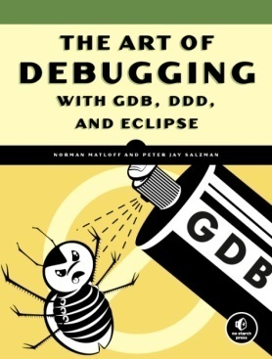


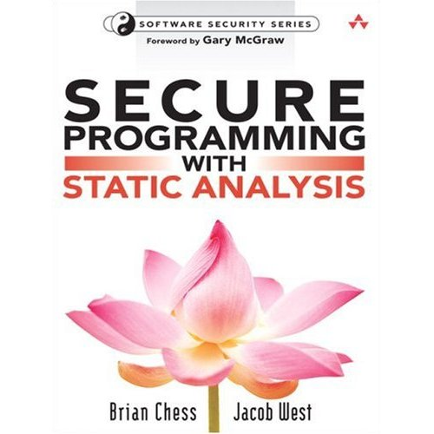
Finding Errors
Brute Force
  Code review, fuzz testing,
  whitehat/grayhat hackers
  Time-consuming, difficult
Static Analysis
  Automatically analyze source,
  formal reasoning, compiler checks
  Intractable, requires expert input,
  no system state

Slide 48
Dynamic Dataflow Analysis
Associate meta-data with program values
Propagate/Clear meta-data while executing
Check meta-data for safety & correctness
Forms dataflows of meta/shadow information
Notes:
Make sure we’re on the same page, since some audience members may be static analysis people where dataflow means something already.
*Associate meta-data with the regular values of the program
**Example: Is this variable initialized?
*As the program executes, you propagate this meta-data to new variables in the program, or clear it from old ones.
**Example: I’m copying an initialized variable into a location; that variable is now initialized.
*Check meta-data values on certain actions to verify integrity of system
**Example: Is this pointer I am about to dereference initialized?
Meta-data flows represent the movement of important testing information from source to checks.

Slide 49
Demand-Driven Dataflow Analysis
Only Analyze Shadowed Data
Instrumented
Application
Instrumented
Application
Native
Application
Shadowed Data
Non-Shadowed Data
Meta-Data Detection

Slide 50
Results by Ho et al.
lmbench Best Case Results:
Results when everything is tainted:
System | Slowdown
Taint Analysis | 101.7x
On-Demand Taint Analysis | 1.98x

Slide 51
Sampling Allows Distribution
End Users
Beta Testers
Many users testing at little overhead see more errors than one user at high overhead.
Developer
No
Analysis
Complete
Analysis
Notes:
For example, developers may be OK with running at high overheads for some tests (devs currently do this for Valgrind, for example.) However, by turning the knob lower, *click* we can allow our larger population beta testers to catch errors at much less overhead.
If we can continue to lower the overhead, it could even be possible to send these analyses off to our very large population of end users *cllick*. And while they would have a low probability of finding any individual error, our hope for this work is that *click* many users testing at little overhead see more errors than one user at high overhead because of their sheer numbers.

Slide 52


Cannot Naïvely Sample Code
Input
x = read_input()
validate(x)
Skip Instr.
x = read_input()
Validate(x)
False Positive
y = x * 1024
w = x + 42
Check w
y = x * 1024
w = x + 42
Check w
a += y
Skip Instr.
a += y
z = y * 75
Check z
Check a
Check z
False Negative
Check a
Notes:
Unfortunately, previous sampling mechanisms do not work for dynamic dataflow analyses. These systems (e.g. Liblit et al.) operate by skipping random instructions throughout the program, which does not work when you must follow long meta dataflows from source to check.
In this example, we will skip some instructions, as a code-based sampling system would. When we skip these instructions, the meta data at the destination will stay the same, as the meta-data system is disabled.
{Go through example}
Therefore you can get both false negatives and false positives. We cannot trust any answer that this analysis gives us, as it may be wrong in either direction.

Slide 53
Dataflow Sampling Example
Input
x = read_input()
x = read_input()
validate(x)
Skip Dataflow
y = x * 1024
Check w
y = x * 1024
w = x + 42
Check w
Skip Dataflow
a += y
a += y
z = y * 75
Check z
Check a
Check z
False Negative
Check a
Notes:
In this slide, rather than skipping instructions, we’ll skip dataflow operations. And, as mentioned, we will clear the meta-data from any variable on a dataflow we’re “skipping”.
{Example here}
Transition: How do we make a system that skips whole dataflows? How can we remove dataflows if our analysis system is disabled?

Slide 54
Benchmarks
Performance – Network Throughput
  Example: ssh_receive
Accuracy of Sampling Analysis
  Real-world Security Exploits
Name | Error Description
Apache | Stack overflow in Apache Tomcat JK Connector
Eggdrop | Stack overflow in Eggdrop IRC bot
Lynx | Stack overflow in Lynx web browser
ProFTPD | Heap smashing attack on ProFTPD Server
Squid | Heap smashing attack on Squid proxy server
Notes:
Our tests for this prototype are in two domains. The first, performance, test the network throughput of the system. Because all the meta-data in the system is derived from I/O, network throughput benchmarks constantly try to operate on meta-data. In the interests of time, I’ll just show one example from the paper. Ssh_receive attempts to receive a constant stream of encrypted packets, , perform decryption calculations within the emulator, and throw away the decoded packets. This yields very poor performance in a classical demand-analysis system, as nearly every calculation in the system is within the emulator.
Our second set of tests are to verify the accuracy of the analysis system when we begin sampling. For this, we test a number of real-world security errors that our full taint analysis system can observe at runtime. This is a collection of remote-code-running exploits on network-facing applications obtained from online exploit databases.

Slide 55
Performance of Dataflow Sampling (2)
netcat_receive
Throughput with no analysis
Notes:
Error bars 95% confidence interval.
Netcat_receive sent a bunch of data from a remote computer into the DUT through a TCP connection. The DUT then took these packets and immediately dumped them into /dev/null

Slide 56
Performance of Dataflow Sampling (3)
ssh_transmit
Throughput with no analysis
Notes:
Error bars 95% confidence interval.
Ssh_transmit sent a bunch of data over an SSH tunnel into a remove machine. The ACKs etc were returned over SSH and required decrypting, but less-so than ssh_receive, so the throughput here is higher.

Slide 57
Accuracy at Very Low Overhead
Max time in analysis: 1% every 10 seconds
Always stop analysis after threshold
  Lowest probability of detecting exploits
Name | Chance of Detecting Exploit
Apache | 100%
Eggdrop | 100%
Lynx | 100%
ProFTPD | 100%
Squid | 100%
Notes:
1% of the time (overhead) in any 10 second window
Always stop the analysis after the threshold
(yields lowest probability)
*Nothing else is happening on the system; no other work at all*
Transition: This is true for a system nothing else happening on it, which is unlikely to be the case on a busy server. Therefore, our next set of tests were run with one of the ssh_receive throughput benchmark also running, simulating a large amount of benign traffic.

Slide 58
Accuracy with Background Tasks
netcat_receive running with benchmark
Notes:
Much higher values because netcat_receive doesn’t hammer QEMU as badly, so more dataflows make their way through the sampling system to catch errors.

Slide 59
Outline
Problem Statement
Proposed Solutions
  Distributed Dynamic Dataflow Analysis
  Testudo: Hardware-Based Dataflow Sampling
  Demand-Driven Data Race Detection
Future Work
Timeline
Watchpoints
HW Dataflow Sampling
Dataflow
Sampling
Demand-Driven Race Detection

Slide 60
Virtual Memory Not Ideal
FAULT
FAULT
netcat_receive
Notes:
A dynamic software data race detector is a tool that adds analysis checks around the memory accesses in a program. These checks look for a number of things in order to identify possible data races.
First: They determine if a memory operation is participating in an inter-thread sharing event. This checks if one thread has written to a shared variable that another thread has read from or written to recently. In other words, does this access move information from one thread to another.
Next: If two accesses are participating in a sharing event, the software race detector then checks if there is some kind of synchronization point between the memory operations. This could be a lock, mutex, memory fence, etc. If no such synchronization point exists, then it would be possible to reorder these accesses in such a way that the output of the program could be affected. In other words, this memory operation is participating in a data race. The SW detector would then record this along with some amount of debugging information and report it to the developer.
Let’s show how this type of analysis would work on our previous example ➔
NOTE: You have to check each access, because if their dynamic orders change, races can appear different places.
(It has been shown that some accesses can be statically proven to not contain races– you need not check those. Not the focus of this work).

Slide 61
Word Accurate Meta-Data
What happens when the cache overflows?
  Increase the size of main memory?
  Store into virtual memory?
Use Sampling to Throw Away Data
Pipeline
Data Cache
Word Accurate
Meta Data Cache

Slide 62
On-Chip Sampling Mechanism
512-entry cache
1024-entry cache
17601
Avg. # of executions

Slide 63
Useful for Scaling to Complex Analyses
If each shadow operation uses 1000 instructions:
%
%
17.3%
Average % Overhead
Average % Overhead
3500
executions
169,000
executions
0.3%
1024-entry Sample Cache
telnet server benchmark

Slide 64

Example of Data Race Detection
Thread 1
Thread 2
mylen=small
mylen=large
TIME
if(ptr==NULL)
len1=thread_local->mylen;
Interleaved Synchronization?
ptr write-shared?
ptr=malloc(len1);
memcpy(ptr, data1, len1)
if(ptr==NULL)
len2=thread_local->mylen;
ptr=malloc(len2);
memcpy(ptr, data2, len2)

Slide 65
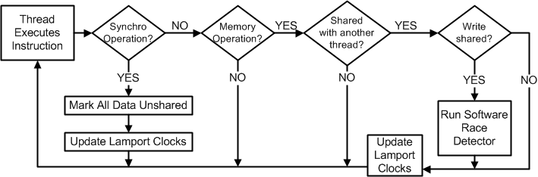
Demand-Driven Analysis Algorithm
Notes:
Original complicated algorithm diagram from the paper.

Slide 66
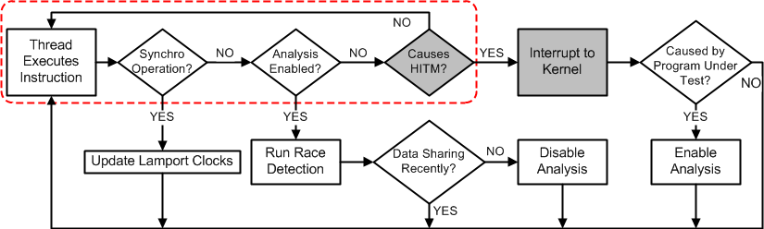
Demand-Driven Analysis on Real HW
Notes:
Other original complicated algorithm diagram from the paper.

Slide 67
Performance Difference
Phoenix
PARSEC
Notes:
This shows the performance difference between the continuous-analysis tool (shown earlier in the talk; yellow) versus our demand-driven analysis tool (blue). This has lowered the slowdowns of Phoenix suite from 83x to 8x, and the PARSEC suite from 75x to 25x. However, it’s a little hard to see just what this means as far as improvement, so that’s the next slide.

Slide 68
Demand-Driven Analysis Accuracy
1/1
2/4
2/4
3/3
4/4
3/3
4/4
4/4
Accuracy vs. Continuous Analysis: 97%

Slide 69
Accuracy on Real Hardware
 | kmeans | facesim | ferret | freqmine | vips | x264 | streamcluster
W→W | 1/1 (100%) | 0/1 (0%) | - | - | 1/1 (100%) | - | 1/1 (100%)
R→W | - | 0/1 (0%) | 2/2 (100%) | 2/2 (100%) | 1/1 (100%) | 3/3 (100%) | 1/1 (100%)
W→R | - | 2/2 (100%) | 1/1 (100%) | 2/2 (100%) | 1/1 (100%) | 3/3/ (100%) | 1/1 (100%)
 | kmeans | facesim | ferret | freqmine | vips | x264 | streamcluster
W→W | 1/1 (100%) | 0/1 (0%) | - | - | 1/1 (100%) | - | 1/1 (100%)
R→W | - | 0/1 (0%) | 2/2 (100%) | 2/2 (100%) | 1/1 (100%) | 3/3 (100%) | 1/1 (100%)
W→R | - | 2/2 (100%) | 1/1 (100%) | 2/2 (100%) | 1/1 (100%) | 3/3/ (100%) | 1/1 (100%)
 | Spider Monkey-0 | Spider Monkey-1 | Spider Monkey-2 | NSPR-1 | Memcached-1 | Apache-1
W→W | 9/9 (100%) | 1/1 (100%) | 1/1 (100%) | 3/3 (100%) | - | 1/1 (100%)
R→W | 3/3 (100%) | - | 1/1 (100%) | 1/1 (100%) | 1/1 (100%) | 7/7 (100%)
W→R | 8/8 (100%) | 1/1 (100%) | 2/2 (100%) | 4/4 (100%) | - | 2/2 (100%)
Notes:
Table of all the races. Note that this is when we can detect RFOs that cause HITMs (see the paper.)

Slide 70
Hardware-Assisted Watchpoints
HW Interrupt when touching watched data
SW knows it’s touching important data
  AT NO OVERHEAD
Normally used for debugging
0
1
2
3
4
5
6
7
A
D
E
G
G
X
B
C
F
X
C
D
E
H
WR X→7
R-Watch 2-4
W-Watch 6-7
LD 2
Notes:
When I say HW watchpoint support, I mean an on-chip device that contains a list of watched addresses. Normally, when you attempt to access a memory location you access it in some way. If you read from it *click* you get the value. If you write to it *click* it changes.
However, if we set watchpoints on certain values, things change. Read watchpoints *click* mean we can’t get values from those memory locations without the hardware causing an interrupt. Similarly, write watchpoints *click* mean we can’t change values in memory without the hardware informing us.
*click* What this means is that with HW WP support, we can let the HW decide when we touch “important” data, without needing to take any runtime slowdowns to check each access individually. Now SW can know when its touching that data.

Slide 71
Existing Watchpoint Solutions
Watchpoint Registers
  Limited number (4-16), small reach (4-8 bytes)
Virtual Memory
  Coarse-grained, per-process, only aligned ranges
ECC Mangling
  Per physical address, all cores, no ranges
Notes:
The concept of HW-assisted WPs is not new. However, a HW watchpoint system that can meet all of these requirements doesn’t yet exist.
Almost every modern processor has some form of HW WP register, such as debug registers in x86 and ARM, These are nice because they are fine-grained: most let you set physical-address watchpoints on as small as a single byte. However, their largest limitation is that they are severely limited in number. x86 has, for instance, and this is not at all an outlier.
It’s long been known that you can use the virtual memory system to set a large number of coarse-grained watchpoints. By setting existing pages as unavailable or read-only in the page table, the VM HW will take a page fault when accessing it. Because every address in a process must go through the VM system, this means we can watch up to all of a process’s memory space. However, this method has numerous limitations that prevent many analyses from easily using it.
One of the important words I said earlier was “coarse-grained.” While you can set WP everywhere, the smallest WP the HW can give you is the size o f one page. This granularity gap makes it possible to take many “false” faults.
VM pages are per-process not per thread, and ranges that are not aligned to page table entries are hard to set.
A slightly more advanced way of setting WPs involves co-opting the ECC memory system. In this case, you would write your data into a location w/ ECC enables, disable ECC, and write a mangles version of your original value into the same location. If you then re-enable the ECC system, the HW will cause an ECC fault when you touch that value, which can basically be treated as a WP fault.
The upside here is that this is relatively unlimited, since every physical address can be watched, and it is relatively fine-grained (depending on the granularity of ECC). However, it won’t work per-core or per-thread, and setting large ranges takes a tremendous amount of time.
Finally, there are many proposals for fine-grained memory protection systems in the literature. I discuss and test a number of these in the paper, but due to time constraints, I’ll just say that none meets all the requirements we would like.

Slide 72
Meeting These Requirements
Unlimited Number of Watchpoints
  Store in memory, cache on chip
Fine-Grained
  Watch full virtual addresses
Per-Thread
  Watchpoints cached per core/thread
  TID Registers
Ranges
  Range Cache
Notes:
All I’ve said up to this point is _what_ our requirements for an unlimited WP system are, and how other systems don’t meet them.
The next question, then, is what should a system that _does_ meet these requirements look like? The design I’m going to desribe from here on out is one way of meeting these needs.
I don’t guarantee that it is an optimal design (I hope there is more work into improving it), but as the experiments will show, it does work.
First, in order to put no artificial constraints on the number of watchpoints in our design, they should be stored in main memory and only _cached_ on chip. Storing all the WPs on chip like debug registers would yield tremendous cores, while avoiding caching would mean hitting main memory on almost every instruction.
If we want fine-grained WPs, then it should be the case that they are compared against the full address, rather than just upper bits (like in VM watchpoints). In our case, we compare against the entire virtually address so that the cache access can take place in parallel to the L1D and DTLB accesses.
One of the hardest parts of these requirements is making the WPs per-thread. This involves, for instance, having a WP cache per core (or multiple per core in an SMT chip) and software-controlled thread ID registers, among other things.
Finally, if we want to set and break ranges easily, there’s an excellent solution that was described at Micro 2008 by Mohit Tiwari and others from Tim Sherwood’s group, a _range cache_

Slide 73
The Need for Many Small Ranges
Some watchpoints better suited for ranges
  32b Addresses: 2 ranges x 64b each = 16B
Some need large # of small watchpoints
  51 ranges x 64b each = 408B
  Better stored as bitmap? 51 bits!
Taint analysis has good ranges
Byte-accurate race detection does not..
Notes:
So, great! It looks like the range cache system is a big winner! Everyone can go home happy, because software is fast again………..
But what happens when the RC doesn’t work?
Let me give you an example of when a range cache falls apart.. {walk through this example}
We can fix this with watchpoint regions that are contained in one _range_ in the RC, but which internally are a bitmap that contains many different watch values.

Slide 74
Watchpoint System Design II
Make some RC entries point to bitmaps
-
-
1
1
Start Addr
End Addr
R
W
V
B
Pointer to
WP Bitmap
Memory
Core
Ranges
Bitmaps
Range Cache
Bitmap Cache
Accessed in Parallel

Slide 75
Watchpoint-Based Taint Analysis
128 entry Range Cache
1429x
10x
30x
206x
423x
23x
28x
19x
20%
Slowdown
Notes:
The Y axis in this graph is _the slowdown_ caused by each tool. You’ll notice that there are four bars in each group.
The first, MINEMU, is an extremely efficient SW taint analysis tool. The second, Umbra, is the slowdown caused by a very (but not extremely) efficient shadow value accessing mechanism built on top of the DynamoRio binary instrumentation engine. The former _is_ doing taint analysis, meaning the overheads of assignment and propagation _are_ included, while the latter is only accessing the shadow values associated with each instruction w/o performing any taint checking or propagation.
The 3rd bar is a system that uses VM watchpoints to perform meta-data checks. If a page fault is taken on an access, only then are shadow values loaded from memory.
The last bar is our range cache watchpoint system. This uses watched ranges for each tainted value in order to find meta-data.
As you can see from the data, even the very efficient SW mechanisms for performing taint analysis have relatively high overheads. MINEMU, which purports to be the fastest taint analysis tool on earth, still sits at ~3x overhead on average. Umbra, which is more portable, sits at almost 5x just to access shadow values.
Using VM watchpoints turns out to be a pretty bad idea in this case. For instance, in vortex, the system is more than a thousand times slower because almost every memory access causes a page fault because the watchpoint granularity is so much larger than the largest tainted region. On average, it is about 4x slower than just using Umbra. Of course, Alex Ho et al published work back in Eurosys2006 showing that demand-driven taint analysis using VM watchpoints works, but it meant that their system stay enabled even when it didn’t need to stay on.
Using our watchpoint system, however, we can skip a large number of analyses in the system. In fact, on most benchmarks, the hardware causes little to no overhead, as every memory access hits in the range cache. Vortex, with its large number of fine-grained watchpoints, misses in the RC sometimes, making the RC take nearly as much overhead to check for shadow values as MINEMU takes to perform the whole taint analysis stack. However, on average, the HW only causes a 20% slowdown to check for the existence of taint values.

Slide 76
Width Test
Notes:
In case the projector is clipping.

