Slide 1
GPGPU Performance and Power Estimation Using Machine Learning
Gene Wu – UT Austin
Joseph Greathouse – AMD Research
Alexander Lyashevsky – AMD Research
Nuwan Jayasena – AMD Research
Derek Chiou – UT Austin

Slide 2
Goals
Create GPU power & performance scalability models:
  Capable of predicting for a wide range of settings
    Number of Compute Units(CUs) or parallel cores
    GPU Core(Engine) Frequency
    Memory Frequency
  Predict many hardware configurations from data gathered on a single configuration
Model
Compute Units = 4
Execution Time/Power
Performance Counter Values
Compute Units = 32
Predicted Execution Time/Power
Notes:
Create power and performance models that can predict scalability across a wide range of parameter settings
In particular we studied scalability across number of compute units, GPU core frequency or engine frequency, and memory frequency.
Our model uses data gathered on one configuration to predict performance across many other potential configurations.
In the example shown here, execution times and performance counter values are gathered for a hardware configuration with 4 compute units. The model uses these values to predict performance for a target hardware configuration with 32 compute units.

Slide 3
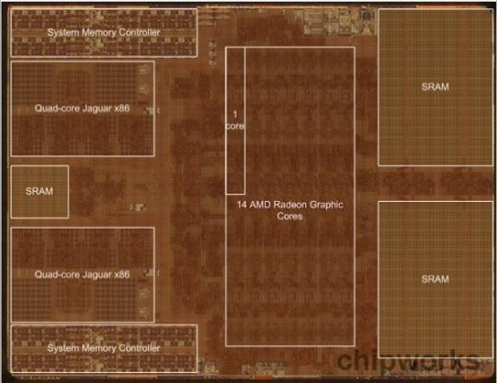
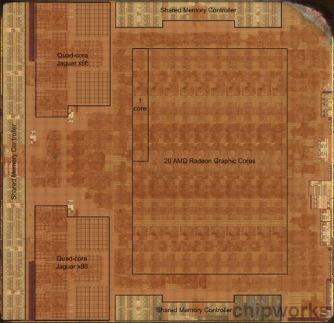
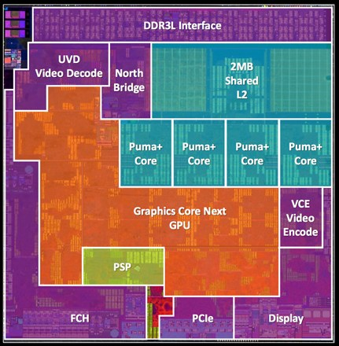
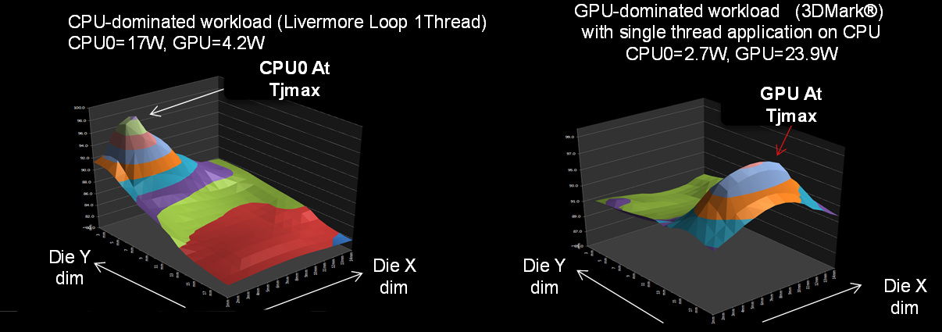
Why Power and Performance Estimation?
Feedback to programmer.
HW Design Exploration (e.g. Semi-Custom)
Online reconfiguration (e.g. DVFS)
Notes:
Provide models to software developers. They can estimate the power and performance of their kernels without access to all hardware configurations
Additionally, by providing a fast, easy to evaluate scalability model, our models can greatly reduce the number of design points that need to be measured during hardware design space exploration.
Scalability models can also be integrated with online power and performance managers to dynamically set hardware configurations at run-time.
Three dies are Xbox One, PS4, and Mullins (embedded chip). The first has 14 CUs, embedded SRAM and quad-channel DDR3-2133. The middle has 20 CUs and GDDR5. The latter has 2 CUs and single-channel DDR3-1600. What’s the right design?
Three example usage scenarios:
SW developer wants improve an application but first needs to study its scaling behavior and look for bottlenecks. The SW developer does not want/can’t spend the money to purchase multiple GPUs. A company like AMD could build the model and supply it without compromising their IP(hidden behind the ML techniques).
AMD is in the early stages of producing a semi-custom design for a customer. There are many reusable IP blocks, such as the compute units. The model could be used to do fast sweeps on the design space. Complements slower detailed simulation, which can be focused on promising design points.
Model could be integrated with a power manager to decide when to power gate or determine DVFS settings.

Slide 4
Outline
Goals
Model Overview
Model Construction
Results

Slide 5
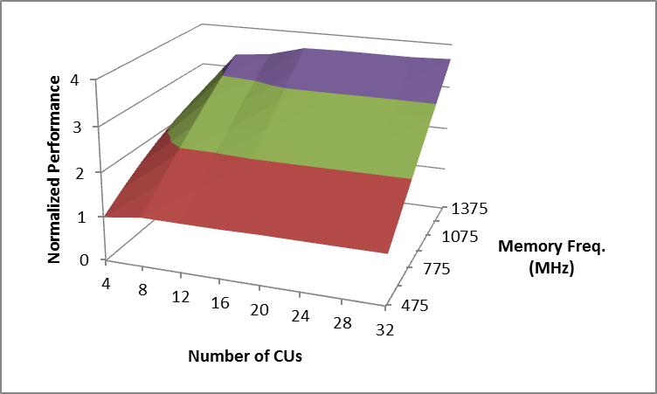
Base to Target Config. Execution
Hardware Configuration
  Compute unit(CU) count
  Engine frequency
  Memory frequency
The hardware configuration from which measurements are taken is the Base Hardware Configuration
The hardware configuration that we wish to predict performance/power at is the Target Hardware Configuration
Notes:
Start with some definitions:
In this talk a hardware configuration refers to 3 parameters…CU count, engine freq, and mem freq.
A model uses measurements from a “Base Hardware Configuration” and predicts performance for a “Target Hardware Configuration”
Requesting multiple “Target Hardware Configurations” will result in a predicted scaling surface
Base Hardware Configuration execution time/power measured on real hardware and then predict the Target Hardware Configuration execution time by using the model to scale the measure time.
Base Hardware Configuration, i.e. the starting point, is always the same for a model. A new model needs to be built to use a different Base Hardware Configuration.

Slide 6
Model Construction and Usage Flow
Kernel
GPU Hardware
Training Set
Execution Time/power
Performance Counters
Model Construction Flow
Model
Target Hardware Configuration
Target Execution Time/Power
Notes:
Construction flow shown in the dotted line box on the left is a one time cost. Typically around 40 min for each model.
Usage flow on the left is done for each prediction is less than a millisecond of run time.

Slide 7
Training Set
CU count,Engine freq., Mem. Freq.
Kernel name | 4,300,375 | 8,300,375 | … | 32,1000,1375 | Perf. Count 1. | Perf. Count. 2 | …
Kernel 1
Kernel 2
…..
Kernel N
Performance Counter Values gathered on base hardware configuration
Execution Times/Power

Slide 8
Outline
Goals
Model Overview
Model Construction
Results

Slide 9
Model Construction
Phase 1: Form clusters of training kernels that scale similarly
Phase 2: Build a classifier to map kernel performance counter values to specific clusters

Slide 10
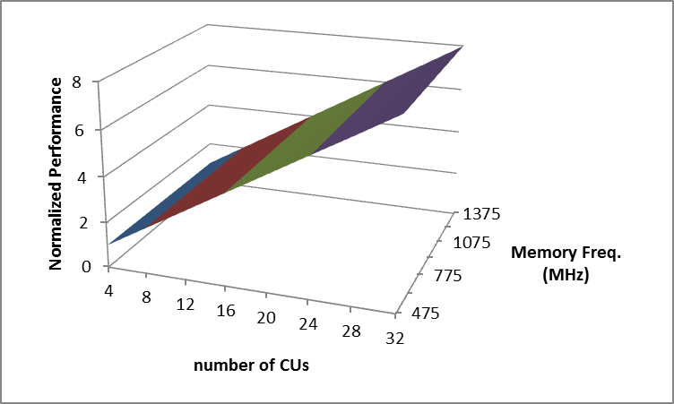
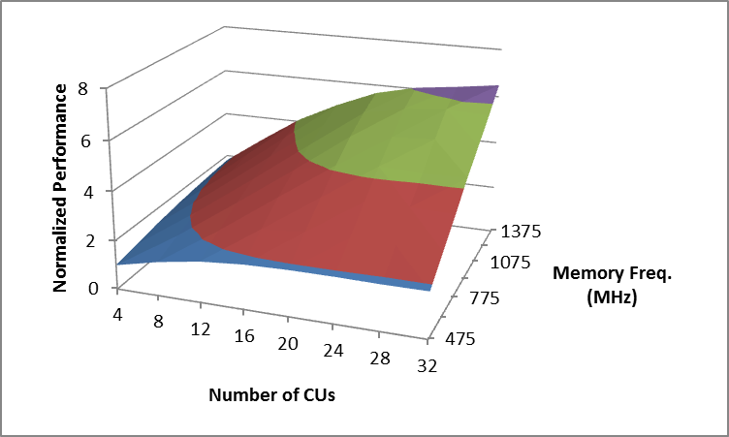
Kernel Scaling Behaviors
Memory Bound
Compute Bound
Balanced
Found many other patterns during this study

Slide 11
Phase 1:Clustering
Training Set
Kernel 1
Kernel 2
Kernel 3
Kernel 4
Kernel 5
Kernel 6
Cluster 1
Cluster 2
Cluster 3

Slide 12



Phase 2:Classification
Cluster 1
?
Classifier
Cluster 2
Performance Counter Values
(from base configuration)
?
?
Cluster 3
Notes:
Classifier tries to decide which cluster best describes the scaling behavior of a kernel based on its performance counter values gathered on the base hardware configuration

Slide 13
Classifier
Classifier
Cluster 1
0 to 1
Cluster 2
0 to 1
Performance Counter Values
(from base configuration)
…
Cluster N
0 to 1
Inputs:
  Performance counter values
Outputs:
  One output per cluster
  Output values between 0 and 1
  Cluster with highest output is chosen
  Ideally a one hot encoding at outputs

Slide 14
Classifier: Neural Network Topology
3 layer, fully connected network
  Input layer: linear
    Number of neurons equals number of features
  Hidden layer: sigmoid
    Number of neurons equals number of clusters
  Output layer: sigmoid
    Number of neurons equals number of clusters
Perf. Counter 0
Cluster 0
Perf. Counter 1
Cluster 1
…
…
…
Perf. Counter N
Cluster M

Slide 15
Putting It All Together
Target Config. Execution Time or Power
Cluster 1
Classifier
?
Perf.
Counter 1
Cluster 2
Perf.
Counter 2
?
…
…
…
Base Config. Execution Time or Power
Perf.
Counter N
?
Cluster M

Slide 16
Outline
Goals
Model Overview
Model Construction
Results

Slide 17
Experimental Setup
Measurements gathered on a AMD Radeon HD 7970 GPU
8 CU settings:
  4, 8, 12, 16, 20, 24, 28, 32
8 Engine Frequencies:
  300, 400, 500, 600, 700, 800, 900, 1000 (MHz)
7 Memory Frequencies:
  475, 625, 775, 925, 1075, 1225, 1375 (MHz)
448(8x8x7) possible hardware configurations
108 OpenCL kernels:
  86 kernels (80%) for training
  22 kernels (20%) for validation

Slide 18
Accuracy vs. Base Configuration
Memory Frequency(MHz) |  |  |  |  | CU Count
 |  | 4 | 8 | 12 | 16 | 20 | 24 | 28 | 32 |  | Legend
 | 475 | 20.4 | 18.2 | 20.5 | 20.7 | 23.5 | 25.9 | 26.5 | 31.6 |  | 10.0
 | 625 | 20.3 | 15.5 | 14.4 | 13.5 | 16.7 | 21.1 | 20.2 | 21.2 |  | 15.0
 | 775 | 24.7 | 15.6 | 11.9 | 13.1 | 13.3 | 17.0 | 17.3 | 19.4 |  | 20.0
 | 925 | 14.5 | 13.7 | 11.3 | 13.5 | 14.2 | 12.9 | 13.4 | 17.2 |  | 25.0
 | 1075 | 13.5 | 13.7 | 13.0 | 12.6 | 13.5 | 13.6 | 13.2 | 18.3 |  | 30.0
 | 1225 | 15.8 | 16.3 | 12.2 | 10.6 | 9.0 | 13.5 | 11.8 | 14.2
 | 1375 | 15.5 | 11.1 | 12.8 | 10.8 | 11.1 | 11.6 | 12.7 | 11.5
Base configuration engine frequency fixed at 1000 MHz
12 Clusters
Each entry is the average error of all validation kernels on all 447 possible target configurations (22 kernels x 447 target configs = 9834 predictions)
Error higher when base configurations has an unbalanced compute to bandwidth ratio
Notes:
Accuracy vs. the model’s base configuration while modeling performance
For visualization purposes, the GPU core frequency fixed at 1000 MHz.
Number of clusters set to 12
Worst errors occur at “unbalanced” base hardware configurations
very low memory bandwidth with many compute resources
very high memory bandwidth with few compute resources

Slide 19
Accuracy vs. Base Configuration
Lowest error at 500 MHz engine frequency
  Avg: 13.7%
  Standard deviation: 2.6%
  Max: 21.4%
  Min: 10.1%
Notes:
Accuracy vs. base configuration with GPU core frequency varied.
Engine frequency settings varied across the x-axis with percent error ranges shown on the y-axis
Lowest error occurs in the middle of the frequency range at 500 MHz.

Slide 20
Performance Error Distribution
447 target configurations
22 validation kernels
5 base configurations:
  32.300.475, 32.300.1375, 32.700.925, 32.1000.475, 32.1000.1375
447x22x5 = 49170 total data points
Notes:
Performance modeling error when 2, 6, and 12 clusters are used

Slide 21
Power Error Distribution
Power easier to model
Modeling a model
Average Error:
  2 Clusters: 11.4%
  6 Clusters: 9.1%
  12 Clusters: 10.1%

Slide 22
Summary
GPU power and performance models
  Constructed with K-means clustering and neural networks
Performance model average error:
  Around 10% for the best base hardware configurations
Power model average error:
  Around 10%
Less than a millisecond for each prediction

Slide 23
Questions
?

Slide 24
Backup Slides

Slide 25
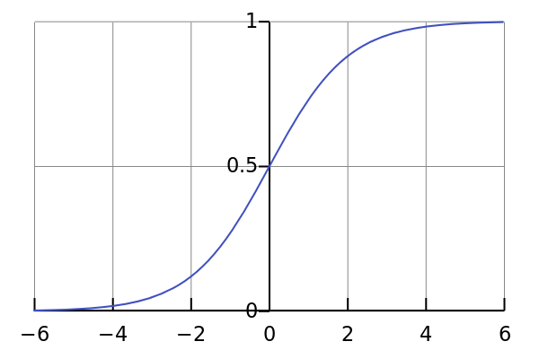
Classifier: Neural Network Topology
3 layer, fully connected network
  Input layer: linear
    Number of neurons equals number of features
  Hidden layer: sigmoid
    Number of neurons equals number of clusters
  Output layer: sigmoid
    Number of neurons equals number of clusters
Perf. Counter 0
Cluster 0
Perf. Counter 1
Cluster 1
…
…
…
Perf. Counter N
Cluster M

Slide 26



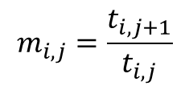

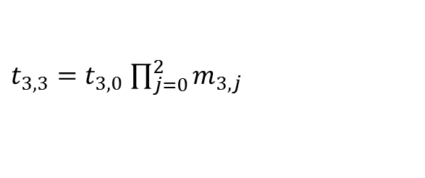

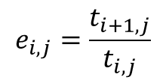


Execution Time Scaling Values
$$m_{3,0}=\frac{t_{3,1}}{t_{3,0}}$$
$$m_{3,0}$$
$$m_{3,1}$$
$$m_{3,2}$$
$$m_{i,j}=\frac{t_{i,j+1}}{t_{i,j}}$$
$$e_{i,j}=\frac{t_{i+1,j}}{t_{i,j}}$$
1000
t_{3,0}
t_{3,1}
t_{3,2}
t_{3,3}
1000
m_{3,0}
m_{3,1}
m_{3,2}
800
t_{2,0}
t_{2,1}
t_{2,2}
t_{2,3}
$$e_{2,3}$$
800
m_{2,0}
m_{2,1}
m_{2,2}
e_{2,0}
e_{2,1}
e_{2,2}
e_{2,3}
800 to 1000
Engine Freq. (MHz)
Engine Freq. (MHz)
$t_{3,3}=t_{3,0}$ $\prod_{j=0}^{2}{m_{3,j}}$
$$e_{1,3}$$
Engine Freq. (MHz)
600
t_{1,0}
t_{1,1}
t_{1,2}
t_{1,3}
600
m_{1,0}
m_{1,1}
m_{1,2}
600 to 800
e_{1,0}
e_{1,1}
e_{1,2}
e_{1,3}
t_{0,0}
t_{0,1}
t_{0,2}
t_{0,3}
$$e_{0,3}$$
m_{0,0}
m_{0,1}
m_{0,2}
e_{0,0}
e_{0,1}
e_{0,2}
e_{0,3}
400
400
400 to 600
400
600
800
1000
400
600
800
1000
400 to 600
800 to 1000
600 to 800
Mem. Freq. (MHz)
Mem. Freq. (MHz)
Mem. Freq. (MHz)
Per kernel in training set
Fixed CU count in this example

Slide 27
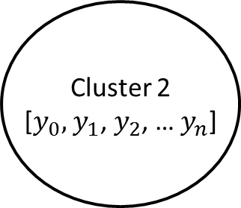

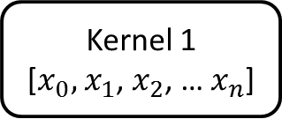


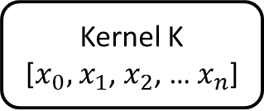

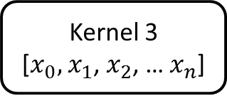


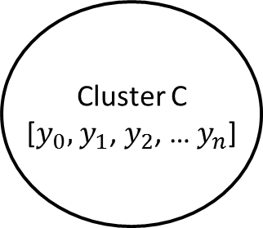
K-means Clustering: the view from 10,000 feet
Cluster 1
[$y_{0},$ $y_{1}$, $y_{2}$, … $y_{n}$]
Each kernel has a feature vector (x vector)
Kernel 1
[$x_{0},$ $x_{1}$, $x_{2}$, … $x_{n}$]
$$distance= \sqrt{{\left(x_{0}−y_{0}\right)}^{2}+{\left(x_{1}−y_{1}\right)}^{2}{+…+\left(x_{n}−y_{n}\right)}^{2}}$$
Kernel 2
[$x_{0},$ $x_{1}$, $x_{2}$, … $x_{n}$]
Cluster 2
[$y_{0},$ $y_{1}$, $y_{2}$, … $y_{n}$]
Cluster 1
($y_{0},$ $y_{1})$
Clustering Algorithm
Cluster 0
($y_{0},$ $y_{1})$
Kernel 3
[$x_{0},$ $x_{1}$, $x_{2}$, … $x_{n}$]
Feature 1
Feature 1
Feature 1
Feature 1
Feature 1
Feature 1
Feature 1
Kernel 1
($x_{0},$ $x_{1})$
Cluster 2
($y_{0},$ $y_{1})$
…
…
Feature 0
Feature 0
Feature 0
Feature 0
Feature 0
Feature 0
Feature 0
Kernel K
[$x_{0},$ $x_{1}$, $x_{2}$, … $x_{n}$]
Cluster C
[$y_{0},$ $y_{1}$, $y_{2}$, … $y_{n}$]
Iterative Algorithm:
  Assign items(kernels) to clusters
  Recalculate cluster centroids
Each kernel has a cluster has a centroid (y vector)
Notes:
The kernel feature vectors, i.e. the X vectors, contain all the memory(m values) and engine(e values) scaling values shown in the execution time scaling values slide
Each cluster’s centroid vector, i.e. the Y vectors, are the mean of all the X vectors of the kernels in the cluster.

Slide 28
Neural Network
Y = W₀*Perf.Count.1+W₁*Perf.Count.2 + C
Perf. Count. 2
Perf. Count. 1
Perf. Count. 1
Cluster 1
Perf. Count. 2
Cluster 2
…
…
…
Perf. Count. N
Cluster M

Slide 29
Neural Network
Y = W₀*Perf.Count.1+W₁*Perf.Count.2 + C
Perf. Count. 2
0
1
Perf. Count. 1
Perf. Count. 1
Cluster 1
Perf. Count. 2
Cluster 2
…
…
…
Perf. Count. N
Cluster M

Slide 30
Neural Network
01
Perf. Count. 2
01
10
11
Perf. Count. 1
Perf. Count. 1
Cluster 1
Perf. Count. 2
Cluster 2
…
…
…
Perf. Count. N
Cluster M

Slide 31
Putting It All Together
800 to 1000
e_{2,0}
e_{2,1}
e_{2,2}
e_{2,3}
Engine Freq. (MHz)
Cluster 1
600 to 800
e_{1,0}
e_{1,1}
e_{1,2}
e_{1,3}
e_{0,0}
e_{0,1}
e_{0,2}
e_{0,3}
Classifier
400 to 600
Perf.
Counter 1
?
400
600
800
1000
Perf.
Counter 2
Cluster 2
Mem. Freq. (MHz)
?
…
…
…
1000
m_{3,0}
m_{3,1}
m_{3,2}
Perf.
Counter N
800
m_{2,0}
m_{2,1}
m_{2,2}
?
Cluster M
Engine Freq. (MHz)
600
m_{1,0}
m_{1,1}
m_{1,2}
Target Config. Execution Time or Power
400
m_{0,0}
m_{0,1}
m_{0,2}
Base Config. Execution Time
400 to 600
800 to 1000
600 to 800
Target Config.
Mem. Freq. (MHz)

Slide 32
Model Architecture
Base Config. Exec. Time & Target Config.
Classifier
Cluster 1
Cluster 2
Cluster N
CUs = 8
set
…
…
Performance Counter Values
…
…
…
Classifier
Cluster 1
Cluster 2
Cluster N
CUs = 32
set
…
Target Config. Exec. Time
Classifier
Cluster 1
Cluster 2
Cluster N
Variable CU count
…
Notes:
There are multiple classifier and cluster set pairs in the model.
4D Scaling surface is split into multiple regions and each region is scaled independently.
Kernels might be in the same cluster in one cluster set but not in another cluster set.
Allows additional flexibility in the clustering compared to clustering over the entire 4D scaling surface in one go.

