Slide 1
Dynamic GPGPU Power Management Using Adaptive Model Predictive Control
Abhinandan Majumdar*, Leonardo Piga†, Indrani Paul†,
Joseph L. Greathouse†, Wei Huang†, David H. Albonesi*
*Computer Systems Laboratory, Cornell University
†Advanced Micro Devices, Inc.

Slide 2
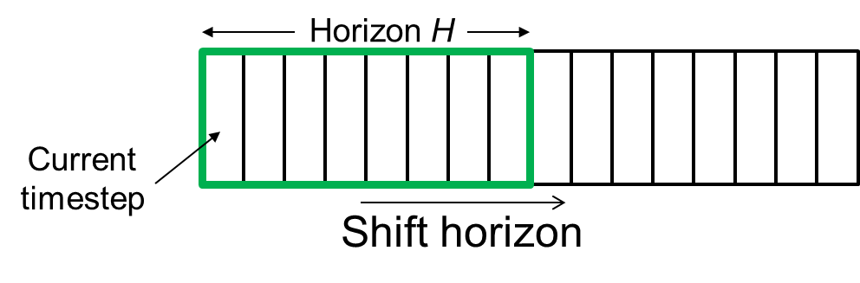
Model Predictive Control (MPC)
Previous dynamic power management policies ignore
future application behavior
  Leads to performance loss or wasted energy
MPC looks into the future to determine the best configuration for the current optimization time step
Though effective in many domains, overheads far too high for short timescales of dynamic power management
Our approach: An approximation of MPC that dramatically improves GPGPU energy-efficiency with orders of magnitude lower overhead
Notes:
With Model Predictive Control we look ahead into the future in order to determine the best configuration for the current timestep. MPC has been shown to be highly effective in many problem domains, but it’s overhead is far too high for online dynamic power management. We’ve developed an approximation of MPC that achieves significant gains in GPGPU energy-efficiency with orders of magnitude lower overhead.

Slide 3
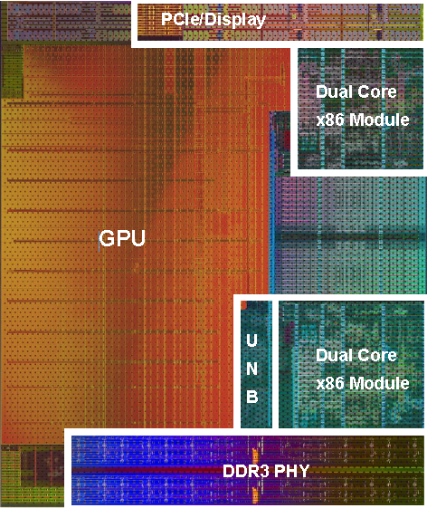
Dynamic GPGPU Power Management
Attempts to maximize performance
within power constraints
Hardware knobs
  Number of active GPU Compute Units
  DVFS states
Goal: Reduce the energy of the GPU application phases compared to the baseline power manager while matching its performance

Slide 4
Applying MPC to Dynamic Power Management
General Idea
MPC has high overhead
  Complexity scales exponentially with H
  Minimizing energy under performance cap with discrete HW settings is fundamentally NP-hard
  Usually requires dedicated optimization solvers, such as CVX, lpsolve, etc.
Horizon H
Apply here
GPU kernels

Slide 5
Approximations to MPC
Greedy Hill Climbing to reduce the search space
Static search order heuristic to make MPC optimization polynomial rather than exponential
Dynamically tuning of the horizon length H to limit the optimization overhead

Slide 6

MPC Power Manager Architecture
Performance
Target
Kernel
Performance
Performance
Power Model
MPC Optimizer
HW setting
Power
Performance Tracker
Performance
Feedback
Perf. Counters of
Future
Kernels
Optimizer
Optimization Overhead
Horizon Length
Kernel Pattern Extractor
Adaptive Horizon Generator
Performance
Counters
Max Overhead

Slide 7
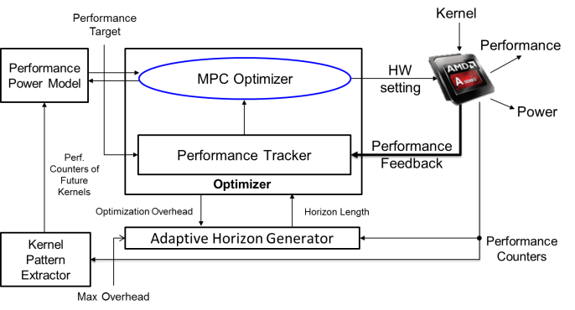
MPC Optimizer
Objective: Find minimum energy HW setting for each kernel without impacting overall performance
Greedy Hill Climbing optimization
  Select the HW knob with highest energy sensitivity
  Search for the lowest energy configuration using hill climbing
MPC Search Heuristic
  Determines a static order without backtracking
  Search cost becomes polynomial
  Details in the paper
65X average reduction in total cost evaluations

Slide 8
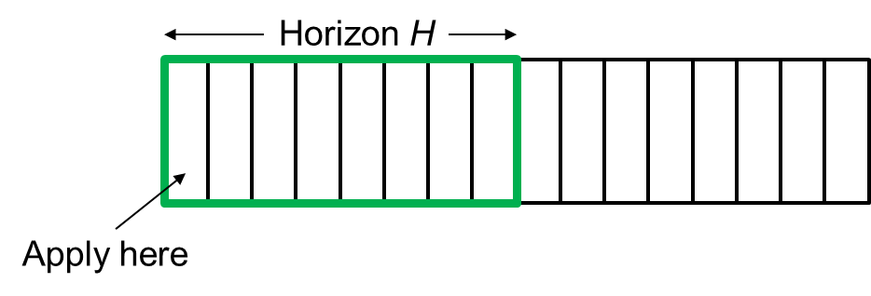
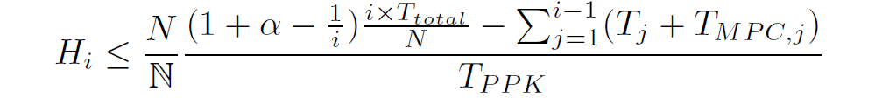

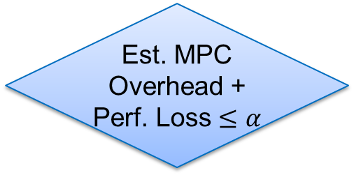
Adaptive Horizon Generator
Longer horizon improves savings but increases MPC optimization time
Limit the overhead to a slowdown factor $α$by dynamically varying the horizon length
General Idea:
Est. MPC Overhead + Perf. Loss $≤α$
No
Yes
Decrease
Horizon Length
Increase
Horizon Length

Slide 9

MPC in Action – An Example
Past
Setting for kernel 1 applied
A
$$H=4$$
Time
Optimizer
Past
Performance
Perf. Tracker
Future Execution Pattern
MPC
Optimizer
Search order
(2, 1, 4, 5, 3, 6)
A
B
2
1

Slide 10

MPC in Action – An Example
Past
Setting for kernel 2 applied
A
A
A
C
$$H=5$$
Time
Optimizer
Updated
Past
Performance
Perf. Tracker
Updated
Future Execution Pattern
MPC
Optimizer
Search order
(2, 1, 4, 5, 3, 6)
C
2

Slide 11
Experimental Testbed
AMD A10-7850K APU
  2 out-of-order dual core CPUs
  GPU contains 512 processing elements (8 CUs) at 720 MHz
DVFS states
Total HW configuration: 336
CPU P States | Voltage (V) | Freq (GHz)
P1 | 1.325 | 3.9
P2 | 1.3125 | 3.8
P3 | 1.2625 | 3.7
P4 | 1.225 | 3.5
P5 | 1.0625 | 3
P6 | 0.975 | 2.4
P7 | 0.8875 | 1.7
NB P States | Freq (GHz) | Memory Freq (MHz)
NB0 | 1.8 | 800
NB1 | 1.6 | 800
NB2 | 1.4 | 800
NB3 | 1.1 | 333
GPU P States | Voltage (V) | Freq (GHz)
DPM0 | 0.95 | 351
DPM1 | 1.05 | 450
DPM2 | 1.125 | 553
DPM3 | 1.1875 | 654
DPM4 | 1.225 | 720
NB and GPU share the same voltage rail

Slide 12
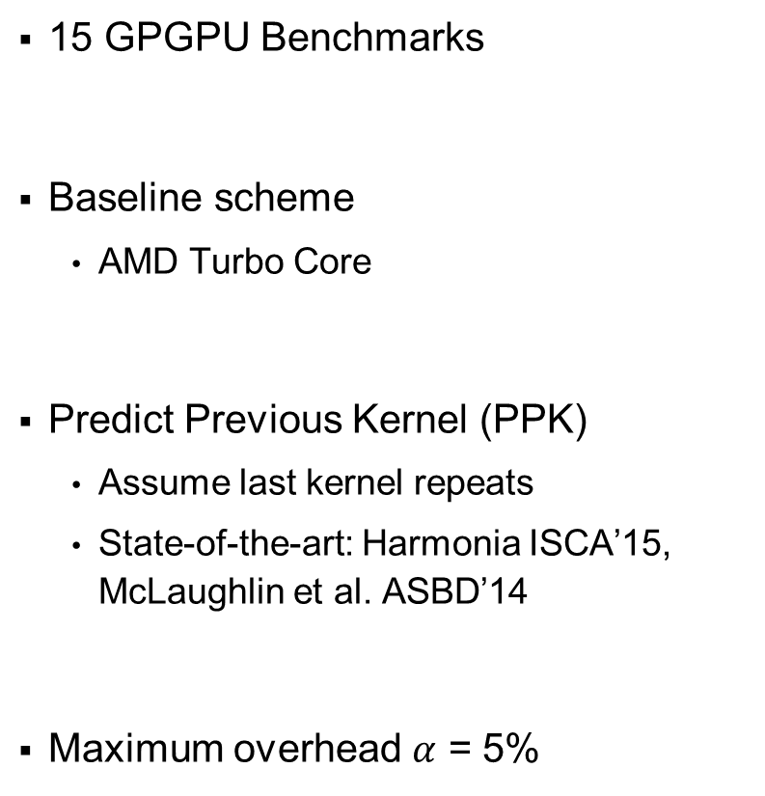
Experimental Setup
15 GPGPU Benchmarks
Baseline scheme
  AMD Turbo Core
Predict Previous Kernel (PPK)
  Assume last kernel repeats
  State-of-the-art: Harmonia ISCA’15, McLaughlin et al. ASBD’14
Maximum overhead $α$ = 5%
Category | Benchmarks | Benchmark Suite | Regular Expression
Regular | mandelbulbGPU | Phoronix | A²⁰
 | Nbody | AMD APP SDK | A¹⁰
 | juliaGPU | Phoronix | A¹⁰
Irregular with repetitive pattern | EigenValue | AMD APP SDK | (AB)⁵
 | XSBench | Exascale | (ABC)²
Irregular with non-repetitive pattern | Spmv | SHOC | A¹⁰B¹⁰C¹⁰
 | Kmeans | Rodinia | AB²⁰
Irregular with kernels varying with input | swat | OpenDwarfs | Complex pattern
 | color | Pannotia
 | pb-bfs | Parboil
 | mis | Pannotia
 | srad | Rodinia
 | lulesh | Exascale
 | lud | Rodinia
 | hybridsort | Rodinia

Slide 13
Energy-Performance Gains
24.8%
19.5%
-1.8%
-10%

Slide 14
MPC Overhead
0.2%
0.3%

Slide 15
Ramification of Prediction Inaccuracy
RF: 12% Power, 25% Perf
15% Power, 10% Perf: Wu et al. [HPCA 2015]
5% Power, 5% Perf: Paul et al. [ISCA 2015]

Slide 16
Conclusions
MPC looks into the future to determine the best configuration for the current optimization time step
Though effective in many domains, overheads far too high for short timescales of dynamic power management
We devise an approximation of MPC that dramatically improves GPGPU energy-efficiency with orders of magnitude lower overhead
Our approach reduces energy by 24.8% with only a 1.8% performance impact

Slide 17
Questions

Slide 18
Backup Slides

Slide 19
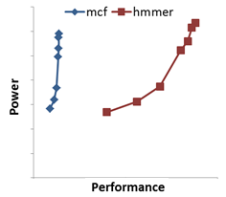
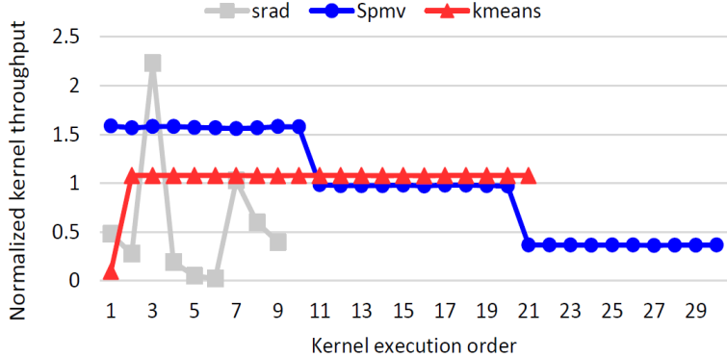
Performance-aware Power Management
Optimum node-level power efficiency is a complex function of SOC configuration, workload characteristics, programming model, and node-level objective/constraints
Reduce energy of the GPGPU kernel phase while performing better than a target
Programming Model
User Application
Maximize Perf under Power/Thermal cap
Host Tasks
GPU Tasks
HW Knobs: DVFS states of CPU, GPU, NB etc.
Non-linear power vs. performance curves
Knob 1
High Perf/Watt
Performance
Minimize Power under Perf cap
Knob 2
Low Perf/Watt
Watt
Time-varying Workload

Slide 20
Model Predictive Control (MPC)
MPC looks into the future to determine the best configuration for the current optimization time step
Though effective in many domains, overheads far too high for short timescales of dynamic power management
Our approach: An approximation of MPC that
dramatically improves GPGPU energy-efficiency
with orders of magnitude lower overhead
Horizon H
Current
timestep
Shift horizon
Notes:
With Model Predictive Control we look ahead into the future in order to determine the best configuration for the current timestep. MPC has been shown to be highly effective in many problem domains, but it’s overhead is far too high for online dynamic power management. We’ve developed an approximation of MPC that achieves significant gains in GPGPU energy-efficiency with orders of magnitude lower overhead.

Slide 21
Dynamic GPGPU Power Management
CPU and GPU consume significant power in servers
Previous approaches to dynamic power management are locally predictive and ignore future kernel behavior
  Performance loss or wasted energy
Applying MPC is challenging for short timescales of dynamic power management
Goal: Approximations to MPC that save GPGPU energy within the timescales of a typical server operation without degrading performance
Model Predictive Control
Proactively looks ahead into the future

Slide 22
Dynamic GPGPU Power Management
Goal: Reduce GPGPU energy within the timescales of a typical server operation without degrading performance
Computationally Intensive
  NP-Hard
  Challenging for short timescales of dynamic power management
Idea: Improve energy efficiency by looking into future phases
  Model Predictive Control (MPC)
  Dynamically vary computation to limit performance overhead

Slide 23
Traditional Energy Management
Static
  Predefined set of decisions
Reactive
  Act after sensing a change in behavior
Locally Predictive
  Predict the immediate behavior
Performance loss or wasted energy
Proactive Energy Management
Adapt from past and look-ahead into the future

Slide 24
Motivating Future Awareness
Baseline
  AMD Turbo Core
Hardware Knobs
  DVFS states, GPU CUs
Predict Previous Kernel (PPK):
  Assume last kernel repeats
  State-of-the-art: Harmonia ISCA’15, McLaughlin et al. ASBD’14
Theoretically Optimal (TO):
  Perfect knowledge of future
  Impractical
50%
46%

Slide 25
Ramifications of Ignoring Future
PPK lowers performance
Spmv
Look ahead
Avoid performance slowdown
Performance
Loss

Slide 26
Ramifications of Ignoring Future
Kmeans
Look ahead
Catch up on performance
PPK spends lot of energy

Slide 27
Background
Typical GPGPU application phase
CPU
DATA
TRANSFER
CPU
DATA
TRANSFER
CPU
DATA
TRANSFER
CPU
DATA
TRANSFER
CPU
…
GPU Kernel
GPU Kernel
Time

Slide 28
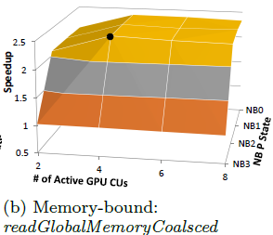
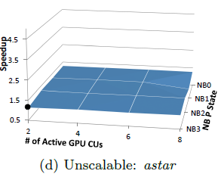
Kernel Performance Scaling
Energy-optimal configuration differ across kernels

Slide 29
Model Predictive Control (MPC)
General Idea
MPC Components
  Accurate system model
  Future input forecast
  Optimization
Horizon H
Apply here
  Power and performance prediction model
  Kernel pattern extractor
  Greedy and heuristic based optimizer

Slide 30
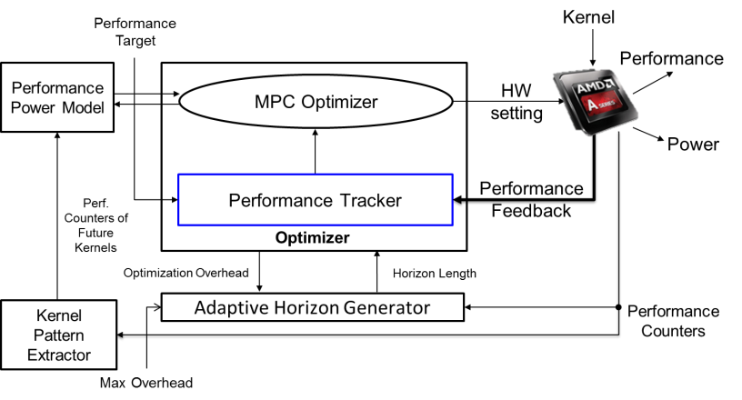
Feedback-based Performance Tracker
Switch the optimization goal based on past performance and the target
Performance met previously?
No
Yes
Relax optimization
Spend energy
Reduce performance loss
Optimize Aggressively
Reduce energy
Avoid performance loss

Slide 31
Performance Power Model
Performance
Target
Kernel
Performance
Performance
Power Model
MPC Optimizer
HW setting
Power
Performance Tracker
Performance
Feedback
Perf. Counters of
Future
Kernels
Optimizer
Optimization Overhead
Horizon Length
Kernel Pattern Extractor
Adaptive Horizon Generator
Performance
Counters
Max Overhead
Trained offline using Random Forest Learning Algorithm
Estimates performance and power for any HW configuration

Slide 32
Kernel Pattern Extractor
Performance
Target
Kernel
Performance
Performance
Power Model
MPC Optimizer
HW setting
Power
Performance Tracker
Performance
Feedback
Perf. Counters of
Future
Kernels
Optimizer
Optimization Overhead
Horizon Length
Kernel Pattern Extractor
Adaptive Horizon Generator
Performance
Counters
Max Overhead
Extracts kernel execution pattern upon the first encounter
Stores the performance counters of dissimilar kernels and retunes it

Slide 33
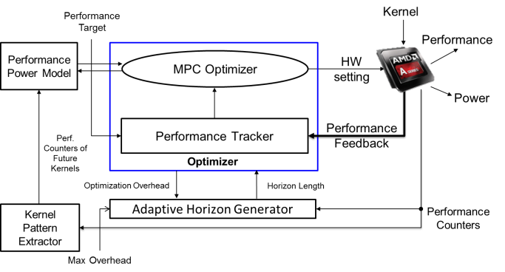
MPC Optimizer
Greedy Hill Climbing optimization
  Using the predictor, select the HW knob with highest energy sensitivity
  Search for low energy configuration using hill climbing
CPU DVFS
NB DVFS
GPU DVFS
GPU CU
Predicted Energy
Hill climbing
GPU DVFS states

Slide 34

MPC Optimizer
Greedy Hill Climbing optimization
  Using the predictor, select the HW knob with highest energy sensitivity
  Search for low energy configuration using hill climbing
CPU DVFS
NB DVFS
GPU DVFS
GPU CU
20$×$ cost reduction over exhaustive
Predicted Energy
Hill climbing
GPU CU count

Slide 35

MPC Optimizer
Greedy Hill Climbing optimization
  Select the HW knob with highest energy sensitivity and search for low energy configuration using hill climbing
MPC Search Heuristic
  Determine a static order requiring no backtracking
  General Idea
    High to low performance (e.g. Spmv): Optimize low performing kernels first
    Low to high performance (e.g. Kmeans): Optimize high performing kernels first
  Search cost becomes polynomial
65$×$ reduction in cost evaluation
Performance
Performance
(High Performance)
Optimize First
(Low Performance)
Optimize Second
(3, 2, 1, 6, 5, 4)

Slide 36

MPC Optimizer
MPC Search Heuristic
  Determine a static order requiring no backtracking
  General Idea
    High to low performance (e.g. Spmv): Optimize low performing kernels first
    Low to high performance (e.g. Kmeans): Optimize high performing kernels first
  Search cost becomes polynomial
65$×$ cost reduction
Performance
Performance
(High Performance)
Optimize First
(Low Performance)
Optimize Second
(3, 2, 1, 6, 5, 4)

Slide 37
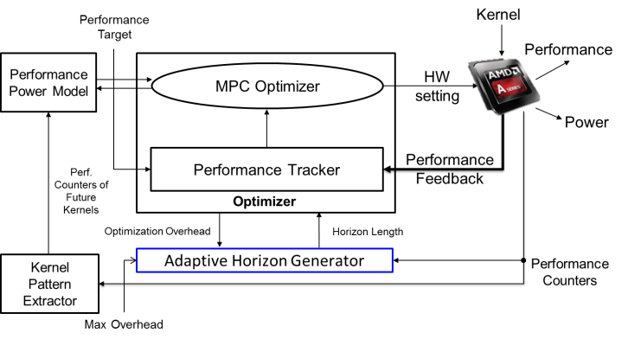

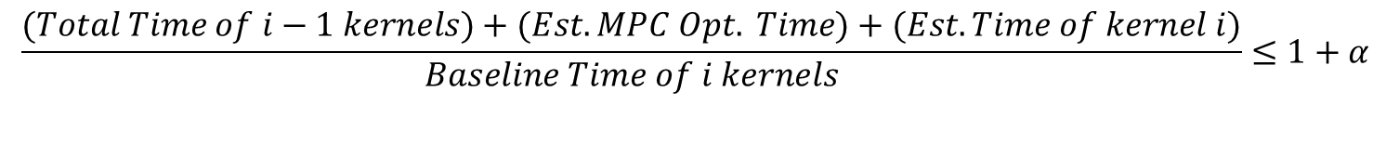

Adaptive Horizon Generator
MPC runs between kernel invocations
Longer horizon increases MPC optimization time
Limit the overhead $α$by dynamically varying the horizon length
General Idea:
$$α$$
Kernels
MPC
$$\frac{(Total Time of i−1 kernels)+(Est. MPC Opt. Time)+(Est. Time of kernel i)}{Baseline Time of i kernels}≤1+α$$

Slide 38
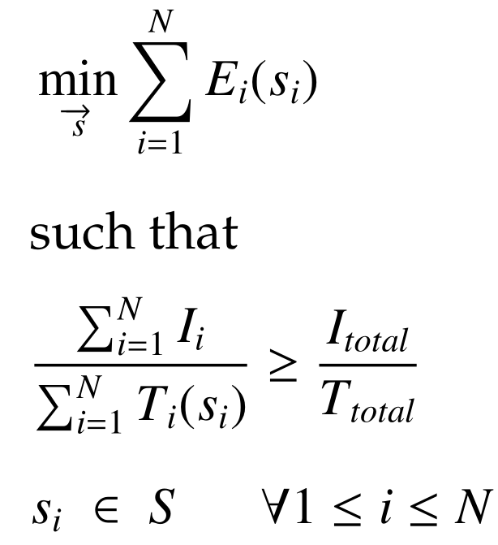

Dynamic GPGPU Power Mgmt. Formulation
Minimize energy over $N$ GPU kernels such that the performance target is met
$$S=\vec{cpu}×\vec{nb}×\vec{gpu}×\vec{cu}$$

Slide 39
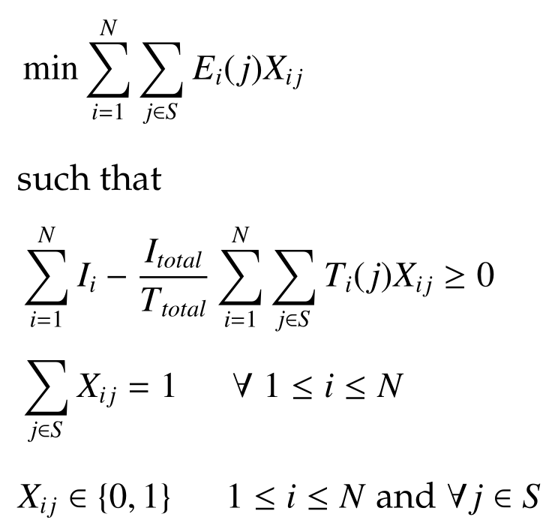
Theoretically Optimal
GLPK to solve the Integer Linear Programming (ILP) formulation

Slide 40
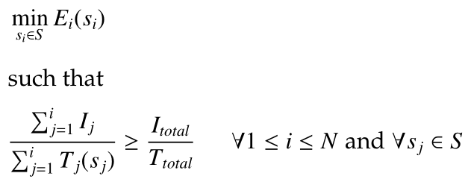

Predict Previous Kernel (PPK)
Minimize energy of kernel $i$ such that the runtime performance so far exceeds the target

Slide 41
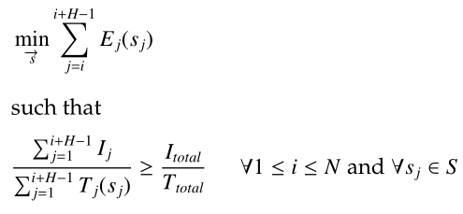

MPC-based GPGPU Power Manager
Optimize energy for next $H$ kernels such that the runtime performance at the end of $H$ kernels exceeds the target

Slide 42



Runtime Performance Tracker
Performance requirement of kernel, $k$, is enforced as follows:
Kernel time headroom is updated according to:

Slide 43
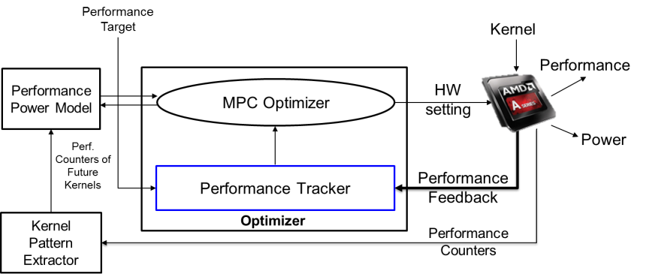
Feedback-based Performance Tracker
Performance met previously?
No
Yes
Relax optimization
Spend energy
Reduce performance loss
Optimize Aggressively
Reduce energy
Avoid performance loss

Slide 44
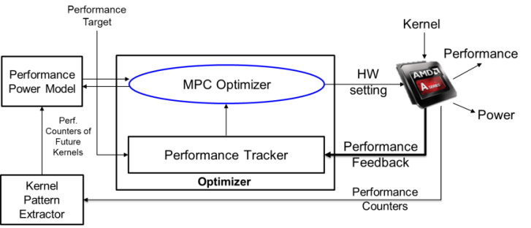
MPC Optimizer
Greedy Hill Climbing optimization
  Select the HW knob with highest energy sensitivity and search for low energy configuration using hill climbing
MPC Search Heuristic
  Determine a static order requiring no backtracking
  General Idea
    High to low performance (e.g. Spmv): Optimize low performing kernels first
    Low to high performance (e.g. Kmeans): Optimize high performing kernels first
  Search cost becomes polynomial
65X average reduction in total cost evaluations
An Example
Search order = (2, 1, 4, 5, 3)
2
1
H
Apply here

Slide 45

MPC Optimizer
Greedy hill climbing optimization
  Greedy: Select the HW knob with highest energy sensitivity
  Hill Climbing: Continue finding low energy configuration (within perf target), and stop
  Reduces search cost by 20X
MPC Search Heuristic
  Determine a static order requiring no backtracking
  General Idea
    High to low performance (e.g. Spmv): Optimize low performing kernels first
    Low to high performance (e.g. Kmeans): Optimize high performing kernels first
  Search becomes polynomial
Average reduction in total cost evaluations: 65X
An Example
Search order = (2, 1, 4, 5, 3)
2
H
Apply here

Slide 46
GPGPU Benchmarks
Category | Benchmarks | Benchmark Suite | Regular Expression
Regular | mandelbulbGPU | Phoronix | A²⁰
 | Nbody | AMD APP SDK | A¹⁰
 | juliaGPU | Phoronix | A¹⁰
Irregular with repetitive pattern | EigenValue | AMD APP SDK | (AB)⁵
 | XSBench | Exascale | (ABC)²
Irregular with non-repetitive pattern | Spmv | SHOC | A¹⁰B¹⁰C¹⁰
 | Kmeans | Rodinia | AB²⁰
Irregular with kernels varying with input | swat | OpenDwarfs | Complex pattern
 | color | Pannotia
 | pb-bfs | Parboil
 | mis | Pannotia
 | srad | Rodinia
 | lulesh | Exascale
 | lud | Rodinia
 | hybridsort | Rodinia

Slide 47
Experimental Testbed (Detailed)
AMD A10-7850K APU
  2 out-of-order dual core CPUs
  GPU contains 512 processing elements (8 CUs) at 720 MHz
    Each CU has 4 SIMD Vector Units
    16 PEs per SIMD vector unit
DVFS states
NB and GPU share the same voltage rail
CPU P States | Voltage (V) | Freq (GHz)
P1 | 1.325 | 3.9
P2 | 1.3125 | 3.8
P3 | 1.2625 | 3.7
P4 | 1.225 | 3.5
P5 | 1.0625 | 3
P6 | 0.975 | 2.4
P7 | 0.8875 | 1.7
NB P States | Freq (GHz) | Memory Freq (MHz)
NB0 | 1.8 | 800
NB1 | 1.6 | 800
NB2 | 1.4 | 800
NB3 | 1.1 | 333
GPU P States | Voltage (V) | Freq (GHz)
DPM0 | 0.95 | 351
DPM1 | 1.05 | 450
DPM2 | 1.125 | 553
DPM3 | 1.1875 | 654
DPM4 | 1.225 | 720
GPU CUs and DVFS states changed in multiples of 2
Total HW configuration: 336

Slide 48
Experimental Setup
15 GPGPU Benchmarks
  Sampled from 73 benchmarks
  75% irregular
  44% vary with input
Baseline scheme
  AMD Turbo Core
Algorithms
  PPK
  MPC
  TO
Results based on real hardware traces
Category | Benchmarks | Benchmark Suite | Regular Expression
Regular | mandelbulbGPU | Phoronix | A²⁰
 | Nbody | AMD APP SDK | A¹⁰
 | juliaGPU | Phoronix | A¹⁰
Irregular with repetitive pattern | EigenValue | AMD APP SDK | (AB)⁵
 | XSBench | Exascale | (ABC)²
Irregular with non-repetitive pattern | Spmv | SHOC | A¹⁰B¹⁰C¹⁰
 | Kmeans | Rodinia | AB²⁰
Irregular with kernels varying with input | swat | OpenDwarfs | Complex pattern
 | color | Pannotia
 | pb-bfs | Parboil
 | mis | Pannotia
 | srad | Rodinia
 | lulesh | Exascale
 | lud | Rodinia
 | hybridsort | Rodinia

Slide 49
Polynomial MPC w/ Theoretical Optimal
92%
93%

Slide 50
GPU Energy Savings

Slide 51
MPC Energy-Performance w.r.t PPK

Slide 52
Amortization of Initial Loses

Slide 53
Final Takeaway
MPC is a versatile scheme
  Does not hurt gains of regular benchmarks
  Improves energy savings
  Reduces performance loss
Online MPC reduces performance loss compared to traditional approaches
Online MPC is resilient to prediction inaccuracy due to
  Performance feedback
  MPC’s greedy and heuristic approximations depend minimally on prediction models
MPC does not need to look into entire future

