Slide 1
Top-pim:
Throughput-Oriented Programmable Processing in Memory
Dong Ping Zhang, Nuwan Jayasena, Alex Lyashevsky
Joe Greathouse, Lifan Xu, Mike Ignatowski
AMD Research
25/06/14

Slide 2
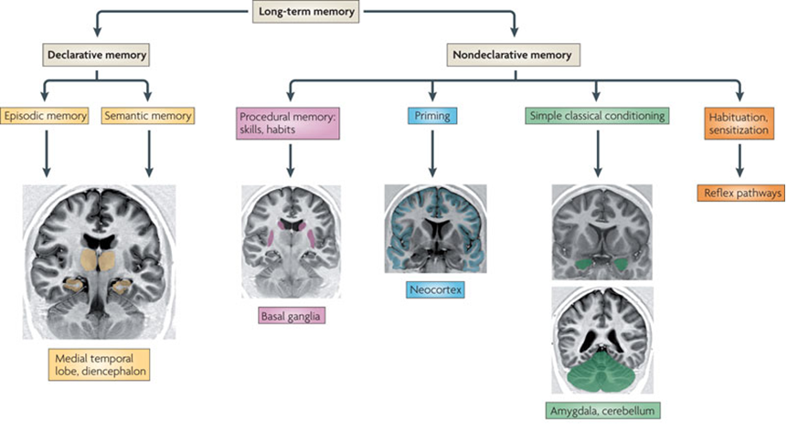
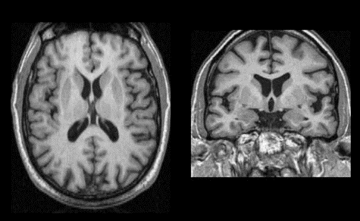
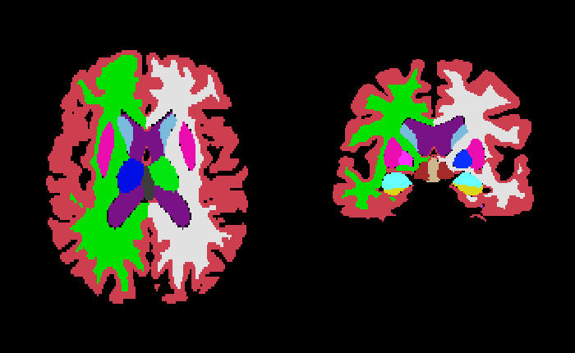
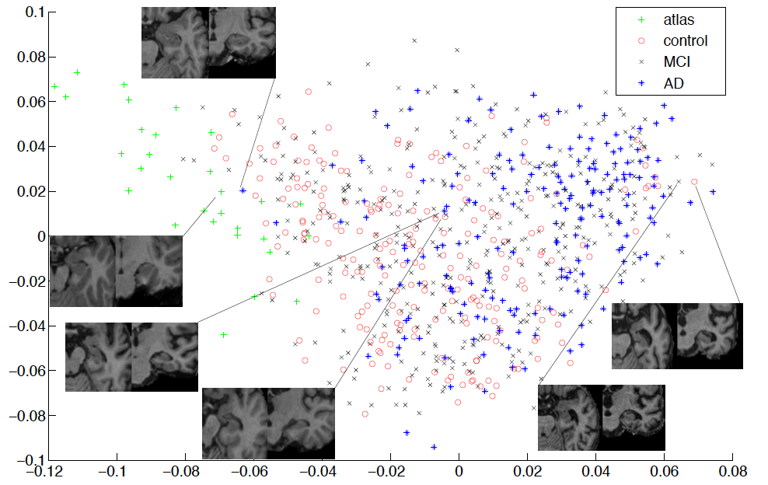
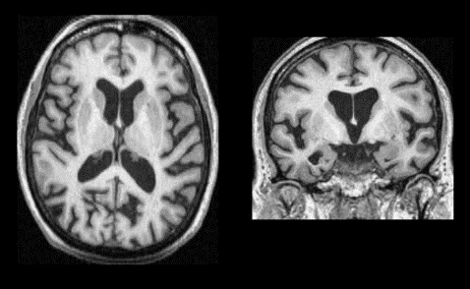
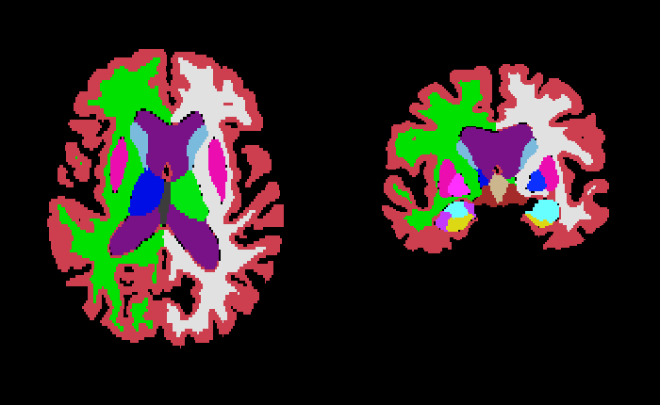
Processing-in-memory? HBM?

Slide 3
Compute is cheap, Data movement is not
CPU
Core
CPU
Core
GPU
$
$
$
Shared $
DRAM
Source: ITRS, S. Keckler et al. [IEEE Micro, Sep-Oct. 2011],
T. Vogelsang [MICRO 2010], T. Farrell [Salishan 2014]

Slide 4
Exascale computing challenges
Energy is the key limiter
  Exascale system
    At 4TB/s, vast majority of node energy could be consumed by the memory system
  10x reduction in memory energy
  25x improvement in system energy efficiency
  While improving performance
Need to rethink compute and memory organization
  Move computation closer to data
  Specialized support for bandwidth-intensive applications
Potential solution: processing-in-memory?
> 50pJ/b
4TB/s
Memory Access Energy
Peak Node Memory BW
~250GB/s
< 5pJ/b
Memory hierarchy
~5 FLOPS/B
50 GFLOPS/W
Compute/BW
Ratio
2.5 FLOPS/B
System Energy Efficiency
~2 GFLOPS/W
Today: ORNL Titan (node: AMD Opteron+Nvidia Tesla K20X)
2020: DOE FastForward RFP (issued May, 2012)
Source: ORNL, Nvidia, top500.org, LLNL
Compute

Slide 5
Outline
Background
  PIM prior work
  Die-stacking
PIM architecture and memory organization
Applications
  Graph apps, HPC apps, GPGPU benchmark
PIM performance and energy model
Evaluation of the PIM design choices
Conclusion and further research

Slide 6
PIM research – in the past
Prior PIM research constrained by
  Implementation technology
  Non-traditional programming models
Examples of prior work:
  Integration of caches and computation
    “A logic-in-memory computer” (1970)
  Logic in DRAM processes
    In-memory processors with reduced performance or highly specialized
    Reduced DRAM due to presence of logic unit
  Embedded DRAM in logic processes
    Not cost-effective to have sufficient memory capacity, reduced DRAM density
Recent work:
  Micron’s Automata Processor
  3D stacked processor for accelerating 3D ultrasound beamformation
  Specialized in-stack processor to accelerate MapReduce workloads

Slide 7
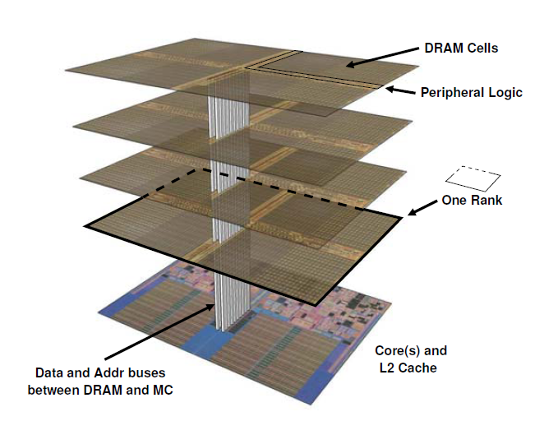
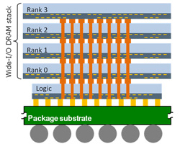
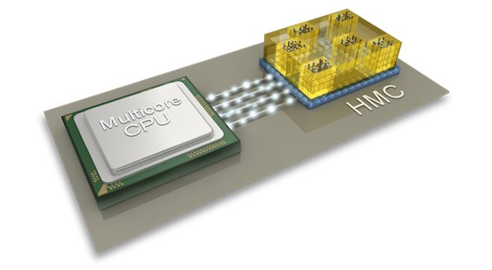
3D Integration
Logic die under DRAM using TSVs
  Higher bandwidth, lower access power
Significant industry momentum
  Recent JEDEC standards (HBM, Wide I/O 2)
  Hybrid Memory Cube (HMC) consortjum
    Micron, Samsung, IBM, ARM, Xilinx, Altera etc.
Gabe Loh, 3D-Stacked Memory Architectures for Multi-Core Processors, ISCA 2008
www.cadence.com/Community/blogs/ii/archive/2013/01/22/cadence-imec-test-methodology-enables-3d-ic-memory-on-logic.aspx
http://www.engadget.com/2013/04/03/hybrid-memory-cube-receives-its-finished-spec/

Slide 8
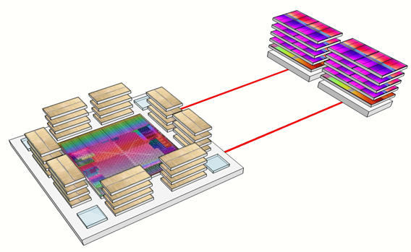
PIM research – new perspective
New opportunity: logic die stacked with memory
  Logic die needed anyway for signal redistribution and integrity
  Potential for non-trivial compute
Key benefits:
  Reduce bandwidth bottlenecks
  Improve energy efficiency
  Increase compute for a fixed interposer area
  Processor can be optimized for high BW/compute ratio
Challenges:
  Programming models and interfaces
  Architectural tradeoffs
  Application refactoring
DRAM
Initial focus: PIM under DRAM stack

Slide 9
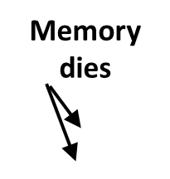
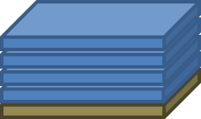
Guiding principles of AMD’s PIM research
Our focus
  3D die stacking
  Use base logic die(s) in memory stack
    General-purpose processors
    Support familiar programming models
Ease of use
  Support familiar programming models
  Build on HSA fundamentals
  Any processor (host or PIM) can access all memory on node
  No significant application change for host and PIM.
Broad applicability
  Across a broad range of applications
  Viable across multiple market segments
Memory stack
Logic die with PIM

Slide 10
Baseline PIM architecture
An overview
An in-memory processor incorporated on the base die of each memory stack
No DRAM die stacked on host processor
Memory dies
Abstract
load/store interface
Timing-specific
DRAM
interface
Host
PIM &
DRAM controller

Slide 11
Baseline PIM Architecture
GPU CUs provide compute throughput
CPU cores provide control and flexibility
Optional fixed-function accelerators
Stacked
Memory
Channel 0
Stacked
Memory
Channel 1
Stacked
Memory
Channel (n-1)
Ctrl 0
Ctrl 1
Ctrl (n-1)
To/From
Inter-PIM
Interconnect
To/From
Host
DRAM or
NVRAM dies
Memory Switch
GPU CU Cluster(s)
CPU Cluster(s)
Fixed-Function
Hardware
GPU CU
CPU Core
CP
X86
X86 Cores
HW Accel.
X86
X86 Cores
Base logic die of DRAM stack

Slide 12
Explore breadth of Applicability of PIM
Broad set of kernels from HPC apps, graph algorithms, GPGPU benchmarks etc.
Analyzed using PIM GPU performance and energy models
PF = ParticleFilter
SP = ShortestPath
RW = RandomWalk
LE = Leukocyte

Slide 13
Why a new Simulator?
Why spend time building a new simulator when we could have used:
  SimNow, TSIM, gem5, Multi2Sim, MARSSx86, PTLsim, Zesto, FeS2, RSIM, ZSIM, Graphite, Flexus, SESC, SST, GPGPUSim, MacSim, Simics+GEMS, SimpleScalar……
Because they don’t answer the question we want to ask
  Runtime overhead too high
  Changes take too long to implement
  Memory overheads preclude large working sets
As a result: they can’t test the PIM design space on applications that matter
PIM Simulator trades off some accuracy for major performance improvements

Slide 14
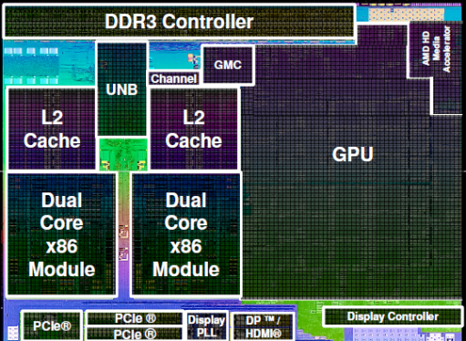
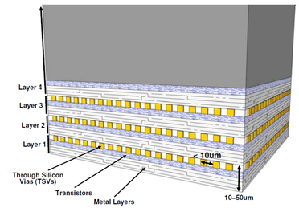
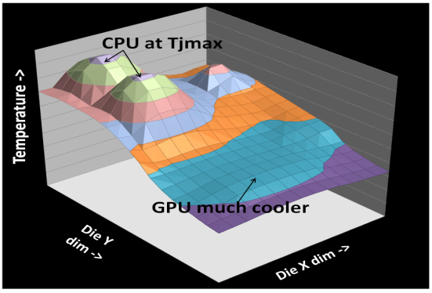
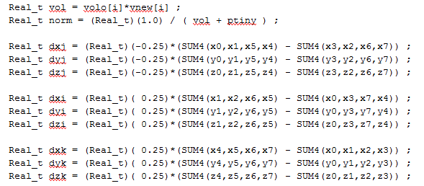
Challenges of modeling future systems
Large design space to explore
Heterogeneous Cores
Stacked Memories
Composition? Size? Speed?
Useful? Compute/BW Ratio? Latency? Capacity? Non-Volatile?
Thermal Constraints
Software Co-Design
Power Sharing? Heat dissipation? Sprinting?
New algorithms? Data placement? Programming models?
Ref: J. Greathouse et al. Simulation of Exascale Nodes through Runtime Hardware Monitoring, ModSim, 2013

Slide 15
Challenges of modeling future systems
Why does simulator performance matter?
Need to run long enough to trigger interesting memory phenomena
  Working sets >> stacked memories of 100s of MB to multiple GB
Run long enough to observe power and thermal effects
  Example measured on a real heterogeneous processor
  ~2.5 trillion CPU instructions, ~60 trillion GPU operations
Applications of interest can be large
  Scaled studies can be challenging and misleading for complex applications
Ref: I. Paul et al., “Cooperative Boosting: Needy Versus Greedy Power Management”, ISCA 2013

Slide 16
PIM Simulator Overview
Multi-Stage Performance Estimation Process
Phase 1
User Application
Host Tasks
PIM Tasks
Phase 2
Machine Description
Performance and Power Models
PIM Software Stack
Trace Post-processor
OS (Linux)
Commodity hardware
(CPU, GPU, APU)
Traces of HW and SW events related to performance and power
Performance & Power Estimates

Slide 17
ML-based performance model
Execution time <--- F (architecture, application)
  Kernel time (and power) depends on:
    Underlying HW configuration
    Algorithms and data structures of the application
PIM GPU Architecture is represented by:
  Number of CUs (8, 16, 32)
  Processor frequency (500 – 100 – 1000 MHz)
  Memory Bandwidth (500 – 100 – 1300 MHz)
Application kernel is represented by feature vectors
  Dynamic CodeXL/Sprofile data, derived from HW counters.
Goals:
  Learn scaling pattern in offline training
  Estimate runtime and power for online prediction
162 design points

Slide 18
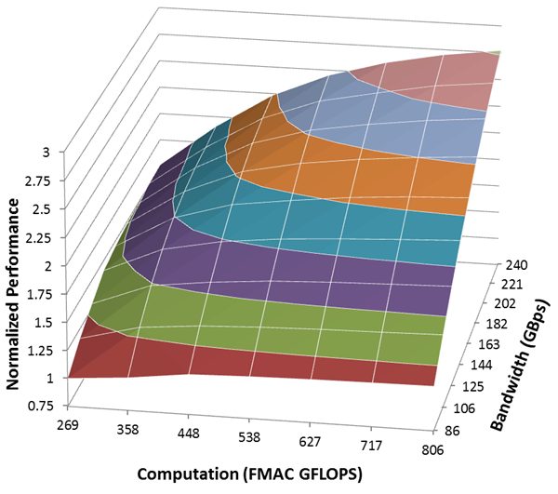
Performance model – offline learning
Gathering data
  70 OpenCL kernels
  Each kernel: 162 hw configurations → 162 pairs of execution time & performance counter feature vector
1.5x Perf Gain
1.75x Perf Gain

Slide 19

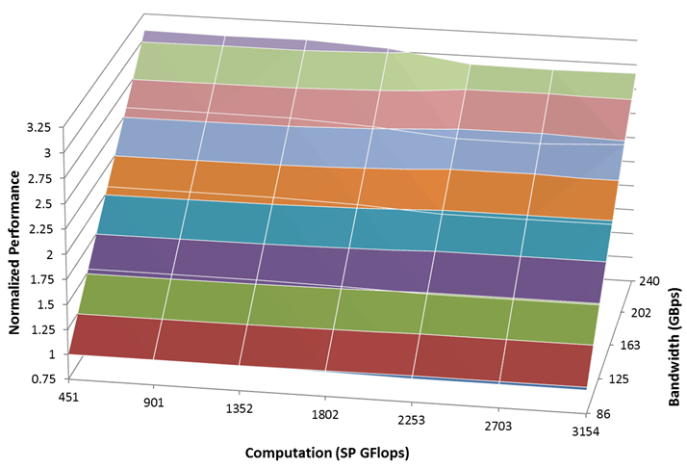
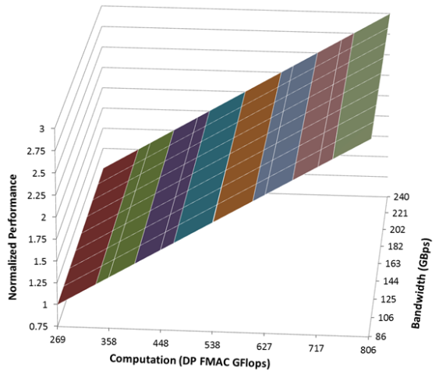
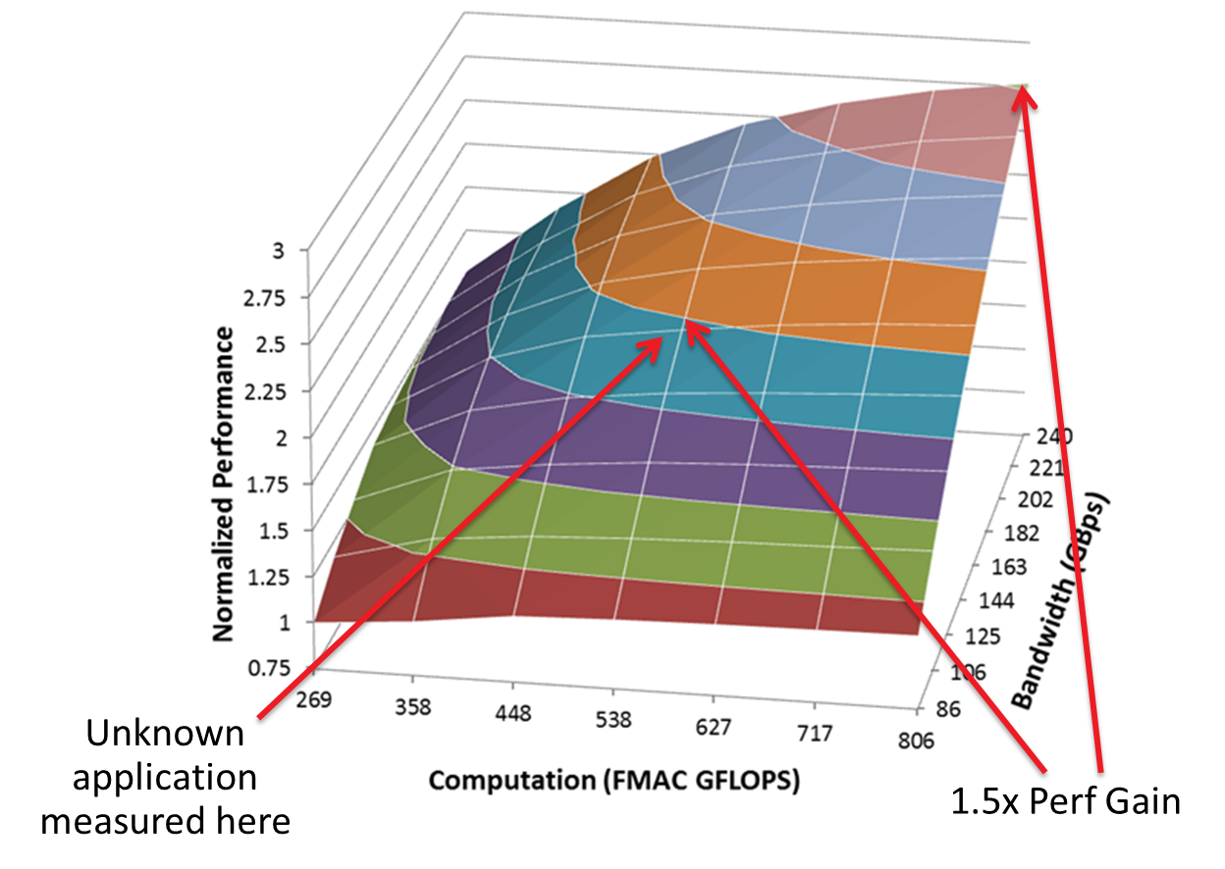
Performance model
Offline learning – clustering of the scaling pattern
Online classification and prediction
  Classify the feature vector of the new kernel
  Performance projection with the scaling pattern of this cluster
Feature vector: VALUUtilization, VALUBusy, SALUBusy, MemUnitBusy, MemUnitStalled, CacheHit, …

Slide 20
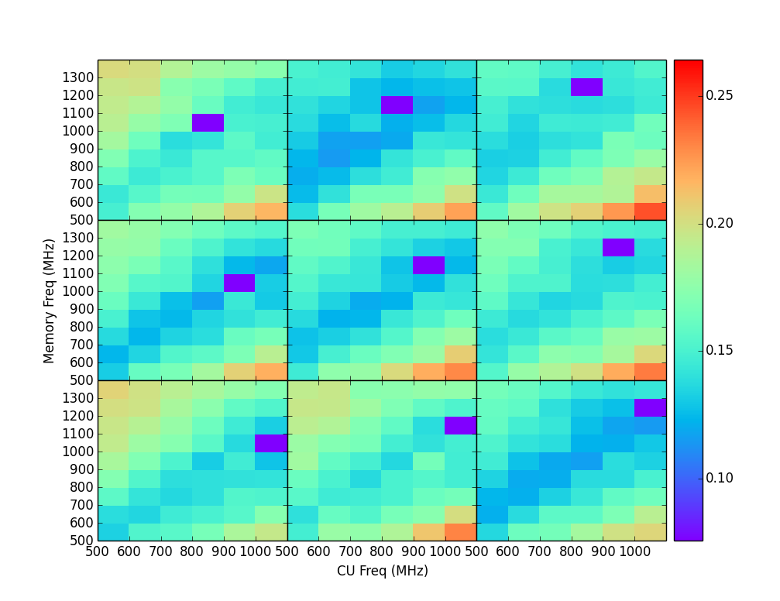
Performance model validation
69 training kernels; leave one kernel out → prediction → validation
    relative error between the prediction and real processing: accuracy verification
Make predictions for all other HW design points from each design point
    Variation of #CUs, bandwidth, engine frequency -> 162 operating points -> 162*161 (26K) data points on the 3D grid for each kernel!
16.1%
Average prediction error - subset
Individual benchmark prediction errors

Slide 21
Technology and configurations
Evaluated for 22nm and 16nm
  Explore viability prior to Exascale timeframe
  Identify tech transfer opportunities
Design points and technology scaling
  PIM: limited by DRAM footprint and 10W/PIM
  Host: extrapolate current trends (assumes HMC-like DRAM interface)
 | Baseline | 22nm |  | 16nm
 | dGPU | Host | PIM | Host | PIM
Freq | 1GHz | 1GHz | 650MHz | 1GHz | 650MHz
Number of CUs | 32 | 32 | 8 | 64 | 12
Number of memory stacks |  | 2 |  | 4
DRAM BW (GB/s) |  | 160 | 640 | 160 | 640
Dynamic power scaling | 1.00 | 0.61 | 0.25 | 0.41 | 0.17
Memory Energy (pJ/64b) |  | 522 | 159 | 520 | 155

Slide 22
PIM can be performance-competitive with host
The higher, the better!
7%
-27%
PF = ParticleFilter
SP = ShortestPath
RW = RandomWalk

Slide 23
significant PERF/W improvements
The higher, the better!
7.7
6.9
PF = ParticleFilter
SP = ShortestPath
RW = RandomWalk

Slide 24
Conclusions and further research
“Computing” is increasingly about data and data movement
  Exploit locality to reduce wasteful data movement
  Specialization to improve efficiency
  PIM potentially provides significant reductions in off-chip traffic.
TOP-PIM implemented using 3D die-stacking feasible in near future.
  Efficiently utilize the high bandwidth available in local stack
  Programmability -> Support a broad range of applications
  Performance and energy efficiency of PIM vs Host
    At 22nm, 27% performance degradation, 76% reduction in EDP
    At 16nm, 7% performance gain, 85% reduction in EDP.
Future Work:
  High level programming models to express data-compute affinity.
  Data movement management and task scheduling for host and PIMs.
  Evaluation of alternative PIM organizations and design options.

Slide 25
Disclaimer & Attribution
The information presented in this document is for informational purposes only and may contain technical inaccuracies, omissions and typographical errors.
The information contained herein is subject to change and may be rendered inaccurate for many reasons, including but not limited to product and roadmap changes, component and motherboard version changes, new model and/or product releases, product differences between differing manufacturers, software changes, BIOS flashes, firmware upgrades, or the like. AMD assumes no obligation to update or otherwise correct or revise this information. However, AMD reserves the right to revise this information and to make changes from time to time to the content hereof without obligation of AMD to notify any person of such revisions or changes.
AMD MAKES NO REPRESENTATIONS OR WARRANTIES WITH RESPECT TO THE CONTENTS HEREOF AND ASSUMES NO RESPONSIBILITY FOR ANY INACCURACIES, ERRORS OR OMISSIONS THAT MAY APPEAR IN THIS INFORMATION.
AMD SPECIFICALLY DISCLAIMS ANY IMPLIED WARRANTIES OF MERCHANTABILITY OR FITNESS FOR ANY PARTICULAR PURPOSE. IN NO EVENT WILL AMD BE LIABLE TO ANY PERSON FOR ANY DIRECT, INDIRECT, SPECIAL OR OTHER CONSEQUENTIAL DAMAGES ARISING FROM THE USE OF ANY INFORMATION CONTAINED HEREIN, EVEN IF AMD IS EXPRESSLY ADVISED OF THE POSSIBILITY OF SUCH DAMAGES.
ATTRIBUTION
© 2014 Advanced Micro Devices, Inc. All rights reserved. AMD, the AMD Arrow logo and combinations thereof are trademarks of Advanced Micro Devices, Inc. in the United States and/or other jurisdictions. SPEC is a registered trademark of the Standard Performance Evaluation Corporation (SPEC). Other names are for informational purposes only and may be trademarks of their respective owners.

