Slide 1
Machine Learning for Performance and Power Modeling of Heterogeneous Systems
Joseph L. Greathouse, Gabriel H. Loh
Advanced Micro Devices, Inc.

Slide 2
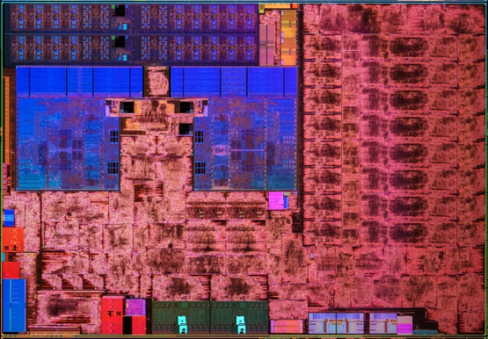
Large Design Space for Heterogeneous Systems
6th Gen. AMD A-Series Processor “Carrizo”
High-Level System Design Points
Some CPU design spaces:
How large?
How many CPUs?
How fast should the CPUs run?
How much power should it use?
Some GPU design spaces:
How much parallelism?
How fast should it run?
How much power should it use?
What accelerators are needed?
How much bandwidth needed?
Video Decode
Video Encode
CPUs
GPU

Slide 3
Example of a Design Space Exploration
Various Designs Using AMD GPUs
Name | CUs | Max Freq. (MHz) | Max DRAM BW (GB/s)
AMD E1-6010 APU | 2 | 350 | 11
AMD A10-7850K APU | 8 | 720 | 35
Microsoft Xbox One™ Processor | 12 | 853 | 68
Sony PlayStation® 4 Processor | 18 | 800 | 176
AMD Radeon™ R9-280X | 32 | 1000 | 286
AMD Radeon™ R9-290X | 44 | 1000 | 352
AMD Radeon™ R9 Fury X | 64 | 1000 | 512

Slide 4
Design Space Explorations Require Long Runtimes
Power and thermals on a real heterogeneous processor
~2.5 trillion CPU instructions, ~60 trillion GPU operations
Real applications of interest are large and complex
Not microbenchmarks, can run for minutes or hours
Performance and power can rely on what happened in the past
Complex interactions between various heterogeneous devices

Slide 5
Design-Space exploration Hard on Existing Platforms
Microarchitecture simulators (e.g., gem5, Multi2Sim, SESC, GPGPU-Sim)
Excellent for low-level details.
Too slow for broad design space explorations of full applications:
6 minutes * 60s/min * 4 CPU cores * ~1.75GHz (AMD A8-4555M) + 6 minutes * 60s/min * 6 CUs * 64 FPU/CU * 425MHz (AMD Radeon™ HD 7600G) = ~60 trillion operations ≈ 1 year of simulation time @ 2 MIPS
Emulators (e.g., Cadence Palladium, Synopsys ZeBu, Mentor Veloce, IBM AWAN)
Much faster than SW simulation, just as detailed, but require a nearly-complete design
Functional simulators (e.g., AMD SimNow, Simics, QEMU, etc.)
Faster than microarchitectural simulators, good for software bring-up
No relation to hardware performance
Spreadsheet analyses
Great for first-order analyses. Much faster and easier than lower-level simulators
Difficult to analyze application differences.

Slide 6
Drive Design Space Exploration from Real Hardware
Gather from running application of interest on real hardware:
Measured performance and power
Information about how the application used the hardware (e.g., performance counters)
Estimate performance and power for different hardware design points
Target Hardware Configuration
GPU Kernel
Execution Time/power
Performance Counters
Performance and Power Models
Target Execution Time/Power
GPU Hardware
6

Slide 7
The “High-Level” Design Space Explored In this Talk
Changes to the following GPU parameters:
Number of parallel compute units (CUs)
Core frequency
Memory bandwidth
Changes to GPU kernel:
Performance
Dynamic power

Slide 8
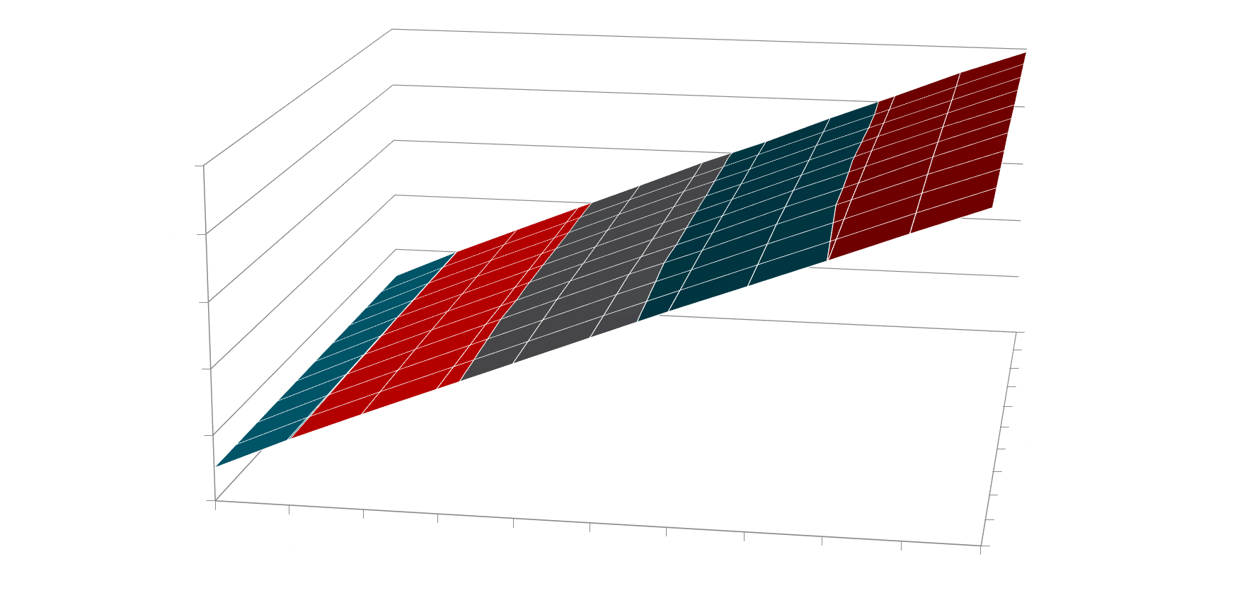
GPU Kernel Performance Scaling with HW Designs (1)

Slide 9
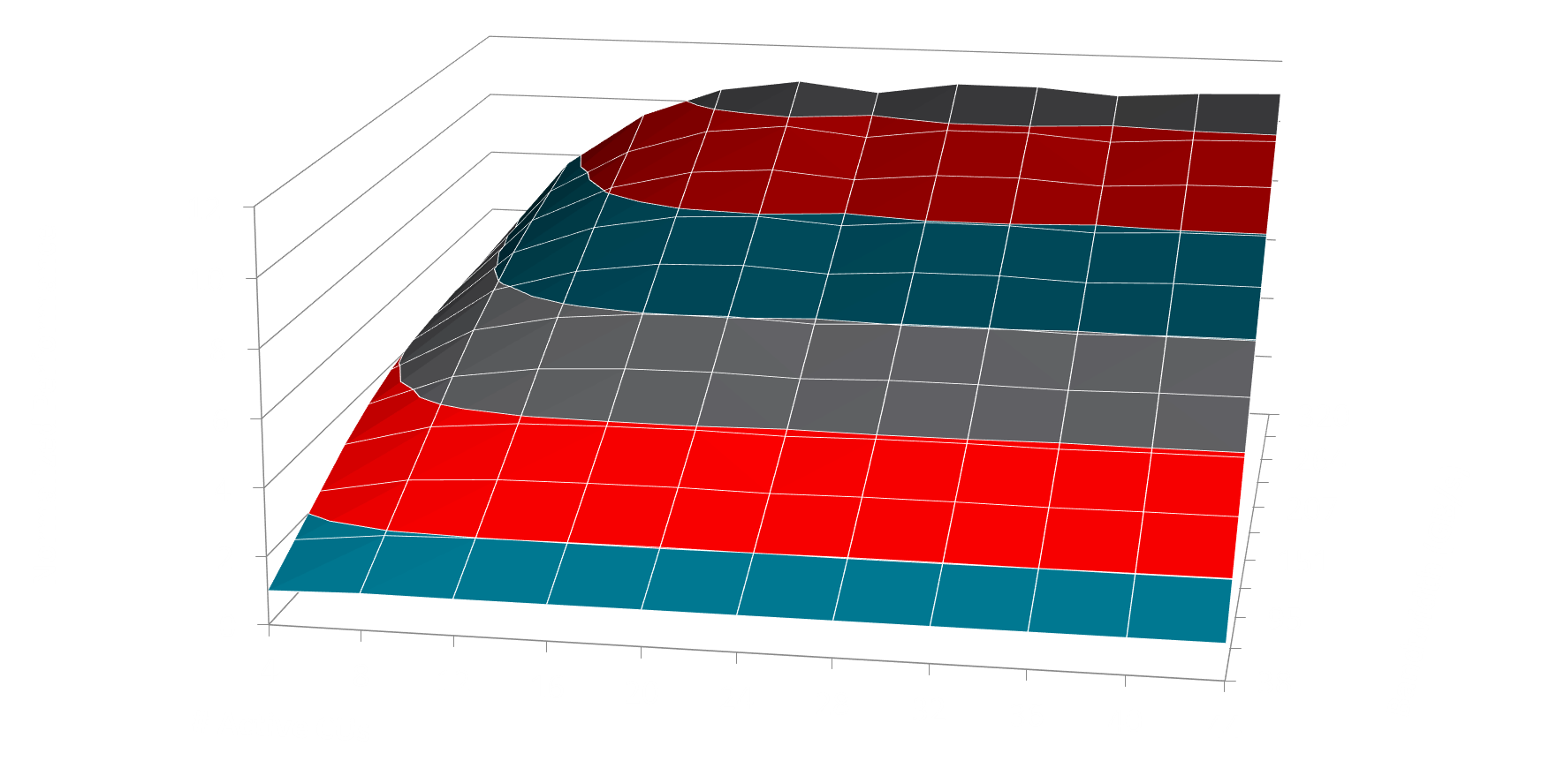
GPU Kernel Performance Scaling with HW Designs (2)

Slide 10
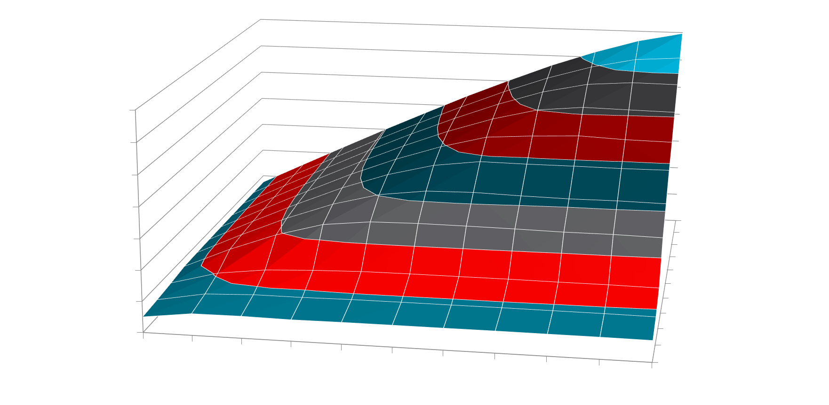
GPU Kernel Performance Scaling with HW Designs (3)

Slide 11
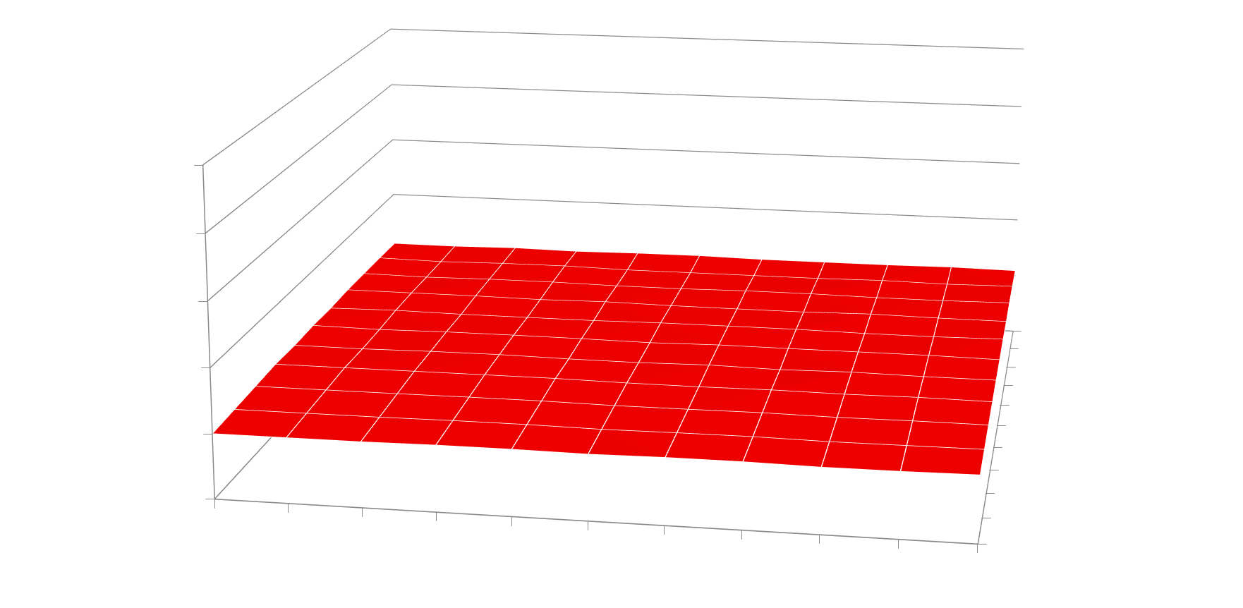
GPU Kernel Performance Scaling with HW Designs (4)

Slide 12
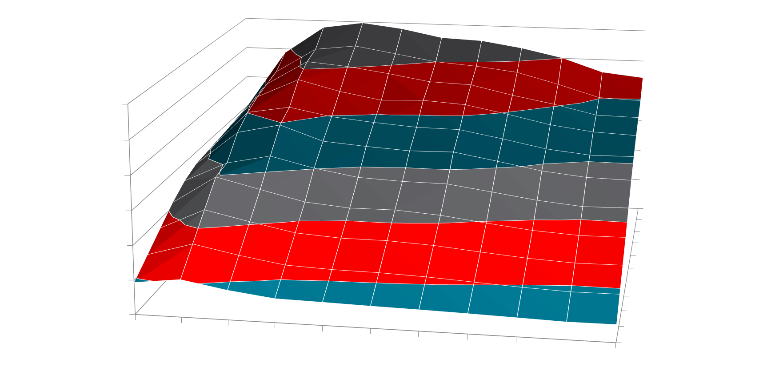
GPU Kernel Performance Scaling with HW Designs (5)

Slide 13
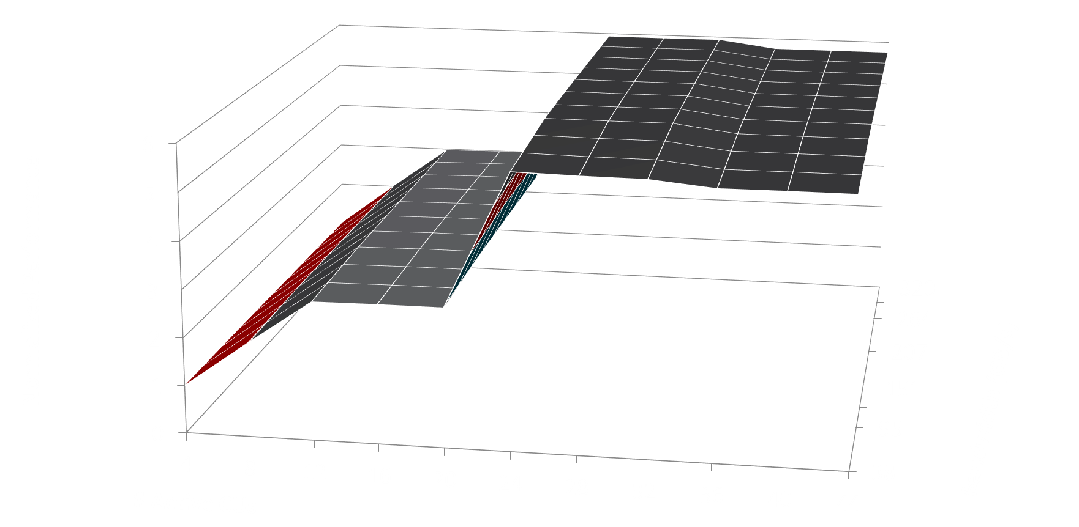
GPU Kernel Performance Scaling with HW Designs (6)

Slide 14
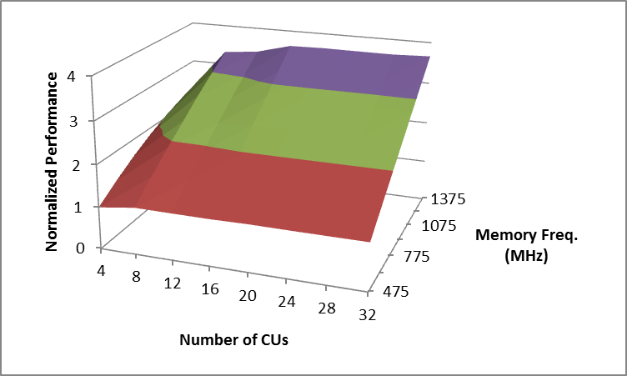
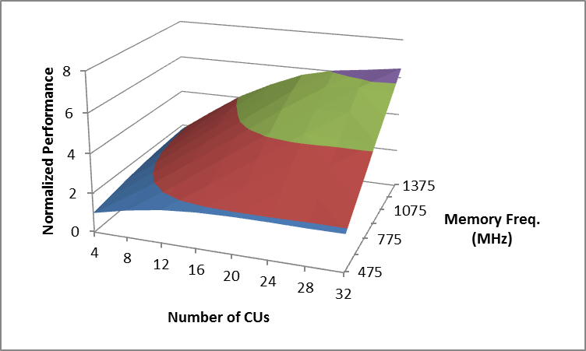
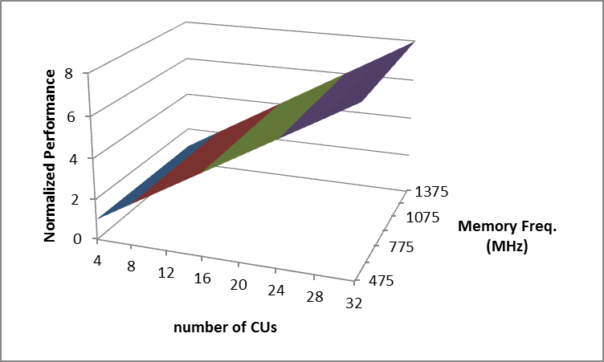
Automatically Clustering Scaling Curves
Training Set
Kernel 1
Kernel 2
Kernel 3
Kernel 4
Kernel 5
Kernel 6
Cluster 1
Cluster 2
Cluster 3

Slide 15
Automatically Clustering Scaling Curves

Slide 16
Finding a Scaling cluster of an Unknown Kernel
Performance counters indicate how the kernel uses the hardware
Counters may thus help indicate which cluster a kernel is in with only one measurement
Perf. Counter 0
Cluster 0
Perf. Counter 1
Cluster 1
…
…
…
Perf. Counter N
Cluster M

Slide 17
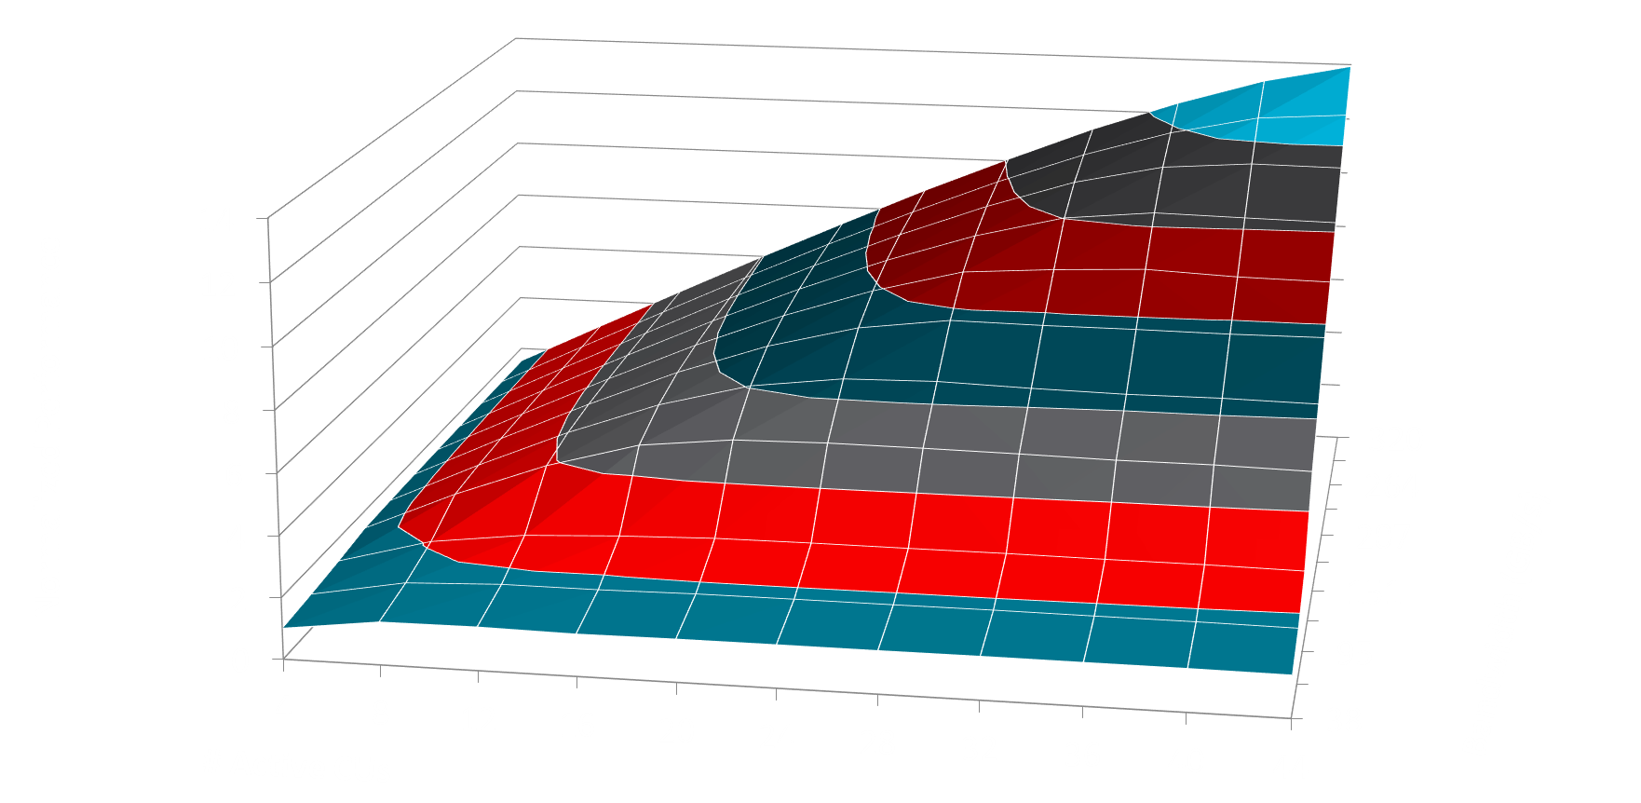
Estimate Kernel Changes Using Cluster’s Curve
Half the CUs but same bandwidth?
~60% Performance

Slide 18
Estimate Kernel Changes Using Cluster’s Curve
Half the CUs but same bandwidth?
~100% Performance

Slide 19
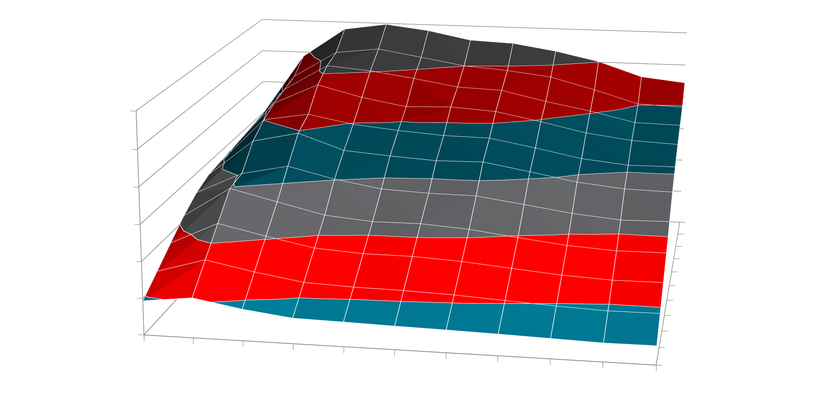
Estimate Kernel Changes Using Cluster’s Curve
Half the CUs but same bandwidth?
~115% Performance

Slide 20
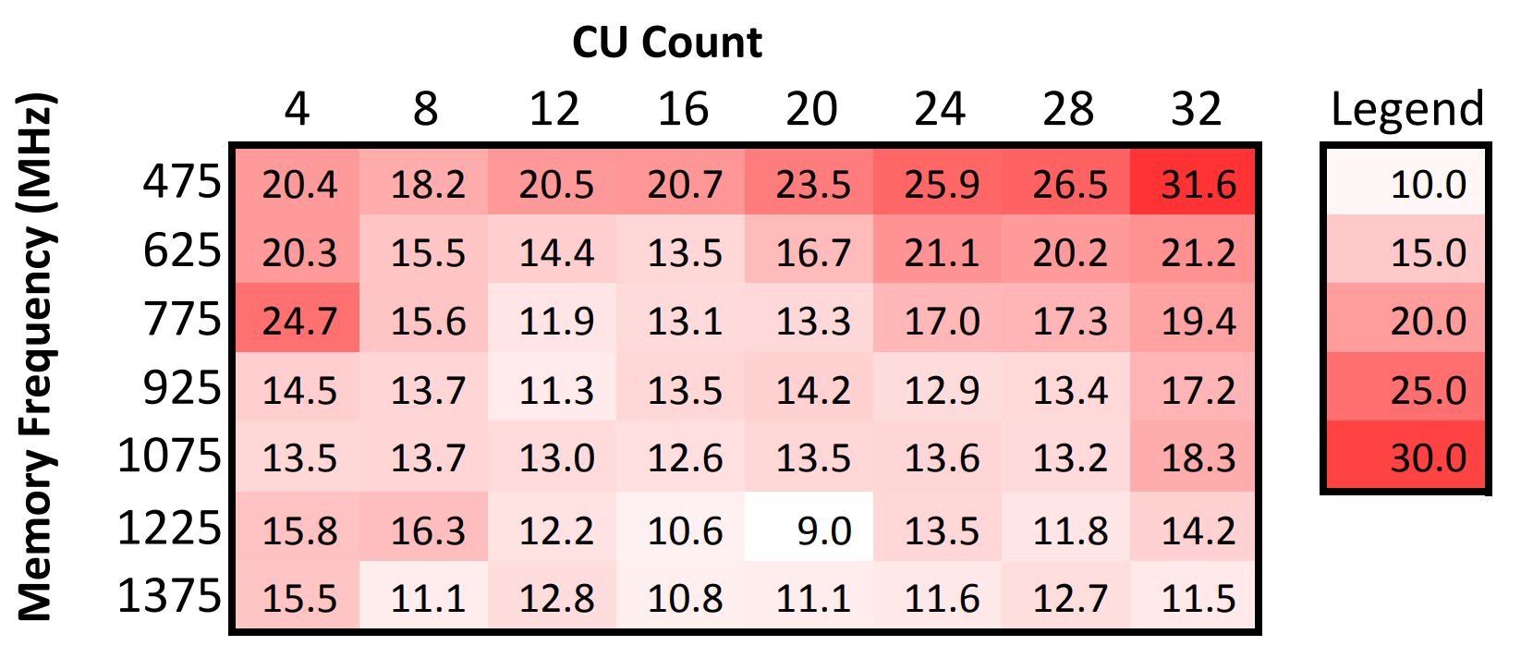
Accuracy from one HW point to All Others

Slide 21
Preparing Good Data is Challenging
This model needs a lot of data:
Multiple applications, many kernels
Numerous design points per application
What kernels are representative?
How to get clean performance and power data?

Slide 22
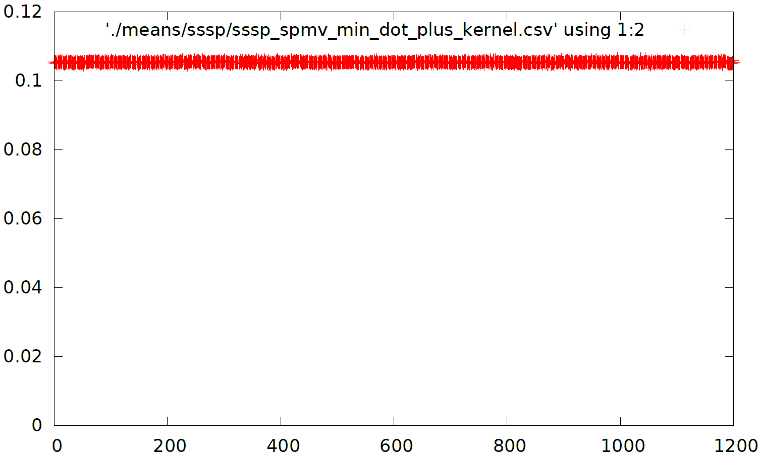
Choosing Representative Kernels
Kernel Runtime
Kernel Invocation

Slide 23
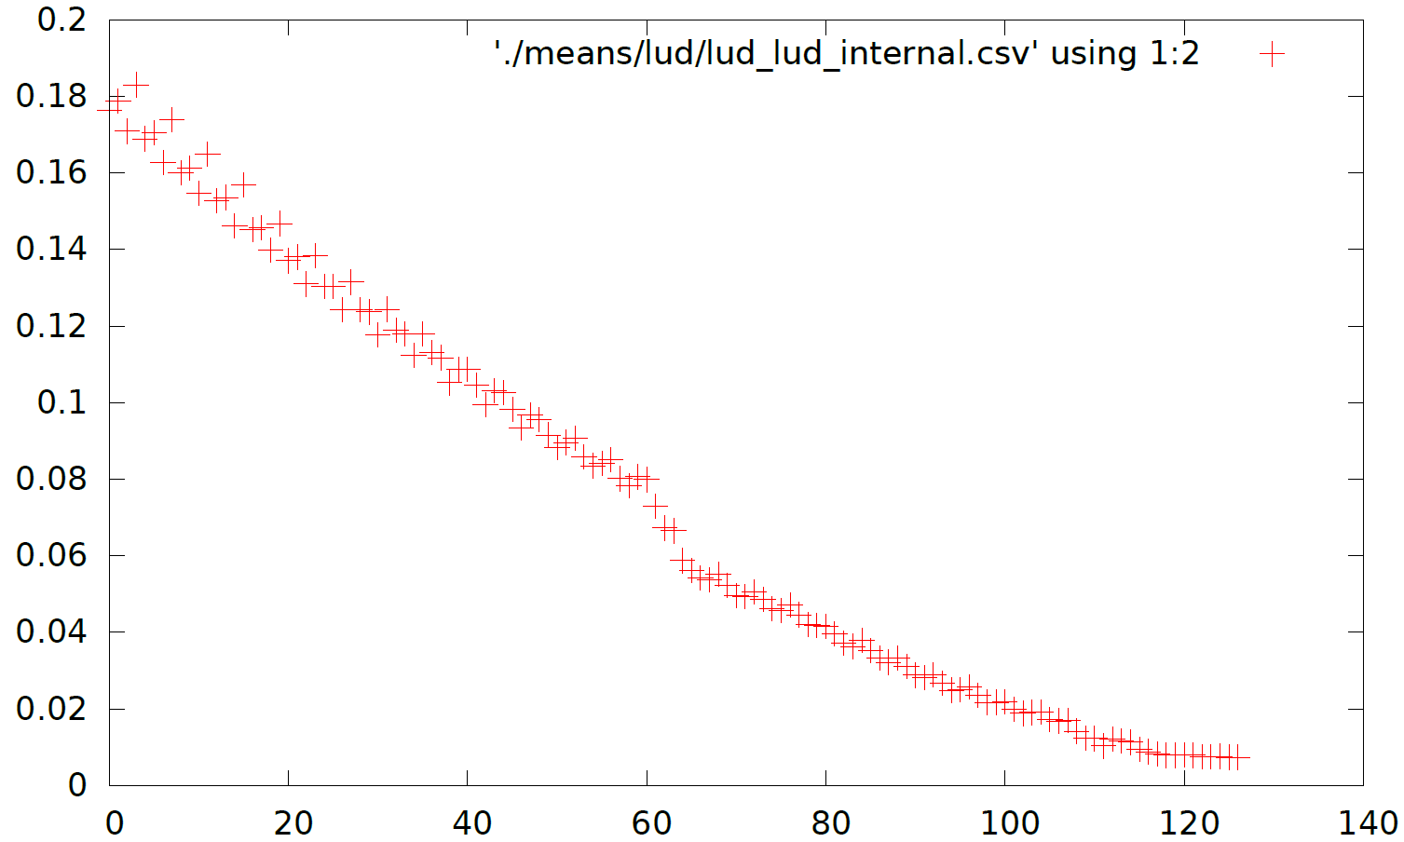
Choosing Representative Kernels
Kernel Runtime
Kernel Invocation

Slide 24
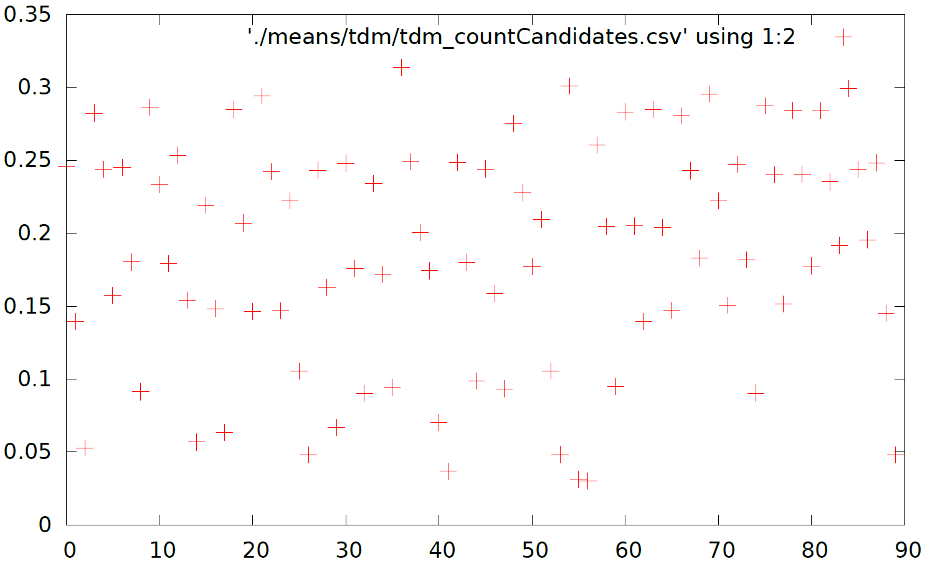
Choosing Representative Kernels
Kernel Runtime
Kernel Invocation

Slide 25
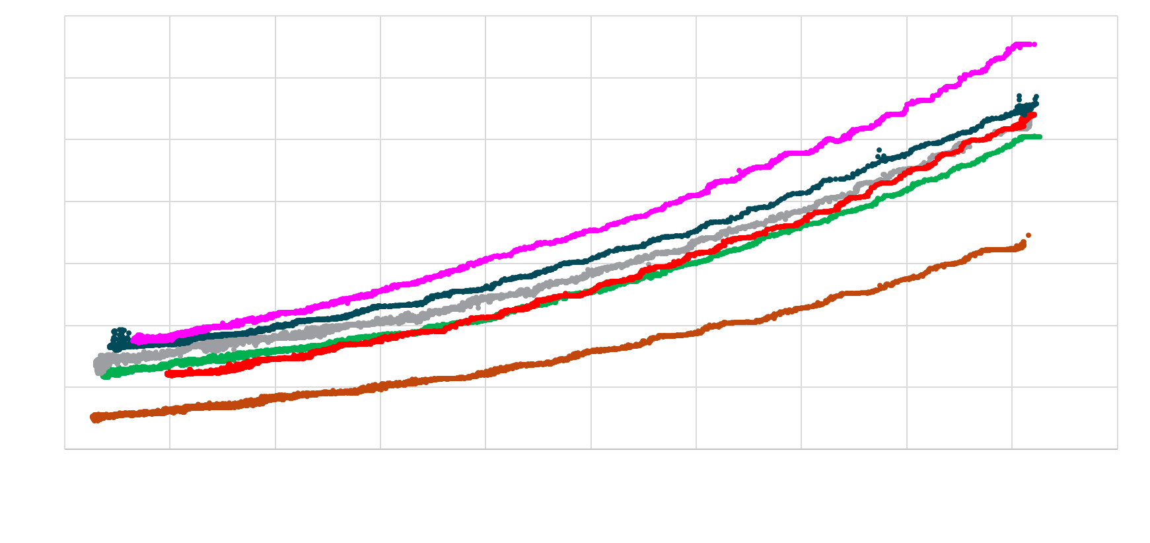
Power Measurements Must Account for Static Power

Slide 26
Summary
Modern systems have a large heterogeneous hardware design space
We need tools to do early design space exploration to help guide designs
ML techniques help perform hardware-driven scaling studies
Reasonable accuracy and very fast!
But building clean, meaningful data sets presents a challenge

Slide 27
Papers About This Topic
J. L. Greathouse, A. Lyashevsky, M. Meswani, N. Jayasena, M. Ignatowski, “Simulation of Exascale Nodes through Runtime Hardware Monitoring,” ModSim 2013
B. Su, J. L. Greathouse, J. Gu, M. Boyer, L. Shen, Z. Wang, “Implementing a Leading Loads Performance Predictor on Commodity Processors,” USENIX ATC 2014
D. P. Zhang, N, Jayasena, A. Lyashevsky, J. L. Greathouse, L. Xu, M. Ignatowski, “TOP-PIM: Throughput-Oriented Programmable Processing in Memory,” HPDC 2014
G. Wu, J. L. Greathouse, A. Lyashevsky, N. Jayasena, D. Chiou, “GPGPU Performance and Power Estimation Using Machine Learning,” HPCA 2015
A. Majumdar, G. Wu, K. Dev, J. L. Greathouse, I. Paul, W. Huang, A. K. Venugopal, L. Piga, C. Freitag, S. Puthoor, “A Taxonomy of GPGPU Performance Scaling,” IISWC 2015
T. Vijayaraghavan, Y. Eckert, G. H. Loh, M. J. Schulte, M. Ignatowski, B M. Beckmann, W. C. Brantley, J. L. Greathouse, W. Huang, A. Karunanithi, O. Kayiran, M. Meswani, I. Paul, M. Poremba, S. Raasch, S. K. Reinhardt, G. Sadowski, V. Sridharan, “Design and Analysis of an APU for Exascale Computing,” HPCA 2017

Slide 28
Questions?
Disclaimer
The information presented in this document is for informational purposes only and may contain technical inaccuracies, omissions and typographical errors.
The information contained herein is subject to change and may be rendered inaccurate for many reasons, including but not limited to product and roadmap changes, component and motherboard version changes, new model and/or product releases, product differences between differing manufacturers, software changes, BIOS flashes, firmware upgrades, or the like. AMD assumes no obligation to update or otherwise correct or revise this information. However, AMD reserves the right to revise this information and to make changes from time to time to the content hereof without obligation of AMD to notify any person of such revisions or changes.
AMD MAKES NO REPRESENTATIONS OR WARRANTIES WITH RESPECT TO THE CONTENTS HEREOF AND ASSUMES NO RESPONSIBILITY FOR ANY INACCURACIES, ERRORS OR OMISSIONS THAT MAY APPEAR IN THIS INFORMATION.
AMD SPECIFICALLY DISCLAIMS ANY IMPLIED WARRANTIES OF MERCHANTABILITY OR FITNESS FOR ANY PARTICULAR PURPOSE. IN NO EVENT WILL AMD BE LIABLE TO ANY PERSON FOR ANY DIRECT, INDIRECT, SPECIAL OR OTHER CONSEQUENTIAL DAMAGES ARISING FROM THE USE OF ANY INFORMATION CONTAINED HEREIN, EVEN IF AMD IS EXPRESSLY ADVISED OF THE POSSIBILITY OF SUCH DAMAGES.
AMD, the AMD Arrow logo, Radeon, and combinations thereof are trademarks of Advanced Micro Devices, Inc. Xbox One is a trademark of the Microsoft Corporation. PlayStation is a trademark or registered trademark of Sony Computer Entertainment, Inc. Other names used herein are for identification purposes only and may be trademarks of their respective companies.

Slide 29
Backup Slides

Slide 30
Use Hardware Measurements to Guide Exploration
Step 1: Measure application on real hardware
Step 2: Estimate how application will work on future hardware
Phase 1
User Application
Software Tasks
Phase 2
Future Machine Description
Performance, Power, and Thermal Models
User-Level Software Stack
Test Operating System
Trace Post-processor
Test System APU, CPU, GPU
Traces of HW and SW events related to performance and power
Performance and Power Estimates

Slide 31
Application’s Use of all Hardware Matters
Time
CPU0
CPU1
GPU
Example when everything except CPU1 gets 2x faster:
CPU0
CPU1
Performance Difference
GPU
Less than 2x gain because CPU1 now on new critical path

Slide 32
Reconstructing Application Critical Paths
In phase 1, gather SW-level relationship between each segments
Use these relationships to build a legal execution order on simulated system
Gather ordering from library calls like pthread_create(), clWaitForEvents(), etc.
Could also split segments on user API calls, program phases
①
②
⑦
CPU0
③
④
⑥
CPU1
⑤
GPU

