Slide 1
Measuring and Modeling On-Chip Interconnect Power on Real Hardware
Vignesh Adhinarayanan, Indrani Paul, Joseph L. Greathouse,
Wei Huang, Ashutosh Pattnaik, Wu-chun Feng

Slide 2
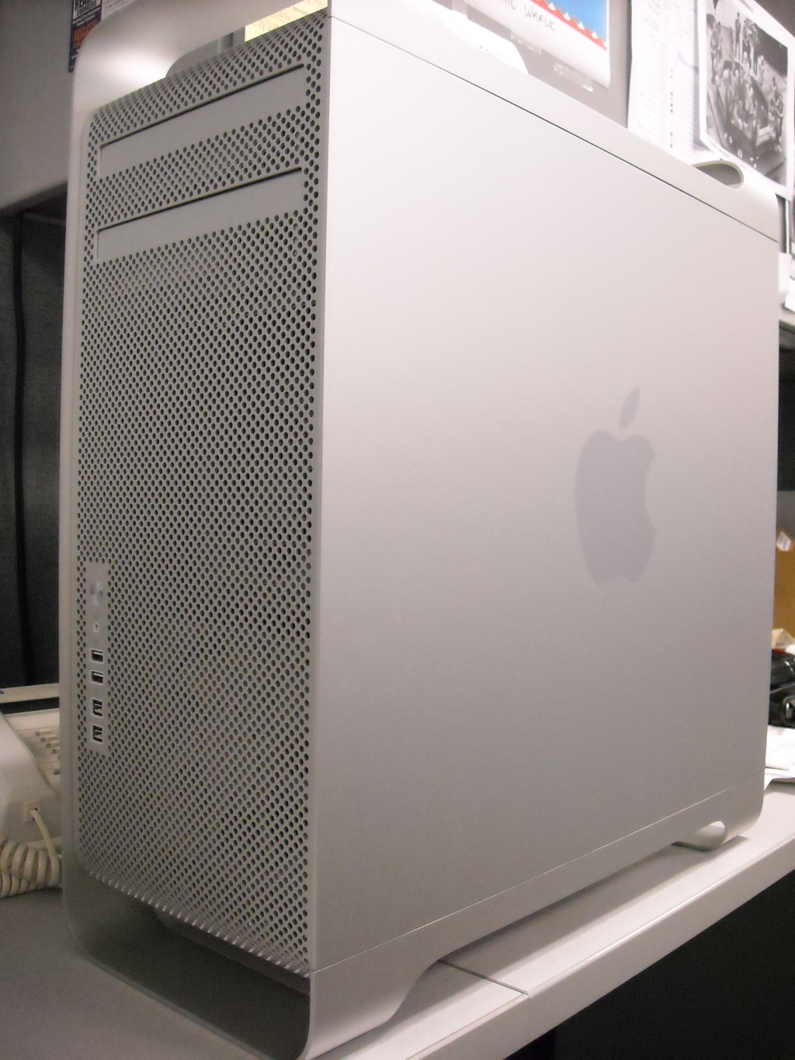
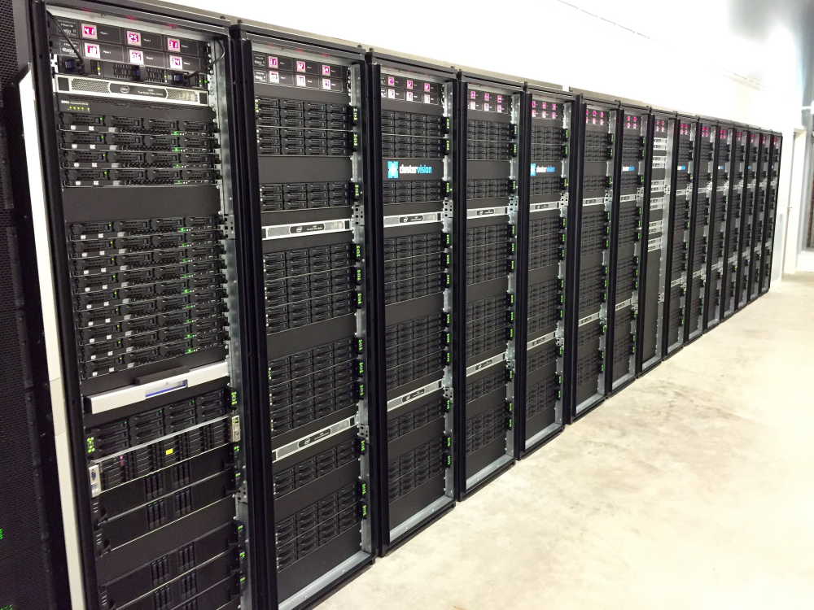
Power and Energy are First-Class Design Constraints
Power and energy have become a first-class design constraint in all areas of computing
Phones and laptops must optimize for energy as they are battery operated
Desktops require loud cooling solutions
Supercomputers and other large data centers are constrained by power
Modified from Image by Vernon Chan CC BY 2.0
Image by Patrick Strandberg
CC BY-SA 2.0
Image by Glenn Batuyong CC BY 2.0

Slide 3
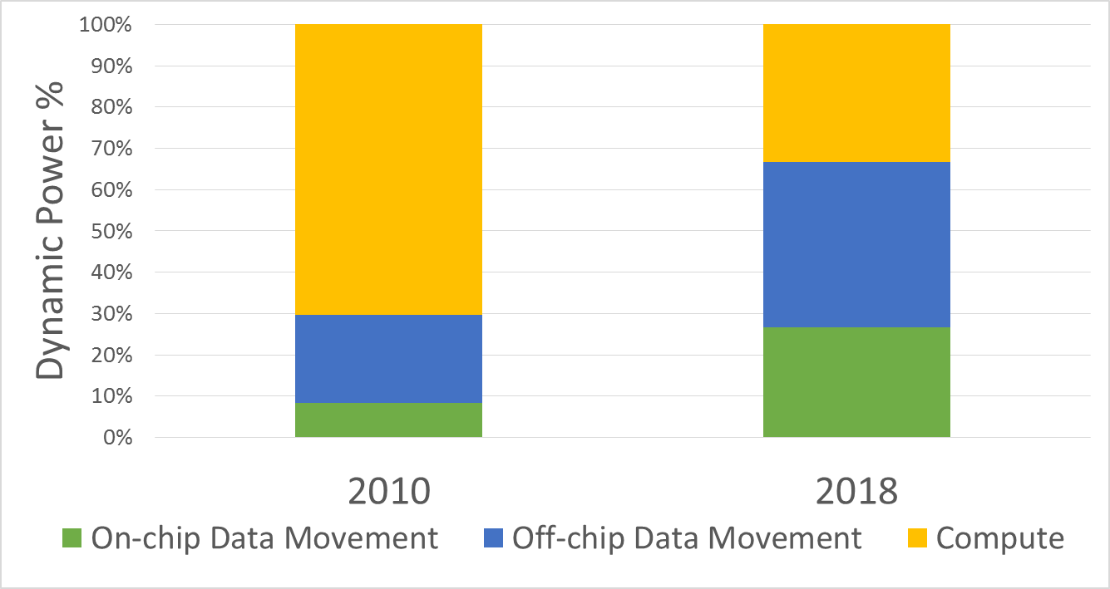
Data Movement: A Major Source of Power Consumption
Data movement through the memory hierarchy thought to be a major source of power consumption
Measurements on real system lacking
Current estimates based on simulation studies
Real-world measurements are coarse-grained and do not give break down for data movement
Based on: Shalf et al., “Exascale Computing Technology Challenges,” VECPAR 2010

Slide 4
This Talk in One Sentence
A new methodology to measure
data-movement power on real hardware

Slide 5
State-of-the-art Measurement Approach
REG
L1
L2
L2 microbenchmark
E_{L2}
L1 microbenchmark
E_{L1}
G. Kestor et al., "Quantifying the energy cost of data movement in scientific applications,” IISWC 2013
E_{L2} = Energy consumed by L2 microbenchmark
E_{L1} = Energy consumed by L1 microbenchmark
Energy cost of moving data from L2 to L1 = E_{L2} - E_{L1}
Issue: Over-estimation of data-movement energy

Slide 6
State-of-the-art Measurement Approach: Limitation
Compute
Compute
L1
L1
Interconnect
Interconnect
L2
L2
L2 microbenchmark
L1 microbenchmark
Issue: Data-movement power also includes L2-access power
Notes:
The same benchmarks from the previous slide, but redrawn to understand the shortcomings of the related work.

Slide 7
Our Proposed Approach

Slide 8
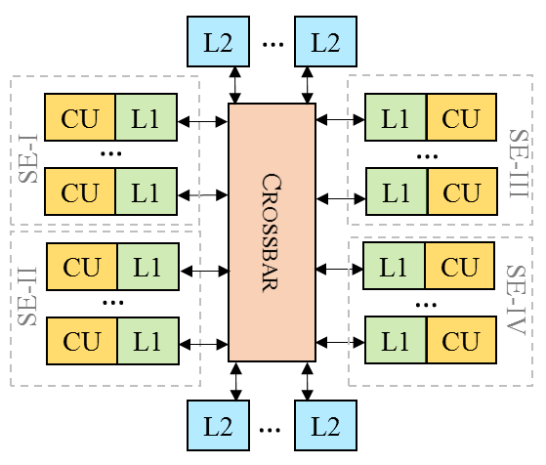
A Bit of Background …
Representative block diagram of AMD FirePro™ W9100 GPU (Previously Code-named “Hawaii”)
Distance between shader engines and L2 banks differ

Slide 9
A Bit of Background …
Representative block diagram of AMD FirePro™ W9100 GPU (Previously Code-named “Hawaii”)
Physical distance traversed by data thought to affect data movement power

Slide 10
Our Proposed Approach
L2 cache
L2 cache
CU
CU
Shader Engine I
Shader Engine I
CU
CU
CU
CU
CU
CU
CU
CU
Shader Engine II
Shader Engine II
CU
CU
CU
CU
CU
CU
Short-path microbenchmark
Long-path microbenchmark
Design microbenchmarks based on data-movement distance to properly isolate the interconnect
Notes:
The difference in distance causes the interconnect activity to differ by a factor of 2, which can help isolate the interconnect power better.

Slide 11
Challenges

Slide 12
Challenges
OpenCL™ lacks native support to pin threads to programmer-specified compute units
Temperature of device during tests will affect the power consumption
Power difference between the two sets of microbenchmarks can be hard to observe

Slide 13
Challenges
Only a small difference between used-L2 and L1 cache size which can make it challenging to write L2-only microbenchmarks
Ensuring that the same amount of work is done by the two microbenchmarks can be challenging due to NUCA effects

Slide 14
Addressing the Challenges
OpenCL™ lacks native support to pin threads to programmer-specified compute units
Temperature of device during tests will affect the power consumption
Power difference between the two sets of microbenchmarks can be hard to observe

Slide 15
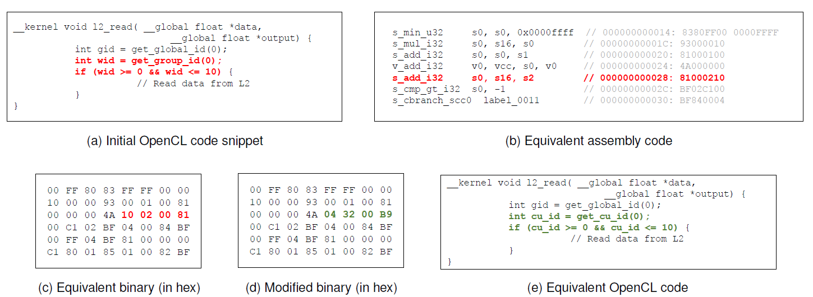
Addressing the challenges Pinning Threads to Cores with OpenCL™
Can be accomplished with some binary hacking

Slide 16
Addressing the challenges Pinning Threads to Cores with OpenCL™
1. Use workgroup ID as a placeholder for CU ID
Notes:
First, we have a snippet of OpenCL code written. Here, we do useful work only when the workgroup ID is within a certain range. The useful work we are doing here is reading from L2.
Workgroup ID can be obtained with OpenCL.
But workgroup is really only a place holder to hold compute unit ID as they are both scalar values.

Slide 17
Addressing the challenges Pinning Threads to Cores with OpenCL™
2. Identify instruction that writes workgroup ID to the register that gets checked in the conditional
Notes:
Second, we disassemble to code and in the assembly language, we manually identify the instruction which is responsible for writing the workgroup ID to the register that gets checked in the conditional. Its equivalent binary instruction is noted.

Slide 18
Addressing the challenges Pinning Threads to Cores with OpenCL™
3. Identify instruction that writes workgroup ID to the register that gets checked in the conditional in binary
Notes:
Then, we read the binary in a hex editor and identify the instruction we just noted earlier.

Slide 19
Addressing the challenges Pinning Threads to Cores with OpenCL™
4. Replace workgroup ID with CU ID (read from read-only HW register) in the correct register in the binary
Notes:
The binary is then modified such that the register that gets checked in the conditional holds CU ID instead of the workgroup ID.
While CU ID cannot be read with OpenCL, AMD hardware itself contains this information in a read-only hardware register. It is possible to read this data by forming the right instruction. The equivalent binary instruction shown in green. This instruction can be formed by going through AMD’s ISA manual for the Hawaii architecture.

Slide 20
Addressing the challenges Pinning Threads to Cores with OpenCL™
5. Get functionally equivalent OpenCL snippet
Notes:
One you modify the binary, you have an executable that is functionally equivalent to the OpenCL snippet at the bottom right. In effect, you can now perform L2 reads only in shader engine 1.
With this method, we can overcome the first challenge.

Slide 21
Addressing the Challenges
OpenCL™ lacks native support to pin threads to programmer-specified compute units
Temperature of device during tests will affect the power consumption
Power difference between the two sets of microbenchmarks can be hard to observe

Slide 22
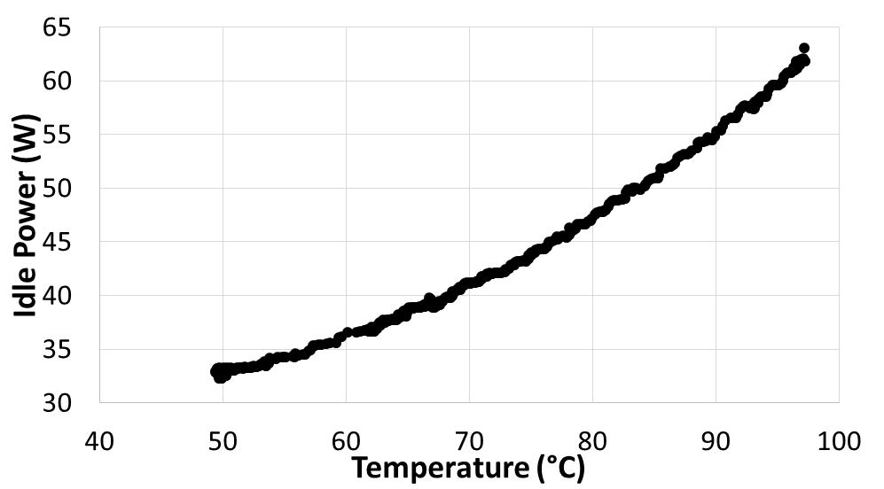
Addressing the challenges Eliminating Temperature Effects
Solution 1: Run GPU fans at very high speed to limit temperature difference between runs

Slide 23
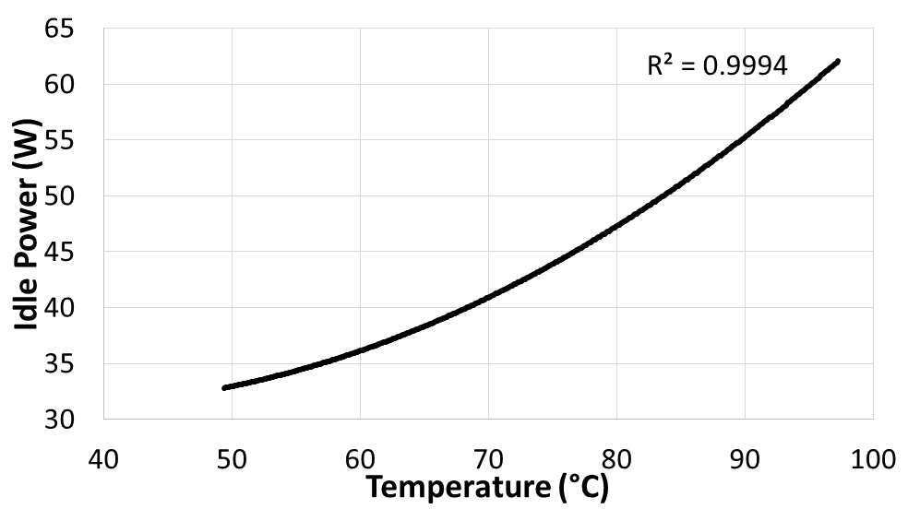
Addressing the challenges Eliminating Temperature Effects
Solution 2: Model idle power separately and subtract from measured power

Slide 24
Addressing the Challenges
OpenCL™ lacks native support to pin threads to programmer-specified compute units
Temperature of device during tests will affect the power consumption
Power difference between the two sets of microbenchmarks can be hard to observe

Slide 25
Addressing the challenges Saturating Interconnect Bandwidth
Power difference between microbenchmarks can be too low to be reliably observed
Unless the amount of data going through the interconnect increases
Difficult to saturate interconnect bandwidth without increasing the number of wavefronts
Fewer wavefronts can result in stalling exposing latency difference issues
More wavefronts can lead to one of the following issues
More L1 hits when accesses per thread is low
Register pressure and memory spills if access per thread is high
Solution: Modify firmware to artificially shrink L1 cache size and then increase number of wavefronts

Slide 26
Challenges
Only a small difference between used-L2 and L1 cache size which can make it challenging to write L2-only microbenchmarks
Ensuring that the same amount of work is done by the two microbenchmarks can be challenging due to NUCA effects
Additional details in the paper

Slide 27
Characterization Studies

Slide 28
Parameters Affecting Interconnect Power
Average interconnect distance
Data toggle rate
Bandwidth observed on the interconnect
Interconnect’s voltage and frequency

Slide 29
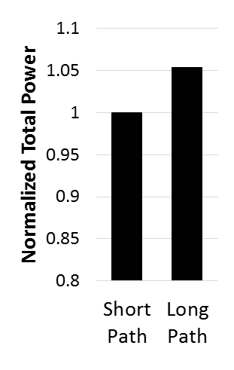
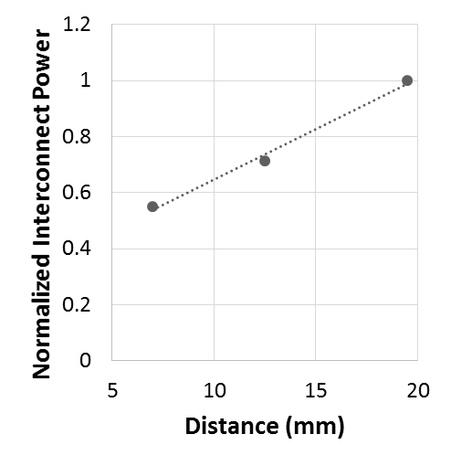
Interconnect Power vs Distance
Our experiments confirm that the distance traversed by data affects power consumption

Slide 30
Interconnect Power vs Distance
Within 15% of industrial estimates for energy/bit/mm

Slide 31
Interconnect Power vs Distance
Linear relationship observed between data-movement distance and interconnect power

Slide 32
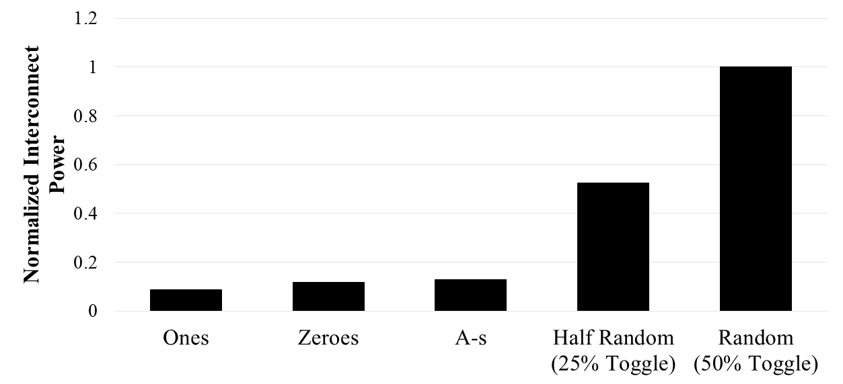
Interconnect Power vs Toggle Rate
(0% Toggle)
(0% Toggle)
(0% Toggle)
11111111
00000000
10101010
0x0x0x0x
xxxxxxxx
Linear relationship observed between toggle rate and interconnect power

Slide 33
Interconnect Power vs Toggle Rate
(0% Toggle)
(0% Toggle)
(0% Toggle)
11111111
00000000
10101010
0x0x0x0x
xxxxxxxx
Approximately 10% of interconnect power goes towards arbitration, etc.

Slide 34
Interconnect Power vs Toggle Rate
(0% Toggle)
(0% Toggle)
(0% Toggle)
11111111
00000000
10101010
0x0x0x0x
xxxxxxxx
Transmitting 0s slightly more expensive than 1s

Slide 35
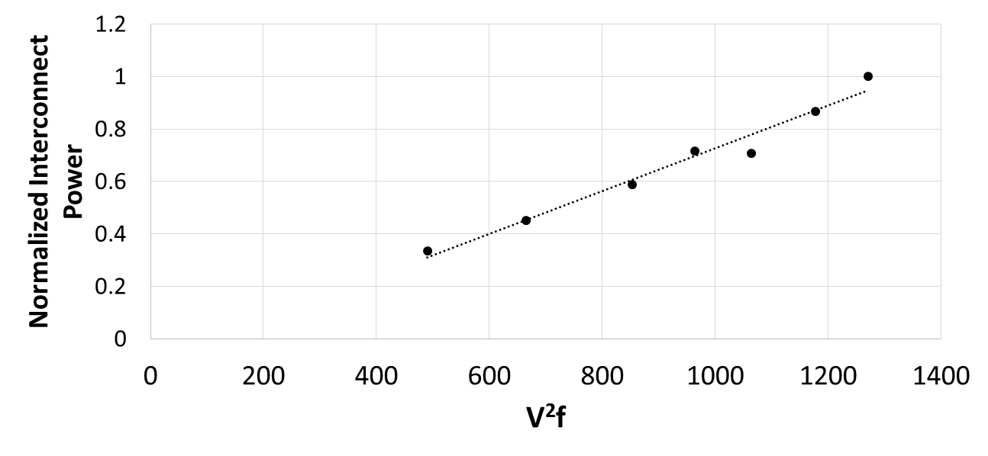
Interconnect Power vs Voltage and Frequency
Impact of voltage and frequency as expected

Slide 36
Putting it all together
Interconnect Power = Energy/bit/mm * avg. distance * avg. bits/sec * scaled voltage² x scaled frequency * avg. toggle rate
For real applications,
Avg. bits per second is calculated from performance counters (e.g. L1 and L2 accesses)
The other parameters are pre-computed or pre-measured (e.g. Distance is measured from layout; energy/bit/mm is computed to be 110 fJ/bit/mm)
Notes:
110 fJ/bit/mm is for random data. That is 50% toggle rate.
Per transition cost would be 220 fJ/bit/mm

Slide 37
Evaluation of Applications

Slide 38
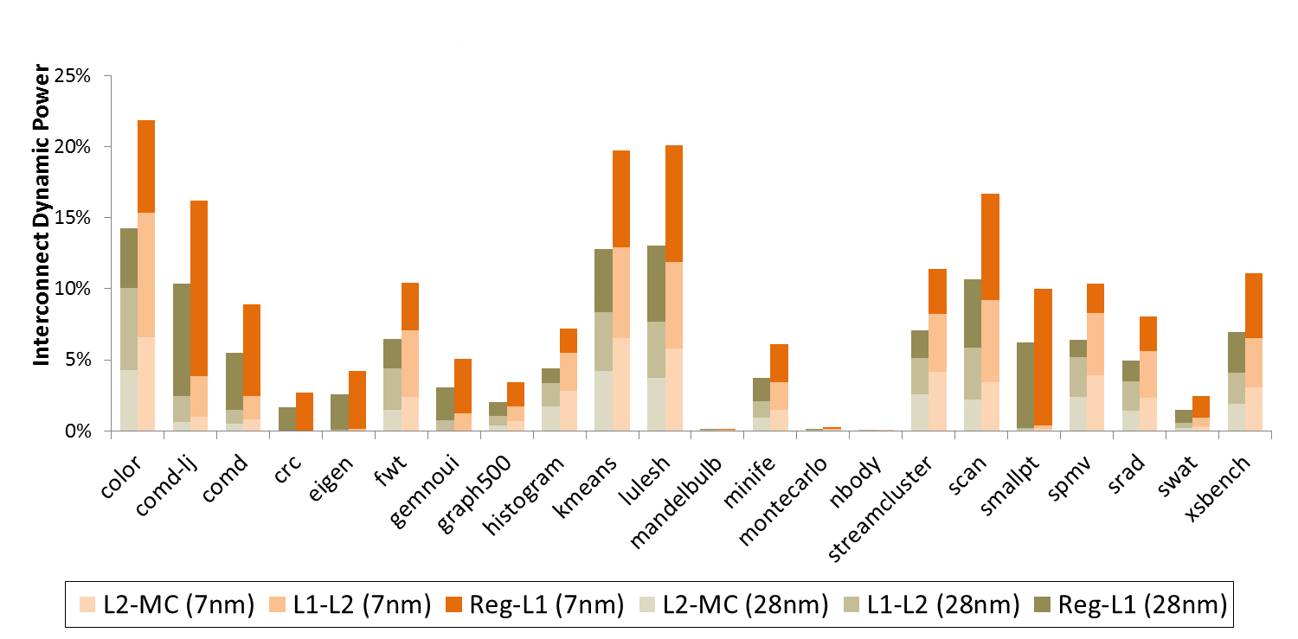
Energy Cost of Data Movement on Real Applications
Up to 14% dynamic power spent on interconnects in today’s chips

Slide 39
Energy Cost of Data Movement on Real Applications
Even non-memory bound applications can show high interconnect power (but at different hierarchy)

Slide 40
Energy Cost of Data Movement on Real Applications
Data-movement power problem exacerbated in future technology nodes

Slide 41
Optimizations

Slide 42
Interconnect Power Optimizations
Layout-Based Optimizations
We explore how much impact layout-based optimization can have on real world applications
We examine two layouts – one reduces distance between L1 and L2 and the other reduces distance between L2 and memory controller
Cache Resizing (details in the paper)
Increasing cache size decreases average data movement distance (most data is fetched from nearer memories)
We quantify the magnitude of difference when we increase the cache size 4 times

Slide 43
Interconnect Power Optimizations – Layout Optimization
L1-$
L2-$
Mem Controller
L1 to L2 = 17.0 units
L2 to MC = 7.6 units
L1 to L2 = 3.5 units
L2 to MC = 12.0 units
Optimized to reduce L2-MC distance. Not too different from current GPUs.

Slide 44
Interconnect Power Optimizations – Layout Optimization
L1-$
L2-$
Mem Controller
L1 to L2 = 17.0 units
L2 to MC = 7.6 units
L1 to L2 = 3.5 units
L2 to MC = 12.0 units
Optimized to reduce L1-L2 distance.

Slide 45
Interconnect Power Optimizations – Layout Optimization
Interconnect power reduces by 48% on average when we use an L1-L2 distance optimized layout

Slide 46
Conclusion
Distance-based microbenchmarking is a promising approach to measure data movement power
Over 14% of dynamic power can go towards on-chip data movement in today’s chips
Lesser than past estimates as we separated out data access power from data movement power
Can increase to 22% by 7nm technology
Optimizing on-chip interconnects to reduce the distance of frequently accessed portions can reduce on-chip data movement power by 48%

Slide 47
Disclaimer & Attribution
The information presented in this document is for informational purposes only and may contain technical inaccuracies, omissions and typographical errors.
The information contained herein is subject to change and may be rendered inaccurate for many reasons, including but not limited to product and roadmap changes, component and motherboard version changes, new model and/or product releases, product differences between differing manufacturers, software changes, BIOS flashes, firmware upgrades, or the like. AMD assumes no obligation to update or otherwise correct or revise this information. However, AMD reserves the right to revise this information and to make changes from time to time to the content hereof without obligation of AMD to notify any person of such revisions or changes.
AMD MAKES NO REPRESENTATIONS OR WARRANTIES WITH RESPECT TO THE CONTENTS HEREOF AND ASSUMES NO RESPONSIBILITY FOR ANY INACCURACIES, ERRORS OR OMISSIONS THAT MAY APPEAR IN THIS INFORMATION.
AMD SPECIFICALLY DISCLAIMS ANY IMPLIED WARRANTIES OF MERCHANTABILITY OR FITNESS FOR ANY PARTICULAR PURPOSE. IN NO EVENT WILL AMD BE LIABLE TO ANY PERSON FOR ANY DIRECT, INDIRECT, SPECIAL OR OTHER CONSEQUENTIAL DAMAGES ARISING FROM THE USE OF ANY INFORMATION CONTAINED HEREIN, EVEN IF AMD IS EXPRESSLY ADVISED OF THE POSSIBILITY OF SUCH DAMAGES.
ATTRIBUTION
© 2016 Advanced Micro Devices, Inc. All rights reserved. AMD, the AMD Arrow logo, AMD FirePro, and combinations thereof are trademarks of Advanced Micro Devices, Inc. in the United States and/or other jurisdictions. OpenCL is a trademark of Apple, Inc. used by permission by Khronos. Other names are for informational purposes only and may be trademarks of their respective owners.

