Slide 1
Interference from GPU System Service Requests
Arkaprava Basu, Joseph L. Greathouse, Guru Venkataramani, JÁn VeselÝ
AMD Research, Advanced Micro Devices, Inc.

Slide 2
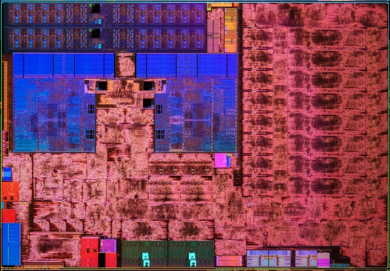
Modern Systems are Powered by Heterogeneity
6th Gen. AMD A-Series Processor “Carrizo”
Accelerators from Industry and Academia
Machine Learning
Databases
Computer Vision
Regular Expressions
Physics
Graph Analytics
Finite State Machines
Genome Sequencing
Reconfigurable (e.g., FPGA)
Video Decode
Video Encode
CPUs
GPU

Slide 3
Traditional Heterogeneous Computing Driven by CPUs
CPU
Data Transfer
Accelerator
Work launched by the CPU to accelerators
Data marshalled by the CPU
Communication and computation are coarse-grained

Slide 4
Modern Accelerators are Equal Partners
CPU
Data Transfer
Accelerator
Accelerators and CPUs can launch work to one another (and themselves)
Data transfer implicit based on usage
Communication and computation are fine-grained

Slide 5
Accelerators can now Request OS Services
GPU-to-CPU Callbacks (Owens et al., UCHPC 2010)
Page Faults / Demand Paging (Veselý et al., ISPASS 2016)
GPU-Initiated Network Requests (GPUnet, USENIX 2014)
GPU-Initiated File System Requests (GPUfs, ASPLOS 2013)
“Generic” System Calls (Genesys, ISCA 2018)
ioctl() for other devices
Memory management (e.g., sbrk(), mmap())
Signals

Slide 6
How a GPU System Service Request Is Handled
3a
3b
CPU 2
CPU 1
CPU 0
GPU
2
Step 1: Set up request arguments in memory
Step 2: Send request interrupt to a CPU
Step 3: (a) Schedule bottom-half handler
(b) ACK request to GPU
1
Memory

Slide 7
How a GPU System Service Request Is Handled
4b
3a
3b
CPU 2
CPU 1
CPU 0
GPU
2
Step 4: (a) Set up kernel work queue arguments
(b) Queue worker thread
1
4a
Memory

Slide 8
How a GPU System Service Request Is Handled
4b
3a
3b
CPU 2
CPU 1
CPU 0
GPU
2
6
Step 5: Perform SSR
Step 6: Send response to GPU
5
1
4a
Memory

Slide 9
System Service Requests Can Lead to Difficulties
GPUs and accelerators can request OS (system) services
These SSRs can interfere with unrelated CPU-based work
Unrelated CPU-Based work can slow down GPU SSR handling
CPUs lose opportunity to sleep because of GPU SSRs

Slide 10
Modes of Interference from GPU SSRs
GPU
GPU Stalls….
2
3
CPU0
3a
4
CPU1
4b
5
CPU2
4b
3a
3b
CPU User Work
GPU User Work
6
2
Mode/Task Switch
Kernel Task Operation
5
4a
1
Low-Performance User-Mode Operation

Slide 11
Modes of Interference from GPU SSRs
GPU
GPU Stalls….
2
3
CPU0
3a
4
CPU1
4b
5
CPU2
Direct CPU Overheads
Indirect CPU Overheads
GPU Overheads

Slide 12
Test Platform Used to Demonstrate this
AMD A10-7850K APU
4x 3.7 GHz CPU cores. AMD Family 15h Model 30h
720 MHz AMD GCN 1.1 (“Sea Islands”, gfx700) GPU, 8 CUs
32 GB Dual-Channel DDR3-1866
Ubuntu 14.04.3 LTS (AMD64)
Linux® kernel 4.0.0 with HSA Drivers (amdkfd 1.6.1)
PARSEC benchmarks for “CPU work”
OpenCL™ benchmark applications modified to create SSRs (page faults)
BPT [Veselý et al., ISPASS 2016]
XSBench [Veselý et al., ISPASS 2016]
SHOC BFS
SHOC SpMV
Pannotia SSSP
µBenchmark

Slide 13
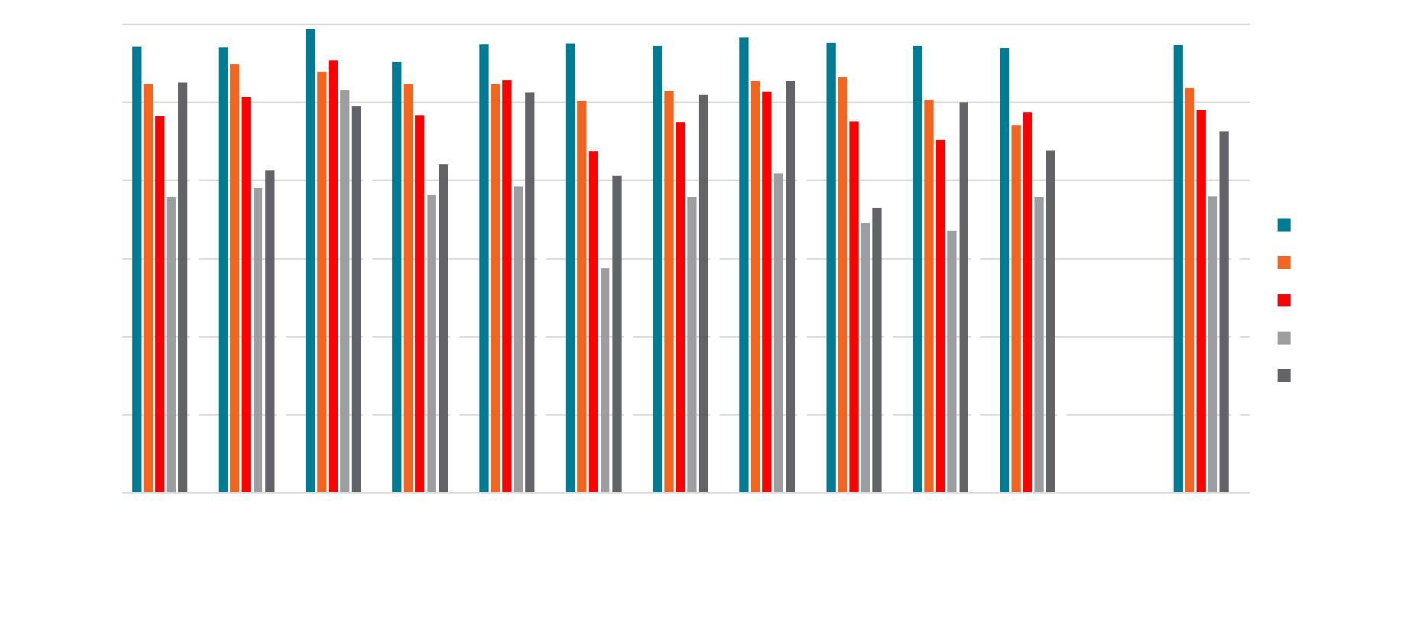
CPU Performance W/ SSR-Using GPU Applications

Slide 14
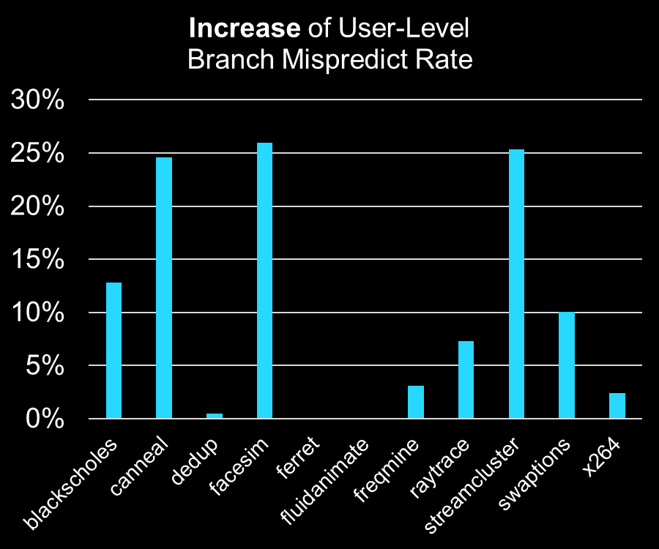
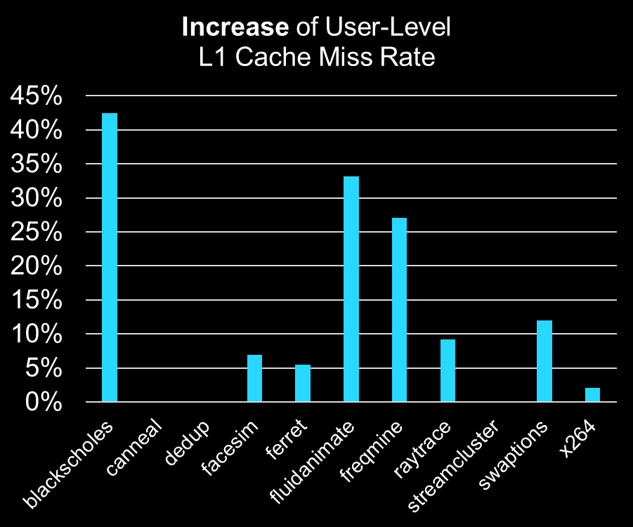
Indirect CPU Overheads from GPU SSRs

Slide 15
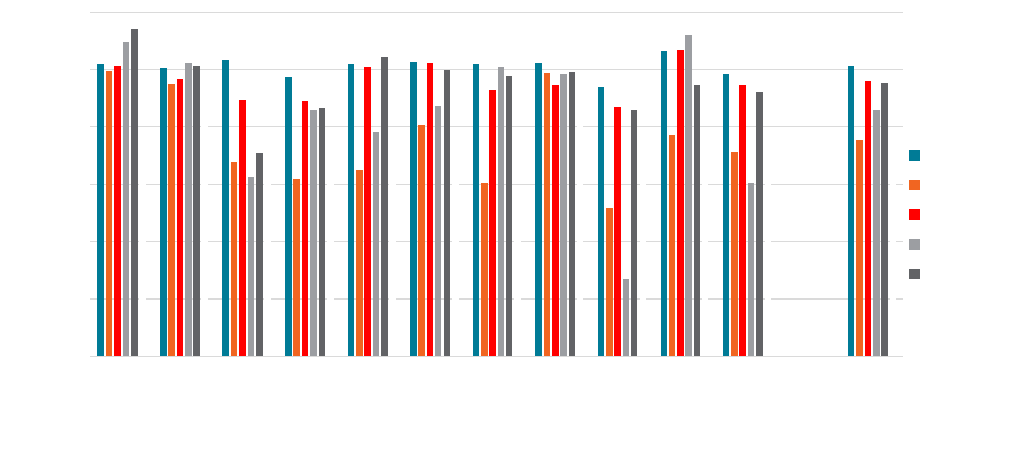
GPU Performance w/ Concurrent CPU Apps
CPU cores avoid going to sleep, which can increase responsiveness to GPU requests

Slide 16
Interrupt Coalescing
Mitigation Strategies
Interrupt Steering
take inspiration from other domains (e.g. high performance Networking)
Merged SSR Handlers
Driver for Enforcing CPU QoS

Slide 17
Mitigation: Interrupt Coalescing
GPU
GPU Stalls….
2
3
Take fewer interrupts and
see less indirect user-level overhead
But more likely to stall the GPU
CPU0
3a
4
CPU1
4b
5
CPU2
4b
3a
3b
Wait until multiple SSR requests arrive before interrupting CPU core
6
2
5
4a
1

Slide 18
Mitigation: Interrupt Steering
GPU
GPU Stalls….
2
3
Limit how many cores are affected. Reduce global indirect overheads.
But harms fairness!
CPU0
3a
4
CPU1
4b
5
CPU2
4b
3a
3b
Ensure that all interrupts go to the same core, rather than round-robin to all cores
6
2
5
4a
1

Slide 19
Mitigation: Merged SSR Handler
GPU
GPU Stalls….
2
3
Fewer interrupts and less indirect overhead.
Handle GPU requests with much less latency.
But runs more CPU code in high-priority context!
CPU0
3a
4
CPU1
4b
5
CPU2
4b
3a
3b
Merge SSR pre-proceeding (4) with interrupt handler (3)
6
2
5
4a
1

Slide 20
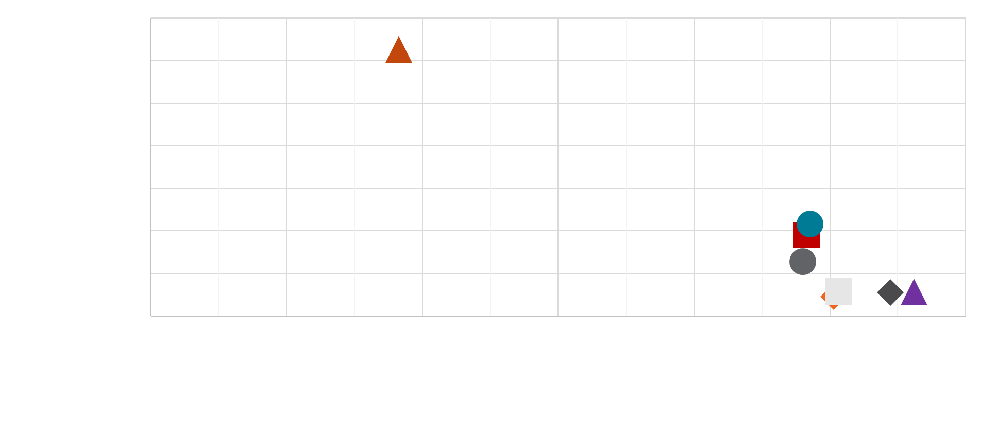
Pareto Curve of Mitigation Strategy Tradeoffs
Merged Handler
Interrupt Steering + Interrupt Coalescing
Interrupt Steering +
Merged Handler
Default

Slide 21
Driver Modifications To Ensure CPU QoS
4b
3a
3b
CPU 2
CPU 1
CPU 0
GPU
2
6
5
1
4a
Memory

Slide 22
Driver Modifications To Ensure CPU QoS
4b
3a
3b
CPU 2
CPU 1
CPU 0
GPU
2
Governor in Driver
5
6
Step 5: Track SSR overheads + delay step 6 to stall the GPU
1
4a
Memory

Slide 23
Governor to Control CPU QOS
CPU Cycles Handling SSRs > Threshold
Delay ← Delay*2
N
Delay == 0?
Y
N
Delay ← 0
Y
Delay ← 10 µsec
Sleep ‘Delay’ µsec
Service SSR and Return GPU Result

Slide 24
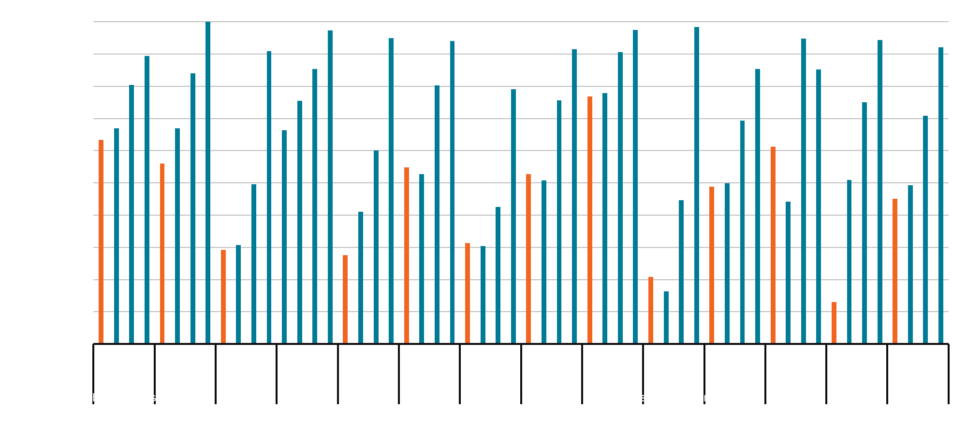
CPU Performance at Different QOS Levels

Slide 25
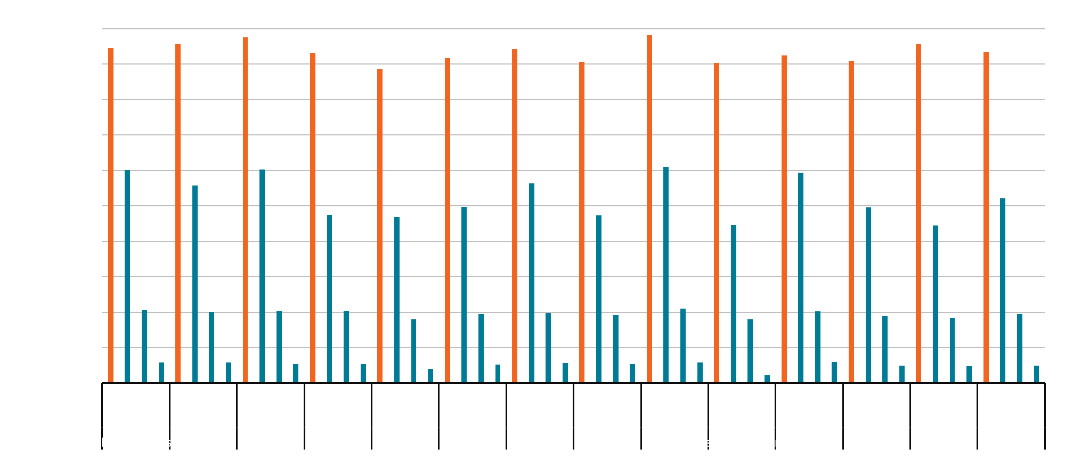
GPU Performance Suffers for CPU QOS

Slide 26
Summary
Heterogeneous systems can include increasingly more accelerators
GPUs and accelerators now request system services
These can cause interference between accelerators & unrelated CPU work
Problem may worsen in the future
Existing mitigation strategies help, but are not complete solution

Slide 27
Questions?
Disclaimer
The information presented in this document is for informational purposes only and may contain technical inaccuracies, omissions and typographical errors.
The information contained herein is subject to change and may be rendered inaccurate for many reasons, including but not limited to product and roadmap changes, component and motherboard version changes, new model and/or product releases, product differences between differing manufacturers, software changes, BIOS flashes, firmware upgrades, or the like. AMD assumes no obligation to update or otherwise correct or revise this information. However, AMD reserves the right to revise this information and to make changes from time to time to the content hereof without obligation of AMD to notify any person of such revisions or changes.
AMD MAKES NO REPRESENTATIONS OR WARRANTIES WITH RESPECT TO THE CONTENTS HEREOF AND ASSUMES NO RESPONSIBILITY FOR ANY INACCURACIES, ERRORS OR OMISSIONS THAT MAY APPEAR IN THIS INFORMATION.
AMD SPECIFICALLY DISCLAIMS ANY IMPLIED WARRANTIES OF MERCHANTABILITY OR FITNESS FOR ANY PARTICULAR PURPOSE. IN NO EVENT WILL AMD BE LIABLE TO ANY PERSON FOR ANY DIRECT, INDIRECT, SPECIAL OR OTHER CONSEQUENTIAL DAMAGES ARISING FROM THE USE OF ANY INFORMATION CONTAINED HEREIN, EVEN IF AMD IS EXPRESSLY ADVISED OF THE POSSIBILITY OF SUCH DAMAGES.
AMD, the AMD Arrow logo, and combinations thereof are trademarks of Advanced Micro Devices, Inc. Linux is a registered trademark of Linus Torvalds. OpenCL is a trademark of Apple Inc. used by permission by Khronos. Other names used herein are for identification purposes only and may be trademarks of their respective companies.

Slide 28
Backup Slides

Slide 29
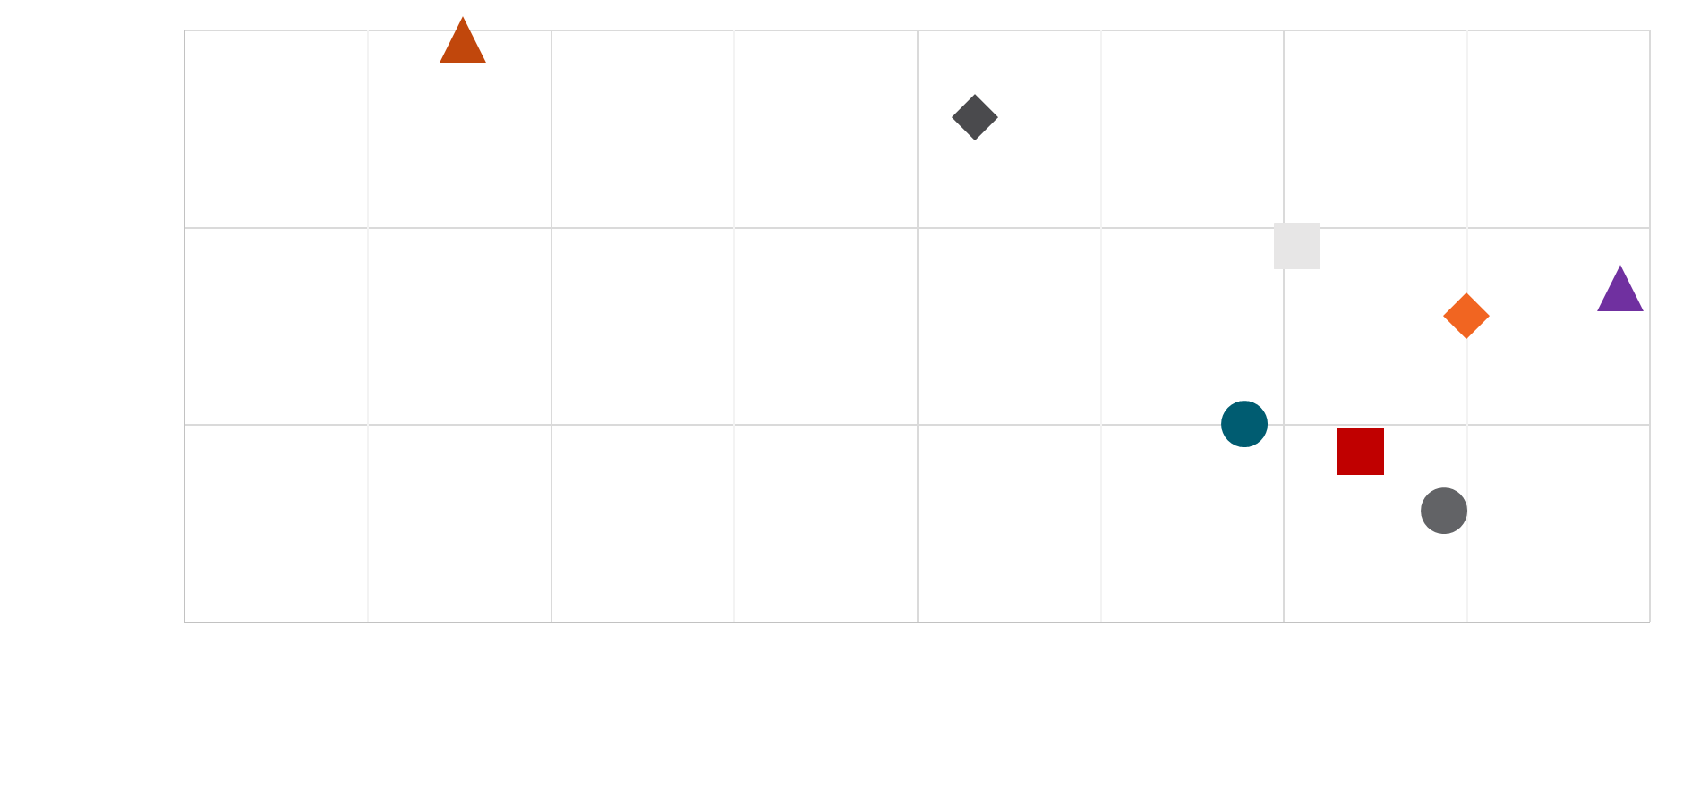
Pareto Curve of Mitigation Strategy Tradeoffs
Interrupt Steering + Interrupt Coalescing
Merged Handler
Merged Handler + Interrupt Coalescing
Merged Handler + Interrupt Steering + Coalescing
Interrupt Coalescing
Merged Handler + Interrupt Steering
Default
Interrupt Steering

Slide 30
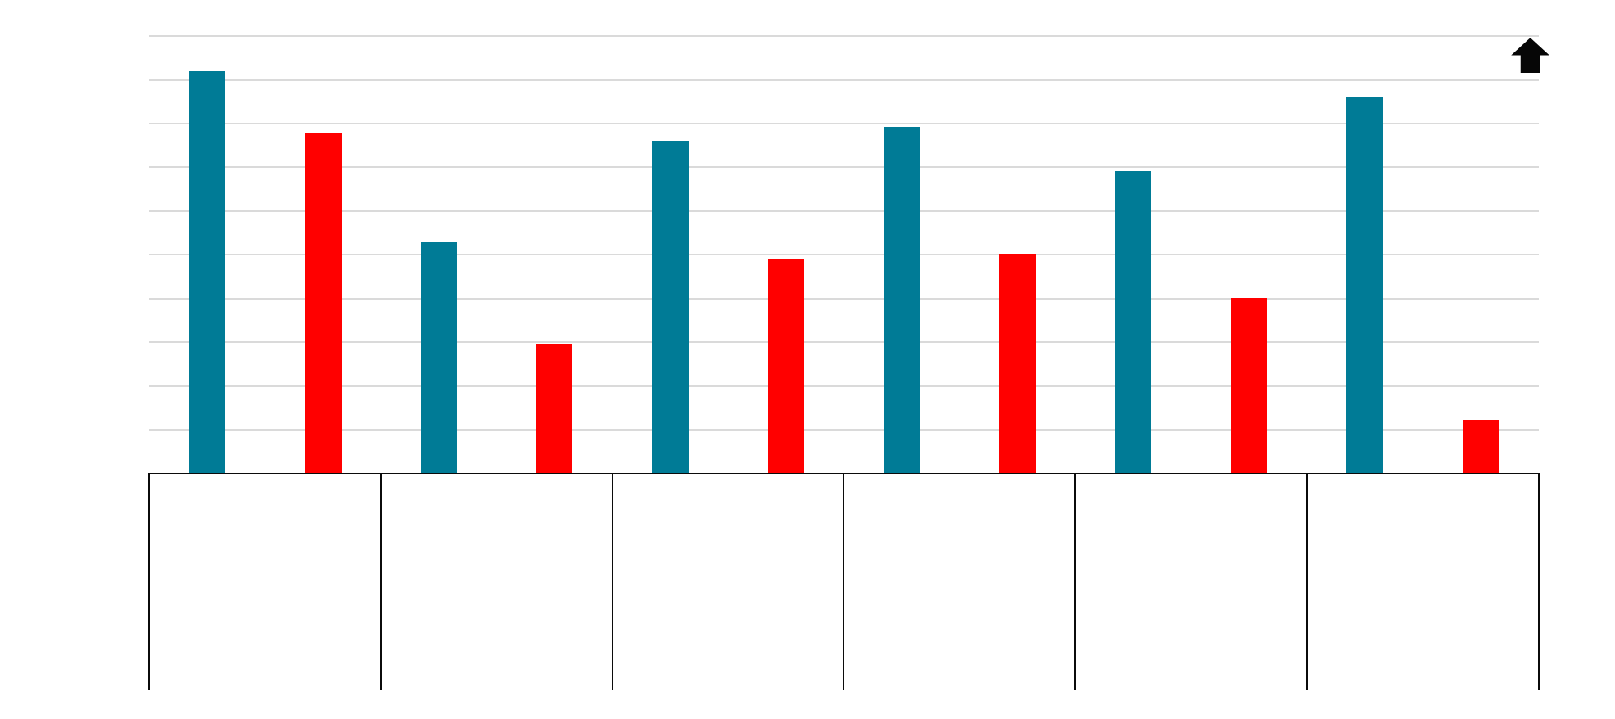
SSRs Limit Low-Power Sleep States

Slide 31
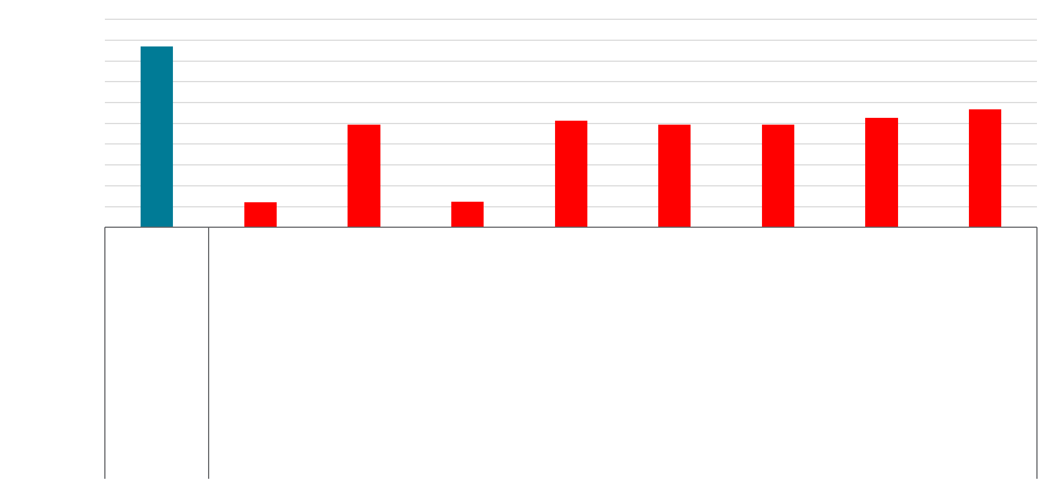
Mitigation Effect on Sleep States

