Slide 1


Demand-Driven Software Race Detection using Hardware Performance Counters
Joseph L. Greathouse†, Zhiqiang Ma‡, Matthew I. Frank‡ Ramesh Peri‡, Todd Austin†
†University of Michigan
‡Intel Corporation
ISCA-38
June 6, 2011
Notes:
Transition: Why am I standing in front of a computer architecture conference talking about software data race detectors?

Slide 2
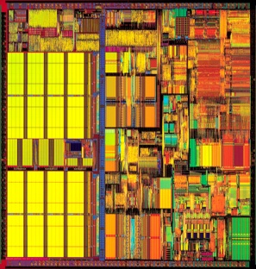
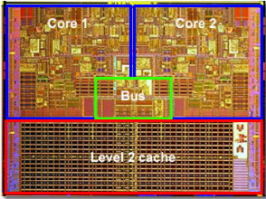
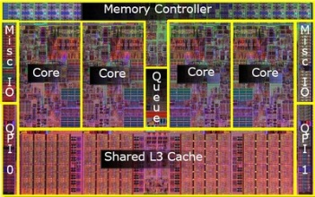
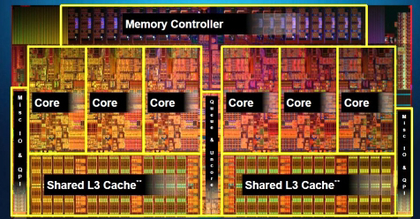
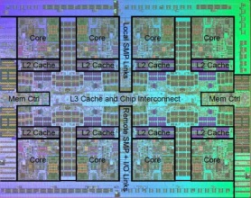
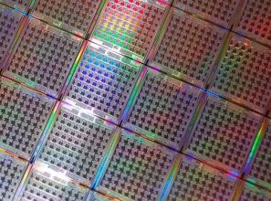
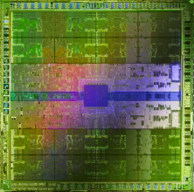



Concurrency Bugs Still Matter
In spite of proposed hardware solutions
Bulk Memory Commits
Hardware Data Race Recording
Deterministic Execution/Replay
TRANSACTIONAL
MEMORY
Bug-Free Memory Models
Atomicity Violation Detectors
Sun
Rock?
AMD
ASF ?
Notes:
I’m here because concurrency bugs still matter, and as I’ll show today, existing hardware can help. Architects have begun to rely on larger degrees of parallelism to increase the performance of their chips. As we’ve moved from *click*
one to two to four to six to eight to 100 to 400+ cores, life has become more complicated for software developers. SW requires more parallelism each generation, but concurrency bugs remain a vexing problem. *click*
This is in spite of research over the last decade into hardware to help solve such problems. Works such as *click*
Hardware race recorders, deterministic execution systems, atomicity violation detectors, bug-free memory models, bulk commits and *click*, transactional memory.
Unfortunately, none of these proposals have made their way into existing hardware. The closest thing we have to real HW for concurrency bug mitigation are *click*
transactional memory proposals like Sun’s Rock and AMD’s Advanced Synchronization Facility. These may or may not end up in released products. The point remains, however, that there is little existing hardware support for fixing concurrency bugs. That’s a problem, because ➔

Slide 3
Concurrency Bugs Matter NOW
Thread 1
Thread 2
mylen=small
mylen=large
TIME
if(ptr==NULL)
if(ptr==NULL)
len2=thread_local->mylen;
ptr=malloc(len2);
Nov. 2010 OpenSSL Security Flaw
len1=thread_local->mylen;
ptr=malloc(len1);
memcpy(ptr, data1, len1)
memcpy(ptr, data2, len2)
ptr
LEAKED
∅
Notes:
Concurrency bugs matter right now. Let me go through an example of a pretety severe concurrency error from only a few months ago. This was a data race in OpenSSL that ended up allowing remote code exploitation, a worrisome security flaw. *click*
This code checks a global pointer, and if it is null, attempts to allocate a buffer of thread-local size, then copy some thread-local data into it. However, there are no locks, so problems can arise when two copies of this code are run in parallel. In this schedule, the accesses to the global pointer are interleaved in a particularly bad way *click*
In this case, thread 1 checks the global pointer to see if it should allocate a buffer. The pointer is null, so it will attempt to do so *click*
Thread 2 does the same. *click*
In this dynamic instruction ordering, thread 2 then allocates a large buffer to the global pointer, based off its thread-local length. *click*
Thread 1 then attempts to do the same, allocating a small buffer to the global pointer. The first thing to notice here is that the large buffer has now been leaked. *click*
Thread 1 then successfully copies its small amount of data into the small buffer *click*
The question then becomes: what happens when thread 2 attempts to copy its data into the global buffer? *click*
In this case, a large amount of data is copied into the small buffer, resulting in a buffer overflow that could lead to security problems such as heap smashing attacks.
Errors such as this are why concurrency bugs are important. ➔

Slide 4
This Talk in One Sentence
Speed up software race detection with existing hardware support.
Notes:
The point of this talk, then, is to describe a way to use existing hardware to make debugging parallel programs faster.
Now, because concurrency bugs matter, and because they can’t wait for hardware to solve the problem some day, software developers have come up with techniques such as SOFTWARE DATA RACE DETECTION to find flaws in parallel programs. As the title of this talk suggests, we’ll start by looking into software data race detectors, then find ways to make them better. ➔

Slide 5
Software Data Race Detection
Add checks around every memory access
Find inter-thread sharing events
Synchronization between write-shared accesses?
No? Data race.
Notes:
A dynamic software data race detector is a tool that adds analysis checks around the memory accesses in a program. These checks look for a number of things in order to identify possible data races.
First: They determine if a memory operation is participating in an inter-thread sharing event. This checks if one thread has written to a shared variable that another thread has read from or written to recently. In other words, does this access move information from one thread to another.
Next: If two accesses are participating in a sharing event, the software race detector then checks if there is some kind of synchronization point between the memory operations. This could be a lock, mutex, memory fence, etc. If no such synchronization point exists, then it would be possible to reorder these accesses in such a way that the output of the program could be affected. In other words, this memory operation is participating in a data race. The SW detector would then record this along with some amount of debugging information and report it to the developer.
Let’s show how this type of analysis would work on our previous example ➔
NOTE: You have to check each access, because if their dynamic orders change, races can appear different places.
(It has been shown that some accesses can be statically proven to not contain races– you need not check those. Not the focus of this work).

Slide 6



Example of Data Race Detection
Thread 1
Thread 2
mylen=small
mylen=large
TIME
if(ptr==NULL)
len1=thread_local->mylen;
Interleaved Synchronization?
ptr write-shared?
ptr=malloc(len1);
memcpy(ptr, data1, len1)
if(ptr==NULL)
len2=thread_local->mylen;
ptr=malloc(len2);
memcpy(ptr, data2, len2)
Notes:
*click* When the first memory operation is executed, the race detector runs its checks for inter-thread sharing and interleaved synchronization. In this example, the global pointer has yet to be shared with another thread, so the detector will declare this access race-free. *click*
*click* The same checks occur on each of the subsequent memory accesses. Because none of these accesses cause write-sharing to the pointer, they are also marked as data-race free, and the program continues as normal.
*click* When we run the code snippet in the second thread, it again is run through the race detection algorithm. *click*
The first thing the race detector looks for is an inter-thread sharing event. In particular, it is checking if one or both threads that access a variable wrote to it recently. In this case, this access causes write-sharing to occur, as Thread 1 wrote to the pointer, and Thread 2 is reading it. *click*
The next check is to see if there is a synchronization operation interleaved with these two accesses. Because this is not the case *click*
The race detector considers this access a data race and will emit the appropriate debugging information. One of the powers of a tool like a software race detector is that it is able to observe this data race even though the output of the program with this dynamic instruction ordering is correct. Unfortunately, software race detectors also have their down-sides. ➔

Slide 7
SW Race Detection is Slow
Phoenix
PARSEC
Notes:
In particular, SW data race detection is extremely slow. This chart shows the slowdowns caused by a commercial software data race detector over a series of multi-threaded benchmarks. The X-Axis lists the benchmarks across these two suites, as well as the geometric means within each suite. The left side is the Phoenix shared-memory MapReduce suite, while the right is the PARSEC suite.
The Y-Axis shows the slowdown caused by the data race detector over running the benchmarks normally. This lists slowdowns in multiples, such as a “100 times slowdown”, not percentages. The Dashed line is illustrative of a 75x slowdown.
As you can see, SW race detection can significantly impact the performance of the application under test. The geometric mean across the Phoenix suite is an 83x, while the PARSEC suite sees a 75x slowdown. Some applications, such as matrix_multiply, are much worse, seeing nearly 300x performance decreases. This is unfortunate for a dynamic analysis tool, as it can severely limit the number of inputs and thread schedules you can test before shipping the program. ➔

Slide 8
Goal of this Work
Accelerate Software Data Race Detection
Technique #1: Making it Fast
Demand-Driven Data Race Detection
Technique #2: Keeping it Real
Find sharing events with existing HW
Notes:
Therefore, the goal of this work is to improve parallel program debugging by accelerating software data race detection. We do this using two techniques.
The first is demand-driven data race detection. This means enabling the software data race detector only when it absolutely must run. If many of the memory accesses that go through a software race detector need not be checked, we can potentially speed up the analysis a great deal.
Our second technique for accelerating race detection is to design a mechanism for observing sharing events with existing hardware. Though it is possible to detect inter-thread sharing in software, or to design new hardware to do so, both have their downsides. We avoid these pitfalls with our design, and use it to build our demand-driven race detector on a real system.

Slide 9
Inter-thread Sharing is What’s Important
“Data races ... are failures in programs that access and update shared data in critical sections” – Netzer & Miller, 1992
Thread-local data
NO SHARING
TIME
if(ptr==NULL)
len1=thread_local->mylen;
ptr=malloc(len1);
Shared data
NO INTER-THREAD SHARING EVENTS
memcpy(ptr, data1, len1)
if(ptr==NULL)
len2=thread_local->mylen;
ptr=malloc(len2);
memcpy(ptr, data2, len2)
Notes:
The first question we must answer when looking to speed up race detection is: WHY is software race detection stuff so slow? *click*
A major part of the problem is the requirement that we send every memory access through the complicated race detection algorithm.
In fact, as Netzer and Miller described in the 1992 paper formalizing race conditions, data races are bugs that occur when a program _accesses shared data_. This means that some of the checks in this example are completely unnecessary.
For instance, *click* the second dynamic memory operation shown here is completely thread-local. It is impossible for this access to cause a data race, as this is not shared data. *click*
In a related manner, while the third and fourth memory operations operate on shared data *click*, they are not participating in dynamic inter-thread sharing events. Both dynamic accesses to the shared global pointer only occur within a single thread, so they cannot participate in a race that is not caught by the first check. *click*
So as we can see, out of this five instructions we originally sent through the race detector, only two (or maybe one, depending on what happens before these snippets are run) need to be sent through the slow software race detection algorithm. ➔

Slide 10
Very Little Inter-Thread Sharing
Phoenix
PARSEC
Notes:
In fact, this lack of inter-thread sharing events is even more pronounced in real parallel programs. This chart lists the same benchmarks I showed previously, except this Y-Axis lists the percentage of memory operations that are participating in inter-thread sharing events. These may be a little hard to see, so let me zoom in so that the Y-Axis is from 0 to 3%, rather than 0 to 100. *click*
The Phoenix suite has very little data sharing, as to be expected of data-parallel programs build using MapReduce style parallelism.
The PARSEC suite has many different styles of parallelism, and thus each program has different amounts of sharing events. Still, even the benchmark with the highest amount of sharing, dedup, has less than 3% of its memory operating actively participating in sharing events.
These numbers make sense, since well-written, scalable parallel programs try to avoid inter-thread sharing. Communication between threads can become very expensive as the execution cores become further apart. Even shared variables should attempt to stick to a single core for long periods of time to avoid the overheads of data movement.
We can take advantage of this fact, therefore, to accelerate our data race detector. ➔
NOTE: ferret is missing because the version of Pin we used to find these numbers had an internal error that crashed while running it.

Slide 11

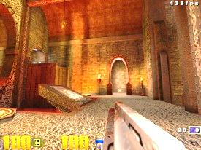


Technique 1: Demand-Driven Analysis
Software Race Detector
Software Race Detector
Multi-threaded
Application
Inter-thread sharing
Local Access
Inter-thread Sharing Monitor
Notes:
Because these local accesses cannot be the cause of a race, sending them through the race detector is a waste of time. Therefore, demand-driven race detection is a technique that only sends instructions through the software race detector if they’re participating in an inter-thread sharing event.
Let me try to illustrate this point. I’m showing a multi-threaded application that’s going to run some instructions from each thread. The software race detector over here would normally receive each of these instructions, grind on it for a while, and then allow the program state to update. Finally, we’ve added this unit at the bottom called the inter-thread sharing monitor. This box will receive instructions and tell us if they’re participating in a sharing event.
{go through example}
What this has allowed us to do is keep the slow race detector disabled for 2 of these 3 instructions. Or, hopefully, for the 97 or more percent of instructions in our benchmarks.

Slide 12
Inter-thread Sharing Monitor
Check each memory op. for write-sharing
Signal software race detector on sharing
Possible to do in software
Can be built now with instrumentation
Slow. May take as long as race detection
Notes:
The big question now becomes: how do we perform this inter-thread sharing detection? It must be able to check each memory operation for active write-sharing with all other thread.
It also must be able to signal the software race detector in some way so that sharing instructions can be caught and analyzed.
Now, the simplest way to do this would be to use binary instrumentation to write a sharing monitor in software. In fact, this is easy enough that it’s been done before. The SW race detector used in this work checks for inter-thread sharing before sending each access through the rest of the race detection algorithm.
As demonstrated by the previous overhead numbers, however, this is slow. It still takes time to run these checks in SW, meaning you may not gain a lot of performance over just running the race detection on every instruction.

Slide 13
Ideal Hardware Sharing Detector
Follow read/write sets of threads
Fast user-level faults
Sharing Monitor
W->R
Sharing
T1
R: ∅
W: {Y}
Thread 1
WRITE Y
T1
R: ∅
W: ∅
T2
R: ∅
W: ∅
Thread 1
WRITE Y
Thread 2
READ Y
Thread 2
READ Y
Multi-threaded
Application
Software Race Detector
Inter-thread Sharing Monitor
Notes:
(NOTE: From here on out, my notes are actual notes instead of a practice script)
So we would like to have a hardware system that does these checks. An idea hardware system would need two big features.
The ability to follow read/write sets between multiple threads. This animation shows one thread writing (changing its write setup in the blue hardware unit) and another thread reading from the same location – This leads to the hardware informing “someone” that W->R data sharing has happened.
However, you also need user-level faults. If, instead, you take SLOW kernel faults on every sharing event, you may spend FAR more time in the sharing monitor, trying to turn on the race detector, than you gain back by skipping race detection. That’s what this animation attempts to show.

Slide 14
Limitations of Existing Hardware
Fast faults
Solution: Enable detector for long periods of time
Read/write sets
Solution:
Multi-threaded
Application
Software Race Detector
NO SHARING
Inter-thread Sharing Monitor
Notes:
Real hardware doesn’t have those things. So what if we want to build this system right now? Is there any way around the lack of these mechanisms?
To avoid the need for user-level fast faults, you can enable the detector for a long time. This means that, while you’ll take a slow kernel fault on a sharing event, you’ll amortize this slowdown because you’ll skip most of them by having the detector already on (and send instructions through it rather than through the sharing detector). While you may send non-shared instructions through the detector, if the theory that “shared instructions are dynamically next to one another”, then you’ll still keep the detector off most of the time and get speedups.
The solution to the read/write set problem is our second technique:

Slide 15
Technique 2: Hardware Sharing Detector
Hardware Performance Counters
Interrupt on cache coherency events
Intel’s HITM event: W→R Data Sharing
Limitations of this method:
SMT sharing can’t be counted
Cache eviction
Others in paper
S
S
HITM
M
I
Notes:
We can use hardware performance counters to detect inter-thread sharing events. In other words, these can be used to, in a sense, take the place of read/write sets. On the Nehalem-and-newer processors from Intel, there is a cache event called (colloquially) “HITM” that indicates that a cache-line in processor 1 is in the modified state, and another processor tries to load some piece of data from the cache line.
The hardware performance counters on Nehalem+ processors can count this event. Therefore, if you set the counter to -1, you can take a fault to the kernel any time one thread (processor) reads data written by another. The handler can set the counter back to -1 and then take another fault the next time the HITM event happens. This is indicative of write-to-read (W->R) data sharing between two threads.
There are limitations to this, however.
Hyper-Threading (SMT) doesn’t play well with this. If two threads are on the same core, their sharing will take place in the same local cache and therefore not cause a HITM event. We solved this by disabling hyper-threading.
If one thread writes a piece of data and then evicts it from the cache before a second thread reads it, the second thread will handle this miss through the LLC or main memory. This also won’t cause a HITM event.
There are others listed in the paper. Probably the biggest ones are that we can’t DIRECTLY observe W->W and R->W sharing. (We can solve W->W but R->W will need different performance counter events). Note that we can still observe W->W and R->W data races if they occur in the time period where we’re keeping the race detector enabled after seeing an event.

Slide 16
Demand-Driven Analysis on Real HW
Execute Instruction
NO
HITM
Interrupt?
NO
Analysis
Enabled?
Disable Analysis
YES
YES
NO
Enable Analysis
SW Race Detection
Sharing Recently?
YES
Notes:
This shows a high-level overview of the total algorithm for how to perform demand-driven race detector within the limitations of current hardware.
You start by executing an instruction
Before finishing any memory operation, you need to see if your software race detector is enabled. (We do this with binary instrumentation, the same way we do race detection)
If it’s enabled, run the instruction through the software racedetector.
The SW RD also keeps track of whether sharing is happening. So after finishing the detection on this instruction, check to see if any “recent” instructions have shared data between two threads.
If so, great, continue in this loop.
If not, however, you can disable your race detector and leave the “race detect all instructions for some period of time” part of the algorithm.
That means when you run the next instruction, rather than going down to the SW race detector, you instead simply execute the instruction and see if hardware interrupts you with a HITM event.
If so, enable the race detector and run this instruction through it.
However, if the hardware doesn’t inform you of a HITM event, then this instruction can commit with no more overhead.
What we’d like to see happen is that we execute within the loop in the red box. In this case, the only overhead we’ll see is the overhead of checking to see if analysis is enabled (and this can be eliminated if you, for instance, keep two copies of the code around, as has been proposed in the literature and as Pin enables you to do with some effort. We don’t do this however). Before the “HITM interrupt” box takes no time (it’s done in hardware), this can result in a big performance win.

Slide 17
Experimental Evaluation
Modified Intel Inspector XE Race Detector
Linux on 4-core Core i7, no Hyper-Threading
Performance Tests:
Phoenix Suite
PARSEC
Accuracy Tests:
Phoenix Suite
PARSEC
Pre-release version of RADBench
Simulation
Notes:
We built this demand-driven system into Intel’s Inspector XE race detector, a commercial happens-before race detector built using Pin. We ran all of our tests on a quad core Core i7 Nehalem processor with SMT disabled, and this system was running Linux with a custom kernel driver to interface with the performance counters.
We had two categories of tests to verify that this system works. The first set were performance tests to verify that this demand-driven scheme shown on the previous slide actually accelerates a software data race detector. For this, we ran two different benchmark suites (which were also used to gather the race detector slowdowns shown earlier in the talk). The Phoenix shared memory map-reduce suite out of Stanford is a collection of small data parallel applications that are basically a best-case scenario for our demand-driven tool. Because there are only a few hundred inter-thread sharing events within the billions of dynamic instructions in these programs, they should spend the vast majority of their time running on the native hardware.
The PARSEC suite out of Princeton is a collection of concurrent programs with a variety of parallelization styles. Some are highly data parallel (e.g. freqmine), while others use software pipelining, etc. Therefore, we expect to see different degrees of speedups in these benchmarks.
The second set of tests are to ascertain the accuracy of a demand-dirven data race detector versus a continuous-analysis race detector. If our technique were able to speed up analysis but now found no errors, it wouldn’t be worth very much. These tests will compare the percentage of races found with our demand-analysis tool versus all those found with the unmodified tool. This isn’t guaranteed to be all the races in the programs, but it should give us an idea of the tradeoffs caused by our demand-analysis technique.
We first searched for all the races in the performance benchmarks, so that it was possible to directly compare performance vs accuracy. We also added in benchmarks from a pre-release version of the RADBench suite (described in HotPar’11), which contains applications such as the Squid proxy server, Apache httpd server, and Mozilla JavaScript engine. These things are similar to GUI or server apps, in that they’re very heterogeneous code versus the homogenous PARSEC/Phoenix benchmarks.
Last thing to note: these were run on a real computer, not in simulation, so we ran them a number of times and present each bar with a 95% confidence interval.

Slide 18
Performance Difference
Phoenix
PARSEC
Notes:
This shows the performance difference between the continuous-analysis tool (shown earlier in the talk; yellow) versus our demand-driven analysis tool (blue). This has lowered the slowdowns of Phoenix suite from 83x to 8x, and the PARSEC suite from 75x to 25x. However, it’s a little hard to see just what this means as far as improvement, so that’s the next slide.

Slide 19
Performance Increases
Phoenix
PARSEC
51x
Notes:
Note that this graph has a different Y-Axis (both in meaning and in scale). This is the performance improvement (in number of times) of the demand-driven tool over the continuous analysis tool. The Phoenix suite sees a pretty strong set of improvements, with a geometric mean of 10x, while the PARSEC suite is a little lower (as expected) at 3x. Note that matrix_multiply is about 51x faster because it has very little data sharing, but was particularly slow in the continuous analysis tool.
Dashed line is 1x

Slide 20
Demand-Driven Analysis Accuracy
1/1
2/4
2/4
2/4
3/3
4/4
4/4
3/3
4/4
4/4
4/4
Accuracy vs. Continuous Analysis: 97%
Notes:
So, since we were able to get such performance gains, the next important question is what type of accuracy we’re able to see versus the continuous analysis tool. The bubbles here, in particular, are pointing to all the races in Phoenix and PARSEC that had data races observed by the regular Inspector XE. The data in the bubbles shows the proportion of these races that the demand-driven analysis found.
The demand-driven tool found most of these, but it did miss two in the program facesim (which is why this bubble animates red). This was caused by the previously mentioned cache eviction issues. The first write and the subsequent accesses to the variable are so far apart in the program that the data is no longer in the first cache by the time the second access occurs. While we were able to manually schedule the threads such that they were close enough together to be caught, this was labor intensive and was only possible because we knew where the race already was.
The green bubbles denote real races that we were able to report to the PARSEC developers (x264 had already been reported by someone else to those devs, but it was not yet patched in PARSEC.) Our demand-driven tool was able to find these, including one in facesim.
Amusing anecdote: For the race in freqmine, and on the demand-driven tool, we were able to find that there was a race, recompile with debug symbols on, and rerun the benchmark a few times to help hunt down the race all before the continuous analysis tool returned for the first time.
If you add in the RADBench benchmarks (that we don’t show here; check the backup slides), our demand-driven analysis tool was able to detect 97% of the races seen by the continuous analysis tool. The two in facesim were the only ones missed.

Slide 21
Future Directions
Better Performance
Fast user-level faults
Application specific hardware
More Accuracy
Better performance counters
Inform SW on cache evictions/misses
Smooth transition to ideal hardware
Combine sampling & demand-driven analysis
Notes:
There are a number of things you could add to this demand-driven analysis mechanism to make it better, though we only briefly discuss them. For instance, if you had user-level faults, you would be able to get better performance since the race detector could be disabled for longer periods of time. Similarly, if you had some sort of application specific hardware to do the race detection (rather than running e.g. a binary instrumentation software tool), you might be able to eliminate most of the overhead entirely.
Similarly, there are techniques that could yield higher accuracy. Better performance counters, for instance. If a performance counter that could detector when one processor performs a read-for-ownership (RFO) on a line that is shared or exclusive in another cache, we could directly detect R->W sharing. Or if you could inform software of cache evictions and misses (like Informing Memory Operations or ECMon propose to do), we might be able to detect the facesim races that we previously missed.
The point is, however, that you can add these in piecemeal, rather than in one big chunk. This means that our demand-driven software analysis proposal can enable a smooth transition from what we’ve presented here to a potential ideal system with hardware race detection, etc.
Last point: You can probably combine this with sampling. While LiteRace and PACER are great works, doing demand-driven analysis on top of them should allow you to see more races under a particular performance overhead.

Slide 22
BACKUP SLIDES

Slide 23
Concurrency Bugs Matter NOW
Thread 1
Thread 2
mylen=small
mylen=large
Nov. 2010 OpenSSL Security Flaw
if(ptr == NULL) {
len=thread_local->mylen;
ptr=malloc(len);
memcpy(ptr, data, len);
}
Notes:
This example was originally longer.

Slide 24
Concurrency Bugs Matter NOW
Thread 1
Thread 2
mylen=small
mylen=large
TIME
if(ptr==NULL)
len1=thread_local->mylen;
ptr=malloc(len1);
memcpy(ptr, data1, len1)
if(ptr==NULL)
len2=thread_local->mylen;
ptr=malloc(len2);
memcpy(ptr, data2, len2)
ptr
∅
Notes:
This runs OK.

Slide 25
Concurrency Bugs Matter NOW
Thread 1
Thread 2
mylen=small
mylen=large
TIME
if(ptr==NULL)
len2=thread_local->mylen;
ptr=malloc(len2);
memcpy(ptr, data2, len2)
if(ptr==NULL)
len1=thread_local->mylen;
ptr=malloc(len1);
memcpy(ptr, data1 ,len1)
ptr
∅
Notes:
This runs OK.

Slide 26
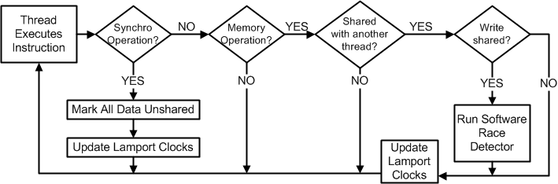
Demand-Driven Analysis Algorithm
Notes:
Original complicated algorithm diagram from the paper.

Slide 27
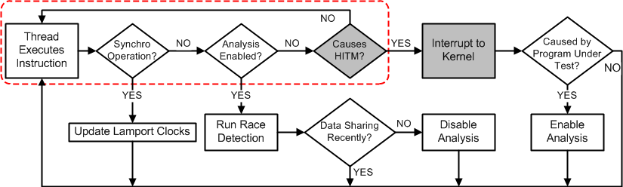
Demand-Driven Analysis on Real HW
Notes:
Other original complicated algorithm diagram from the paper.

Slide 28
Accuracy on Real Hardware
 | kmeans | facesim | ferret | freqmine | vips | x264 | streamcluster
W→W | 1/1 (100%) | 0/1 (0%) | - | - | 1/1 (100%) | - | 1/1 (100%)
R→W | - | 0/1 (0%) | 2/2 (100%) | 2/2 (100%) | 1/1 (100%) | 3/3 (100%) | 1/1 (100%)
W→R | - | 2/2 (100%) | 1/1 (100%) | 2/2 (100%) | 1/1 (100%) | 3/3/ (100%) | 1/1 (100%)
 | kmeans | facesim | ferret | freqmine | vips | x264 | streamcluster
W→W | 1/1 (100%) | 0/1 (0%) | - | - | 1/1 (100%) | - | 1/1 (100%)
R→W | - | 0/1 (0%) | 2/2 (100%) | 2/2 (100%) | 1/1 (100%) | 3/3 (100%) | 1/1 (100%)
W→R | - | 2/2 (100%) | 1/1 (100%) | 2/2 (100%) | 1/1 (100%) | 3/3/ (100%) | 1/1 (100%)
 | Spider Monkey-0 | Spider Monkey-1 | Spider Monkey-2 | NSPR-1 | Memcached-1 | Apache-1
W→W | 9/9 (100%) | 1/1 (100%) | 1/1 (100%) | 3/3 (100%) | - | 1/1 (100%)
R→W | 3/3 (100%) | - | 1/1 (100%) | 1/1 (100%) | 1/1 (100%) | 7/7 (100%)
W→R | 8/8 (100%) | 1/1 (100%) | 2/2 (100%) | 4/4 (100%) | - | 2/2 (100%)
Notes:
Table of all the races. Note that this is when we can detect RFOs that cause HITMs (see the paper.)

