Slide 1
3D Numerical Analysis of Two-Phase Immersion Cooling for Electronic Components
Xudong An, Manish Arora, Wei Huang, William C. Brantley, Joseph L. Greathouse
AMD Research
Advanced Micro Devices, Inc.

Slide 2
Motivation
Cooling solutions for supercomputers
Air cooling
Water cooling
One-phase immersion cooling
Two-phase immersion cooling
Cooling solutions applied in Top50 Supercomputing systems [1]
Air Cooling
Water Cooling
One-phase immersion cooling
Where is two-phase immersion cooling?
[1] “Top 500 supercomputers,” Top 500 list for November 2017. www.top500.org

Slide 3
Introduction
Two phase immersion cooling
Heat release
Power source (CPU, GPU)
Liquid vaporization
Condensing pipe
Chilling facility
Vapor condensing
Liquid vaporizing
Main advantages
High latent heat in liquid vaporization
Less space for heat sink / cold plate
Less cooling energy
Computing rack of two-phase immersion cooling

Slide 4
Introduction
Research goals
Understand impact of two-phase immersion cooling on CPU/GPU processors
Investigate thermal coupling between nearby processors
Obtain capable processor power
Analyze trade-offs in supercomputing system design
Research approaches
Numerical study in ANSYS FLUENT (current work)
Experiment testbed

Slide 5
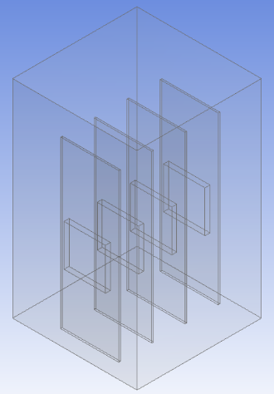
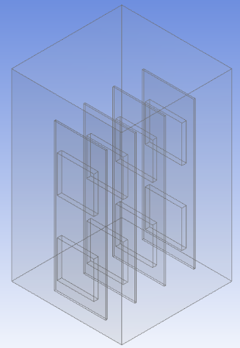
Model configuration
Modeling approach
Main features:
Mimic structure in computing rack
4 boards, 4 or 8 processors
Consider boiling, ignore condensing
4B
2B
3B
4
1B
2
3
1
4A
2A
3A
1A
Simulation geometries in ANSYS FLUENT

Slide 6
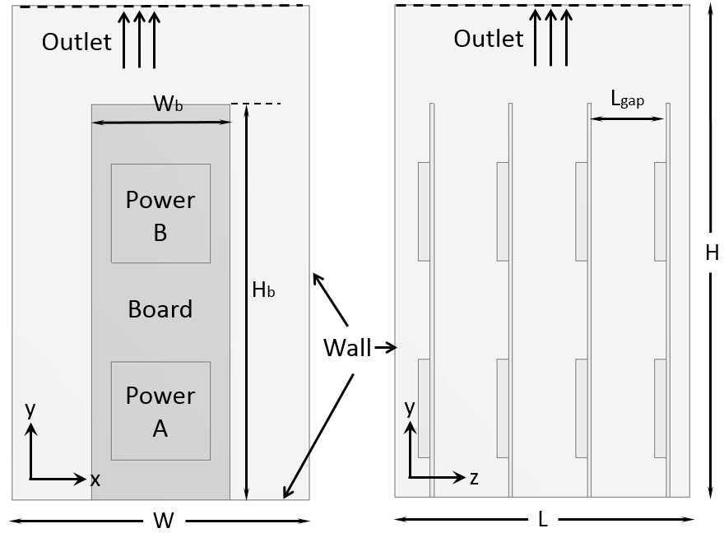
Model configuration
Dimensions and boundary conditions
Dimensions
Simulation zone: 15cm × 25cm × 15cm
Compute board: 7cm × 20cm
Board gap: 3.8cm
CPU package: 5cm × 5cm
Conditions
Cooling liquid: Novec7000 & FC72
Boiling point: 34℃ & 56℃
Subcooling: No
Package power: 50W – 300W
Top of domain: Flow outlet
Model configuration

Slide 7
Model configuration
Governing equations
Mass conservation:
$$\frac{∂ρ}{∂t}+∇∙\left(ρ\vec{v}\right)=0$$
Momentum equation:
$$\frac{∂}{∂t}\left(ρ\vec{v}\right)+∇∙\left(ρ\vec{v}\vec{v}\right)=−∇p+∇∙\left(\overset{̿}{τ}\right)+ρ\vec{g}+\vec{F}$$
Energy conservation:
$$\frac{∂}{∂t}\left(ρh\right)+∇∙\left(ρh\vec{v}\right)=∇∙\left[\left(k+k_{t}\right)∇T\right]+S_{h}$$
Turbulence model:
Standard k - ɛ model
Boiling model:
RPI model

Slide 8
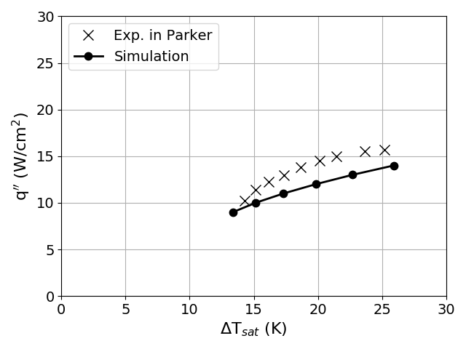
Model validation
Conditions
Cooling liquid: FC72
Boiling point: 56℃
Power source: 1cm × 1cm
Comparison of FLUENT model and experiment data [1]
Comparison data points near CHF
 | q’’ (W/cm²) | ΔT_{sat} (K)
Experiment | 15.7 | 25.2
FLUENT | 14 | 25.9
error | 10% | 3%
[1] Jack L. Parker, and Mohamed S. El-Genk. "Effect of surface orientation on nucleate boiling of FC-72 on porous graphite." Journal of heat transfer 128.11: 1159-1175, 2006.

Slide 9
Numerical simulation
One package on board vs. two packages on board
Phenomenon of liquid vaporization in first 5 seconds when package power is 125W (Blue is liquid phase, red is vapor phase)

Slide 10
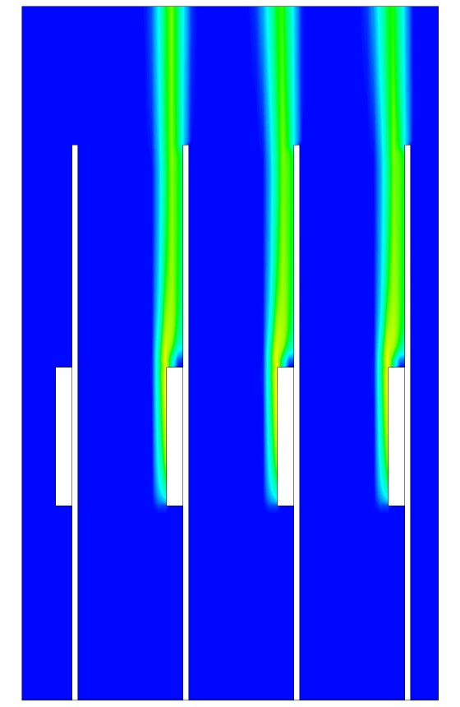
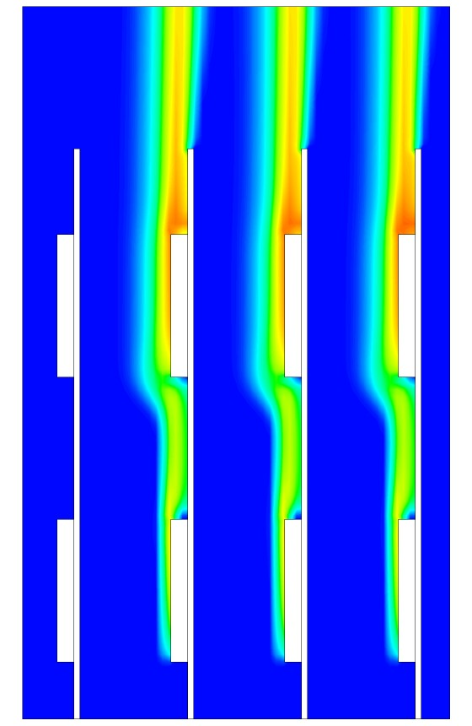
Numerical simulation
One package on board vs. two packages on board
One package
Two packages
Volume fraction contour when package power is 125W (Blue is liquid phase, red is vapor phase)
Upper packages are covered by thicker vapor
Lower packages in “two packages” test and all packages in “one package“ test are covered by thinner vapor and those thicknesses are similar

Slide 11
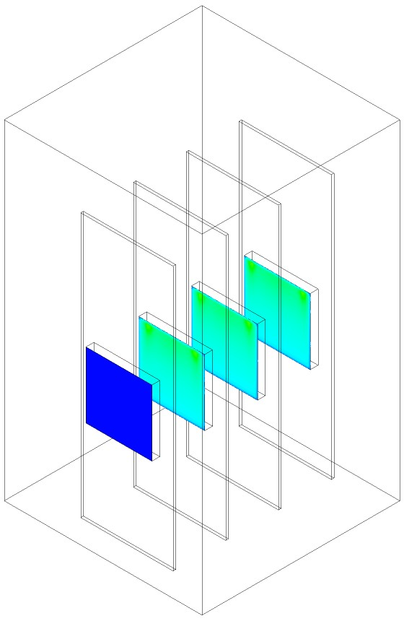
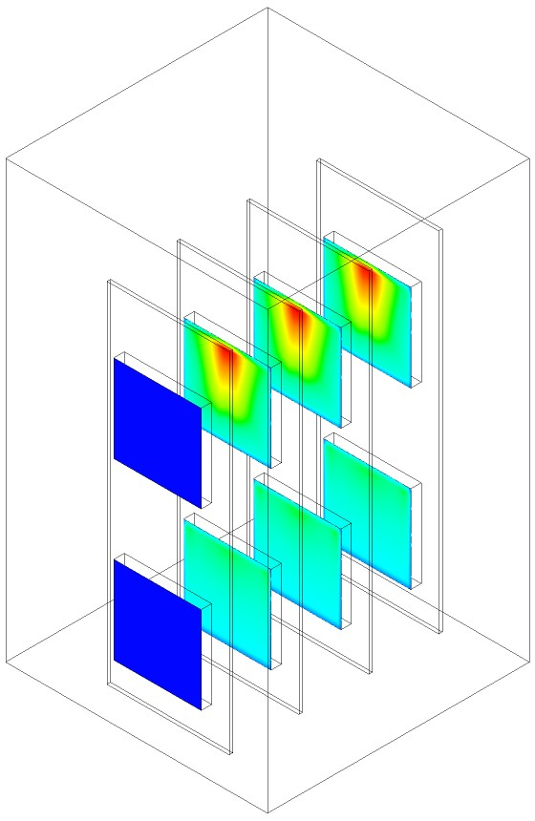
Numerical simulation
One package on board vs. two packages on board
One package
Two packages
Lid temperature contour
Hot zones appear on top central area due to insufficient liquid contact
Temperature maps on “related” packages are similar

Slide 12
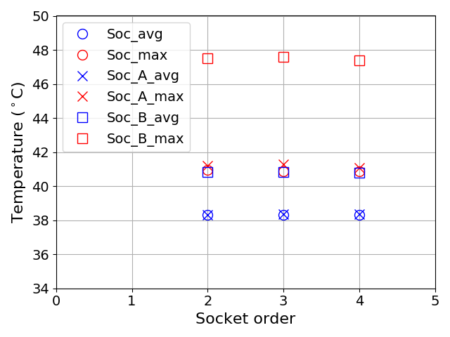
Numerical simulation
One package on board vs. two packages on board
Temperature on each package when power is 125W
Summary
Temperature situations on different boards are almost the same
Lower packages in “two packages” test and all packages in “one package“: same temperature
Upper packages are much hotter than lower packages

Slide 13
Numerical simulation
Two packages on board
50W
150W
250W
Phenomenon of liquid vaporization in first 5 seconds, different power values
(Blue is liquid phase, red is vapor phase)

Slide 14
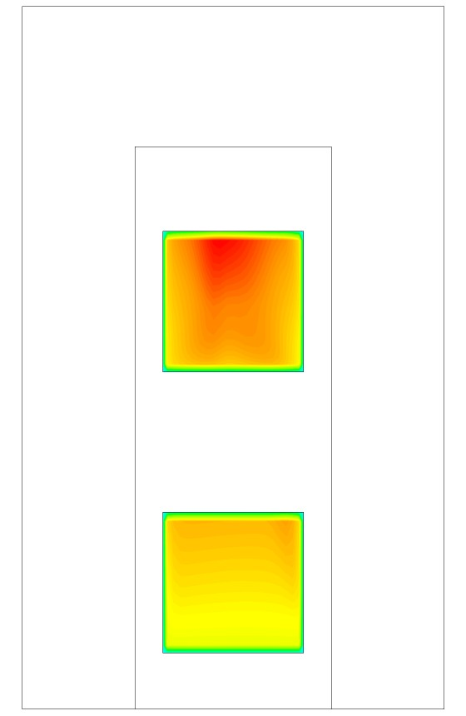
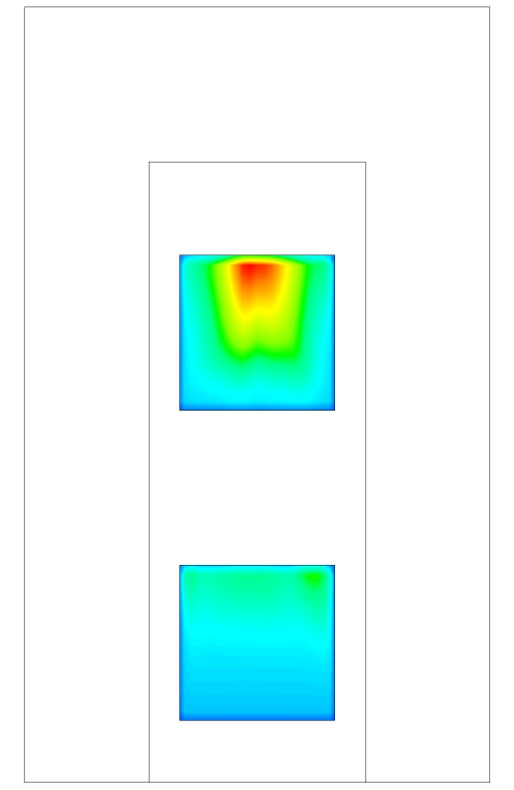
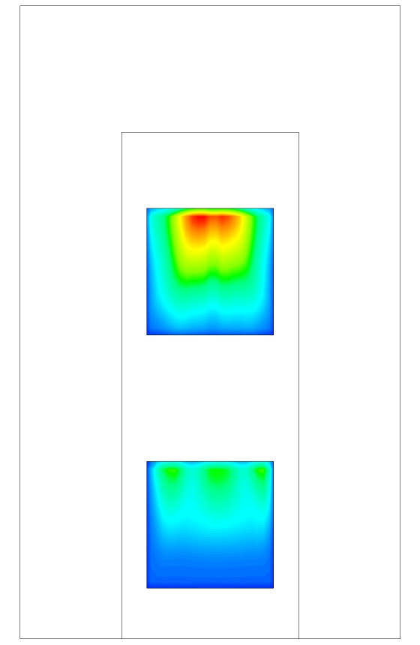
Numerical simulation
Two packages on board
50W
150W
250W
Lid temperature contour on 2nd board from left
When power is higher, temperature gradient on lid is bigger
Temperature gradient on lower package is smaller

Slide 15
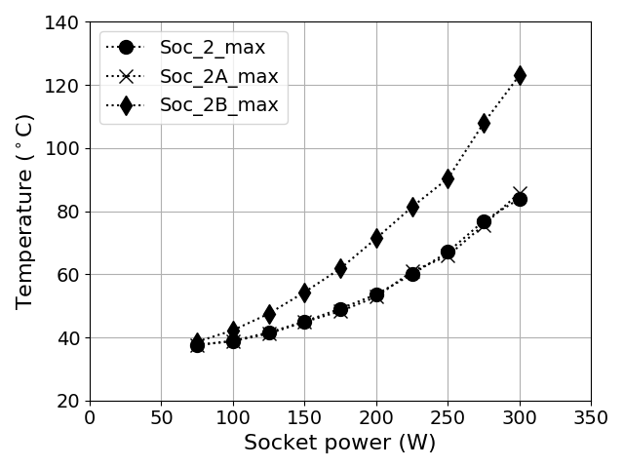
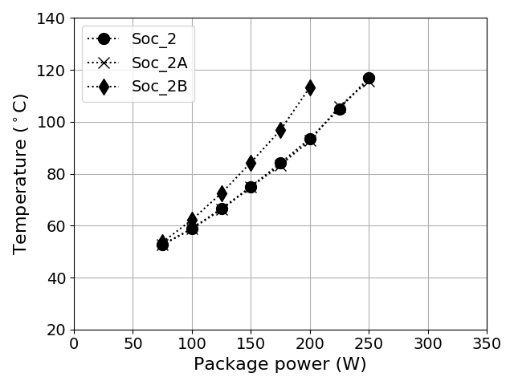
Numerical simulation
Two packages on board
Package power and lid temperature
Package power and temperature on silicon (estimation)
When power rises, temperature increases faster
Assume package thermal resistance is 0.2℃/W (lid to silicon)
In “one package” test, highest capable package power is about 230W
In “two packages” test, highest capable package power is about 180W

Slide 16
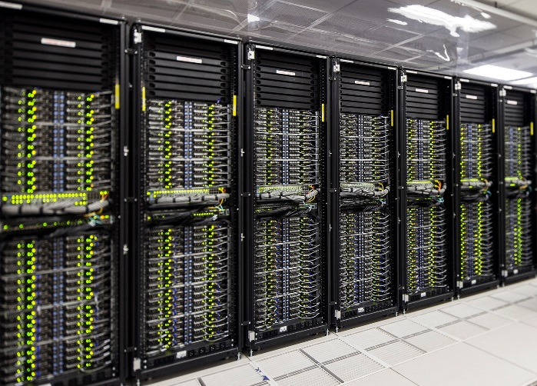
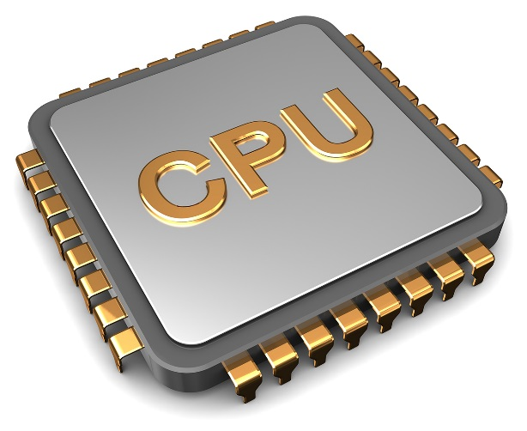
Summary
Macro scale: provide cooling solutions for computing center
Micro scale: provide thermal info for processor design

Slide 17
Thank You – Questions?

Slide 18
Disclaimer & Attribution
The information presented in this document is for informational purposes only and may contain technical inaccuracies, omissions and typographical errors.
The information contained herein is subject to change and may be rendered inaccurate for many reasons, including but not limited to product and roadmap changes, component and motherboard version changes, new model and/or product releases, product differences between differing manufacturers, software changes, BIOS flashes, firmware upgrades, or the like. AMD assumes no obligation to update or otherwise correct or revise this information. However, AMD reserves the right to revise this information and to make changes from time to time to the content hereof without obligation of AMD to notify any person of such revisions or changes.
AMD MAKES NO REPRESENTATIONS OR WARRANTIES WITH RESPECT TO THE CONTENTS HEREOF AND ASSUMES NO RESPONSIBILITY FOR ANY INACCURACIES, ERRORS OR OMISSIONS THAT MAY APPEAR IN THIS INFORMATION.
AMD SPECIFICALLY DISCLAIMS ANY IMPLIED WARRANTIES OF MERCHANTABILITY OR FITNESS FOR ANY PARTICULAR PURPOSE. IN NO EVENT WILL AMD BE LIABLE TO ANY PERSON FOR ANY DIRECT, INDIRECT, SPECIAL OR OTHER CONSEQUENTIAL DAMAGES ARISING FROM THE USE OF ANY INFORMATION CONTAINED HEREIN, EVEN IF AMD IS EXPRESSLY ADVISED OF THE POSSIBILITY OF SUCH DAMAGES.
ATTRIBUTION
© 2018 Advanced Micro Devices, Inc. All rights reserved. AMD, the AMD Arrow logo and combinations thereof are trademarks of Advanced Micro Devices, Inc. in the United States and/or other jurisdictions. Other names are for informational purposes only and may be trademarks of their respective owners.

