Slide 1
clSPARSE: A Vendor-Optimized Open-Source Sparse BLAS Library
Joseph L. Greathouse, Kent Knox, Jakub Poła*,
Kiran Varaganti, Mayank Daga
*Univ. Of Wrocław & Vratis Ltd.
Notes:
Some of the following slides have text that describe the script for what I wanted to say during the talk. This is not exactly what was said, only a target.

Slide 2
Sparse Linear Algebra
Operate on matrices and vectors with many zero values
Useful in numerous domains
Computational fluid dynamics, other engineering applications
Computational physics, other HPC applications (e.g. HPCG)
Graph algorithms
Requires very different optimizations than dense BLAS
Kernels are often bandwidth-bound
Sometimes lack parallelism
Needs different library support than traditional dense BLAS
Notes:
Before diving into the details of our library, I want to spend a minute discussing sparse BLAS and its importance. You may be familiar with dense BLAS kernels, DGEMM, SGEMM, and the like, but perhaps you are less familiar with sparse algorithms.
Essentially, sparse algorithms operate on data that contains many zero values. For example, I’m illustrating a 2D matrix where the majority of the values are zero, or have no color.
We can skip operations on these zero values -- multiplications by zero, for instance, always produces a result of zero. And we can store only the non-zero values. This allows sparse algorithms allow larger problems to be run faster on existing hardware.
This property is useful in many computational domains. Engineering applications like computational fluid dynamics are an important business area, and computational physics in the HPC Domain have moved to using more sparse algorithms in recent years.
For example, Jack Dongara’s group has argued that their HPCG benchmark should supplant (or at least augment) LINPACK. HPCG spends about 30% of its time doing sparse matrix-dense vector multiplication, and most of its remaining time doing a Gauss-Seidel preconditioner that looks a lot like a sparse triangular solve.
Even graph algorithms can be formulated as sparse linear algebra code; Tyler’s talk yesterday about cross-platform OpenCL development used AMD Research’s Pannotia benchmark suite, which performs much of its graph algorithms using modified sparse linear algebra techniques.
But because the underlying algorithms for sparse BLAS are different than dense BLAS, they also require very different optimizations. The kernels themselves can often be memory bandwidth bound (SpM-DV is a classic example), and other algorithms (such as triangular solves) can require a great deal of work to effectively parallelize.
We need libraries instead of requiring every computational scientist to become an expert on hardware optimizations for sparse algorithms

Slide 3
Examples of Existing Libraries
Proprietary, optimized libraries
Nvidia cuSPARSE
Intel MKL
Open-source libraries
ViennaCL
MAGMA
Numerous one-off academic libraries (clSpMV, bhSPARSE, yaSpMV, etc.)
Notes:
Such libraries do exist for sparse BLAS, and I break them down into two (broad) categories.
1) Proprietary, optimized libraries from vendors such as Nvidia and Intel. Nvidia’s cuSPARSE library is perhaps the best-known sparse BLAS library for GPUs, and Intel’s MKL is known for all kinds of math algorithms; they also have sparse linear algebra support. Both are highly optimized, but closed source.
2) In contrast, there are open-source BLAS libraries such as ViennaCL (developed by our gracious local host, Karl Rupp) and MAGMA from the Univ. of Tennessee. Perhaps harking back to Karl’s talk, there are also a large number of one-off academic libraries that were built to discuss an algorithm in a single paper or perhaps in a dissertation, and then abandonded.

Slide 4
Proprietary Libraries
Often highly optimized (especially by hardware vendors) – performance matters!
Lots of engineers working to optimize libraries for customers
Often work on (or optimized for) limited set of hardware
Nvidia cuSPARSE only works on Nvidia GPUs
Intel MKL optimized for Intel processors
Can be slow to add new features from the research community
More than 50 GPU-based SpMV algorithms in the literature; few end up in proprietary libraries
You can’t see or modify the code!
e.g. Kernel fusion shown to be performance benefit – closed-source libraries don’t allow this
Difficult for academic research to move forward the state of the art
Notes:
The “50 GPU-based SpMV algorithms” statistic comes from Daniel Langr, Pavel Tvrdík, “Evaluation Criteria for Sparse Matrix Storage Formats”, IEEE Transactions on Parallel and Distributed Systems 27(2), Feb. 2016.
Note that the author of this presentation does not know exactly what algorithms exist in proprietary libraries (obvious, they are closed-source and proprietary). However, many of the algorithms listed by Langr and Tvrdík use matrix storage formats that no proprietary library supports, as such it is the authors belief that few of these formats were integrated into proprietary libraries.

Slide 5
Open-Source Libraries
You can see and modify the code!
Not only can you modify code to improve performance, you can advance the algorithms
Often closely integrated with research community
e.g. ViennaCL support for CSR-Adaptive and SELL-C-σ within months of their publication
Sometimes work across vendors (thanks to languages like OpenCL™!)
e.g. ViennaCL works on Nvidia GPUs, AMD CPUs & GPUs, Intel CPUs & GPUs, Intel Xeon Phi, etc.
Sometimes do not work across vendors
e.g. Caffe (DNN library) originally CUDA-only (ergo Nvidia hardware only)
Not always the best performance
Can trade off performance for portability and maintainability
Do not always include hardware-specific optimizations

Slide 6
AMD and the GPUOpen Initiative
Vendor-optimized open-source support for important GPU software
http://gpuopen.com/
Most source code available on GitHub or Bitbucket!
Open-source Gaming Libraries
e.g. TressFX – Hair physics
e.g. AOFX – optimized ambient occlusion
Many others!
Open-source Compute Libraries
clBLAS
clFFT
clRNG

Slide 7
And clSPARSE
Open-source OpenCL™ Sparse BLAS Library for GPUs
Source code available, mostly Apache licensed (some MIT)
Compiles for Microsoft Windows®, Linux®, and Apple OS X
Vendor optimizations. Developed as a collaboration between:
AMD (both product and research teams)
Vratis Ltd. (of SpeedIT fame)
Available at https://github.com/clMathLibraries/clSPARSE

Slide 8
clSPARSE: An OpenCL™ Sparse BLAS Library

Slide 9
clSPARSE Design Choices
C Library API
Make using library in C and FORTRAN programs easier
Allow full control of OpenCL™ data structures, work with normal cl_mem buffers
Abstract internal support structures from user
Use compressed sparse row (CSR) as sparse matrix storage format
Much existing code already uses CSR – no GPU-specific storage format
Many complex algorithms (SpMSpM, SpTS) require CSR, so no structure swapping in clSPARSE

Slide 10
clSPARSE API Examples – Initializing a Sparse Matrix (1)
// CSR matrix structure
clsparseCsrMatrix A;
// Matrix size variables
clsparseIdx_t nnz, row, col;
// read matrix market header to get the size of the matrix
clsparseStatus fileErr = clsparseHeaderfromFile( &nnz, &row, &col, mtx_path.c_str( ) );
A.num_nonzeros = nnz; A.num_rows = row; A.num_cols = col;
// Allocate device memory for CSR matrix
A.values = clCreateBuffer( ctxt, CL_MEM_READ_ONLY, nnz * sizeof(float), NULL, &cl_status );
A.col_indices = clCreateBuffer( ctxt, CL_MEM_READ_ONLY, nnz * sizeof(clsparseIdx_t), NULL, &cl_status );
A.row_pointer = clCreateBuffer( ctxt, CL_MEM_READ_ONLY, (num_rows + 1) *
sizeof(clsparseIdx_t), NULL, &cl_status );

Slide 11
clSPARSE API Examples – Initializing a Sparse MatriX (2)
// Reminder: clsparseCsrMatrix A;
// clSPARSE control object
// Control object wraps CL state (contains CL queue, events, and other library state)
clsparseCreateResult createResult = clsparseCreateControl( cmd_queue );
// Read matrix market file with explicit zero values straight into device memory
// This initializes CSR format sparse data
err = clsparseSCsrMatrixfromFile( &A, mtx_path.c_str(), createResult.control, CL_TRUE );
// OPTIONAL - This function allocates memory for rowBlocks structure.
// The presence of this meta data enables the use of the CSR-Adaptive algorithm
clsparseCsrMetaCreate( &A, createResult.control );

Slide 12
clSPARSE API Examples – Initializing Vectors
// Allocate and set up vector
cldenseVector x;
clsparseInitVector(&x);
// Initialize vector in device memory
float one = 1.0f;
x.num_values = A.num_cols;
x.values = clCreateBuffer( ctxt, CL_MEM_READ_ONLY, x.num_values * sizeof(float),
NULL, &cl_status);
cl_status = clEnqueueFillBuffer( cmd_queue, x.values, &one, sizeof(float),
0, x.num_values * sizeof(float), 0, NULL, NULL);

Slide 13
clSPARSE API Examples – Initializing Scalars
// Allocate scalar values in device memory
clsparseScalar alpha;
clsparseInitScalar(&alpha);
alpha.value = clCreateBuffer( ctxt, CL_MEM_READ_ONLY, sizeof(float), nullptr,
&cl_status);
// Set alpha = 1;
float* halpha = (float*) clEnqueueMapBuffer( cmd_queue, alpha.value, CL_TRUE,
CL_MAP_WRITE, 0, sizeof(float), 0, NULL, NULL, &cl_status);
*halpha = 1.0f;
cl_status = clEnqueueUnmapMemObject( cmd_queue, alpha.value, halpha, 0, NULL, NULL);

Slide 14
clSPARSE API Examples – Performing SpMV
// Reminder:
// clsparseCsrMatrix A;
// clsparseScalar alpha, beta;
// cldenseVector x, y;
// clsparseCreateResult createResult;
// Call the SpMV algorithm to calculate y=αAx+βy
// Pure C style interface, passing pointer to structs
cl_status = clsparseScsrmv(&alpha, &A, &x, &beta, &y, createResult.control );

Slide 15
clSPARSE API Examples – CG Solve
// Create solver control object. It keeps info about the preconditioner,
// desired relative and absolute tolerances, max # of iterations to be performed
// We use: preconditioner:diagonal, rel tol:1e-2, abs tol:1e-5, max iters: 1000
clsparseCreateSolverResult solverResult =
clsparseCreateSolverControl( DIAGONAL, 1000, 1e-2, 1e-5 );
// OPTIONAL - Different print modes of the solver status:
// QUIET:no messages (default), NORMAL:print summary, VERBOSE:per iteration status;
clsparseSolverPrintMode( solverResult.control, VERBOSE);
// Call into CG solve
cl_status = clsparseScsrcg(&x, &A, &y, solverResult.control, createResult.control );

Slide 16
Underlying Algorithms from the Research Literature
SpMV uses CSR-Adaptive algorithm
Described by AMD in research papers at SC’14 and HiPC’15
Requires once-per-matrix generation of some meta-data ( clsparseCsrMetaCreate() )
Falls back to slower CSR-Vector style algorithm if meta-data does not exist
Batched CSR-Adaptive for SpM-DM multiplication
SpMSpM uses algorithm described in Liu and Vinter at IPDPS’14 and JPDC’15

Slide 17
clSPARSE Performance Comparisons

Slide 18
Benchmarking clSPARSE
AMD Test Platform
Nvidia Test Platform
AMD Radeon™ Fury X
Intel Core i5-4690K
16 GB Dual-channel DDR3-2133
Ubuntu 14.04.4 LTS
fglrx 15.302 driver
AMD APP SDK 3.0
clSPARSE v0.11
ViennaCL v1.7.1
Nvidia GeForce GTX TITAN X
Intel Core i7-5960X
64GB Quad-channel DDR4-2133
Ubuntu 14.04.4 LTS
Driver 352.63
CUDA 7.5
clSPARSE v0.11
cuSPARSE v7.5

Slide 19
Comparison to Proprietary Vendor-Optimized Library
Compare clSPARSE performance to Nvidia’s cuSPARSE library
clSPARSE works across vendors, directly compare on identical Nvidia hardware
Also compare AMD GPU to all of this

Slide 20
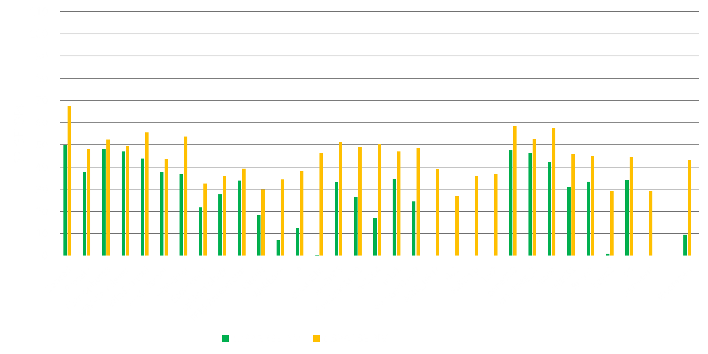
Single Precision Spmv – Vendor Optimized
Major Algorithmic Improvements
Notes:
Note that these cuSPARSE performance results are using the cuSPARSE csrmv functions.

Slide 21
Single Precision Spmv – Vendor Optimized
All-around Performance Improvements

Slide 22
Single Precision Spmv – Vendor Optimized
Avg. of 4.5x faster than cuSPARSE on identical hardware

Slide 23
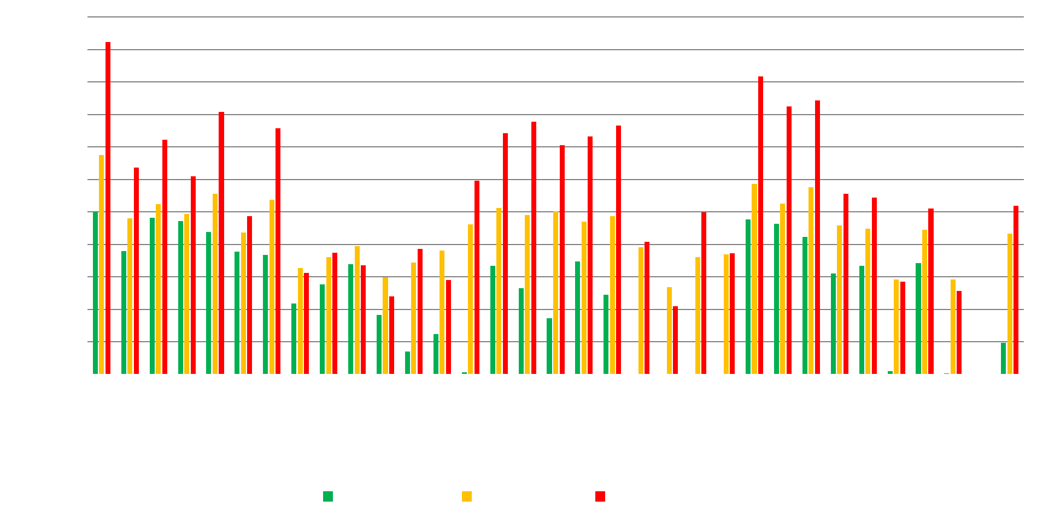
Single Precision Spmv – Vendor Optimized
AMD Hardware 20% Faster

Slide 24
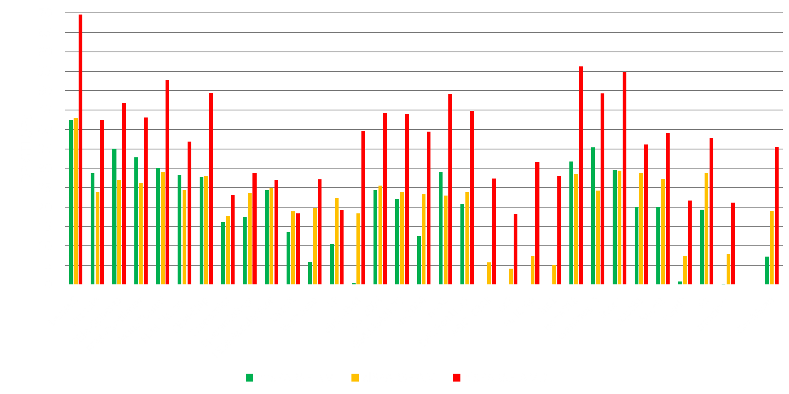
Double Precision Spmv – Vendor Optimized
AMD Hardware 87% Faster

Slide 25
Double Precision Spmv – Vendor Optimized
Lack of OpenCL™ 64-bit Atomics

Slide 26
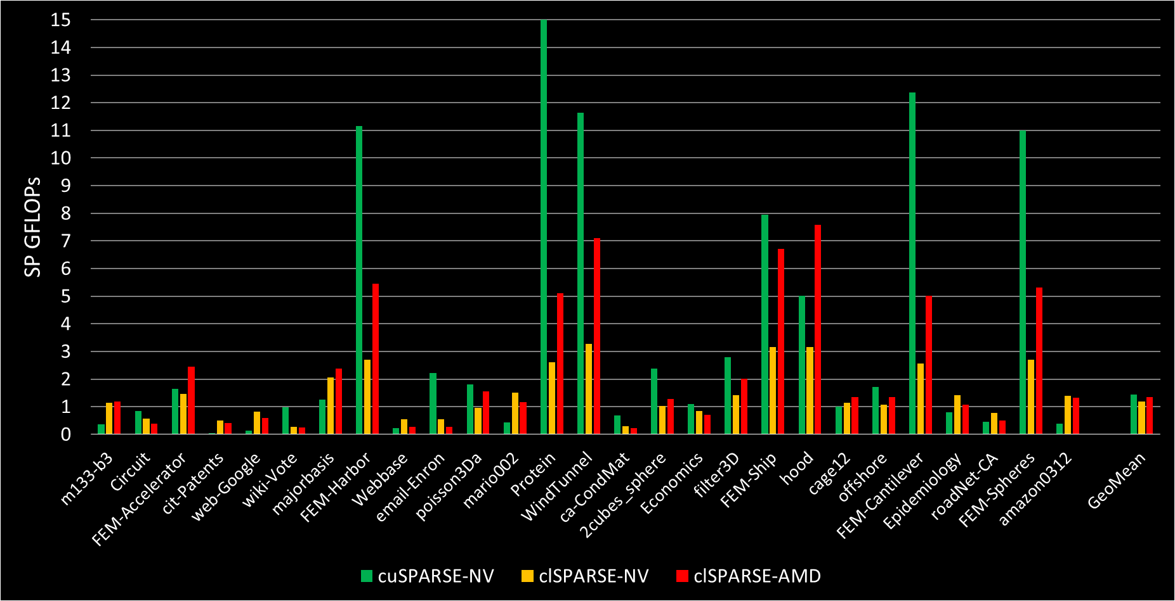
Single Precision Spm-SpM – Vendor Optimized
Notes:
clSPARSE 20% slower on NV hardware compared to cuSPARSE
AMD hardware within 7% slower than cuSPARSE on average

Slide 27
Single Precision Spm-SpM – Vendor Optimized
Average within 20% of cuSPARSE on Nvidia Hardware
AMD hardware within 7% of cuSPARSE on avg.
Notes:
clSPARSE 20% slower on NV hardware compared to cuSPARSE
AMD hardware within 7% slower than cuSPARSE on average

Slide 28
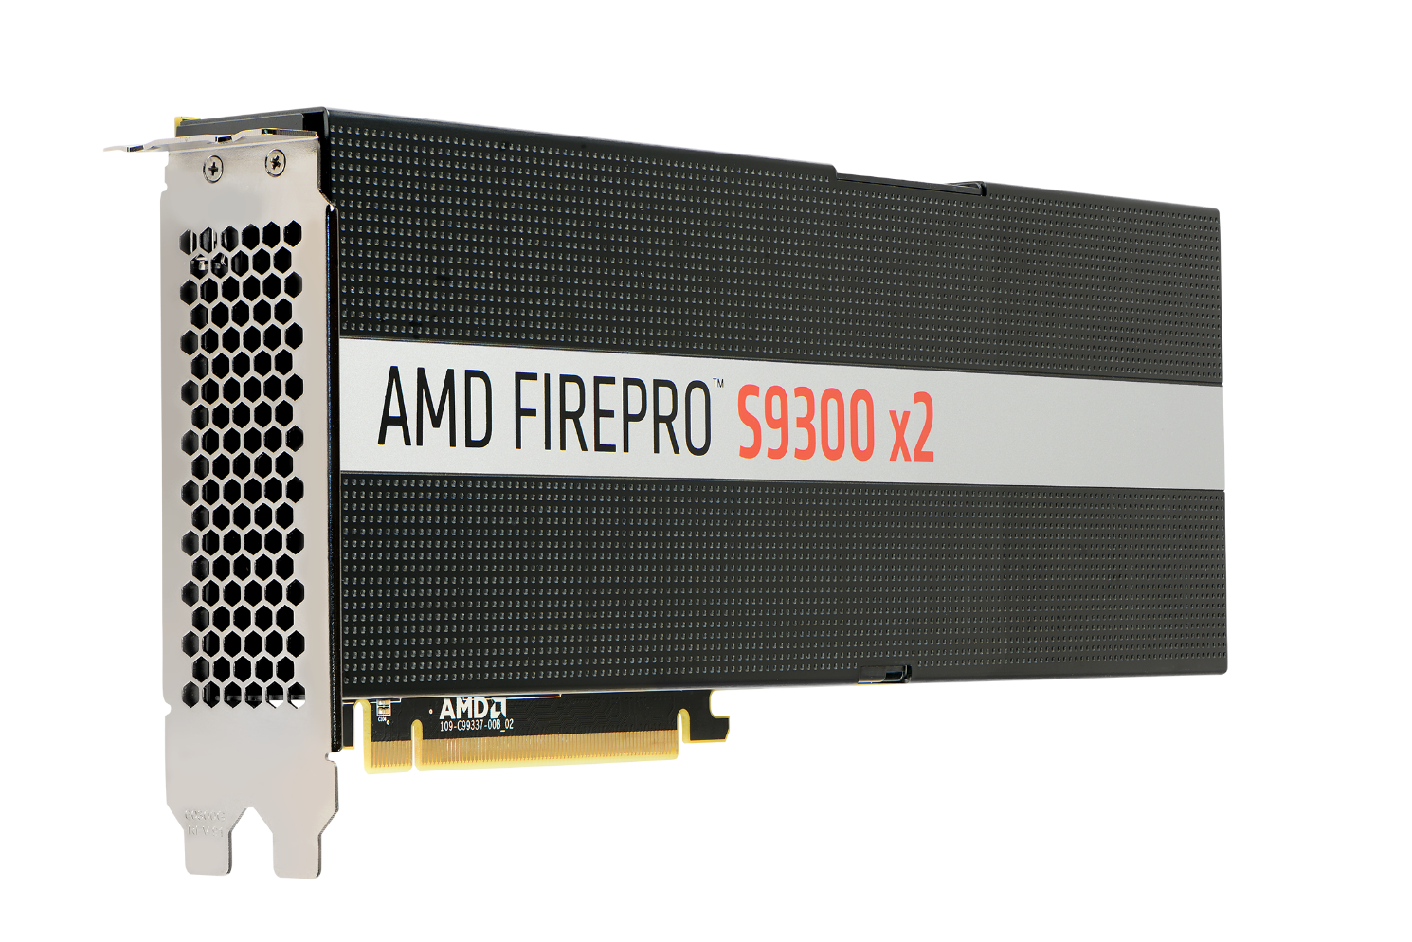
clSPARSE Is Portable Across Vendors
OpenCL™ gives you the Freedom to Choose Your Hardware
AMD Radeon™ Fury X
512 GB/s Memory BW
AMD FirePro™ S9300 x2
1024 GB/s Aggregate Memory BW

Slide 29
Comparison to Open-Source Library
Comparison against ViennaCL, the popular open-source linear algebra library
Only used AMD hardware for this to ease readability
Both libraries work across vendors
ViennaCL implements an older version of AMD’s CSR-Adaptive algorithm for SpMV

Slide 30
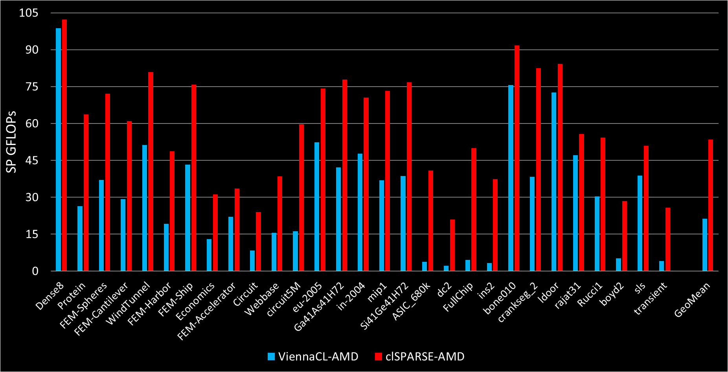
Single Precision Spmv – Open Source
Same algorithmic benefits

Slide 31
Single Precision SpMV – Open Source
clSPARSE 2.5x faster on average

Slide 32
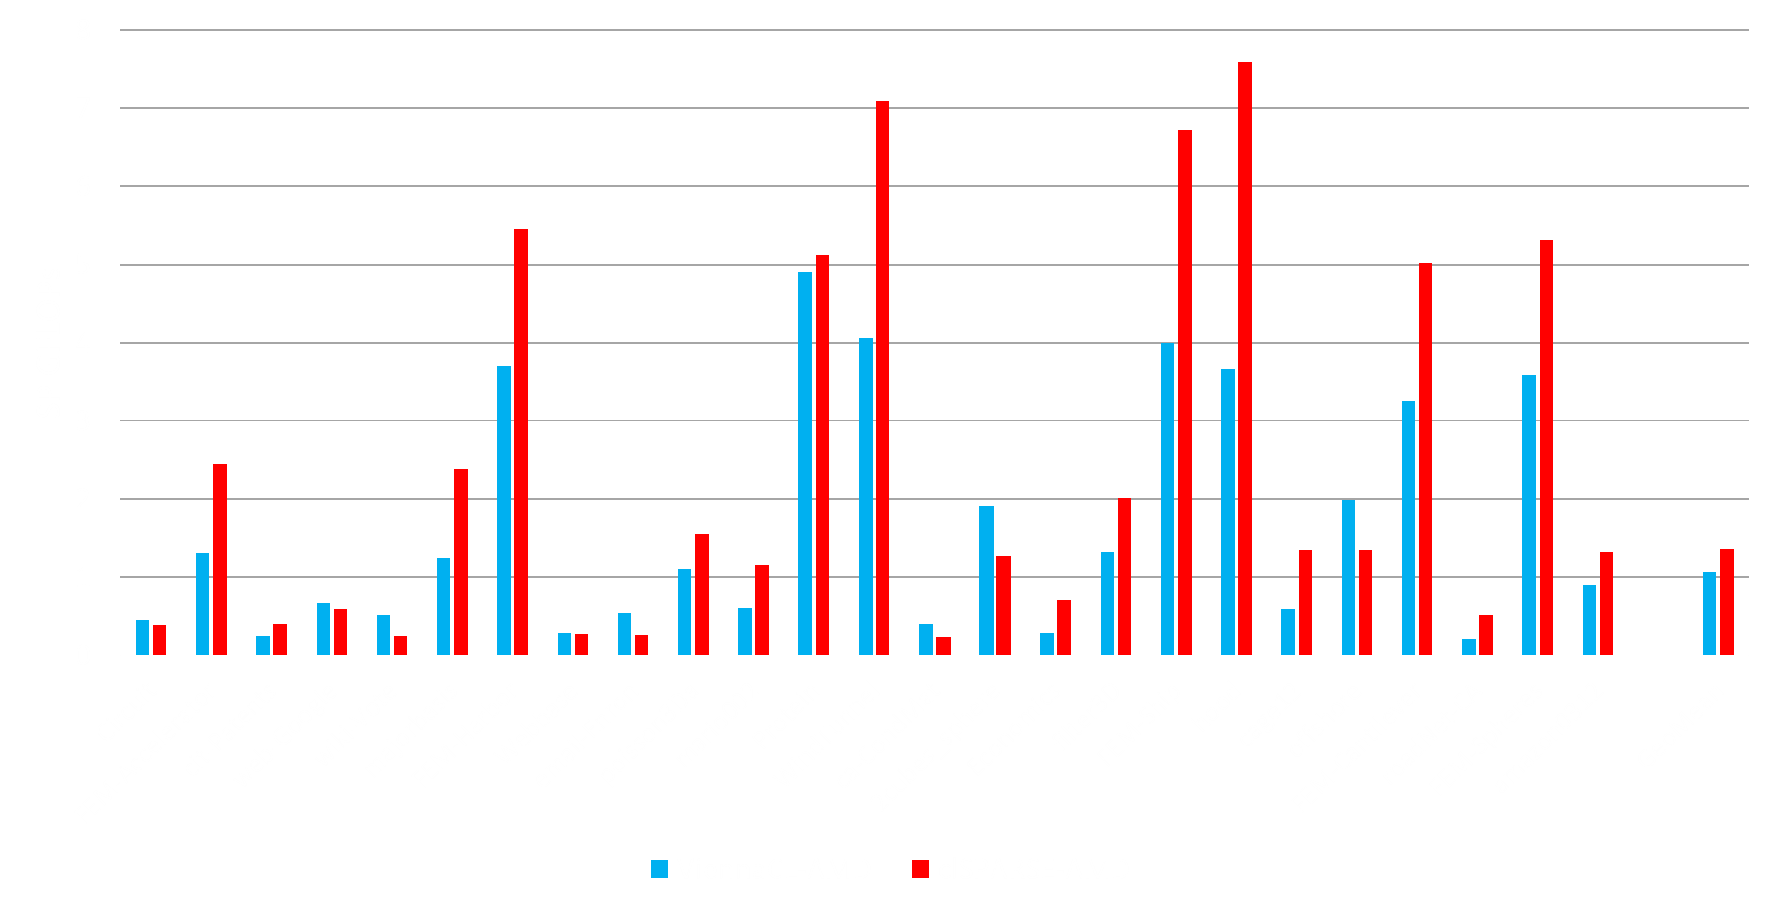
Single Precision SpM-SpM – Open Source
clSPARSE 27% faster on average
Notes:
27% faster than ViennaCL SpMSpM

Slide 33
clSPARSE: A Vendor-Optimized Open-Source Sparse BLAS Library
Available at:
https://github.com/clMathLibraries/clSPARSE
Contributions welcome!

Slide 34
For more information on the range of AMD FirePro™ S-series graphics accelerators, contact:
Christian Seithe
Sr. Business Development Manager EMEA –
AMD Professional Graphics
AMD GMBH, Einsteinring 24, D-85609 Dornach b. München, GERMANY
Email: christian.seithe@amd.com
Mobile Office: +49 (0) 89 45053 255
Mobile Phone: +49 (0) 172 999 77 41
Donal Harford
Business Development Manager, UK/Ireland/Nordics – AMD Professional Graphics Division
Email: donal.harford@amd.com
Mobile: +353 87 442 62 62
Joshue “Josh” Saenz
Sales, AMD Professional Graphics
7171 Southwest Parkway, Austin, TX 78735 USA
Email: Joshue.Saenz@amd.com
Office: +(1) 512-602-0256
Mobile: +(1) 512-201-3065

Slide 35
Disclaimer & Attribution
The information presented in this document is for informational purposes only and may contain technical inaccuracies, omissions and typographical errors.
The information contained herein is subject to change and may be rendered inaccurate for many reasons, including but not limited to product and roadmap changes, component and motherboard version changes, new model and/or product releases, product differences between differing manufacturers, software changes, BIOS flashes, firmware upgrades, or the like. AMD assumes no obligation to update or otherwise correct or revise this information. However, AMD reserves the right to revise this information and to make changes from time to time to the content hereof without obligation of AMD to notify any person of such revisions or changes.
AMD MAKES NO REPRESENTATIONS OR WARRANTIES WITH RESPECT TO THE CONTENTS HEREOF AND ASSUMES NO RESPONSIBILITY FOR ANY INACCURACIES, ERRORS OR OMISSIONS THAT MAY APPEAR IN THIS INFORMATION.
AMD SPECIFICALLY DISCLAIMS ANY IMPLIED WARRANTIES OF MERCHANTABILITY OR FITNESS FOR ANY PARTICULAR PURPOSE. IN NO EVENT WILL AMD BE LIABLE TO ANY PERSON FOR ANY DIRECT, INDIRECT, SPECIAL OR OTHER CONSEQUENTIAL DAMAGES ARISING FROM THE USE OF ANY INFORMATION CONTAINED HEREIN, EVEN IF AMD IS EXPRESSLY ADVISED OF THE POSSIBILITY OF SUCH DAMAGES.
ATTRIBUTION
© 2016 Advanced Micro Devices, Inc. All rights reserved. AMD, the AMD Arrow logo, AMD Radeon, AMD FirePro, AMD Catalyst and combinations thereof are trademarks of Advanced Micro Devices, Inc. in the United States and/or other jurisdictions. OpenCL is a trademark of Apple, Inc. used by permission by Khronos. Microsoft is a registered trademark of Microsoft Corporation. Windows is a registered trademark of Microsoft Corporation. Linux is a registered trademark of Linus Torvalds. Other names are for informational purposes only and may be trademarks of their respective owners.

Slide 37
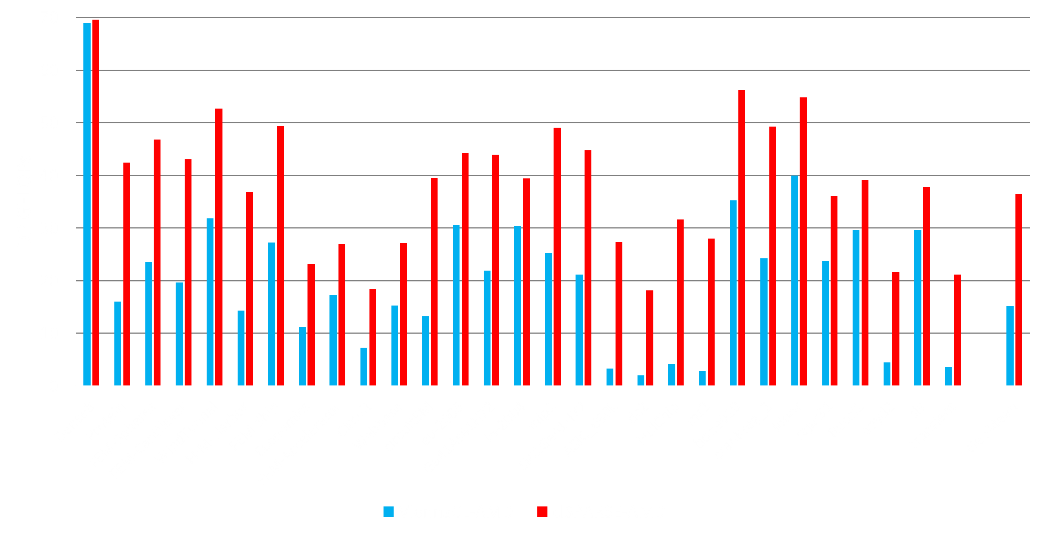
Double Precision Spmv – Open Source

