Slide 1
clARMOR: a dynamic buffer overflow detector for OpenCL kernels
Chris Erb, Joe Greathouse,
May 16, 2018
Notes:
We’re here today to present unto you clARMOR as a quick solution for finding gpu buffer overflow type errors in OpenCL programs.
clARMOR is a tool arising from personal need, that upon further inspection, we thought would be a benefit to the OpenCL community at large.

Slide 2
Anecdote
Discovering a buffer overflow
CPU
GPU
MEMORY
MEMORY
Data
Data
Data
Data
Data
Notes:
So first an anecdote.
We often deal with CPU/GPU interactions at AMD, and at one time we were developing a tool that would move data originally resident in GPU memory into the host memory.
This allowed us to perform some additional analysis, but of course the GPU kernels we were testing were not written with this in mind.
Mysteriously enough this was causing segfaults and crashes in our tool.
We found it very difficult to source the cause of these segfaults, as the applications we were analyzing were working fine in isolation, as well as our own tool was working with many other applications and had no obvious fault at the point of termination.
Neither would GDB nor watchpoints show when the data was corrupted.
We would find things like a double free on a variable that had not been touched by the host execution.
After spending a good deal of time investigating this, we discovered the GPU was writing over host data.
Which was bombing our process.
At this point we decided we would really like a GPU buffer overflow detector.
Clipart of bomb from https://openclipart.org/detail/131257/black-bomb
Relevant license text from https://openclipart.org/unlimited-commercial-use-clipart: “All Clipart on Openclipart are available for unlimited commercial use.”
Further, from https://openclipart.org/share: “All Clipart are Released into the Public Domain.”
Sites visited on 1/16/2017.

Slide 3
Background: Normal Buffer Fill
buf[n+1]
memcpy(buf, src, n+1)
src[0]
src[1]
src[2]
…
src[n]
adjacent data
buf
buf+1
buf+2
…
buf+n
Notes:
This is probably nothing new for the attendees here, but let’s review data buffers just for the sake of the exercise.
In the normal case of using a buffer, the program allocates the amount of space that it will use, and writes or reads to any portion of that allocation.

Slide 4
Background: Buffer Overflow
buf[n+1]
memcpy(buf, src, n+5)
overflow
src[0]
src[1]
src[2]
…
src[n]
adjacent data src[n+1] – [n+4]
adjacent data
buf
buf+1
buf+2
…
buf+n
Notes:
In the case that the program uses indexes outside of this region when interacting with the buffer, it will be accessing data it most likely should not.
This is particularly disruptive with writes.

Slide 5
Gpu induced overflow
Shared memory corruption
GPU can overflow buffers in system memory
Over Interconnects like PCIe®
SYSTEM MEMORY
GPU
memcpy(buf, src, n+5)
0
assert(x == y + z)
x = y + z
CPU
GPU Buffer
4
…
PCIe
n-3
x
GPU MEMORY
CPU Data
y
z
Notes:
Here we have a host connected to a GPU over PCIe.
The host has some data which it has operated on, and the GPU has an adjacent buffer in host memory.
Should the GPU walk off the end of this buffer with one of its operations, it will be stomping on host data.
Which may cause problems later.
But this is a discrete GPU system so you can avoid this by having the GPU operate within its own memory right?

Slide 6
Gpu induced overflow
Shared memory corruption
CPU and GPU as part of the same package
Every GPU buffer overflow may affect CPU data
assert(x == y + z)
x = y + z
CPU
MEMORY
CPU
0
GPU Buffer
4
…
GPU
n-3
GPU
memcpy(buf, src, n+5)
x
CPU Data
y
z
Notes:
What if your system looks like this?
Both Intel and AMD have chips where the CPU and GPU share memory.
This is the same situation as the previous slide, but now there is no option of quarantining the GPU to its own area.

Slide 7
Gpu induced overflow
Remote Code Execution
Overflows on GPU can cause remote GPU code execution
A. Miele. Buffer Overflow Vulnerabilities in CUDA: A Preliminary Analysis.
B. Di, J. Sun, and H. Chen. A Study of Overflow Vulnerabilities on GPUs.
GPU
MEM
MEM
memcpy(buf, src, n+5)
0
CORE
Buffer
4
Normal exec
…
n-3
Func Addr
Redirected exec
Notes:
But even if you had quarantined the GPU to its own data space, it would still be perfectly capable of sabotaging its own execution with a buffer overflow.
The two papers listed here explore remote code execution through address rewriting using GPU based buffer overflows.

Slide 8
Goals
clARMOR: AMD Research Memory Overflow Reporter for OpenCL
Software tool to detect buffer overflows caused by GPU
Memory buffers, Sub buffers, SVM, Images
Overflow and Underflow detection
Runnable with most OpenCL™ applications
Tested for GPU and CPU devices from multiple vendors
Low runtime overhead
9.7% average overhead
Notes:
With this in mind we wanted a high performance debugging tool, that would help us catch these kinds of errors while minimizing our time searching for them.
Up to today we have equipped clARMOR with detection strategies for buffer, sub buffer, svm, and image overflows.
We can also detect underflows for buffer, sub buffer, and svm.
We’ve confirmed it to work across a number of different architectures for various vendors.
And we’ve managed to keep the runtime overhead below 10% on average.

Slide 9
Goals
clARMOR: AMD Research Memory Overflow Reporter for OpenCL
Software tool to detect buffer overflows caused by GPU
Memory buffers, Sub buffers, SVM, Images
Overflow and Underflow detection
Runnable with most OpenCL™ applications
Tested for GPU and CPU device types from multiple vendors
Low runtime overhead
9.7% average overhead
Notes:
So first lets talk about our detection strategy.

Slide 10
Buffer overflow Detection Methodology
Canary-Based Detection
Inserting known values around a protected region.
buf[n+1]
memcpy(buf, src, n+1)
src[0]
src[1]
src[2]
…
src[n]
canary
adjacent data
buf
buf+1
buf+2
…
buf+n
verify
Notes:
We use a simple and sweet canary-based detection scheme.
And when I say canary I of course mean the bird.
Which is borrowed from the practice of using these smaller and more delicate creatures to detect the presence of noxious gases in enclosed environments (mineshafts).
The concept namely being if the creature is in distress or incapacitated, you to soon will be.
Moving on from perils of mineshafts, this means adding an extra bit of coding space onto the end of the space we are using for our buffer.
While operating our buffer we will occasionally do a life check on the canary region.
The canary region contains a known set of values, and if they are unchanged, then most likely everything is fine.
Canary image from
https://commons.wikimedia.org/wiki/File:The_illustrated_book_of_canaries_and_cage-birds,_British_and_foreign_(1878)_(14748666991).jpg
Per that page (accessed on 1/19/2017):
“This image was originally posted to Flickr by Internet Archive Book Images at https://flickr.com/photos/126377022@N07/14748666991. It was reviewed on 25 September 2015 by the FlickreviewR robot and was confirmed to be licensed under the terms of the No known copyright restrictions.”

Slide 11
Buffer overflow Detection Methodology
Canary-Based Detection
Inserting known values around a protected region.
buf[n+1]
memcpy(buf, src, n+5)
Absence of known canary values indicates an invalid write.
Can find underflow as well!
overflow src[n+1] – [n+4]
canary
src[0]
src[1]
src[2]
…
src[n]
canary
adjacent data
buf
buf+1
buf+2
…
buf+n
verify
Notes:
For those programs that write past the bounds of the buffer, the canary region will be the first thing they reach.
A verification of the canary region would then reveal the invalid write.
Write underflows can also be caught this way.

Slide 12
Goals
clARMOR: AMD Research Memory Overflow Reporter for OpenCL
Software tool to detect buffer overflows caused by GPU
Memory buffers, Sub buffers, SVM, Images
Overflow and Underflow detection
Runnable with most OpenCL™ applications
Tested for GPU and CPU device types from multiple vendors
Low runtime overhead
9.7% average overhead
Notes:
The next question I would like to answer is how we interact with OpenCL to accomplish the detection.

Slide 13
Launching an Opencl™ kernel
Buffer Create
Buffer
Notes:
So first we’ll talk about how OpenCL launches a kernel and then contrast it to our additions.
First the OpenCL program must instantiate its buffers.

Slide 14
Launching an Opencl™ kernel
Buffer Create
Set Arguments
Buffer
Kernel
Buffer
Notes:
This is followed by an attribution of those buffers and any constants to the kernel.

Slide 15
Launching an Opencl™ kernel
Set Arguments
Launch Kernel
Kernel
Buffer
Unrelated Memory
Notes:
Followed by a launching and execution of the kernel.

Slide 16
Launching an Opencl™ Kernel WiTH clARMOR
Buffer Create
Buffer Metadata
Buffer Metadata
Buffer
Canary
Canary
Notes:
clARMOR adds just a few steps to this.
At the time of buffer create, clARMOR will add extra space and initialize a canary.
As well as create some working annotations for the buffer.

Slide 17
Launching an Opencl™ Kernel WiTH clARMOR
Kernel Information
Buffer Create
Set Arguments
Buffer Metadata
Buffer Metadata
Buffer
Canary
Kernel
Buffer
Canary
Notes:
When assigning arguments to the kernel, clARMOR keeps a record of these buffer attachments.

Slide 18
Launching an Opencl™ kernel WiTH clARMOR
Kernel Information
Set Arguments
Buffer Metadata
Launch Kernel
Kernel
Buffer
Canary
Notes:
The kernel is launched and performs its operations on the modified buffers.

Slide 19
Launching an Opencl™ kernel WiTH clARMOR
Kernel Information
Buffer Metadata
Canary Verification
Kernel
Buffer
Canary
Notes:
After which, clARMOR collects the buffers described in its kernel record and performs a canary verification and refresh.

Slide 20
Wrapping Opencl™
clARMOR between your application and opencl
clARMOR is a Linux® library that uses LD_PRELOAD to wrap OpenCL™ library calls
Call Wrapping
Buffer, SVM, and Image creates
Argument setters
Kernel launches
Information functions
User App
clARMOR
OpenCL
Notes:
clARMOR requires no modification to the user application or OpenCL libraries.
It is a preload library that is inserted directly between the two.

Slide 21
Goals
clARMOR: AMD Research Memory Overflow Reporter for OpenCL
Software tool to detect buffer overflows caused by GPU
Memory buffers, Sub buffers, SVM, Images
Overflow and Underflow detection
Runnable with most OpenCL™ applications
Tested for GPU and CPU device types from multiple vendors
Low runtime overhead
9.7% average overhead
Notes:
With that I think it is time to qualify my statement on runtime overhead.

Slide 22
Test Setup
Hardware Specifications and Benchmarks suites
Suite | Num Benchmarks
AMDAPP | 33
FINANCEBENCH | 1
GPUSTREAM | 1
HETEROMARK | 9
MANTEVO | 2
NPB_OCL | 8
OPENDWARFS | 7
PANNOTIA | 6
PARBOIL | 8
POLYBENCH | 21
PROXYAPPS | 6
RODINIA | 19
SHOC | 14
VIENNACL | 8
AMD Ryzen™ 7 1800X CPU
AMD Radeon™ Vega Frontier Edition discrete GPU
ROCm 1.7
143 benchmarks in 14 benchmark suites
Notes:
We performed our runtime measurements on a Ryzen 7 1800X with a Vega Frontier discrete GPU using ROCm 1.7.
The GPU benchmarks we tested are taken from a wide variety of benchmark suites.

Slide 23
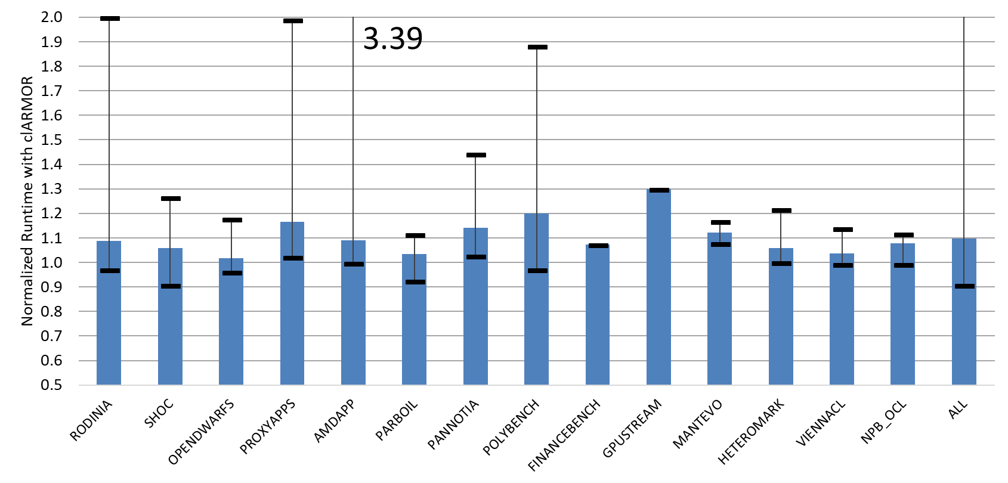
Performance Evaluation
Application runtime: with / without tool
Lower is better
9.6%
Notes:
Here is the suite view on our benchmark overheads.
This is normalized overhead per suite, so lower is better, 1.0 being perfect.
The whiskers represent the max and min overheads per suite.
clARMOR adds a constant overhead per buffer and scales with the number of buffers.
Worst case overhead comes when an application has many buffers and short kernels.
These are the applications that have 2 and 3x normalized overhead.

Slide 24
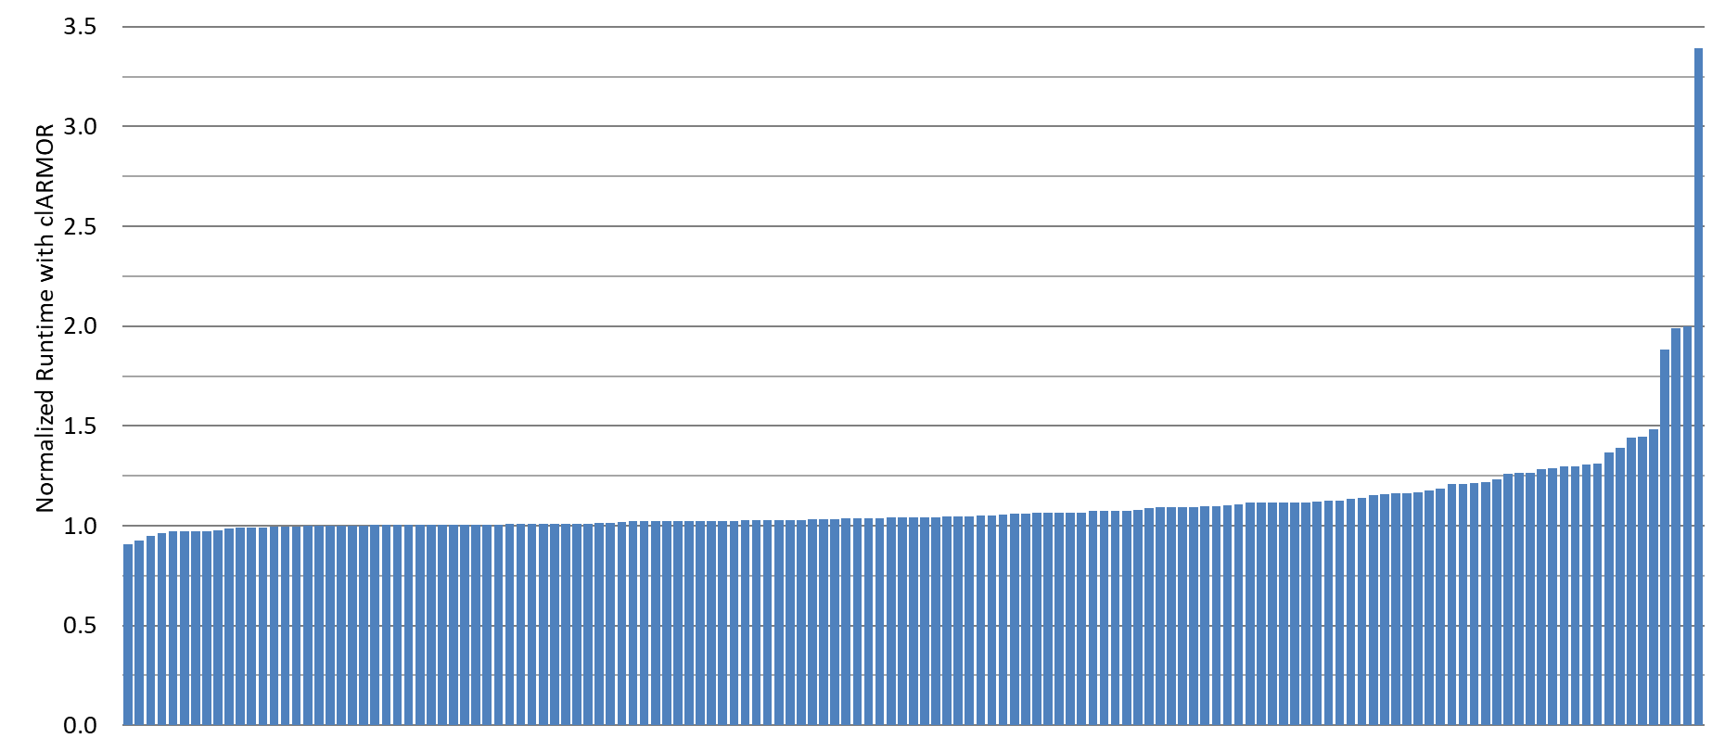
Performance Evaluation
Application runtime: with / without tool
Notes:
This is the same data, but broken out per benchmark.
From this we can see that the majority of applications have very low overheads.

Slide 25
Example Usage
Bad_cl_mem test
Notes:
Here is an example of interacting with clARMOR from the terminal.
clARMOR is initiated from a script, which will take your program invocation as an argument.
This script creates a prefix to your progam invocation, which includes the LD_PRELOAD and environment variable options to communicate with the clARMOR wrapper.
This is the output of one of our tests applications when run with clARMOR.
The application writes 10 bytes after the end of the buffer.
clARMOR responds in the tagged lines with the first infringing write.

Slide 26
Example Usage
Good_cl_mem test

Slide 27
Bonus Details
What do the wrapped OpenCL™ library calls have to do?
Buffer and Image creates
Argument setters
Kernel launches
Information functions
What are we doing to make the check faster?
Notes:
This next part is for those attendees who are interested in what clARMOR does in its wrapped functions to accomplish the overflow detection.
I also throw in a few details on getting some performance bumps.

Slide 28
Wrapping the Opencl™ api
Buffer and image Creation
Buffer Creation
Calls to clCreateBuffer or clSVMAlloc
Allocate buffer
Create sub buffer for user
Surround with canary
Image Creation
Calls to clCreateImage, clCreateImage2D, or clCreateImage3D
Potential for multi dimensional overflow
Add canary regions to each dimension
Annotations for location of canaries, etc.
User Pointer
Canary
Buffer
User Buffer
Canary
Image Row0
Canary
Image Row1
Image Row0
Canary
Canary
Image Row1
Canary Slice
Image Row2
Canary
Canary
Image Row2
Canary
Canary Row
Canary Row
Notes:
clARMOR must augment the buffers the user is creating with canary regions, while being opaque to their presence.
For a buffer or SVM clARMOR will allocate a region for the buffer, and return a sub-buffer or SVM pointer to the middle of that region for the user.
I will also initialize the canary regions at this time.
An image presents the possibility of overflow in three dimensions.
This is handled by adding canary regions to each.

Slide 29
Wrapping the Opencl™ api
Buffer creation from existing allocations
OpenCL allows buffer creation using an existing memory allocation (host pointers and sub buffers)
Cannot extend buffer
Cannot move buffer
Solution using a temporary copy at run time
References
Make this a buffer.
Adjacent Memory
Data Array
Buffer
Adjacent Memory
Canary
Buffer
Buffer Copy
Canary
Notes:
These regions may not be extended as they could be surrounded by occupied memory.
Neither can they be moved, as they may have multiple pointers referencing them.
Our solution is to allow the user to create the buffer in place and let the user have the real pointer.
At the same time we annotate that this buffer could not be augmented.
At the time of a kernel launch we copy the contents of these buffers to new buffers that have canaries.
clARMOR will use the copies for the duration of the kernel, after which it will update the original buffer.

Slide 30
Wrapping the Opencl™ api
Set arguments
clARMOR needs to know which buffers/images to check for overflows
Kernel information object
map kernel argument number to buffer information
Update on call to clSetKernelArg or clSetKernelArgSVMPointer
Kernel Information
ARG1
ARG2
ARG3
Constant
Buffer Metadata
Buffer Metadata
Notes:
Every time a buffer is created clARMOR makes a record of how the buffer was created.
But in order for clARMOR to know when the buffer is used, it needs a kernel information object.
It matches these records to a kernel information object on calls to clSetKernelArg and clSetKernelArgSVMPointer.
This will be used as a reference when the kernel is eventually launched.

Slide 31
Wrapping the Opencl™ api
Kernel launch
Do the work of detecting buffer overflows
On call to clEnqueueNDRangeKernel
Enqueue the kernel
Retrieve affected buffers
Run the canary check
Report errors
Kernel Information
Buffer Metadata
Kernel
Canary
Buffer
Canary
Buffer
Canary
Notes:
The clEnqueueNDRangeKernel function is where the bulk of the work of clARMOR is done.
Before a kernel is launched, any copies necessary for host pointers and sub-buffers are made.
At which point the execution of the modified kernel is handed off to OpenCL.
When the kernel completes, the buffers as described by the kernel information object are assembled.
And submitted to a canary scanning implementation.

Slide 32
Wrapping the Opencl™ api
Getters and setters
GetMemObjectInfo, GetImageInfo
Reserve space for canaries
Enqueue Functions
Read / Write / Fill / Copy
Buffer / BufferRect / Image
Notes:
With all of this manipulation of buffers, some disinformation is necessary to avoid misuse.
For example when querying the max buffer size, the application will receive the max size minus the space clARMOR needs for canaries.
As a bonus we also provide overflow detection for all of the Enqueue API functions.
Which is the one case were we include read overflows in our list of capabilities.

Slide 33
Acceleration
Selecting a device for performing canary verification
CPU is faster
small / few canary regions (latency advantage)
GPU is faster
large / many canary regions (throughput advantage with embarrassingly parallel workload)
reduced transfers over PCIe® by keeping on GPU
CPU
GPU
Canary
Canary
Canary
Canary
Canary
Canary
Notes:
clARMOR has execution paths for verification on CPU and GPU.
It attempts to select the best performing path for the workload at hand.
For larger workloads, the GPU path often has throughput advantage due to the embarrassingly parallel nature of the canary check.
This is coupled with a reduction in PCIe® transfers, from keeping work local to the GPU.

Slide 34
Acceleration
Using Opencl™ events to increase throughput
Maximizing asynchrony
Event-based programming wherever possible
GPU check kernels enqueue behind work kernels and wait on completion
Evaluation of check kernel results is done with call-backs
synchronous
asynchronous
CPU
clARMOR Prelaunch
clARMOR Postlaunch
clARMOR Prelaunch
clARMOR Postlaunch
GPU
User Kernel
Canary Check
User Kernel
Canary Check
Notes:
We take advantage of OpenCL™ event based programming.
This is a method for managing CPU & GPU work asynchronously.
If we did all work synchronously we would have to wait for the user kernel to finish before we could enqueue our GPU based canary check and continue with postlaunch work.
However using events, we can enqueue the work and immediately continue with host side execution.

Slide 35
Conclusion
clARMOR is ready for you to use
Canary-based detection scheme finds GPU write overflows
Memory buffers, Sub buffers, SVM, Images
Overflow and Underflow detection
Works for most OpenCL™ applications
Running on GPU or CPU, not vendor specific
Near real-time detection
9.7% average overhead
Open Sourced
https://github.com/ROCm-Developer-Tools/clARMOR - MIT
Technical Details
Dynamic buffer overflow detection for GPGPUs, CGO 2017

Slide 36
Disclaimer & Attribution
The information presented in this document is for informational purposes only and may contain technical inaccuracies, omissions and typographical errors.
The information contained herein is subject to change and may be rendered inaccurate for many reasons, including but not limited to product and roadmap changes, component and motherboard version changes, new model and/or product releases, product differences between differing manufacturers, software changes, BIOS flashes, firmware upgrades, or the like. AMD assumes no obligation to update or otherwise correct or revise this information. However, AMD reserves the right to revise this information and to make changes from time to time to the content hereof without obligation of AMD to notify any person of such revisions or changes.
AMD MAKES NO REPRESENTATIONS OR WARRANTIES WITH RESPECT TO THE CONTENTS HEREOF AND ASSUMES NO RESPONSIBILITY FOR ANY INACCURACIES, ERRORS OR OMISSIONS THAT MAY APPEAR IN THIS INFORMATION.
AMD SPECIFICALLY DISCLAIMS ANY IMPLIED WARRANTIES OF MERCHANTABILITY OR FITNESS FOR ANY PARTICULAR PURPOSE. IN NO EVENT WILL AMD BE LIABLE TO ANY PERSON FOR ANY DIRECT, INDIRECT, SPECIAL OR OTHER CONSEQUENTIAL DAMAGES ARISING FROM THE USE OF ANY INFORMATION CONTAINED HEREIN, EVEN IF AMD IS EXPRESSLY ADVISED OF THE POSSIBILITY OF SUCH DAMAGES.
ATTRIBUTION
© 2018 Advanced Micro Devices, Inc. All rights reserved. AMD, the AMD Arrow logo, AMD Ryzen, Radeon, and combinations thereof are trademarks of Advanced Micro Devices, Inc. in the United States and/or other jurisdictions. OpenCL is a trademark of Apple Inc. used by permission by Khronos. PCIe is a registered trademark of PCI-SIG Corporation. Linux is a registered trademark of Linus Torvalds. Other names are for informational purposes only and may be trademarks of their respective owners.

Slide 38
Analysis of tool overhead with SNAP_MPI
Example SNAP_MPI kernel launch
CPU
Application Prelaunch
clARMOR Prelaunch
clARMOR
Postlaunch
Application Postlaunch
GPU
User Kernel
Canary Check
Launch Delay
SNAP_MPI Synchronization
Possible improvement for SNAP_MPI kernel launch
CPU
Application Prelaunch
clARMOR Prelaunch
clARMOR
Postlaunch
Application Postlaunch
Application Prelaunch
GPU
User Kernel
Canary Check
User Kernel
Launch Delay
Launch Delay

Slide 39
Hetero-Mark OpenCL™ 1.2 SW Overflow Error
Kernel
Host
__kernel void sw_compute0( … const unsigned M_LEN, … __global double *cu,
… ) {
int x = get_global_id(0);
int y = get_global_id(1);
cu[(y + 1) * M_LEN + x] = <input_equation>
…
}
size_t sizeInBytes = sizeof(double) * m_len_ * n_len_;
…
cu_ = clCreateBuffer(context_, CL_MEM_READ_WRITE, sizeInBytes, NULL, &err);
…
const size_t globalSize[2] = {m_len_, n_len_};
…
err |= clSetKernelArg(kernel_sw_compute0_, 6, sizeof(cl_mem), reinterpret_cast<void *>(&cu_));
…
err = clEnqueueNDRangeKernel(cmdQueue_, kernel_sw_compute0_, 2, NULL, globalSize, localSize, 0, NULL, NULL);
(y + 1) * M_LEN + x
x = m - 1
(y + 1) * m + x
y = n - 1
(n) * m + x
m == M_LEN
n * m + m - 1
m*n – 1 + m <= m*n - 1
m <= 0
Notes:
A detailed example of an overflow in the cl 1.2 implementation of sw within hetero-mark.
The kernel is sw_compute0, the buffer is cu.
A size of m x n is declared and this is used to initialize the cu buffer.
Global worksize is declared as m x n.
The cu buffer is set to sw_compute0 as an argument
Sw_compute0 is launched with globalsize m x n
X and y represent the work dimensions
Lets take these to some logical extremes
x will max out at m – 1 and y will max out at n - 1 as defined by globalsize.
Lets put this into the indexing equation for cu
M is m_len so we’ll remove that first
Y is n – 1
X is m – 1
Notice that this is greater than the allocated space for cu

Slide 40
Example Error

Slide 41
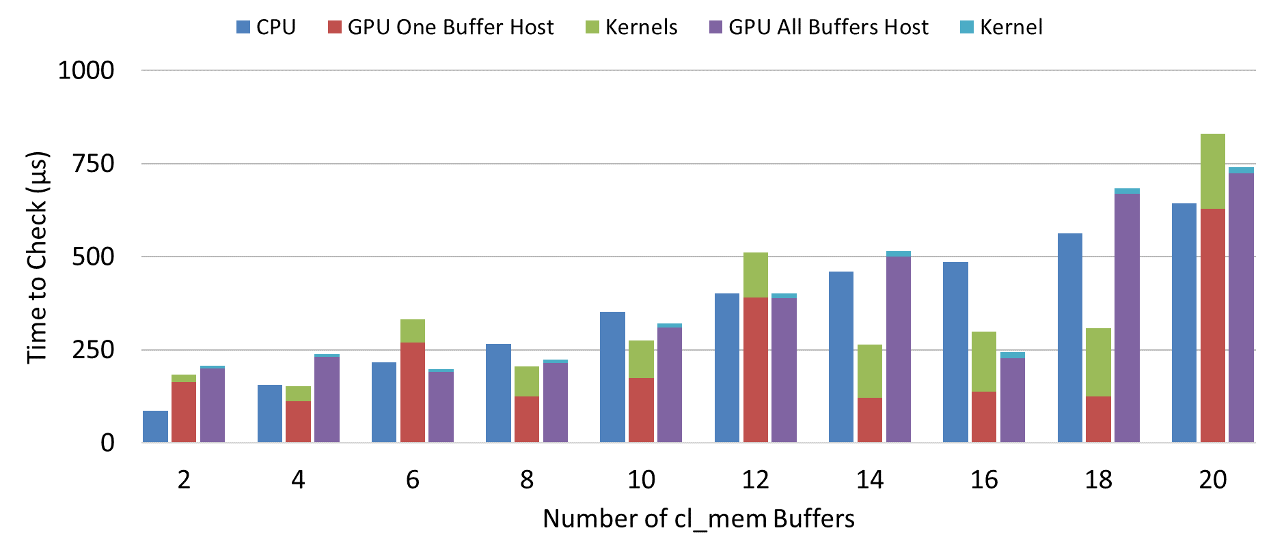

Slide 42
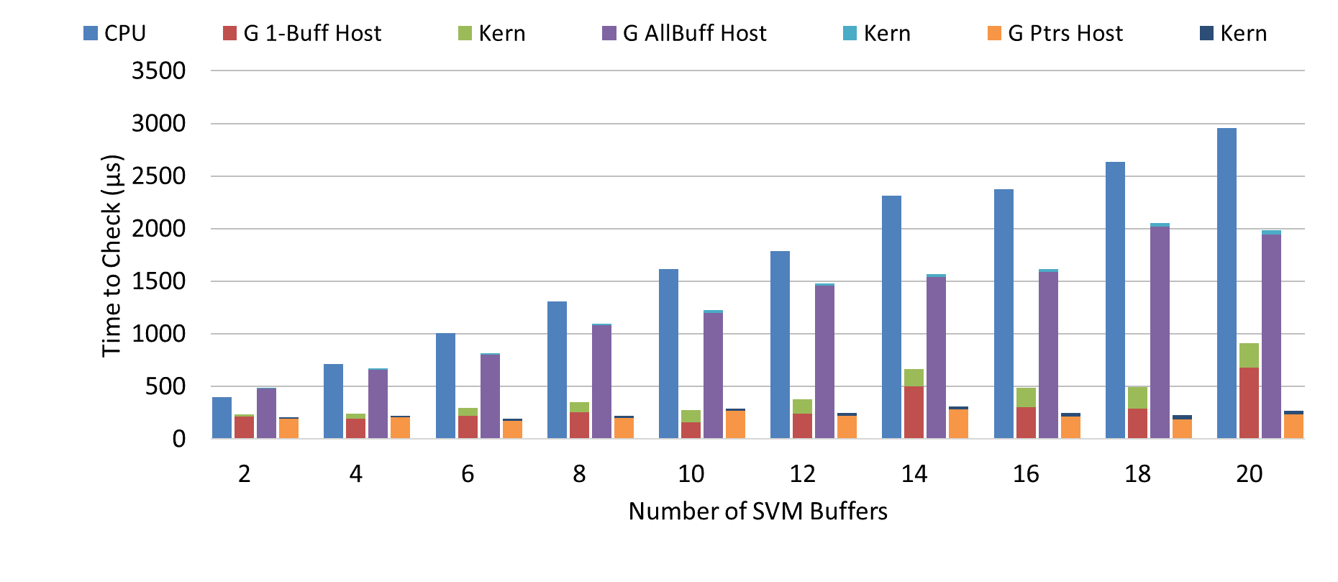

Slide 43
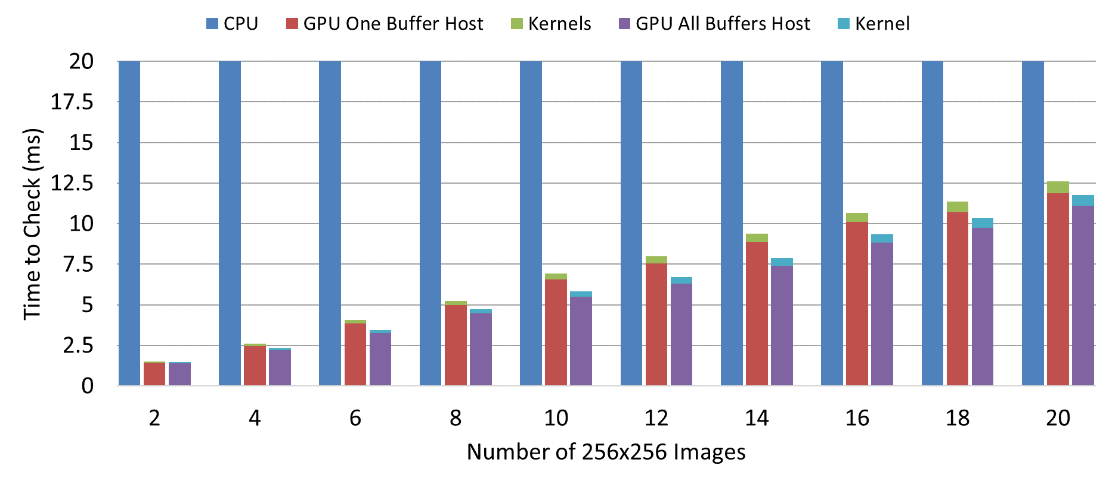

Slide 46
clARMOR detection results
List of benchmarks with buffer overflows
Parboil
mri-gridding
StreamMR
kmeans
wordcount
Hetero-Mark
OpenCL™ 1.2 kmeans
OpenCL 2.0 kmeans
OpenCL 1.2 sw, 4 errors
OpenCL 2.0 sw, 4 errors
SNU OpenCL
CG (data races resulting in negative indexing, underflow)
Note: These have been reported, and most fixed.
Detect GPU Buffer Overflows
Compatible With Most OpenCL™
Low Runtime Overhead
Notes:
Eye chart of benchmarks with overflows detected
We found 13

Slide 47
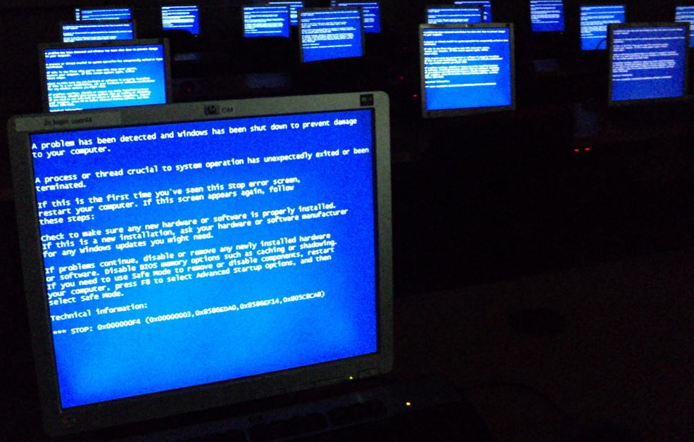
Consequences of Buffer overflows
Degrading user experience, and security risks
Data Corruption
Segmentation Faults
Altered Control Flow
(Security Subversion)
Notes:
Data corruption image taken from https://commons.wikimedia.org/wiki/File:Data_loss_of_image_file.JPG
Per that page (accessed on 1/17/2017):
“I, the copyright holder of this work, release this work into the public domain. This applies worldwide.”
“I grant anyone the right to use this work for any purpose, without any conditions, unless such conditions are required by law.”
Blue-screen image obtained from https://commons.wikimedia.org/wiki/File:Windows_Blue_Screen_on_room_full_of_computers.JPG
Per that page (accessed on 1/17/2017), this image was licensed at Creative Commons CC0 1.0:
“The person who associated a work with this deed has dedicated the work to the public domain by waiving all of his or her rights to the work worldwide under copyright law, including all related and neighboring rights, to the extent allowed by law. You can copy, modify, distribute and perform the work, even for commercial purposes, all without asking permission.”
Why should you care about buffer overflows?
Here are a few reasons.
The first is data corruption.
A buffer overflow may result in a write that destroys files or invalidates program results.
Next are segmentation faults.
A buffer overflow can cause program to end prematurely, this ranging from application crashes to the infamous blue screen of death.
A third consequence is vulnerability to execution redirection.
This last one is often exploited to subvert system security.

