Slide 1

Testudo:
Heavyweight Security Analysis via Statistical Sampling
Joseph L. Greathouse
Ilya Wagner
David A. Ramos
Gautam Bhatnagar
Todd Austin
Valeria Bertacco
Seth Pettie
Advanced Computer Architecture Laboratory
University of Michigan
MICRO, Lake Como, Italy
November 11, 2008
Notes:
Good morning everyone. I’m Joseph Greathouse, and I will be discussing Testudo, a system for heavyweight security analysis via statistical sampling.

Slide 2
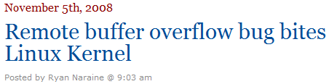


Bad Software is Everywhere
NIST: SW errors cost U.S. $60 billion/year as of 2002
These errors include security vulnerabilities.
"Security bugs are out there, in fact in web apps they're pretty much a plague.” - Zeev Suraski, co-creator of PHP
CERT-Cataloged Vulnerabilities
Notes:
I’m here because bad software is everywhere. As proof: the u.s. national institute of standards and technology reported that as of the year 2002, software errors cost the U.S. economy alone $60 billion per year. While not all of these problems were security vulnerabilities, security problems still make up a large, and dangerous, group of software errors.
In fact, Zeev Suraski, one of the co-creators of PHP, has called bugs not just a problem, but a plague.
Proof of that assertion can be seen in these statistics from CERT, the computer emergency response team, a group that catalogs security vulnerabilities on the internet. In the year 2002, when the $60 bil/year estimate was made, there were about 4000 newly-published security vulnerabilities. This year, we’re on track to see over 8000.
In fact, if you use Gentoo Linux, you were just affected by a security bug in a kernel driver last week. Microsoft just released an unscheduled patch for a severe security hole three weeks ago. And if you needed a passport to make it to MICRO, you may have used a passport reader that was affected by a severe security vulnerability.

Slide 3
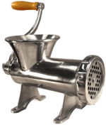



Software Dynamic Analysis for Security
Valgrind, Rational Purify, DynInst
  Multiple types of tests, runtime protection
  Extremely high runtime overheads
Analysis Instrumentation
Program
Instrumented Program
In-House
Test Server(s)
Developer
Analysis Results
LONG run time
Notes:
So because these problems are so numerous, there has been a great deal of work on methods to combat them. I’d like to focus on one class of methods that has seen a lot of recent work: dynamic analyses.
Dynamic analyses are security checks that are performed while the program is running, allowing the developer to monitor the runtime state of the program and use that information to reason about the safety of the process.
The current way that dynamic analyses are used is through software instrumentation tools like Valgrind, IBM Rational Purify, and DynInst. These tools instrument the software, which allows it to perform tests on itself at runtime. They offer a wide variety of tests, from simple taint checking to dynamic bounds checking and beyond. They also offer the benefit of runtime protection against security attacks, since a program that knows it is being exploited can stop before bad things happen. However, this benefit is counteracted by the extremely high runtime overheads incurred by software dynamic analysis. These overheads are on the orders of 20x, 30x, or 200x.
Because of these runtime overheads, a developer that wishes to use dynamic analysis on his program will probably use it in a manner like this:
This developer starts with his program, and sends it through some kind of instrumentation tool. It comes out larger, due to carrying the analysis instrumentation along. It then will run on some kind of in-house test server. Because of the extremely long runtimes, this instrumented version of the program will never go out to users.
After this long runtime, the developer gets back the analysis results, both positive and negative. However, because dynamic analysis relies on the runtime state of the system, the developer may want to run more tests with different inputs. Once again, the long runtimes make this prohibitive.

Slide 4
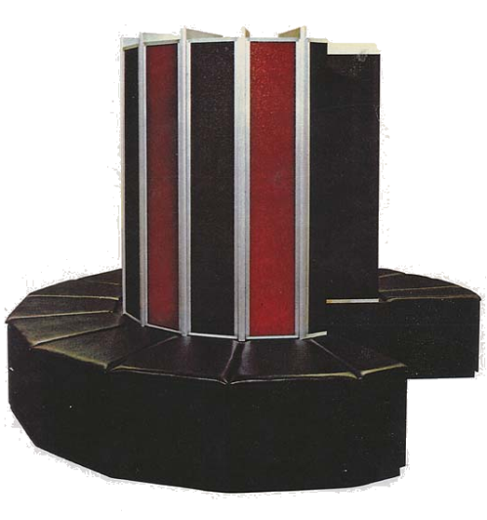
Hardware Dynamic Analysis for Security
DIFT, Raksha, FlexiTaint, et al.
  Low/no runtime overhead, runtime protection
  Limited analysis types, complex HW overhead
Program
In-House
Test Server(s)
Developer
Analysis Results
Hardware-Instrumented
Test Server(s)
Notes:
That’s where research in the hardware community comes in. Recent work on solving overhead problem.

Slide 5




Testudo: Distributed Dynamic Analysis
Split analysis across population of users
  Low HW cost, low runtime overhead,
  runtime information from the field
  Analysis only
Users running at full speed
Instrumented Program
Potential problems encountered
Developer
Reported before they are exploited

Slide 6
Heavyweight Dynamic Analysis
Heavyweight analyses use shadow values.
Shadow values hold meta-information about associated memory values
Can be used to detect potential errors without an active exploit.
Shadow
Value
Memory Location
Meta-Data:
Trusted/Untrusted
Maximum/Minimum
Symbolic Information
Data
6

Slide 7
Example of Heavyweight Analysis
Code:
int sample(int a[8]){
int x = read_in();
int y = x + 1;
int z = x * 2;
print a[x];
if(y>0&&y<8)
print a[y];
return a[z];
}
Memory:
Shadow
Value
Memory Location
a[0]
Dataflow:
I/O
x
6
UT
Key:
= has shadow value
7
UT
y
T
x=read_in()
z
12
UT
y = x + 1
z = x * 2

Slide 8
Contributions of Testudo
Reduce hardware complexity: Shadow storage is a small, constant size. No out-of-core changes.
Reduce runtime overhead: Divide work across users to reduce overhead for each individual.
Increase analysis quality: Large user population allows analysis of large, varying state spaces.

Slide 9

Dataflow Sampling Example: 1st User
Code:
int sample(int a[8]){
int x = read_in();
int y = x + 1;
int z = x * 2;
print a[x];
if(y>0&&y<8)
print a[y];
return a[z];
}
Memory:
Memory Location
a[0]
Single shared shadow value
Dataflow:
I/O
UT
x
6
Key:
*
= shadow value
y
7
No Replacement
*
= no shadow value
x=read_in()
= globally observed
shadow value
z
12
y = x + 1
z = x * 2

Slide 10
Dataflow Sampling Example: 2nd User
Code:
int sample(int a[8]){
int x = read_in();
int y = x + 1;
int z = x * 2;
print a[x];
if(y>0&&y<8)
print a[y];
return a[z];
}
Memory:
Memory Location
a[0]
Single shared shadow value
UT
Dataflow:
I/O
T
x
6
Key:
*
= shadow value
y
7
= no shadow value
x=read_in()
*
x=read_in()
= globally observed
shadow value
z
12
*
y = x + 1
z = x * 2

Slide 11
Dataflow Sampling Example: 3rd User
Code:
int sample(int a[8]){
int x = read_in();
int y = x + 1;
int z = x * 2;
print a[x];
if(y>0&&y<8)
print a[y];
return a[z];
}
Memory:
Memory Location
a[0]
Single shared shadow value
Dataflow:
I/O
UT
x
6
Key:
*
= shadow value
y
7
No Replacement
= no shadow value
x=read_in()
*
x=read_in()
= globally observed
shadow value
z
12
*
*
y = x + 1
z = x * 2

Slide 12
A Pipeline for Testudo
IF
ID
EX
MEM
WB
S
Regs
Instruction Decode
Extend registers with single shadow bit.
Also extend pipeline buffers.
Common in hardware DIFT
Register File
Shadow Values

Slide 13
A Pipeline for Testudo
IF
ID
EX
MEM
WB
S
Regs
Calc
Execution Stage
Compute new shadow bits
Generally hard-coded in some way
Common in hardware DIFT

Slide 14
A Pipeline for Testudo
IF
ID
EX
MEM
WB
S
Regs
Calc
Sample
Cache
Memory Stage
Contains addresses of shadowed variables
Drop some values when this small cache is full
Replacement scheme not deterministic
Sample Cache
Shadowed Location

Slide 15
A Pipeline for Testudo
IF
ID
EX
MEM
WB
S
Regs
Calc
Sample
Cache
Policy
Map
Write Back
Different actions & opcodes lead to different handler code
Replaces or augments EX-stage modifications
Allows for complicated testing and propagation
Policy Map
opcode
Handler address

Slide 16
Experimental Framework
Insecure programs (with exploits), including:
  TIFF image engine
  Eggdrop IRC bot
  Lynx web browser
  PDF library
  Simulated SQL injection
CACTI v5.0 used for cache estimation.
Modified Virtutech Simics
+
Modified Bochs
x86 emulator
Custom Sample Cache Simulator
Shadow value
traces

Slide 17
How many runs will I need?
To see all of a program’s dataflows with high statistical confidence.
Some need few samples with tiny sample caches
Others need a larger cache and/or more runs for good results
32-entry cache
64-entry cache
512-entry cache
1024-entry cache
17601
Avg. # of executions
Avg. # of executions

Slide 18
Does it scale to complex analyses?
If each shadow operation uses 1000 instructions:
Each execution sees few shadow values
Fewer shadow values reduce overhead
Tradeoff: need more executions
%
%
17.3%
3500
executions
Average % Overhead
Average % Overhead
169,000
executions
0.3%
1024-entry Sample Cache
telnet server benchmark

Slide 19
How much will it cost?
~0 change in clock period of modern CPU
No overhead outside of the CPU core
Very low hardware overhead in CPU core
Sample Cache Access Time
Sample Cache Area Overhead
% of CPU Cycle
% Increase of Core+L1
2.5GHz AMD Phenom
1.4GHz UltraSPARC T2
AMD Phenom
UltraSPARC T2
Notes:
Why cache access is so short: cache is very small

Slide 20
Conclusions from Testudo
Simplified hardware design for dynamic analysis
Reduced runtime overhead for heavyweight security analysis
Increased heavyweight dynamic analysis quality
Future Directions
Adapting Testudo hardware for multicore
What is the best cache replacement method?
Can we skip the hardware additions?

Slide 21

Thank you

Slide 22
BACKUP SLIDES
Picture rights:
  One of the following Testudo pictures has been removed, but I don’t remember which one.
Testudo picture 1
http://www.flickr.com/photos/frield/1254958611/
Testudo picture 2
http://www.flickr.com/photos/manel/154985772/
'The Art of Debugging ...' and 'The IDA Pro Book':
http://nostarch.com/
Fuzzing for Software Security Testing and Quality Assurance
http://www.artechhouse.com/Detail.aspx?strIsbn=978-1-59693-214-2
Secure Programming with Static Analysis
copyright Addison-Wesley

Slide 23

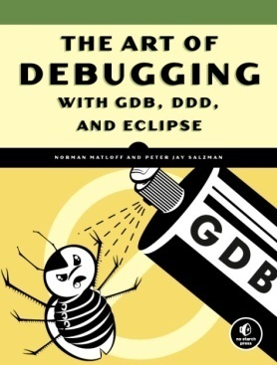
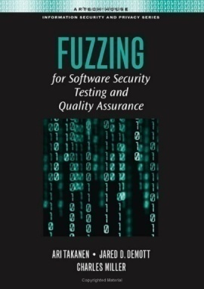

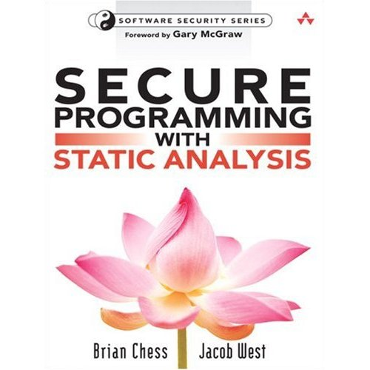
Systems for Detecting Security Errors
Eyeballs
  Disassembly, debugging, fuzz
  testing, whitehat/grayhat hackers
  Time-consuming, difficult
Static Analysis
  Analyze source, formal reasoning
  methods, compile-time checks
  Intractable, requires expert input,
  no system state

Slide 24
Security Vulnerability Example
Buffer overflows a large class of security vulnerabilities
Return address
void foo()
{
int local_variables;
int buffer[256];
…
buffer = read_input();
…
return;
}
New Return address
Local variables
Bad Local variables
buffer
Buffer Fill
buffer
If read_input() reads 200 ints
If read_input() reads >256 ints

Slide 25
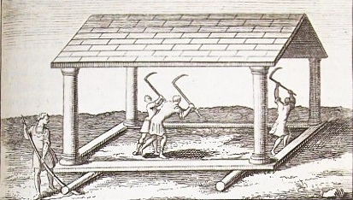









Testudo–Distributed Dynamic Debugging
Current Heavyweight Analysis Systems
Analyses
Program
Developer
In-House
Test Server(s)
LONG runtimes
Testudo: Heavyweight Sampling Analysis
Users running at full speed
Analyses
Program
Developer
Problems reported
before they’re exploited

Slide 26
Example Dataflow
void function(int &y, int &z, int &a)
{
int x = read_input();
y = x*1024;
a += y;
z = y * 75;
…
y++;
z = x+42;
return;
}
I/O
x=read_input()
y = x * 1024
z = x + 42
Key:
= has shadow value
a += y
z = y * 75
y++

Slide 27
Sampling of a Dataflow
HW limitations force us to ignore some shadow value stores
1st execution:
void function(int &y, int &z, int &a)
{
int x = read_input();
y = x*1024;
a += y;
z = y * 75;
…
y++;
z = x+42;
return;
}
I/O
*
x=read_input()
x=read_input()
*
y = x * 1024
z = x + 42
z = x + 42
Key:
= has shadow value
= no shadow value
= globally observed
shadow value
*
a += y
z = y * 75
y++

Slide 28
Sampling of a Dataflow
2nd execution:
void function(int &y, int &z, int &a)
{
int x = read_input();
y = x*1024;
a += y;
z = y * 75;
…
y++;
z = x+42;
return;
}
I/O
*
x=read_input()
x=read_input()
*
*
y = x * 1024
y = x * 1024
z = x + 42
Key:
= has shadow value
= no shadow value
= globally observed
shadow value
*
*
a += y
a += y
z = y * 75
*
z = y * 75
y++

Slide 29
Sampling of a Dataflow
3rd execution:
void function(int &y, int &z, int &a)
{
int x = read_input();
y = x*1024;
a += y;
z = y * 75;
…
y++;
z = x+42;
return;
}
I/O
*
x=read_input()
x=read_input()
*
*
y = x * 1024
y = x * 1024
z = x + 42
z = x + 42
Key:
= has shadow value
= no shadow value
= globally observed
shadow value
*
*
*
a += y
z = y * 75
y++
*
y++

Slide 30
Sampling of a Dataflow
3rd execution:
void function(int &y, int &z, int &a)
{
int x = read_input();
y = x*1024;
a += y;
z = y * 75;
…
y++;
z = x+42;
return;
}
I/O
*
x=read_input()
x=read_input()
*
*
y = x * 1024
y = x * 1024
z = x + 42
z = x + 42
Key:
= shadow value
= no shadow value
= globally observed
shadow value
*
*
*
a += y
z = y * 75
y++
*
y++

