Slide 1
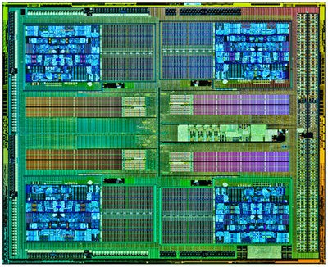
PPEP: online Performance, power, and energy prediction framework
and DVFS Space Exploration
Bo Su† Junli Gu‡ Li Shen† Wei Huang‡ Joseph L. Greathouse‡ Zhiying Wang†
†National University of Defense Technology ‡AMD Research
Dynamic Voltage & Frequency Scaling Challenge
How to predict performance & power across VF states
Difficulties on modern processor
Multiple clock domains
Multiple power planes
Cores
Cores
North Bridge
Core
Clock Domain
& Power Plane
North Bridge
Clock Domain
& Power Plane
Cores
Cores
Scalable
Not scalable
AMD FX-8320
Notes:
Good morning, I’m Bo Su from the National University of Defense Technology. The title of our paper is “PPEP: online Performance, power, and energy prediction framework and DVFS Space Exploration”.
Dynamic voltage and frequency scaling is now widely employed in modern processors to boost performance, lower power, and improve energy efficiency.
Good DVFS decisions require accurate performance and power predictions across different VF states.
However, these predictions are difficult because of the complexities of modern processors, such as multiple clock domains and multiple power planes.

Slide 2
Q1: performance prediction
Core VF State
Performance
Power
Higher
VF₅
CPI(VF₅)
Power(VF₅)
Running at:
Running at:
VF₄
CPI(VF₄)
Power(VF₄)
VF₃
CPI(VF₃)
Power(VF₃)
VF₂
CPI(VF₂)
Power(VF₂)
Lower
VF₁
Performance prediction?
CPI(VF₁)
Power(VF₁)
LL-MAB: Miss Address Buffer (MAB) based Leading Loads (LL) CPI Predictor;
Core
&
L1$
L2$
MAB0
MAB0
L3$
&
DRAM
MAB1
MAB1
3.2% error
>2X freq. diff.
MAB2
MAB2
…
MABn
Core Clock Domain
Other Clock Domains
Notes:
In this work, we overcome these difficulties. Starting from measurements taking at one VF state, we can predict the performance and power of all other VF states on commercial AMD processors.
For performance prediction, we implement a Cycles-Per-Instruction predictor, named LL-MAB.
It takes advantage of the Miss Address Buffer (or known as Miss Status Handling Register) of the L2 cache, to count the memory stall cycles according to the Leading Loads theory. The CPI prediction error is 3.2 percent across a more than 2x change in frequency..

Slide 3
Q2: power prediction
Core VF State
Performance
Power
Higher
VF₅
CPI(VF₅)
Power(VF₅)
Running at:
Running at:
VF₄
CPI(VF₄)
Power(VF₄)
VF₃
CPI(VF₃)
Power(VF₃)
VF₂
CPI(VF₂)
Power(VF₂)
Lower
VF₁
CPI(VF₁)
CPU Power prediction?
Power(VF₁)
Power model: CPU Events + Temperature
Power prediction: LL-MAB + 2 observations of CPU events.
4.2% error across 5 VF states.
Wednesday 11:05AM
Notes:
For power prediction: First, we use CPU events and temperature to build a power model. And then, based on 2 observations, we implement a predictor that allows us to take measurements at one VF state and predict the chip’s power usage at all other VF states. The power prediction error is 4.2 percent.
Finally, we combine the CPI predictor and the power predictor to form the PPEP framework. PPEP runs as a software user level daemon without requiring hardware or operating system modifications.
Our talk is at 5 past 11 on Wednesday morning before the “Test-of-Time Awards”. Glad to see you then, thank you!

