Slide 1
PPEP: online Performance, power, and energy prediction framework
Bo Su† Junli Gu‡ Li Shen† WEI HUANG‡
Joseph L. Greathouse‡ Zhiying WAng†
†NUDT ‡AMD Research
DECEmbER 17, 2014
Notes:
Good morning, everyone. I’m Bo Su from the National University of Defense Technology.
The topic of my talk is “PPEP: online performance, power, and energy prediction framework”.
This work took place when I was interned with AMD Research.

Slide 2
Background
Dynamic Voltage and Frequency Scaling (DVFS)
  Widely employed
    Boost performance, lower power, and improve energy efficiency
  Good DVFS decisions require
    Accurate performance & power predictions across Voltage Frequency (VF) states
Challenges Brought by Modern Processors
  Cores and north bridge
    Different clock domains and power planes
  Off-chip Memory
    Own clock domain
Notes:
Dynamic Voltage and Frequency Scaling, or DVFS, is widely employed in modern processors to boost performance, lower power, and improve energy efficiency.
*click1*
Good DVFS decisions require accurate performance and power predictions across different Voltage Frequency states.
*click2*
However, these predictions are difficult because of the complexities of modern processors.
First, cores and the north bridge are in different clock domains and power planes.
Second, the off-chip memory also works in its own clock domain.
The conjunction of these factors makes the performance and power predictions difficult to handle on modern processors.

Slide 3
Two Questions
Q1: How does the application’s performance change with the VF state?
Q2: How does the application’s
power change with the VF state?
Notes:
Facing these difficulties, in this talk, we focus on two questions.
The first question is: How does the application’s performance change with VF states?
And the second one is: How does the application’s power change with VF states?
In other words, if we know the application’s performance and power at the VF state it is running at, what would the performance and power be if the application were running at other VF states?
Now I’m going to describe the methods of estimating the answers to these two questions on commercial AMD processors.

Slide 4
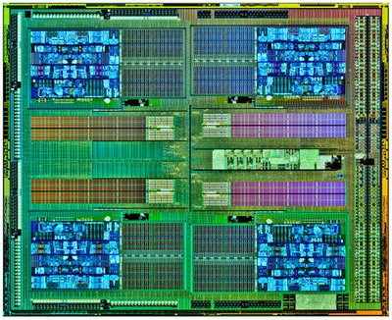
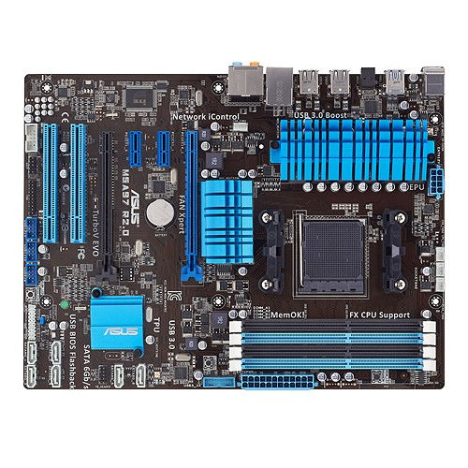

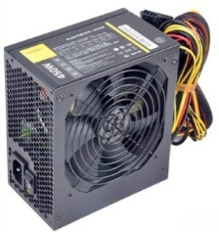
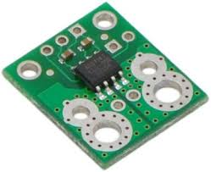
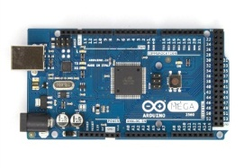
Experimental setup
CU
CU
platform & benchmarks
Processor: AMD FX-8320
  2nd Generation Family 15h “Piledriver”
  4 CUs (Compute Units)
    2 Cores in a CU
    5 VF (Voltage-Frequency) states
  The NB (North Bridge)
    Shared by all CUs
    L3$ and memory controller
Power Measurement
  Pololu ACS711: Current sensor
  Arduino: Power reading
Benchmark Suites
  SPEC® CPU 2006, PARSEC, NAS Parallel Benchmarks
North Bridge
CU
CU
FX-8320 CPU
Power Supply
ACS711
ASUS M5A97
Arduino
Notes:
I’d like to introduce our experimental setup first.
The processor we used is AMD FX-8320. It’s a product in AMD Family 15h. For short, we call it FX processor in our following slides. The die of the processor is shown in the right.
*click1*
It contains 4 compute units and each compute unit has 2 cores. There are 5 VF states for these cores.
*click2*
The north bridge contains the shared on-chip resources, including the L3 cache and the memory controller.
*click3*
To measure the power consumed by the processor, a current sensor is tied on the processor’s power line.
*click4*
At the same time, a microcontroller samples the current value and sends it to the processor.
*click5*
To validate our work, we use three benchmark suites. They are SPEC, PARSEC, and NPB.

Slide 5
outline
Background
Experimental Setup
Performance Prediction Across DVFS States
Power Prediction Across DVFS States
PPEP Framework
Conclusion
Q1: How does the application’s performance change with the VF state?
Notes:
So, let’s go to our first question: How does the application’s performance change with the VF state?

Slide 6
How CPI changes with frequency
(lower is better)
Estimate #1
CPI does not change when frequency increases.
Estimate #2
CPI also increases when frequency increases.
mcf
GAP
bzip2
Notes:
When we change the VF state, the factor impacts the performance is frequency.
So what happens to an application’s performance when core frequency changes?
The graph I’m showing here shows frequency on the X axis and Cycles-per-Instruction on the Y axis, both normalized to some point at the bottom left.
How does the application’s CPI scale when we change the core frequency?
*click* An optimistic answer is that the CPI does not change when frequency increases.
Applications such as bzip2, are like this.
*click* However, a more realistic case is that the CPI also increases when frequency increases.
Applications such as mcf, are like this.
*click* So how should we handle this difference?

Slide 7
What makes the CPI difference?
Core Frequency: f -> f’
Core clock cycles
bzip2
Core
Does not scale.
L3+DRAM
Cycles working in the CPU Core.
Core Frequency doesn’t matter.
GAP
mcf
Core
Does not scale.
L3+DRAM
Scales by f’/f.
Cycles stalled on Memory Accessing.
Scale with Core Frequency.
Key: Memory Stall Cycles estimation
Notes:
Here I’m illustrating a core clock cycle line of bzip2. It spends the majority of the clock cycles inside the core clock domain, and *click1* this cycle numbers is not affected by the core frequency. Therefore the CPI does not change.
However, for mcf, the condition is different.
*click2* Some amount of its work takes place inside the core clock domain.
*click* And other cycles, as in orange, take place outside of the core clock domain. In these cycles, the core is stalled, waiting for data from memory. Because it happens outside of the core clock domain, the time spent on waiting for data from the memory is not affected by the frequency. But, this same time leads to different clock cycle numbers at different core frequencies.
*click*
So, when we increase the core frequency from f to f’, *click* the number of the cycles spend on the core does not scale, but *click* the number of the cycles stalled for memory accessing scales.
This makes the programs such as mcf, have different execution cycle numbers, and CPI, at different core frequency.
*click* So if we want to estimate how a program’s CPI changes with the core frequency, the KEY issue we need to estimate is the number of memory stall cycles.

Slide 8
“Leading Loads” Memory Time Estimation
[CF’10 Keramidas+], [TOC’10 Eyerman+], and [IGCC’11 Rountree+]
Core clock cycles
Memory Stall Cycle
Memory Stall Cycles
Core
L3+DRAM
Leading Load
Leading Load
Not Leading
Leading Loads Model:
Memory stall cycles = cycles that leading loads are active
AMD hardware has MAB0 performance counter which can estimate Leading Loads cycles. [USENIX-ATC’14 Su+]
Notes:
However, in modern processors it is difficult to estimate the memory stall cycles.
*click1* First, modern microarchitectures allow memory level parallelism.
*click2* Second, out-of-order execution incurs overlap between computation and memory access.
*click3* And finally, different memory accesses also have different latencies.
These factors make that we could not accurately estimate the memory stall cycles from the memory access counts.
*click4* A few groups looked into this problem and proposed the “leading loads” estimation model on simulators.
A leading load is the first non-prefetch load to leave a core while there is no other active leading load from that core.
In other words, *click5* the first memory access shown in this timeline is a leading load. The following two parallel accesses *click6* are not. After the first leading load completes, the next memory access *click7* becomes a leading load, and so on.
*click8* The leading load model assumes that the cycles spent waiting for these leading loads is memory stall cycles.
*click9* The good news is, on AMD hardware we can estimate Leading Loads Cycles through the existing performance counter on the L2 cache’s Miss Address Buffer, or commonly known as Miss Status Handling Register. We’ve demonstrated how to make this performance counter work on different generations of AMD processors.
////////////////////////////////////////////////////////////////////////////////////////////////////////////////
Citations:
“Interval-based Models for Run-time DVFS Orchestration in Superscalar Processors,” Georgios Keramidas, Vasileios Spiliopoulos, Stefanox Kaxiras, In Proc. of the 7th ACM Int’l Conf on Computing Frontiers, May 2010.
“A Counter Architecture for Online DVFS Profitability Estimation,” Stijin Eyerman and Lieven Eeckhout, IEEE Trans. On Computers, Vol 59, No 11, November 2010.
“Practical Performance Prediction under Dynamic Voltage Frequency Scaling,” Barry Rountree, David K. Lowenthal, Martin Schulz, Bronis R. de Supinski, 2011 Int’l Green Computing Conference and Workshops, July 2011.

Slide 9
CPI predictor
# | Code | Event Name
E1 | 0x76 | CPU_Clocks_not_Halted
E2 | 0xc0 | Retired_Instructions
E3 | 0x69 | MAB0_Wait_Cycles
3 HW events
Step=200ms
MAB based Leading Loads Cycles
Running Frequency = f
Core clock cycles
Core
E1-E3
Instruction number = E2
L3 + DRAM
E3
CPI(f) = E1/E2
E1
LL-MAB CPI Predictor
Another
Frequency = f’
Core
E1-E3
Instruction number = E2
L3 + DRAM
E3*(f’/f)
CPI(f’) = (E1+E3*(f’/f - 1))/E2
E1+E3*(f’/f - 1)
Notes:
Now, with the leading load counter, we further implement a CPI predictor in this paper.
The table shows the 3 HW events we used.
Event 1 is “CPU_clock_not_halted” which counts the total execution cycles.
Event 2 counts the “Retired_Instructions”.
Event 3 is “MAB0_wait_cycles” which counts the memory stall cycles according to the leading load theory.
Suppose the core is running at frequency f.
Using these events we can get
*click1* the total execution cycle number,
*click2* the memory stall cycle number,
*click3* the core working cycle number,
*click4* the instruction number,
*click5* and the CPI.
*click6* And we could also predict these values at another frequency f’.
*click7* The core working cycle number does not change.
*click8* The memory stall cycle number scales with the 2 frequencies.
*click9* The total execution cycle number is their sum.
*click10* The instruction number does not change.
*click11* And finally the CPI at f’ can be predicted.
We name this CPI predictor “LL-MAB”, means it is an MAB based Leading Loads CPI predictor.
To make the predictor online, we count the HW events periodically with a 200ms step interval. Through this we can get a curve of the predicted CPI.

Slide 10
Predicted CPI curve V.S. measured CPI curve
1.7GHz (VF2) -> 3.5GHz (VF5)
Notes:
This slide shows the predicted CPI curve and the real measured CPI curve. The example benchmark is astar from SPEC.
In each figure, the X axis is the instruction line and the Y axis is the CPI.
The higher figure shows the predicted CPI curve of 3.5GHz from measurements taken at 1.7GHz.
And the lower figure shows the measured CPI curve of 3.5GHz.
We compare these two curves to evaluate the error of the CPI prediction.

Slide 11
CPI prediction error
FX-8320 Processor
All 52 benchmarks in SPEC, PARSEC, and NPB
1.7GHz (VF2) -> 3.5GHz (VF5)
15.5%
14.2%
3.0%
Notes:
We verify the LL-MAB CPI predictor on the FX processor with all benchmarks in the 3 benchmark suites.
We set 1.7GHz to be f and 3.5GHz to be f’.
This chart shows the CPI prediction error of each benchmark.
And the average prediction error is 3.0%.

Slide 12
outline
Background
Experimental Methodology
Performance Prediction Across DVFS States
Power Prediction Across DVFS States
PPEP Framework
Conclusion
Q2: How does the application’s
power change with the VF state?
Notes:
Till now, we have get the answer to the first question.
So let’s consider our second question: How does the application’s power change with the VF state?
To answer this:
First, we estimate the power consumed by the processor at the VF state it’s running at;
Then, we try to find the relationship between the power at different VF states.

Slide 13
  idle power model + Dynamic power model
Relationship?
Heating
Cooling
VF State | Voltage(V) | Frequency(GHz) | Error of P_{idle}
VF5 | 1.320 | 3.5 | 2.4%
VF4 | 1.242 | 2.9 | 2.6%
VF3 | 1.128 | 2.3 | 3.6%
VF2 | 1.008 | 1.7 | 2.8%
VF1 | 0.888 | 1.4 | 2.7%
Notes:
The processor’s power can be divided into 2 parts: the idle power and the dynamic power.
The idle power is the power consumed when the processor runs nothing but the OS housekeeping threads. It scales with the VF state and the temperature.
*click1* So, in each VF state, we use an experiment to figure out the relationship between the idle power and the temperature. In this figure, the X axis is the time line, the left Y axis is the normalized power, and the right Y axis is the temperature.
*click2* First, we run heavy workloads to heat up the processor until it reaches a steady-state temperature.
*click3* Then we remove the workloads. The chip then becomes idle and enters the cooling process.
*click4* During the cooling process, we collect the traces of the power and the temperature.
*click5* Finally, based on these data, we try to find the relationship between them.
We did the same experiment at every VF state. The paper details our formula that incorporates VF-state and temperature to estimate the idle power.
*click6* Here, this table shows the Voltage, Frequency, and the idle power estimation error of all VF states. The average error is lower than 3 percent.

Slide 14

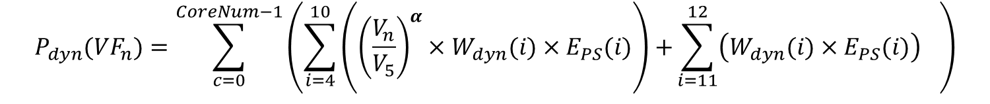
idle power model + Dynamic power model
  Chip Dynamic Power: $P_{dyn}(VF_{n})=P_{chip}−P_{idle}(VF_{n})$
Use 9 HW Events to Build the Dynamic Power Model
# | Event | Code
E4 | Retired_uOPs | 0xc1
E5 | FPU_Pipe_Assignment | 0x00
E6 | L1I$_Fetches | 0x80
E7 | L1D$_Accesses | 0x40
E8 | L2$_Requests | 0x7d
E9 | Retired_Branches | 0xc2
E10 | Retired_MisBranches | 0xc3
E11 | L2$_Misses | 0x7e
E12 | Dispatch_Stalls | 0xd1
$$P_{dyn}(VF_{n})=\sum_{c=0}^{CoreNum−1}{\left({\sum_{i=4}^{10}{\left({\left(\frac{V_{n}}{V_{5}}\right)}^{α}×W_{dyn}(i)×E_{PS}(i)\right)+}\sum_{i=11}^{12}{\left(W_{dyn}(i)×E_{PS}(i)\right)}}_{}\right)}$$
(PS= Per-Second Count Value)
Notes:
The dynamic power is the other part in the total power of the chip. It is consumed by the computation when the processor is busy running some user applications. Because we cannot directly measure the dynamic power, we get it by subtracting the estimated idle power from the measured chip power.
*click1* To estimate the dynamic power, we build a performance counter based model.
We select 9 HW events to build the model, as shown in the table.
*click2* This formula, which is detailed in the paper, relates these HW events to the total dynamic power of the chip at a particular VF state. In the model, we use the per-second count value of the events.

Slide 15
power model validation
experiment
Benchmark Combination
  Totally 152 combinations
  Thread number: 1, 2, 3, and 4
    SPEC: single-/multi- programed
    PARSEC: single-/multi- threaded
    NPB: single-/multi- threaded
4-fold cross validation
  Divide 152 benchmark combination in to 4 sets
  Train on all combinations of 3 sets
  Test on the remaining set
Number | SPEC | PARSEC | NPB | Total
1-thread | 29 | 13 | 10 | 52
2-thread | 15 | 13 | 10 | 38
3-thread | 10 | 12 | 10 | 32
4-thread | 7 | 13 | 10 | 30
Total | 61 | 51 | 40 | 152
Notes:
We get the chip power model by combining the idle power model and the dynamic power model.
To validate the power model, we generate 152 benchmark combinations from the 3 benchmark suites.
The detailed benchmark number is shown in the table.
*click1*
To test the accuracy of the power model, we divide the benchmark combinations into 4 sets and perform the 4-fold cross validation. This method uses 3 sets for training and use the remaining set for testing, to ensure that at any point we do not test the model on the training data.

Slide 16
power model validation
(lower is better)
Error: 4.6%
Standard Deviation: 2.8%
Notes:
This figure shows the estimation error of the chip power.
The columns show the average absolute error of the benchmark combinations from each suite, at each VF state.
For all benchmark combinations at all VF states, the average error is 4.6%.
The crosses in the figure show the standard deviation, which is 2.8% in average.

Slide 17
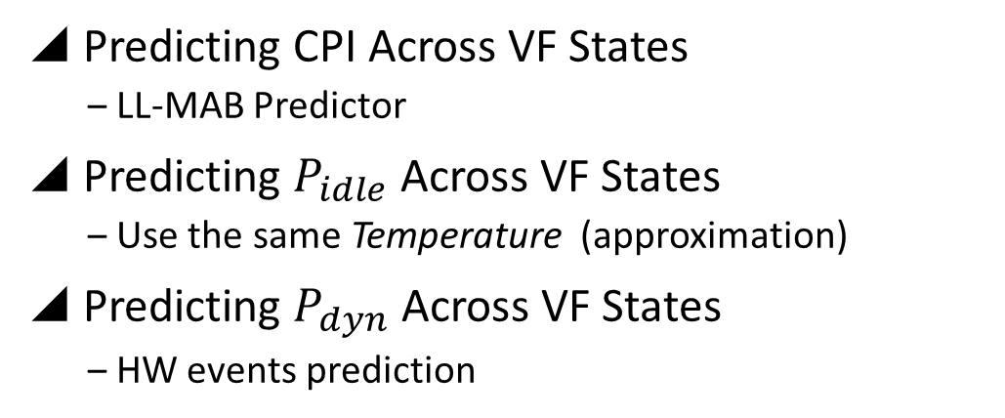
  Predicting Power Across VF States
VF5
CPI(VF₅)
P_{idle} (VF₅)
P_{dyn} (VF₅)
VF4
3 Events => CPI(VF₄)
T => P_{idle}(VF₄)
9 Events => P_{dyn}(VF₄)
VF3
CPI(VF₃)
P_{idle} (VF₃)
P_{dyn} (VF₃)
VF2
CPI(VF₂)
P_{idle} (VF₂)
P_{dyn} (VF₂)
VF1
CPI(VF₁)
P_{idle} (VF₁)
P_{dyn} (VF₁)
LL-MAB
same T
HW event prediction ?
Predicting CPI Across VF States
  LL-MAB Predictor
Predicting $P_{idle}$ Across VF States
  Use the same Temperature (approximation)
Predicting $P_{dyn}$ Across VF States
  HW events prediction
E_{PS(i)}(VF5)
E_{PS(i)}(VF4)
E_{PS(i)}(VF3)
?
i=4,…,12
E_{PS(i)}(VF2)
E_{PS(i)}(VF1)
2 observations + LL-MAB CPI Predictor
Notes:
Till now, (Suppose there is a program running at VF4. )
For performance, we can use 3 events to figure out the CPI and predict CPI from one VF state to other VF states with the LL-MAB predictor.
For power, we could use Temperature to estimate the idle power and use 9 events to estimate the dynamic power.
So the remaining question is, how do we predict power from one VF state to other VF states?
*click1* For the idle power, *click*, we directly use the temperature at the current VF state, to calculate the idle power at other VF states. It is a simple approximation. (And we leave the temperature prediction to our future work.)
*click2* It is more complicate to predict the dynamic power across VF states.
*click3* Because the dynamic power model is based on 9 HW events, to do this, we need to predict these events across VF states.
*click4* The good news is, we can manage it based on 2 experimental observations and the LL-MAB CPI predictor.

Slide 18
observation 1 + observation 2
At any given point in the execution of a program, core-private HW event counts per instruction are independent of VF state.
=> To execute the same section of instructions in a program, the activities of core-private resources are independent of VF state.
# | Event Name
E4 | Retired_uOPs
E5 | FPU_Pipe_Assignment
E6 | L1I$_Fetches
E7 | L1D$_Accesses
E8 | L2$_Requests
E9 | Retired_Branches
E10 | Retired_MisBranches
E11 | L2$_Misses
Error
0.6%
0.9%
0.7%
0.7%
5.0%
0.7%
1.3%
4.0%
On FX-8320, between 3.5GHz (VF5) and 1.7GHz (VF2)
Notes:
Now let’s look the 2 observations.
Observation 1 indicates that, At any given point in the execution of a program, core-private HW event counts per instruction are independent of VF state.
In other words: at different VF states, to execute the same section of instructions in a program, the core private resources’ activities are the same.
They include the activities of the pipeline, the L1 cache, and the L2 cache.
The first 8 HW events in the dynamic power model, from Event 4 to Event 11 shown in the table, follow this observation.
Their counts are only related with the application’s behavior and the core microarchitecture, but are not related with the core frequency.
*click*
We verified this using all benchmarks form the 3 suites. On FX processor, the differences of these HW events are all under 5% between VF2 and VF5.

Slide 19

Observation 1 + observation 2
At any given point in the execution of a program, $C_{PI}$ - ${DispatchStall}_{PI}$ is independent of VF state. (PI=Per Instruction)
=> To execute the same section of instructions, E1-E12 is independent of VF state.
# | Event
E1 | CPU_Clock_not_Halted
E12 | Dispatch_Stalls
Gap Error
1.7%
On FX-8320, between3.5GHz (VF5) and 1.7GHz (VF2)
Cycles retiring 4 instructions
Cycles retiring 3 instructions
Cycles retiring 2 instructions
Cycles retiring 1 instruction
Cycles without retiring
Overheads of mispredicted branches and exceptions
Dispatch Stalls
Freq = f
Start
Frequency Independent
end
Freq = f’
0.6%
0.9%
1.0%
1.5%
Notes:
So this is the observation 2. This observation indicates that, At any given point in the execution of a program, the gap between Cycles_Per_Instruction and Dispatch_Stall_Per_Instruction is independent of VF states.
In other words, at 2 different VF states, to execute the same section of instructions in a program, the gap between the total cycle number and the dispatch stall cycle number does not change.
*click0* Through the measurements of the 2 events at VF2 and VF5, the error of this observation is 1.7%.
I analyzed this observation on FX processor. In the processor, a core can retire at most 4 instructions in each cycle.
*click1* According to how many instructions are retired in a cycle, we classify the cycles into 5 classes.
*click2* The figure shows these cycles at the two frequencies f and f’.
*click3* We measured the cycles retiring 1, 2, 3, and 4 instructions at VF2 and VF5, finding these cycle numbers are frequency independent. Their differences are all below 1.5%. (//only 0.6%, 0.9%, 1.0%, and 1.5%, respectively.)
The cycles without retirement can be further divided into two part.
*click4* One part is the cycles in which the instructions are executed but not retired. The main cause is the mispredicted branches and the exceptions. Because they are only related with the program behavior and the microarchitecture, so the number of these cycles is also frequency independent.
*click5* The other cycles are dispatch stalls. So, the gap between the total cycles and the dispatch stall cycles is the summation of all other cycles. Therefore the gap is frequency independent.

Slide 20




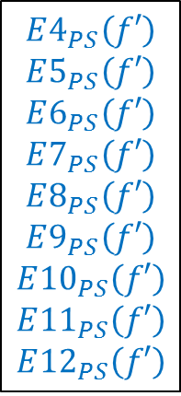
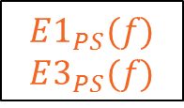
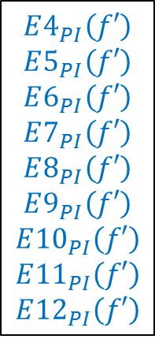


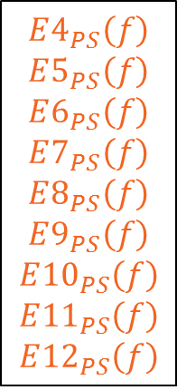
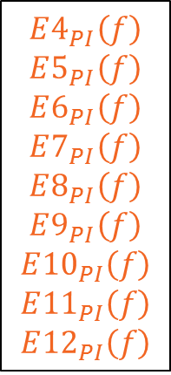
Dynamic power prediction – flow
HW Events
Prediction Flow (Bridge: LL-MAB + 2 OBs)
# | Event
E1 | CPU_Clock_not_Halted
E2 | Retired_Instructions
E3 | MAB0_Wait_Cycles
E4 | Retired_uOPs
E5 | FPU_Pipe_Assignment
E6 | L1I$_Fetches
E7 | L1D$_Accesses
E8 | L2$_Requests
E9 | Retired_Branches
E10 | Retired_MisBranches
E11 | L2$_Misses
E12 | Dispatch_Stalls
Running Frequency = $f$
Another Frequency = $f′$
From PMC
$$E1_{PS}(f)$$
$$E3_{PS}(f)$$
LL-MAB
$$CPI(f)$$
$$CPI(f′)$$
$$E2_{PS}(f)$$
$$E4_{PS}\left(f′\right)$$
$$E5_{PS}\left(f′\right)$$
$$E6_{PS}\left(f′\right)$$
$$E7_{PS}\left(f′\right)$$
$$E8_{PS}\left(f′\right)$$
$$E9_{PS}\left(f′\right)$$
$$E{10}_{PS}\left(f′\right)$$
$$E{11}_{PS}\left(f′\right)$$
$$E{12}_{PS}\left(f′\right)$$
$$E4_{PI}\left(f\right)$$
$$E5_{PI}\left(f\right)$$
$$E6_{PI}\left(f\right)$$
$$E7_{PI}\left(f\right)$$
$$E8_{PI}\left(f\right)$$
$$E9_{PI}\left(f\right)$$
$$E{10}_{PI}\left(f\right)$$
$$E{11}_{PI}\left(f\right)$$
$$E{12}_{PI}\left(f\right)$$
$$E4_{PI}\left(f′\right)$$
$$E5_{PI}\left(f′\right)$$
$$E6_{PI}\left(f′\right)$$
$$E7_{PI}\left(f′\right)$$
$$E8_{PI}\left(f′\right)$$
$$E9_{PI}\left(f′\right)$$
$$E{10}_{PI}\left(f′\right)$$
$$E{11}_{PI}\left(f′\right)$$
$$E{12}_{PI}\left(f′\right)$$
$$E4_{PS}\left(f\right)$$
$$E5_{PS}\left(f\right)$$
$$E6_{PS}\left(f\right)$$
$$E7_{PS}\left(f\right)$$
$$E8_{PS}\left(f\right)$$
$$E9_{PS}\left(f\right)$$
$$E{10}_{PS}\left(f\right)$$
$$E{11}_{PS}\left(f\right)$$
$$E{12}_{PS}\left(f\right)$$
Observation 1 Observation 2
$$P_{dyn}(f^{′})$$
PS=per-second
PI=per-instruction
Notes:
Now, with these 2 observations and the CPI predictor, we can predict the dynamic power from frequency f to frequency f’.
In the table I list all the 12 HW events we need. Three Events, from NO.1 to NO.3, are used in the LL-MAB CPI predictor. Nine events, from NO.4 to NO.12 are used in the dynamic power model.
Here is the prediction flow of the dynamic power.
*click1* First, the per-second counts of all the events are measured by the performance counters at frequency f.
*click2* And through these data we calculate their per-instruction counts.
*click3* Then, through LL-MAB, we predict the CPI at f’.
*click4* And, according to the 2 observations, we get the per-instruction counts of the nine power-related events at the new frequency f’.
*click5* After that, with the predicted CPI, we can further get their per-second counts from their per-instruction counts.
*click6* And finally, we can estimate the dynamic power at frequency f’.

Slide 21
Predicting error of average chip power
Lower is better
Error: 4.2%
Standard Deviation: 3.6%
Notes:
Combining the idle power prediction and the dynamic power prediction, we can do the chip power prediction across VF states.
We tested on all of the benchmark combinations, and do the power prediction from every VF state to every VF state.
For each bar of the figure, Vfi -> VFj means we run the program at Vfi, predict the power of VFj, and then compare the predicted average power with the measured average power of VFj.
In each bar, the column is the prediction error and the cross is the standard deviation among different benchmarks. Their average values are 4.2% and 3.6%.

Slide 22
outline
Background
Experimental Methodology
Performance Prediction Across DVFS States
Power Prediction Across DVFS States
PPEP Framework
Conclusion
Q1: How does the application’s performance change with the VF state?
Q2: How does the application’s
power change with the VF state?
Notes:
Now, we have answered these 2 questions, *click*.
And, based on our answers, we finally build the PPEP Framework.

Slide 23
PPEP framework
Online
Commercial
Processors
Performance
Power
PMC based User Daemon
Periodically Running
Energy
Prediction
Notes:
This figure shows the overview of PPEP, after we split the chip power to each core.
The flow in the block shows how we predict the PPE information starting from the measurements through the performance counters.
*click1* Generally, PPEP is a centralized software user level daemon that runs alongside regular applications.
It can do the online performance, power, and energy predictions across VF states on commercial AMD processors.
Therefore, PPEP could be served as a infrastructure for DVFS policies.
The paper also includes the usage of the PPEP framework, such as the one-step power capping and further DVFS space exploration.

Slide 24
conclusion
On Commercial Processor
Demonstrated an across-VF CPI predictor “LL-MAB”
  According to the Leading Loads theory
Demonstrated an across-VF power predictor
  Through the “LL-MAB” CPI predictor and 2 observations
Combining them together: PPEP Framework
  Supplies performance, power, and energy information
  SW method w/o requiring HW or OS modification
Notes:
And here is the conclusion of this work.
On commercial processor, we demonstrated the LL-MAB CPI predictor according to the leading loads theory.
Based on the measured CPI of the current VF state, LL-MAB allows us to predict the CPI of all other VF states.
And further, based on the CPI predictor and 2 observations, we also demonstrated a power predictor across VF states.
Finally, combining the performance and power predictors together, we get the PPEP framework which supplies performance, power, and energy information of all VF states. It is a software framework without requiring hardware or Operating System modifications.

Slide 25
Thank you!
Questions
Notes:
That’s all of the talk, thank you for your attention!

Slide 26
Disclaimer & Attribution
The information presented in this document is for informational purposes only and may contain technical inaccuracies, omissions and typographical errors.
The information contained herein is subject to change and may be rendered inaccurate for many reasons, including but not limited to product and roadmap changes, component and motherboard version changes, new model and/or product releases, product differences between differing manufacturers, software changes, BIOS flashes, firmware upgrades, or the like. AMD assumes no obligation to update or otherwise correct or revise this information. However, AMD reserves the right to revise this information and to make changes from time to time to the content hereof without obligation of AMD to notify any person of such revisions or changes.
AMD MAKES NO REPRESENTATIONS OR WARRANTIES WITH RESPECT TO THE CONTENTS HEREOF AND ASSUMES NO RESPONSIBILITY FOR ANY INACCURACIES, ERRORS OR OMISSIONS THAT MAY APPEAR IN THIS INFORMATION.
AMD SPECIFICALLY DISCLAIMS ANY IMPLIED WARRANTIES OF MERCHANTABILITY OR FITNESS FOR ANY PARTICULAR PURPOSE. IN NO EVENT WILL AMD BE LIABLE TO ANY PERSON FOR ANY DIRECT, INDIRECT, SPECIAL OR OTHER CONSEQUENTIAL DAMAGES ARISING FROM THE USE OF ANY INFORMATION CONTAINED HEREIN, EVEN IF AMD IS EXPRESSLY ADVISED OF THE POSSIBILITY OF SUCH DAMAGES.
ATTRIBUTION
© 2014 Advanced Micro Devices, Inc. All rights reserved. AMD, the AMD Arrow logo and combinations thereof are trademarks of Advanced Micro Devices, Inc. in the United States and/or other jurisdictions. SPEC is a registered trademark of the Standard Performance Evaluation Corporation (SPEC). Other names are for informational purposes only and may be trademarks of their respective owners.

Slide 27
Backup Slides
Notes:
StaP Pre 6.3% 12.6%
TotP Pre 4.2% 30.2%
TotP Est 4.6% 27.6%
AccuE Pre 6.1% 78%

Slide 28
Performance & power prediction
Running VF state: VF4
Predicting performance, power of other VF states
Core VF State
Performance
Power
Higher
VF₅
CPI(VF₅)
Power(VF₅)
Running at:
Running at:
VF₄
CPI(VF₄)
Power(VF₄)
VF₃
CPI(VF₃)
Power(VF₃)
VF₂
CPI(VF₂)
Power(VF₂)
Lower
VF₁
Performance prediction?
CPI(VF₁)
CPU Power prediction?
Power(VF₁)
Notes:
In this work, we overcome these difficulties. Starting from measurements taking at one VF state, we can predict the performance and power of all other VF states on commercial AMD processors.
For performance prediction, we implement a Cycles-Per-Instruction predictor, named LL-MAB.
It takes advantage of the Miss Address Buffer (or known as Miss Status Handling Register) of the L2 cache, to count the memory stall cycles according to the Leading Loads theory. The CPI prediction error is 3.2 percent across a more than 2x change in frequency..

Slide 29
Experimental methodology
Software tools
Operating System
  Ubuntu 12.04 LTS Desktop (kernel version 3.2.0-24)
Tools
  taskset: A2C mapping
  msr-tools: PMC control
  CPUFreq userspace governor: VF Scaling
  hwmon tree in sysfs: temperature measurement
Benchmark Suites
  SPEC® CPU 2006 v1.2 (29 benchmarks)
  PARSEC v2.1 (13 benchmarks)
  NAS Parallel Benchmarks v3.3.1 (10 benchmarks)
Notes:
For the software, we use the Ubuntu operating system, along with some tools employed in our experiments.
To validate our work, we use 3 widely used benchmark suites. They are SPEC CPU 2006, PARSEC, and NAS Parallel Benchmarks.
//On this OS, we use “Tastset” to tie applications to cores.
//We use “msr-tools” to set and read the performance counters.
//We use the userspace governor of CPUFreq to change the VF states of the CPU.
//And we get the temperature of the processor in the hardware-monitor tree.

Slide 30
How to estimate “memory stall cycles”?
Modern Cores Make this Difficult
Memory level parallelism
Accesses overlap computation
Variable latencies
memory access counts do not estimate memory time accurately
Core clock cycles
Core Work
L3+DRAM
Variable Latencies
Multiple Parallel Accesses
Accesses Overlap Computation
Notes:
How, then, do we estimate memory time?
Unfortunately, modern CPU microarchitectures make it difficult to do so.
If we look at an example of execution trace *click* a CPU will do some work in the core and then eventually access memory. However, out-of-order execution allows cores to perform work while waiting for these cache misses to return *click*. And, in fact, that work can create more parallel memory accesses. *click*
The CPU will eventually stall because of program or resource limitations, but *click* these multiple parallel accesses mean that simple cache miss counts don’t directly correlate to memory time. Three misses could be back-to-back or in parallel, for example.
Eventually, when useful data returns from the memory *click* the CPU can continue its work. However *click* that means that computation can overlap with memory accesses – meaning that simply counting the amount of time that a load is outstanding doesn’t match memory time either.
*click* And as a final note, memory accesses can have variable latencies, meaning that it’s even more difficult to use memory access counts to estimate memory time.

Slide 31
Leading Loads on AMD Processors
L2 cache misses held in Miss Address Buffer (MAB)
  MAB entries have a static priority (e.g. MAB0 is highest priority)
  Highest priority empty MAB holds the miss until it returns from memory
Performance event 0x69 allows SW to count # of cycles with filled MABs
Core Clock Domain
NB and Memory Clock Domains
Miss Address Buffers
CPU Core
&
L1 Cache
L2 Cache
MAB0
MAB0
L3 Cache & DRAM
MAB1
MAB1
MAB2
MAB2
…
MABn
Notes:
Good news, then: you can approximate a leading loads performance counter on existing AMD hardware.
On AMD processors, CPU cores and their first two levels of cache share a clock domain. Computation and memory accesses that hit in these caches are affected by core frequency.
When an L2 cache miss is sent to memory, the request is stored in a structure referred to as a miss address buffer, or MAB. (This is commonly called a miss status handling register in the literature).
These entries are allocated with a fixed priority. For example, in the latest generation of cores, lower numbered MABs have higher priority (MAB0 has the highest priority). The highest priority entry that does not currently hold a request is then used to hold the newest memory request.
For example: The first L2 cache miss *click* is inserted into MAB0 before being sent to the memory system *click*.
If the next L2 miss happens before that data returns, it’s put into MAB1 *click* and so on *click*.
When a value is returned from memory, its MAB is cleared and the data is sent back into the core *click*. The next request *click* then goes back into MAB0.
This last bit is important, because if you look closely, that’s exactly what we need to count leading loads. So long as MAB0 is full, there is a leading load. Once MAB0 is empty, there is no leading load, and the next load will be a leading load.
In addition, AMD processors have the ability to count the number of core clock cycles that any particular MAB is full. Performance event 69 lets us count the amount of memory time using this leading loads model.
(There are limitations to this model which are discussed into the paper, which I’m glossing over due to time constraints).

Slide 32
Mab based leading loads model: ll-mab
experiment
Benchmark
  Running on core 0.
Manager
  Running on Core 7. Collects the counts every 200ms.
CU 0
CU 1
CU 2
CU 3
Core 0
Core 1
Core 2
Core 3
Core 4
Core 5
Core 6
Core 7
Benchmark
Manager
L2 Cache
L2 Cache
L2 Cache
L2 Cache
L3 Cache & Memory Controller
200ms
Core 0
Core 7
CPI(f)
CPI(f)
CPI(f)
CPI(f)
CPI(f)
CPI(f)
Measured
CPI(f)
CPI(f)
Predicted CPI(f’)
CPI(f’)
CPI(f’)
CPI(f’)
CPI(f’)
CPI(f’)
CPI(f’)
CPI(f’)
Notes:
To validate the LL-MAB model, we took experiments on the FX processor.
*click* the benchmarks, as shown in red, are attached on Core 0.
*click* A manager program, as shown in blue, is attached on the Core 7.
Using the model described in the last slide, in each step, *click*, we get a measured CPI at frequency f, and a predicted CPI at frequency f’.
Then, *click*, with the execution of the benchmark, we get a predicted CPI curve at f’.
After that, we run the same benchmark at frequency f’, and get a measured CPI curve at f’.
//We embedded “msr-tools” in the manager. And it sets and reads the performance counters in every 200-millisecond step.

Slide 33
Predicted CPI V.S. measured CPI
1.7GHz -> 3.5GHz
a) Divide each curve into 20 segments;
b) Compare cycle numbers in each segment-pair;
c) Average absolute error => CPI Prediction Error.
Notes:
This slide shows the predicted CPI curve and the real measured CPI curve.
In each figure, the X axis is the instruction line and the Y axis is the CPI.
The example benchmark is astar from SPEC.
The higher figure shows the predicted CPI curve of 3.5GHz from measurements taken at 1.7GHz.
And the lower figure shows the measured CPI curve of 3.5GHz.
*click1* Then we compare the curves and get the prediction error like this.
*click2* First, we divide the curves into 20 segments;
*click3* Second, we compare the two cycle numbers in each segment-pair;
And finally, we calculate the average absolute error of the 20 segment-pair, as the CPI prediction error.

Slide 34
CPI Prediction Error V.S. memoryboundedness
1.7GHz -> 3.5GHz

Slide 35

Chip idle power model
Model and error
Idle Power Estimation Model
  $P_{idle}\left(VF_{n}\right)=W_{idle1}\left({VF}_{n}\right)×Temperature+W_{idle0}({VF}_{n})$
  $W_{idle1}\left({VF}_{n}\right)=a_{3}V_{n}^{3}+{a_{2}V}_{n}^{2}+{a_{1}V}_{n}^{}+a_{0}$
  $W_{idle0}\left({VF}_{n}\right)=b_{3}V_{n}^{3}+{b_{2}V}_{n}^{2}+{b_{1}V}_{n}^{}+b_{0}$
Notes:
with the idle power trace and temperature traces, we build regression models to describe the relationship between the idle power and the temperature.
To simplify the problem, we first build 5 regression models for the 5 VF states of the FX processor.
Theoretically, the relationship between idle power and temperature should be exponential. However, we observed that, when the variation ranges of power and temperature are small, a linear model is also accurate enough to describe the relationship of idle power and temperature. In this equation, Widle1 and Widle0 are constants in a specific VF state.
Then, we find the 5 separate linear models could be unified to one model.
The constants Widle1 and Widle0 could be described by a third-order polynomial of the voltage, as shown.
We verified the accuracy of our chip idle power model, from VF5 to VF1, the error is 2%, 3%, 4%, 3%,and 3%, respectively.

Slide 36

Chip dynamic power model
experiment
App threads mapping & Manager
CU 0
CU 1
CU 2
CU 3
Core 0
Core 1
Core 2
Core 3
Core 4
Core 5
Core 6
Core 7
App thread
App thread
App thread
App thread
Manager
L2 Cache
L2 Cache
L2 Cache
L2 Cache
L3 Cache & Memory Controller
Time
Step (200ms)
  Count events on each core
  Get $P_{chip}$ and Temperature
2 Half-steps (100ms each)
  Time-multiplexing the counters
  Count 6 events on each core
10 Power-steps (20ms each)
  Read power from microcontroller
  $P_{chip}$ is the average power
Step = 200ms
1st half-step (100ms)
2nd half-step (100ms)
power-step (20ms) x10
Manager sleeping
Manager working
Notes:
Now we show how we build and verify the dynamic power model.
The threads of the applications to be tested are attached on the 1st core of each compute unit. We use taskset to do the attachement. The number of the threads varies from 1 to 4, as marked in red color.
And again there is a manager program running along with the applications being tested. The manager program would collect the HW events on each core, and get the power and temperature of the chip. We still use 200 millisecond as one step.
Here we illustrate how the manager program works in one step.
First, one step is cut into 2 half-step equally. Each half-step has 100 millisecond. We do this because every core has only get 6 performance counters, but we need more events to estimate the core’s dynamic power. So we need to use the performance counters in a time multiplexing way. Now, we could count 6 events in the 1st half-step and count the other 3 in the 2nd. By doing this we could count at most 12 events in one step. However, this is a compromise. The price is losing some counting accuracy, especially the program phases in the 1st half-step and the 2nd half-step are very different.
Further, we cut each half-step into 5 smaller power-steps, which has the length of 20 milliseconds. So there are totally 10 power-steps. In each power step, we read a measured chip power value from the Arduino board. P_chip of this step is the average of the 10 power values.
So, with these settings, in every step, we get the data we need in the chip dynamic power model.

Slide 37
Fitting error: dynamic power model
(Lower is better)
Error: 10.6%
Standard Deviation: 5.8%
Notes:
This chart show the error of the dynamic power model, under the 4-fold cross validation.
The columns show the average absolute error of the benchmark combinations. For all benchmark combinations at all VF states, the Average Absolute Error of the dynamic power estimates is 10.6%.
The crosses show the corresponding average standard deviation, which is 5.8%.

Slide 38
Predicting error: average $P_{dyn}$
(Lower is better)
Error: 8.3%
Standard Deviation: 6.9%
Notes:
We verify the dynamic power prediction method from every VF states to every VF states.
For example, Vfi -> VFj means we run the program and collect event counts at Vfi, and predict the dynamic power of VFj. The prediction is taken in every step, and when the program is finished, we get the average value of these predicted dynamic power values.
After that, we run the same program at VFj, and measure the average dynamic power by the power meter.
Then we compare the predicted average dynamic power and the measured dynamic power, and get an prediction error.
We tested all the 152 benchmark combinations, from every VF states to every VF states.
As there are 5 VF states, so there are totally 25 bars in the chart.
In each bar, the column is the average error of all benchmark combinations, the overall average error is 8.3%.
The cross is the standard deviation, the overall standard deviation is 6.9%.

Slide 39

  The impact of Power Gating
Getting per-core power
  $P_{dyn}$ ---- has already split to cores naturally
  $P_{idle}$ ---- what is the quotas for each core and the north bridge?
Splitting the $P_{idel}$
  With the help of Power Gating feature of the processor
Enabling Power Gating (PG) in FX-8320
  Per-CU Power Gating
  CU: Both cores in a CU are idle => CU is power gated
  NB: All CUs are idle => NB is power gated
Notes:
Now the last thing in the model is how to split the chip power to every core, as we need a per-core power model in the final.
Currently, the power model is for the processor configuration in which the Power Gating feature is disabled. So it is quite straight forward to split the chip power to each core. For the dynamic power, as we select the HW events which could be counted in the per-core way, so the dynamic power model is naturally a per-core model. The cores executing programs would have high dynamic power. And the cores lying in idle would have nearly zero dynamic power. For the idle power, a simplest way is equally splitting the estimated chip idle power to the busy cores. In fact, in this case, a busy core would carry more idle power it actually consumes, as long as there are core is in idle state. It is OK when the power gating feature is disabled.
However, things are different when we enable the Power Gating feature.
Let us first look at how the Power Gating feature works. In the FX processor, Power Gating is implemented at the CU level. That is, a CU would be power gated if both of its cores are idle. The NB would also be power gated if all of the CUs are idle. Thus, if any part of the CPU is power gated, the estimated chip idle power would be larger than the real idle power. So we need to estimate exactly how much idle power is consumed by each CU and the north bridge. Only with these estimate, we could correctly handle the idle power when PG is enabled.

Slide 40
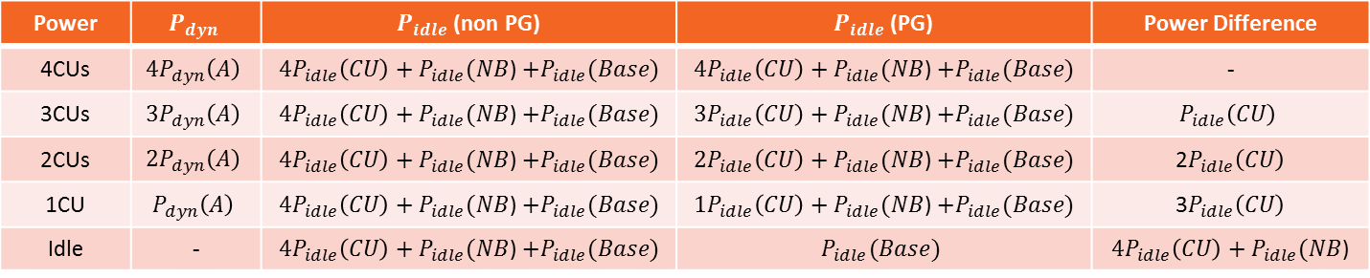


The impact of Power Gating
Micro Benchmark: “A”
  Dataset is fitted in L1 data cache => No NB activity (dynamic power)
  N instances of “A” times the dynamic power of “A” by N
Power | $$P_{dyn}$$ | $P_{idle}$ (non PG) | $P_{idle}$ (PG) | Power Difference
4CUs | $${4P}_{dyn}\left(A\right)$$ | $4P_{idle}\left(CU\right)+P_{idle}(NB$) $+P_{idle}(Base)$ | $4P_{idle}\left(CU\right)+P_{idle}(NB$) $+P_{idle}(Base)$ | -
3CUs | $${3P}_{dyn}\left(A\right)$$ | $4P_{idle}\left(CU\right)+P_{idle}(NB$) $+P_{idle}(Base)$ | $3P_{idle}\left(CU\right)+P_{idle}(NB$) $+P_{idle}(Base)$ | $$P_{idle}\left(CU\right)$$
2CUs | $${2P}_{dyn}\left(A\right)$$ | $4P_{idle}\left(CU\right)+P_{idle}(NB$) $+P_{idle}(Base)$ | $2P_{idle}\left(CU\right)+P_{idle}(NB$) $+P_{idle}(Base)$ | 2$P_{idle}\left(CU\right)$
1CU | $$P_{dyn}\left(A\right)$$ | $4P_{idle}\left(CU\right)+P_{idle}(NB$) $+P_{idle}(Base)$ | $1P_{idle}\left(CU\right)+P_{idle}(NB$) $+P_{idle}(Base)$ | 3$P_{idle}\left(CU\right)$
Idle | - | $4P_{idle}\left(CU\right)+P_{idle}(NB$) $+P_{idle}(Base)$ | $$P_{idle}(Base)$$ | $4P_{idle}\left(CU\right)+P_{idle}(NB$)
4P_{dyn}(A)+P_{idle}(Chip)
A2C Mapping | CU0 C0, C1 | CU1 C2, C3 | CU2 C4, C5 | CU3 C6, C7
4CUs | A, - | A, - | A, - | A, -
3CUs | A, - | A, - | A, - | Idle
2CUs | A, - | A, - | Idle | Idle
1CU | A, - | Idle | Idle | Idle
Idle | Idle | Idle | Idle | Idle
P_{idle}(CU)
3P_{dyn}(A)+P_{idle}(Chip)
2P_{idle}(CU)
2P_{dyn}(A)+P_{idle}(Chip)
P_{dyn}(A)+P_{idle}(Chip)
3P_{idle}(CU)
4P_{idle}(CU)
+P_{idle}(NB)
P_{idle}(Chip)
P_{idle}(Base)
n = busy cores in Chip
m = busy cores in CU
Get P_{idle}(CU), P_{idle}(NB), P_{idle}(Base)
When Power Gating is disabled:
When Power Gating is enabled:
$$P_{idle}\left(core\right)=\frac{{4P_{idle}\left(CU\right)+P}_{idle}\left(NB\right)+P_{idle}(Base)}{n}$$
$$P_{idle}\left(core\right)=\frac{P_{idle}\left(CU\right)}{m}+\frac{P_{idle}\left(NB\right)+P_{idle}(Base)}{n}$$
Notes:
We design an experiment to peel the CU’s idle power and north bridge’s idle power.
We implement a north bridge free microbenchmark, named “A”. It has steady program phase and its dataset is well fitted in the L1 data cache. Thus, when multiple instances of “A” are running on different CUs, each instance’s performance and dynamic power is the same as it was running alone.
We set 5 experiment configurations. The A2C mapping in each configuration is shown in the table.

Slide 41
PPEP framework
Computation complexity
Computation complexity on each core
If core number is c, VF number is k
For the current VF state | ADD | MUL | DIV
CPI calculation |  |  | 1
Power calculation | 18 | 29
Total | 18 | 29 | 1
For every other VF state | ADD | MUL | DIV
CPI prediction | 4 | 1 | 11
Power prediction | 18 | 39 | 1
Total | 22 | 40 | 12
OP | Number | Example: FX-8320, c=8, k=5
ADD | c*(18+22*(k-1)) | 848
MUL | c*(29+40*(k-1)) | 1512
DIV | c*(1+12*(k-1)) | 392
<3k FPOPs Per-step
(computing flow w/o optimized)

Slide 42
PPEP framework
Running overhead
Measured Running Overhead
Overhead of PPEP (FX-8320, VF5) | Step = 200ms | Step = 20ms
Power | Negligible | 1.3W
Performance (App and PPEP is not attached on a same core) | Negligible | Negligible
Performance (App and PPEP is attached on a same core) | 1.6% slowdown | 5.8% slowdown

Slide 43
PPEP Usage example: one-step power capping
PPEP could rapidly reach the cap

