Slide 1
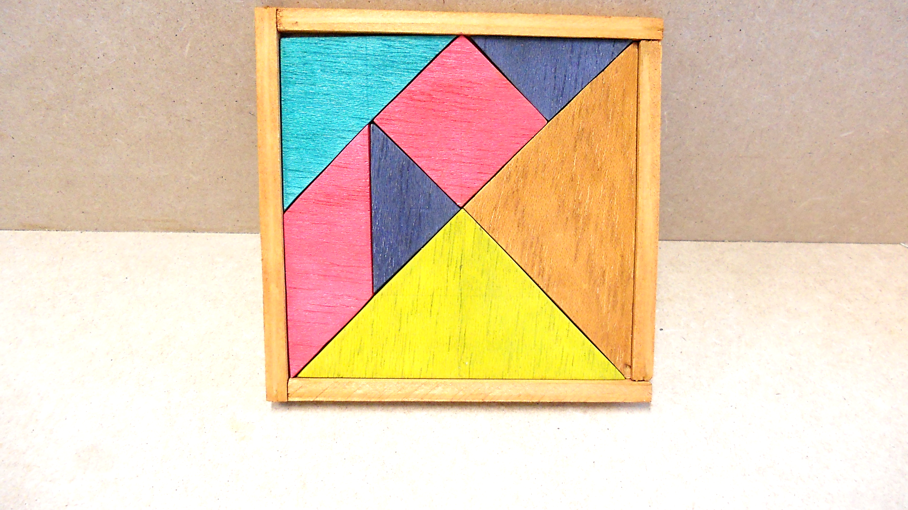
Tangram: Integrated Control of Heterogeneous Computers
Raghavendra Pradyumna Pothukuchi, Joseph L. Greathouse, Karthik Rao, Christopher Erb, Leonardo Piga, Petros Voulgaris, Josep Torrellas
International Symposium on Microarchitecture (MICRO), October 2019
Session III B 5:10 PM, Monday

Slide 2
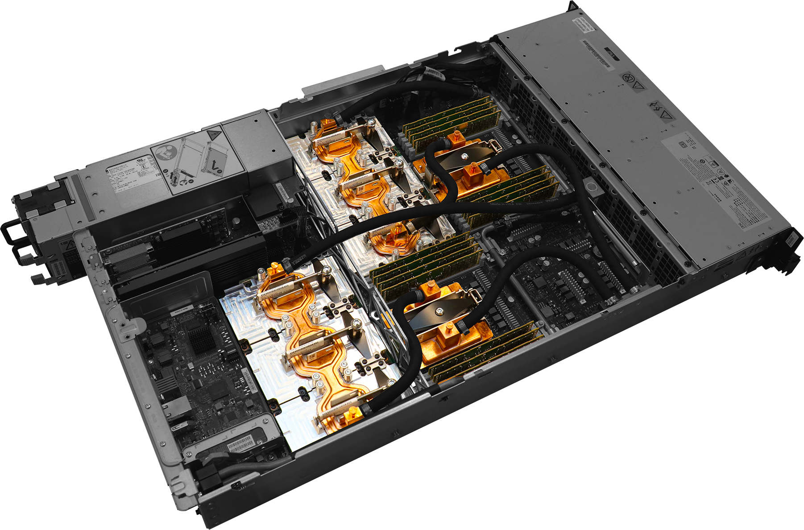
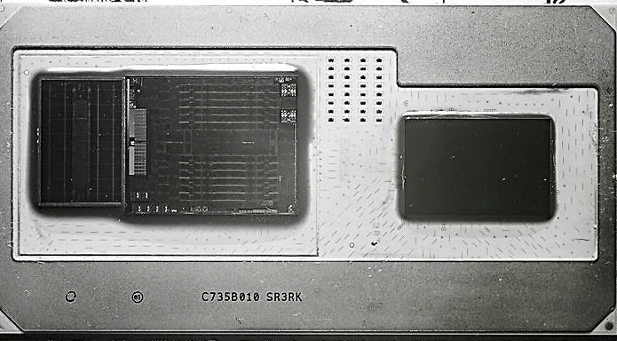
Heterogeneity Comes With Modularity
Heterogeneous computers are integrated from independent subsystems
Nvidia GPU
IBM CPU
AMD GPU
Intel CPU
Board controller
IBM CPU
HBM2
Nvidia GPU
(Image courtesy: NVIDIA)
Challenge: System-wide efficiency with distributed resource control

Slide 3
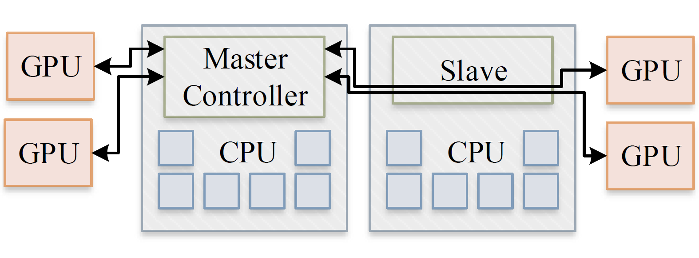
State-of-the-Art Resource Controllers
Limitation 1: Many heuristic algorithms
Conflicting, ineffective and little reuse
Limitation 2: Centralized control
Slow, non-modular and ineffective

Slide 4
Tangram: Fast, Modular and Coordinated
C
Formal controller with standard interface
C
C
C
Chip 1
C
Chip 2
Cluster 1
C
Cluster 2
Node

Slide 5
Tangram: Fast, Modular and Coordinated
C
Formal controller with standard interface
Real system prototype
C
C
C
Chip 1
32% faster
13% lower energy
C
Chip 2
Cluster 1
C
Cluster 2
Node

Slide 6
Tangram: Fast, Modular and Coordinated
C
Formal controller with standard interface
Real system prototype
C
C
C
Chip 1
32% faster
13% lower energy
C
Chip 2
Session III B
5:10 PM
Cluster 1
C
Cluster 2
Node

