Slide 1



Tangram: Integrated Control of Heterogeneous Computers
Raghavendra Pradyumna Pothukuchi, Joseph L. Greathouse, Karthik Rao, Christopher Erb, Leonardo Piga, Petros Voulgaris, Josep Torrellas
International Symposium on Microarchitecture (MICRO), October 2019

Slide 2
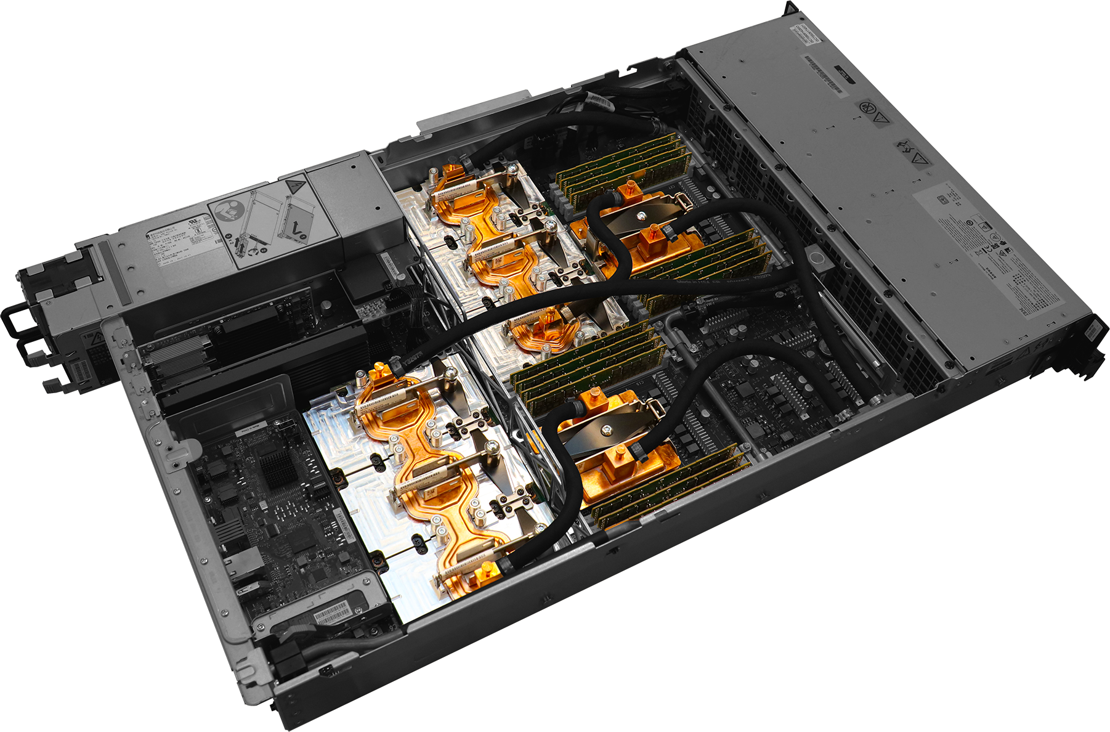
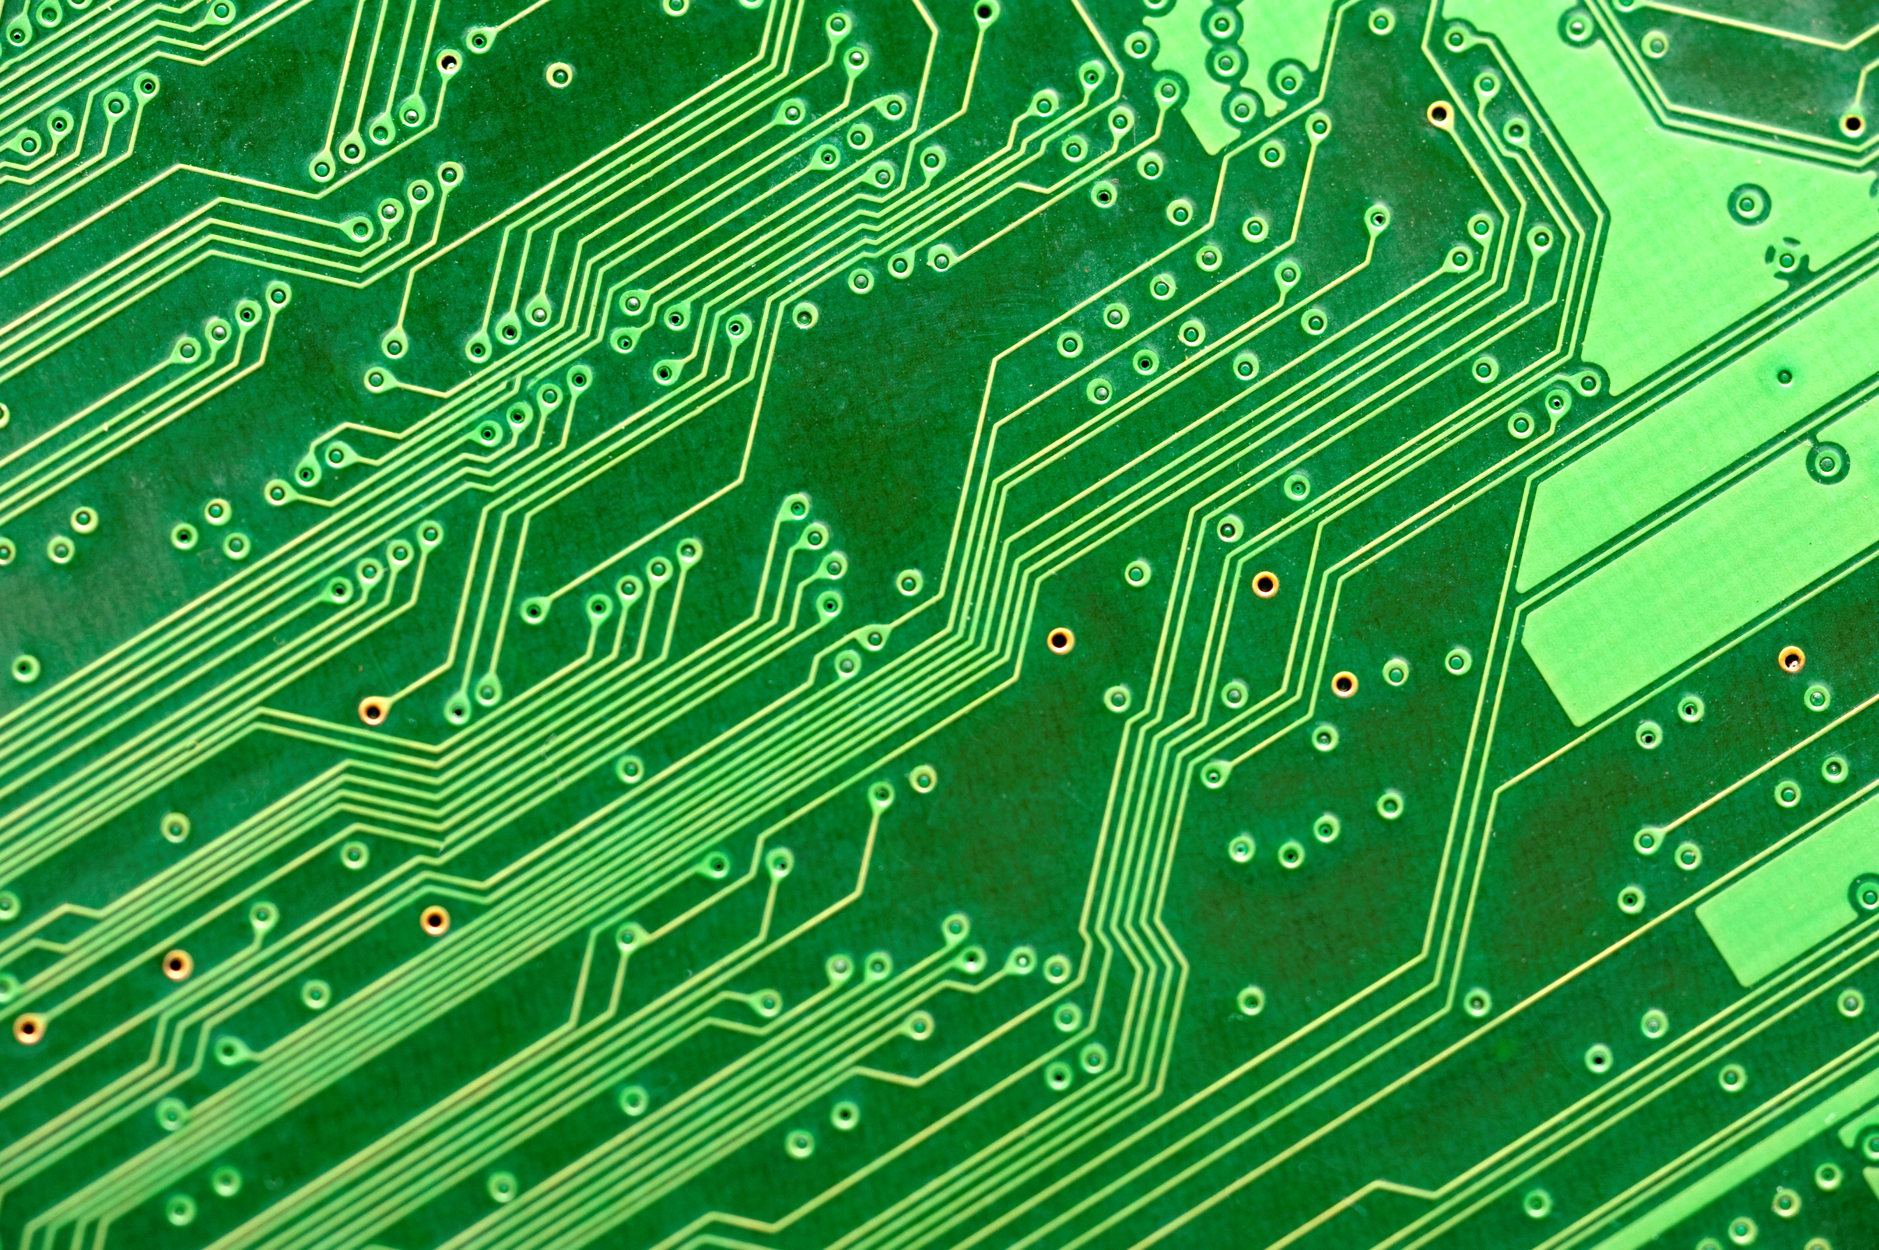
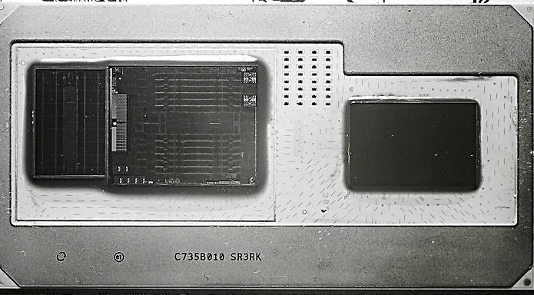
Heterogeneous Systems
Nvidia GPU
IBM CPU
AMD GPU
Intel CPU
Board controller
IBM CPU
HBM2
Nvidia GPU
On-package integration
Discrete integration
(Image courtesy: NVIDIA)
Challenge: System-wide efficiency with distributed resource control

Slide 3
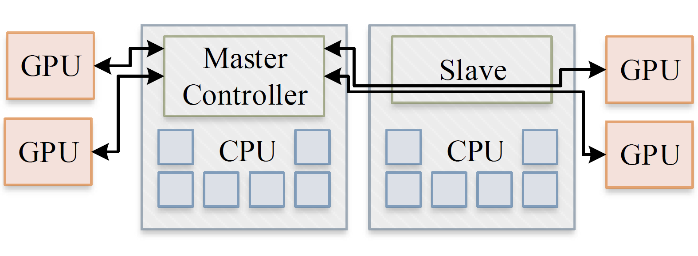
State-of-the-Art Resource Controllers
Run as firmware on embedded microcontrollers
Limitation 1: Many heuristic algorithms
Conflicting, and hard to reuse
Limitation 2: Centralized control
Slow, ineffective because of non-modularity. Hard to reuse.
Why is the state of the art so limited?
1. Distributed control is difficult
2. Heuristics appear intuitive

Slide 4
Contributions
Tangram: a distributed control framework that is modular, fast, and globally coordinated
A novel controller design that uses formal control, and with a standard interface
Prototype on a multi-vendor heterogeneous server

Slide 5

Classifying Resource Control Goals
Safety
Preconfigured
Enhancement
thermals, voltage droops
optimal for common patterns
minimize Energy$×$Delay
Immediate response for protection
Immediate response for optimality
Requires search

Slide 6





Enhancement: Robust Control
Coordination signals
Enhancement Engine
Targets
Deviations
Inputs
Outputs
Planner
$$+$$
$$−$$
DVFS
#cores
Performance
Power
min Energy$×$Delay
Robust Controller
CPU Chip
Formal, coordinated optimization replaces piecemeal heuristics

Slide 7

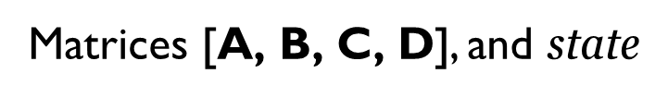
Robust Controller Operation
deviations
inputs
Matrices $\text{[}\text{A}\text{, }\text{B}\text{, }\text{C}\text{, }\text{D}\text{]}$, and state
$$\text{inputs}=\text{C}×\text{state}+\text{D}×\text{deviations}$$
Every T time-units
$$\text{stat}{\text{e}}_{new}=\text{A}×\text{state}+\text{B}×\text{deviations}$$
Deviations are small even when runtime conditions differ from design conditions

Slide 8

Proposed Controller
Coordination signals
Controller
Enhancement Engine
3
Safety Engines
Low frequency
1
2
Preconfigured Engines
Enhancement engine is robust to interference from other engines, and subsystems

Slide 9
Proposed Controller Interface
Optimize/control locally and propagate constraints hierarchically
Parent to Child
C
C
C
max power,
min performance, etc.
Local outputs
C
Local inputs
Child to Parent
power used,
performance achieved, etc.
Subsystem, e.g., CPU Chip

Slide 10
Tangram Control Framework
Control organization naturally fits the hierarchical organization of the computer
Fast
Globally coordinated
Modular
C
C
C
Chip 1
C
Chip 2
Obvious and simple:
Cluster 1
Thanks to formal control!
C
Cluster 2
Node

Slide 11
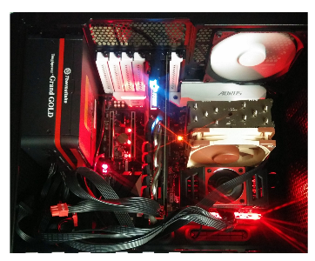
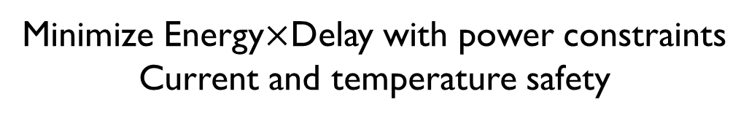
Prototype
Node
CPU Cluster
CPU Chip 1
CPU Chip 2
GPU Chip
Minimize Energy$×$Delay with power constraints
Current and temperature safety
CPUs: AMD Ryzen™ 1800X
GPU: AMD Radeon™ RX 580
Controllers built as privileged processes

Slide 12
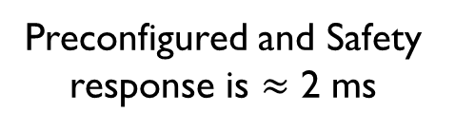
Prototype Response Times
Centralized
C
CPU Chip 1
Tangram
C
C
C
Always 200 ms
Common case: 15 ms
Worst case: 515 ms
C
CPU Chip 2
Preconfigured and Safety response is $≈$ 2 ms
CPU Cluster
C
GPU Chip
Node

Slide 13
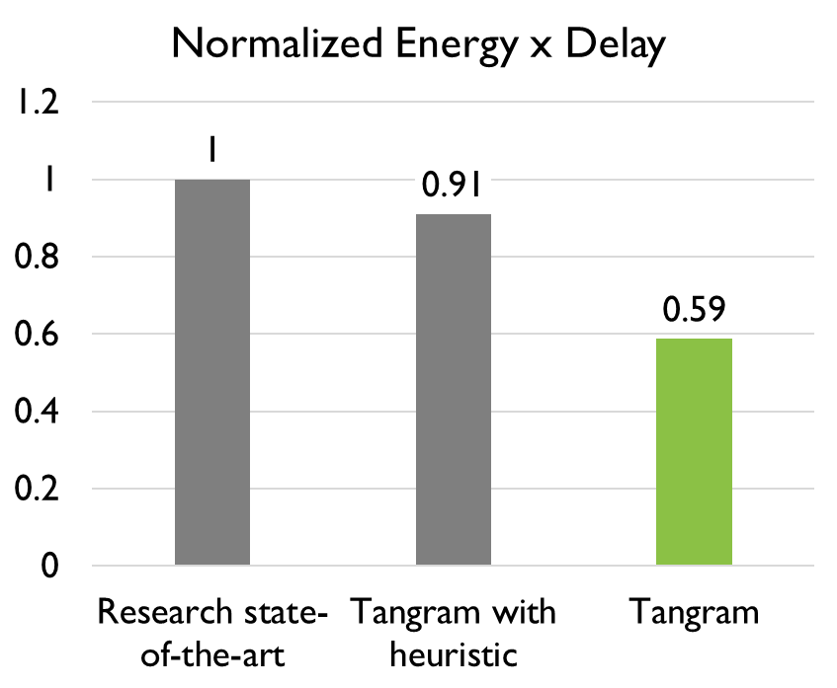
Prototype Evaluation Highlights
Control frameworks
Research state-of-the-art
Tangram with heuristic
Tangram
Chai applications
Fine grained concurrent CPU-GPU execution
Tangram: 32% faster with 13% lower energy $⇒$ 41% better EDP

Slide 14
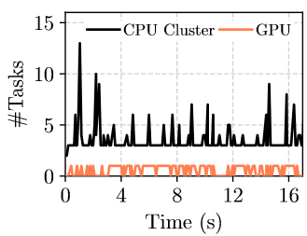
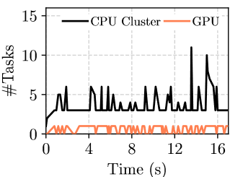
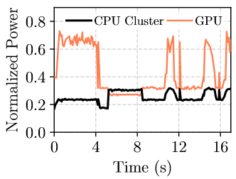
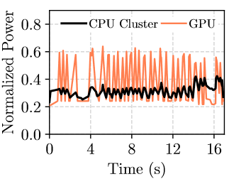
Collaborative Application: rsct from Chai
Research state-of-the-art
Tangram
Fine-grained power re-assignment

Slide 15
Summary
Heterogeneous hardware is ubiquitous
Need to rethink resource control for efficiency and safety
Tangram is a fast, coordinated, and modular resource control framework
Uses formal control, multiple engines per controller, and a standard interface
Prototype shows significant benefits
41% lower EDP over state-of-the-art research
Modular
Also in the paper:
Resource control from leading chip-makers
Detailed design of Tangram
Prototype implementation
Complete evaluation

Slide 16
Disclaimer
The information presented in this document is for informational purposes only and may contain technical inaccuracies, omissions and typographical errors.
The information contained herein is subject to change and may be rendered inaccurate for many reasons, including but not limited to product and roadmap changes, component and motherboard version changes, new model and/or product releases, product differences between differing manufacturers, software changes, BIOS flashes, firmware upgrades, or the like. AMD assumes no obligation to update or otherwise correct or revise this information. However, AMD reserves the right to revise this information and to make changes from time to time to the content hereof without obligation of AMD to notify any person of such revisions or changes.
AMD MAKES NO REPRESENTATIONS OR WARRANTIES WITH RESPECT TO THE CONTENTS HEREOF AND ASSUMES NO RESPONSIBILITY FOR ANY INACCURACIES, ERRORS OR OMISSIONS THAT MAY APPEAR IN THIS INFORMATION.
AMD SPECIFICALLY DISCLAIMS ANY IMPLIED WARRANTIES OF MERCHANTABILITY OR FITNESS FOR ANY PARTICULAR PURPOSE. IN NO EVENT WILL AMD BE LIABLE TO ANY PERSON FOR ANY DIRECT, INDIRECT, SPECIAL OR OTHER CONSEQUENTIAL DAMAGES ARISING FROM THE USE OF ANY INFORMATION CONTAINED HEREIN, EVEN IF AMD IS EXPRESSLY ADVISED OF THE POSSIBILITY OF SUCH DAMAGES.
AMD, the AMD Arrow logo, Radeon, Ryzen, and combinations thereof are trademarks of Advanced Micro Devices, Inc. Other names used herein are for identification purposes only and may be trademarks of their respective companies.

Slide 17
Image sources
Tangram image on the cover slide by Unknown Author is used under license by CC BY
Kaby Lake G image (Slide 2) by Fritzchens Fritz is used from public domain
Circuit background (Slide 2) from http://creativity103.com is used under license by CC BY

