Slide 1
A new perspective on processing-in-memory architecture design
Dong Ping Zhang, Nuwan Jayasena, Alexander Lyashevsky, Joe Greathouse, Mitesh Meswani, Mark Nutter, Mike Ignatowski
AMD Research
These data are submitted with limited rights under Government Contract No. DE-AC52-8MA27344 and subcontract B600716 from Advanced Micro Devices, Inc. on behalf of AMD Advanced Research LLC. These data may be reproduced and used by the Department of Energy on a need-to-know basis, with the express limitation that they will not, without written permission of the AMD Advanced Research LLC, be used for purposes of manufacture nor disclosed outside the Government.
This notice shall be marked on any reproduction of these data, in whole or in part.

Slide 2
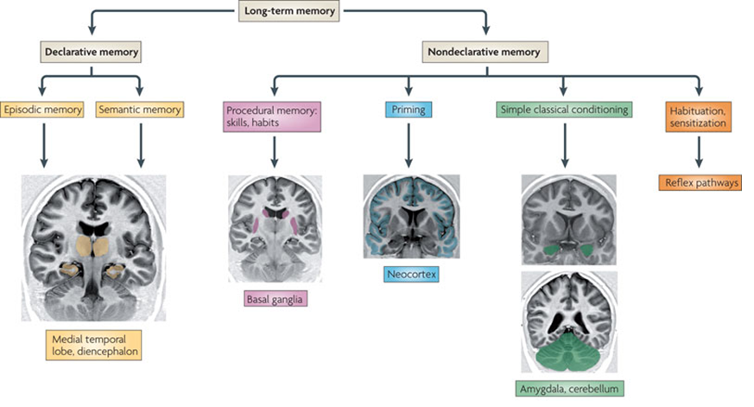
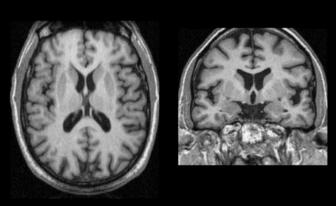
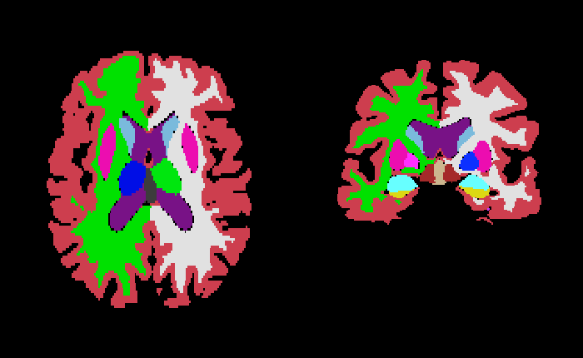
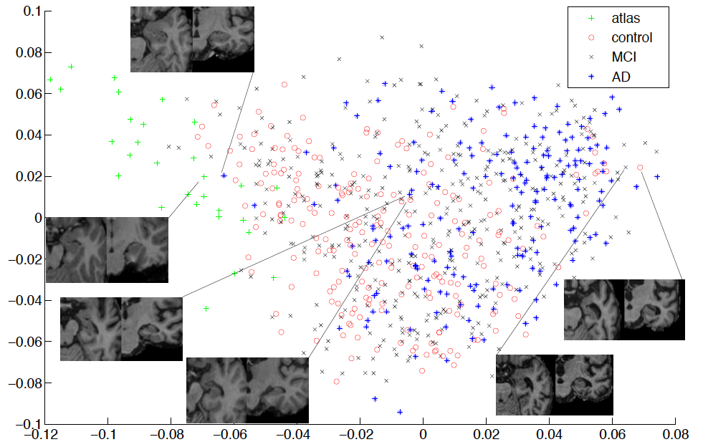
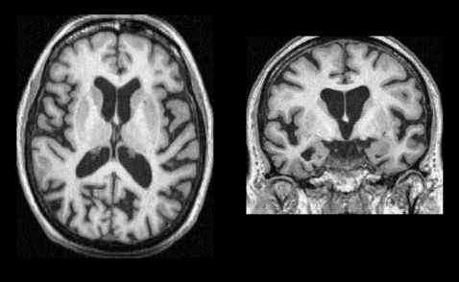
Processing-in-memory?

Slide 3
Highlight
Memory system is a key limiter
At 4TB/s, vast majority of node energy could be consumed by the memory system
Prior PIM research constrained by
Implementation technology
Non-traditional programming models
Our focus
3D die stacking
Use base logic die(s) in memory stack
General-purpose processors
Support familiar programming models
Arbitrary programs vs a set of special operations
Memory stack
Logic die with PIM

Slide 4
Processing-in-memory (PIM) --- Overview (I)
Moving compute close to memory promises significant gains
Memory is a key limiter (performance and power)
Exascale goals of 4TB/s/node and <5pj/bit
Prior research
Integration of caches and computation
“A logic-in-memory computer” (1970)
No large scale integration was possible.
Logic in DRAM processes
In-memory processors with reduced performance or highly specialized for a limited set of operations.
Reduced DRAM due to the presence of compute logic.
Embedded DRAM in logic processes
Not cost-effectively accommodate sufficient memory capacity
Reduced density of embedded memory

Slide 5
Processing-in-memory (PIM) --- Overview (II)
New opportunity: logic die stacked with memory
Logic die needed anyway for signal redistribution and integrity
Potential for non-trivial compute
Key benefits
Reduce bandwidth bottlenecks
Improve energy efficiency
Increase compute for a fixed interposer area
Processor can be optimized for high BW/compute ratio
Challenges
Programming models and interfaces
Architectural tradeoffs
Application refactoring

Slide 6
outline
PIM architecture baseline
API specification
Emulator and performance models
Application studies

Slide 7
Node Hardware organization
Single-level of PIM-attached memory stacks
Host has direct access to all memory
Non-PIM-enabled apps still work
Unified virtual address space
Shared page-tables between host and PIMs
Low-bandwidth inter-PIM interconnect
Memory
dies
Memory stack
Interposer or board
Logic die with PIM
Host Processor

Slide 8
PIM API overview
Current focus is on single PIM-enabled node
Current PIM hardware baseline is general-purpose processor
Key goals of API
Facilitate data layout control
Dispatch compute to PIMs using standard parallel abstractions
A “convenient” level of abstraction for early PIM evaluations
Aimed at PIM feasibility studies
annotation of data and compute for PIM with reasonable programmer effort
Key API features:
discover device
query device characteristics
manage locality
dispatch compute

Slide 9
PIM Pthread example: Parallel prefix sum
…
list_of_pims = malloc(max_pims * sizeof(pim_device_id));
failure = pim_get_device_ids(PIM_CLASS_0, max_pims, list_of_pims, &num_pims);
for (i = 0; i < num_pims; i++) {
failure = pim_get_device_info(list_of_pims[i], PIM_CPU_CORES, needed_size, device_info, NULL);
…
}
…
for (i = 0; i < num_pims; i++) {
parallel_input_array[i] = pim_malloc(sizeof(uint32_t) * chunk_size, list_of_pims[i],
PIM_MEM_DEFAULT_FLAGS, PIM_PLATFORM_PTHREAD_CPU);
parallel_output_array[i] = pim_malloc(sizeof(uint64_t) * chunk_size, list_of_pims[i],
PIM_MEM_DEFAULT_FLAGS, PIM_PLATFORM_PTHREAD_CPU);
}
…
for (i = 0; i < num_pims; i++) {
pim_args[PTHREAD_ARG_THREAD] = &(pim_threads[i]); // pthread_t
arg_size[PTHREAD_ARG_THREAD] = sizeof(pthread_t);
pim_args[PTHREAD_ARG_ATTR] = NULL; // pthread_attr_t
arg_size[PTHREAD_ARG_ATTR] = sizeof(pthread_attr_t);
pim_args[PTHREAD_ARG_INPUT] = &(thread_input[i]); // void * for thread input
arg_size[PTHREAD_ARG_INPUT] = sizeof(void *);
pim_function.func_ptr = parallel_prefix_sum;
spawn_error = pim_spawn(pim_function, pim_args, arg_size, NUM_PTHREAD_ARGUMENTS,
list_of_pims[i], PIM_PLATFORM_PTHREAD_CPU);
}
for (i = 0; i < num_pims; i++) {
pthread_join(pim_threads[i], NULL);
}
…

Slide 10
PIM Emulation and performance model
Phase 1: Emulation
User Application
Host Tasks
PIM Tasks
Phase 2: Perf Model
Emulated Machine Description
Performance Models
PIM Software Stack
Event Trace & Stats
Linux
Trace Post-processor
Commodity Hardware (CPU/GPU/APU)
Phase 1: Native execution on commodity hardware
Capture execution trace and performance stats
Phase 2: Post-process with performance models
Predict overall performance on future memory and processors

Slide 11
Parallel Prefix Sum – HOST-only vs HOST+PIM
Time
Initialization
Parallel 1
Parallel 2
Host frequency: 4GHz
Latency: Same as present
Total runtime: 0.943s
CPU0
0.466s
0.251s
0.155s
CPU1
0.279s
0.170s
CPU2
0.305s
0.171s
CPU3
0.306s
Host
CPU0
Host frequency: 4GHz
PIM frequency: 2GHZ
Host latency: current
PIM latency: 30% reduction
Total runtime: 0.820s
15% Faster
PIM computation benefits from reduced latency
0.466s
PIM0
0.187s
0.12
Improvement
PIM1
0.206s
0.13
PIM2
0.224s
0.13
PIM3
0.225s

Slide 12
Parallel Prefix Sum – host-only vs host+PIM
Time
Initialization
Parallel 1
Parallel 2
Host
CPU0
Host frequency: 4GHz
PIM frequency: 2GHZ
Host latency: current
PIM latency: 50% reduction
Total runtime: 0.728s
30% Faster
0.466s
PIM0
0.14
0.09
Improvement
PIM1
0.152
0.1
PIM2
0.165
0.1
PIM3
0.165
Host
CPU0
Host frequency: 4GHz
PIM frequency: 2GHZ
Host latency = PIM latency
Total runtime: 0.958s
2% Slower
0.466s
PIM0
0.259s
0.162s
PIM1
0.287s
0.178s
PIM2
0.313s
0.178s
PIM3
0.314s

Slide 13
waxpby – host-only vs host+PIM
Time
Initialization
waxpby
CPU0
Host GPU frequency: 1GHz
Host GPU CUs: 192
Host DRAM BW: 2TB/s (4 stacks)
GPU0
0.47ms
Host
CPU0
PIM GPU frequency: 800MHz
PIM GPU CUs: 16 (per PIM)
PIM DRAM BW: 1TB/s/stack
PIM0
0.24ms
Improvement
PIM1
0.24ms
PIM2
0.24ms
PIM3
0.24ms
Host
CPU0
PIM GPU frequency: 800MHz
PIM GPU CUs: 16 (per PIM)
PIM DRAM BW: 2TB/s/stack
Kernel performance scales with Bandwidth
PIM0
0.12ms
Improvement
PIM1
0.12ms
PIM2
0.12ms
PIM3
0.12ms

Slide 14
Summary and Future work
PIM architecture baseline
API specification
Emulator and performance models
Application studies
Design space study
Evaluation of the performance models
Further work on API, execution model, applications etc.

Slide 15
Acknowledgement:
Lee Howes
Gabe Loh
Questions?
Further discussions:
Dongping.zhang@amd.com

