Slide 1

The Potential of Sampling for Dynamic Analysis
Joseph L. Greathouse Todd Austin
Advanced Computer Architecture Laboratory
University of Michigan
PLAS, San Jose, California
June 5, 2011
Notes:
I’m here to present a quick argument for “The Potential of Sampling for Dynamic Analysis.”
So that we're all on the same page, I'm first going to give a bit of background by what I mean by "dynamic analysis" and describe how I believe it relates to security. I then hope to convince you that one of the best ways to speed up many of these heavyweight software tests is to have any individual test look at only a small portion of the program– In other words, sample these analyses.

Slide 2
Dynamic Security Analysis
Finds flaws in programs as they run
  Makes programs more robust
Insert checks around instructions
check(x!=NULL);
y = x->data;
*w += y;
check(w!=NULL);
z = 75/y;
check(y!=0);
Notes:
What do I mean when I refer to dynamic security analyses?
Many of the papers in this workshop focus on formal proofs of or static analysis for security, or languages that make it impossible to create insecure software. Dynamic analyses, OTOH, admit that security bugs (and, in fact, any bugs) will happen and attempt to hunt them down at runtime.
More specifically, the point of these tests is to make software more robust by informing developers about software errors and allowing them to be fixed before they can be exploited. This, it’s hoped, can be another layer of security as bugs are a major cause of security flaws.
This is done by *click* inserting checks around the original program’s instruction.
This example piece of code shows three regular instructions within some program. Each could cause the program to crash, so *click*
a dynamic analysis tool might insert checks before each one to ensure that at the very least can preemptively handle the error.
The types of assertions inserted will affect how strong this analysis is at finding errors. CCured, for instance, can use checks such as this to prevent buffer overflows and other memory corruption attacks, rather than simply seeing NULL pointer exceptions and divide-by-zeroes.

Slide 3
Dynamic Information Flow Tracking
Data
Input
Untrusted
x = read_input()
validate(x)
Inputs are untrusted
Propagate untrusted status while executing
Check trustedness for safety
x = read_input()
Only works on current dynamic control path
y = x * 1024
y = x * 1024
w = x + 42
Check w
Check w
z = y * 75
Check z
z = y * 75
Check z
Notes:
Let’s go through a more complicated example of a dynamic security analysis. This is a sample of DIFT, Dynamic Information Flow Tracking. This term is a bit overloaded in the security community, so let me describe what this means in the context of this example. This is an analysis that augments the dynamic dataflow of the program with shadow values, and uses these values to infer, in some manner, the security or correctness of the program.
In this taint analysis example, variables whose value is derived from input are untrusted (since they can be controlled by malicious entities). Taint bits (the yellow boxes) indicated that a variable is untrusted. Values derived from untrusted values are also untrusted, causing a shadow dataflow that partially mirrors that of the program. Taint bit checks are inserted before potentially dangerous operations (such as jumps), and if they checked variable is tainted (in other words, untrusted), an error can be raised.
{go through example}
This turns out to be a pretty powerful way to catch a number of security flaws, and taint analysis is in use within a number of research projects.
However, there’s one important caveat with dynamic analyses such as assertion checking and DIFT. *click* They are only able to find errors that exist on the current dynamic control path, meaning that errors that exist on code that is not executed cannot be observed by these techniques. Therefore, in order to find as many bugs as possible, it is beneficial to run the analysis large number of inputs. Unfortunately, as you may have gathered from these examples, dynamic analyses can do *a lot* of work around each instruction. And therein lies the difficulty ➔

Slide 4
Problem: Dynamic Analyses are Slow
Assertion Checking
Race Detection
2x
100x
DIFT
Symbolic Execution
150x
200x
Atomicity Checking
400x
Notes:
Dynamic analyses are very slow. Each operation a dynamic analysis adds around the original instructions of a program adds to the total dynamic runtime. While this isn’t outrageous for simple tests such as assertion testing, complicated systems such as symbolic execution can have overheads as extreme as 200x or more. Such slowdowns significantly curtail the amount of testing that can be done on any particular program.
So, the question then becomes: how do we make dynamic analysis faster? Other researchers have proposed solutions that lower the overheads of selected tests a few times – Flannagan & Freund were able to reduce the slowdowns caused by their race detector to about 8x, for instance. Unfortunately, that’s still a significantly slowdown if you’re trying to test a large bank of cases. Your nightly test suite would basically become your weekly test suite. ➔

Slide 5
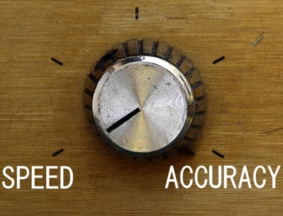
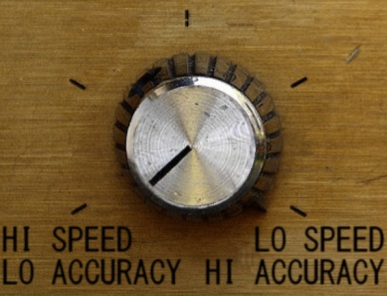
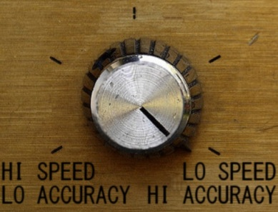
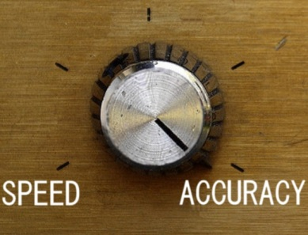
Dynamic Analysis Sampling
Lower overheads by skipping some analyses
No
Analysis
Complete
Analysis
Notes:
I’d like to make the argument that one excellent solution to this quandary is sampling. In other words, analyzing a random part of the program’s dynamic state during each execution, where the amount of analysis is controlled by our desired maximum overhead.
This graph represents the desired results of an ideal sampling system. On the far left side, the system would see zero overhead, but have no chance of detecting errors; this is where we are right now, never performing analysis. Current analysis systems lie on the right, where our overhead is high but we detect every error observable to the tool.
We want to fill in the middle through sampling techniques, where our probability of finding an error is proportional to the observed overhead.
*click* In essence, this would give users (or developers) a knob that allows them to choose their individual accuracy versus speed tradeoff. ➔

Slide 6


Sampling Allows Distribution
End Users
Beta Testers
Many users testing at little overhead see more errors than one user at high overhead.
Developer
Notes:
For example, developers may be OK with running at high overheads for some tests (devs currently do this with Valgrind, for example.) However, by turning the knob lower, *click* we can allow a larger population beta testers to catch errors at much less overhead.
If we can continue to lower the overhead, it could even be possible to send these analyses off to a large population of end users *cllick*. And while they would have a low probability of finding any individual error, I’d assert that *click* many users testing at little overhead see more errors than one user at high overhead because of the sheer number of dynamic states they can observe. ➔

Slide 7
Sampling Assertion Checking
Perform a random subset of checks
1/1000 checks: ~3x slowdown→30% overhead
Dynamic #1
Static Code
Dynamic #2
Dynamic #3
check(x!=NULL);
check(x!=NULL);
check(x!=NULL);
y = x->data;
y = x->data;
y = x->data;
y = x->data;
y = x->data;
check(w!=NULL);
check(w!=NULL);
check(w!=NULL);
*w += y;
*w += y;
*w += y;
*w += y;
*w += y;
check(y!=0);
check(y!=0);
check(y!=0);
z = 75/y;
z = 75/y;
z = 75/y;
z = 75/y;
z = 75/y;
Notes:
How do we perform this sampling? It depends on the type of analysis. The simplest type of sampling can be used for the assertion-checking example I gave earlier. In this case, because each check is self-contained, we can simply skip a certain percentage of checks in order to reduce slowdowns.
As you can see, this is our example from before, which contains *click* three checks.
If we run this code 3 times with sampling enabled, the executions may look like this *click*
In each execution, a random subset of the checks are executed. In this case, each dynamic execution performs one check, but others may have all, none, or other combinations. If there were an error on the first line of code, only the first dynamic execution would catch it in this example. That is the performance/accuracy tradeoff.
Of course, making the decision to run any particular check has its overheads too. *click* Liblet et al. showed that if they ran 1 out of every 1000 checks in a program instrumented with CCured, they were able to lower the overheads to about 30%.

Slide 8
Sampling DIFT
Must sample dataflows instead of instructions
0.1-10% of faults: 10% overhead
Notes:
More complicated analyses may also require more complicated sampling techniques. DIFT, for instance, will fall apart if random instructions are blithely skipped. It can result not only in more false negatives than normal, but can also lead to false positives.
A solution, then, is to sample _the shadow dataflows_, not the instructions.
Let’s look at this example dynamic dataflow. Rather than skipping any individual instruction that forms it, you can non-deterministically choose some subset of the dataflows *click*
Because errors higher in a dataflow are easier to see (check out the first bubble, for instance), the error detection rate of this technique under a specified overhead varies. We showed in an earlier work that between a tenth and 10% of security flaws that our continuous-analysis tool caught were observed when sampling to reach a 10% overhead.

Slide 9
Advanced Sampling Techniques
Cold region Hypothesis
  Sample “cold” code at higher rate
New atomicity violation detection
  Trace atomic regions and correlate crashes
Notes:
There are also a number of more advanced sampling mechanisms that, due to time constraints, I’ll just mention in passing.
For example, Marino et al. described a sampling data-race detector that chose which memory accesses to check using a cold-code hypothesis. In their system, sections of code that have not been executed before are analyzed with a much higher probability, hopefully exposing bugs in previously unanalyzed code.
On a different tack, Jin et al. described an atomicity violation detector that could _only_ exist if you run it in a distributed manner. It keeps track of regions of code that are run atomically and sends this info back to the developer on program crashes. They then correlate many crashes to areas of code that were not run atomically, exposing bugs.
Their statistical analyses require large populations of users reporting this info to work well, and they are only able to do allow this through analysis sampling.

Slide 10
Future Research Directions
Sampling for more dynamic analyses
New types of analyses because of sampling
Studies on users slowdown acceptance
Notes:
Despite these advanced techniques, there are numerous open research questions in the field of analysis sampling.
For instance, how can other existing dynamic tests, like symbolic analyses, be sampled? Do current sampling techniques work?
There is also the question of new analyses. As Jin et al. showed, sampling + distribution can enable completely new ways of solving a problem. Can this be done elsewhere?
Finally, what kinds of overheads are acceptable, or at least unnoticeable, to users? If you let them directly input their desired slowdowns, they’ll say “zero overheads”.. But if you automatically slow it down by some small degree, when do they begin to notice?
The paper also contains some recommendations for other research and for engineering work that must be done to make these analyses widely applicable, but I’ll skip these for now in favor of taking any questions or comments.
Thank you.

Slide 11
BACKUP SLIDES

Slide 12
Needed Engineering Efforts
Push-button sampling mechanisms for Valgrind, DynamoRIO, Pin, etc.
Libraries to integrate bug reporting into analysis tools
Back-end infrastructure for handling distributed, sampled bug reports

