Slide 1
Efficient Sparse Matrix-Vector Multiplication on GPUs using the CSR Storage Format
Joseph L. GreathousE, Mayank Daga
AMD Research
11/20/2014
Notes:
NOTE: These notes are a general script for what I planned to say during the talk. This is not a transcript, and it tapers off near the end when I felt that a script was no longer needed.
Good morning everyone. As Kirk said, my name is Joseph Greathouse from AMD Research, and I’m here to describe a new method of performing sparse matrix-vector multiplication on GPUs without needing to change the matrix storage format from the traditional CSR.

Slide 2
This Talk in One Slide
Demonstrate how to save space and time by using the CSR format for GPU-based SpMV
Optimized GPU-based SpMV algorithm that
increases memory coalescing by using LDS
14.7x faster than other CSR-based algorithms
2.3x faster than using other matrix formats
Notes:
Before I dive into the details, I’d like to give a one-slide overview of what this talk will be about.
First, I’m going to demonstrate how perform GPU-based sparse matrix-vector multiplication without needing to change your matrix storage structure from the traditional CSR format. This means that you don’t need to waste time or space transforming the matrix whenever you want to perform SpMV on a GPU.
To do this, I’m going to describe a new SpMV algorithm that uses the CSR storage format and that removes the bottlenecks that were believed to prevent optimal performance on GPUs.
In particular, by significantly increasing memory coalescing, and using local scratchpads for scatter-gather accesses, our algorithm offers an almost 15x performance improvement over previous algorithms that use the CSR format. In addition, it’s over 2 times faster than existing state-of-the-art algorithms that use more complex storage formats.

Slide 3
Background
Notes:
I’m going to start the talk by walking through a good deal of background information on this problem. A lot of you in the audience may be familiar with many or all of these concepts.
Nonetheless, I hope you’ll follow along, because the algorithm I’m going to present later is not extraordinarily complex.
In fact, I think that it falls out very simply from the background information I’m going to present. So keep paying attention, because this background information is going to directly inform our new optimized SpMV algorithm.

Slide 4
Sparse Matrix-Vector Multiplication
1.0 | - | 2.0 | - | 3.0
- | 4.0 | - | 5.0 | -
- | - | 6.0 | - | -
7.0 | - | - | 8.0 | -
- | 9.0 | - | - | -
1
2
3
4
5
22
28
18
39
18
×
=
Traditionally Bandwidth Limited
Notes:
To start, let’s talk about “sparse matrix vector multiplication”
On the left, you’ll see a sparse matrix. Most of the values are zero (denoted by dashes). In the middle, we have a dense vector, which we want to multiply by the matrix.
Each entry in the matrix is multiplied by the entry in the vector that corresponds to its column *click click click*, and the results from the same row are added together to produce one of the dense vector outputs.
This process is continued for every non-zero value in the matrix, until we have filled the output vector.
You may have noticed that entries in the input vector were used multiple times, while the values in the vector were only used once. This streaming access of the vector, and the small amount of mathematical operations used to produce the output *click* mean that this is considered to be a memory bandwidth-bound kernel. Its performance is primarily constrained by how fast you can load the vector from memory.

Slide 5
Compressed Sparse Row (CSR)
1.0 | - | 2.0 | - | 3.0
- | 4.0 | - | 5.0 | -
- | - | 6.0 | - | -
7.0 | - | - | 8.0 | -
- | 9.0 | - | - | -
0 | 3 | 5 | 6 | 8 | 9
row delimiters:
0 | 2 | 4 | 1 | 3 | 2 | 0 | 3 | 1
columns:
1.0 | 2.0 | 3.0 | 4.0 | 5.0 | 6.0 | 7.0 | 8.0 | 9.0
values:

Slide 6
AMD GPU Memory System
I$
I$
K$
K$
64 Bytes per clock L1 bandwidth per CU
L1
L1
L1
L1
L1
L1
L1
L1
64 Bytes per clock L2 bandwidth per partition
L2
L2
L2
64-bit Dual Channel Memory Controller
64-bit Dual Channel Memory Controller
64-bit Dual Channel Memory Controller
Uncoalesced accesses are much less efficient!

Slide 7
AMD GPU Compute UNit
Vector Units
(4x SIMD-16)
L1 Cache
(16 KB)
Vector Registers
(4x 64KB)
Local Data Share
(64KB)
Must do parallel loads to maximize bandwidth

Slide 8
Local Data Share (LDS) Memory
Scratchpad (software-addressed) on-chip cache
Statically divided between all workgroups in a CU
Highly ported to allow scatter/gather (uncoalesced) accesses
Local Data Share
(64KB)

Slide 9
CSR-Scalar
One thread/work-item per matrix row
Workgroup #1
Workgroup #2
Workgroup #3
Uncoalesced accesses

Slide 10
CSR-Vector
One workgroup (multiple threads) per matrix row
Workgroup #1
Workgroup #2
.
.
.
Workgroup #12
Bad: poor parallelism
Good: coalesced accesses

Slide 11
Making GPU SpMV Fast
Neither CSR-Scalar nor CSR-Vector offer ideal performance.
CSR works well on CPUs and is widely used
Traditional solution: new matrix storage format + new algorithms
ELLPACK/ITPACK, BCSR, DIA, BDIA, SELL, SBELL, ELL+COO Hybrid, many others
Auto-tuning frameworks like clSpMV try to find the best format for each matrix
Can require more storage space or dynamic transformation overhead
Can we find a good GPU algorithm that does not modify the original CSR data?

Slide 12
CSR-Adaptive

Slide 13
Increasing Bandwidth Efficiency
CSR-Vector coalesces long rows by streaming into the LDS

Slide 14
CSR-Vector Using the LDS
Local Data Share
+
+
+
+
Fast uncoalesced accesses!
Fast accesses
everywhere

Slide 15
Increasing Bandwidth Efficiency
How can we get good bandwidth for other “short” rows?
Load these into the LDS

Slide 16
CSR-Stream: Stream Matrix Into the LDS
Local Data Share
Fast accesses
everywhere
Block 1
Block 2
Block 3
Block 4

Slide 17
Finding Blocks for CSR-Stream
Done Once on the CPU
Assuming 8 LDS entries per workgroup
row blocks:
0 | 3 | 6 | 11 | 12
CSR Structure Unchanged
row delimiters:
0 | 3 | 6 | 8 | 10 | 14 | 16 | 17 | 19 | 20 | 22 | 24 | 32
columns:
values:
Block 1
Block 2
Block 3
Block 4

Slide 18
What about Very Long Rows?
Local Data Share
CSR-Adaptive
CSR-Stream
CSR-Vector
Block 1
Block 2
Block 3
Block 4

Slide 19
CSR-Adaptive
Create Row Blocks
(Once per matrix) On CPU:
On GPU (each workgroup assigned one row block):
Read Row Block Entries
Single Row?
No
Yes
CSR-Stream
CSR-Vector
Vector Load Multiple Rows into LDS
Vector Load Row
into LDS
Perform Reduction out of LDS
(serially or in parallel)
Perform Parallel Reduction out of LDS

Slide 20
Experiments

Slide 21
Experimental Setup
CPU: AMD A10-7850K (3.7 GHz)
32 GB dual-channel DDR3-2133
GPU: AMD FirePro™ W9100
44 parallel compute units (CUs)
930 MHz core clock rate (5.2 single-precision TFLOPs)
16 GDDR5 channels at 1250 MHz (320 GB/s)
CentOS 6.4 (kernel 2.6.32-358.23.2)
AMD FirePro Driver version 14.20 beta
AMD APP SDK v2.9

Slide 22
SpMV Setup
SHOC Benchmark Suite (Aug. 2013 version)
CSR-Vector (details in paper: CSR-Scalar, ELLPACK)
ViennaCL v1.5.2
CSR-Scalar, COO, ELLPACK, ELLPACK+COO HYB
4-value and 8-value padded versions of CSR-Scalar
Best of these for each matrix: “ViennaCL Best”
clSpMV v0.1
CSR-Scalar, CSR-Vector, BCSR, COO, DIA, BDIA, ELLPACK, SELL, BELL, SBELL
Best of these for each matrix: “clSpMV Best”
Details in paper: clSpMV “Cocktail” format
CSR-Adaptive
20 matrices from Univ. of Florida Sparse Matrix Collection

Slide 23
Data Structure Generation Times
Note: Some matrices could not be held in ELLPACK or BCSR

Slide 24
Performance in Single-Precision GFLOPs
Roughly Equal Performance (7/20)
Others Better (4/20)
Notes:
The arrows on this slide point to the only benchmarks where the previous CSR-Vector algorith matches the performance of CSR-Adaptive.

Slide 25
Performance in Single-Precision GFLOPs
CSR-Adaptive Performance Higher (9/20)

Slide 26
Performance Benefit of CSR-Adaptive

Slide 27
Conclusion
CSR-Adaptive up to 14.7x faster than previous GPU-based SpMV algorithms
Requires little work beyond generating the traditional CSR data structure
Less than 0.1% extra storage compared to CSR
Algorithm is not complex: easy to integrate into libraries and existing SW
AMD Sample Code Available Soon – Ask Us!
Independently Implemented Version in ViennaCL 1.6.1

Slide 28
Disclaimer & Attribution
The information presented in this document is for informational purposes only and may contain technical inaccuracies, omissions and typographical errors.
The information contained herein is subject to change and may be rendered inaccurate for many reasons, including but not limited to product and roadmap changes, component and motherboard version changes, new model and/or product releases, product differences between differing manufacturers, software changes, BIOS flashes, firmware upgrades, or the like. AMD assumes no obligation to update or otherwise correct or revise this information. However, AMD reserves the right to revise this information and to make changes from time to time to the content hereof without obligation of AMD to notify any person of such revisions or changes.
AMD MAKES NO REPRESENTATIONS OR WARRANTIES WITH RESPECT TO THE CONTENTS HEREOF AND ASSUMES NO RESPONSIBILITY FOR ANY INACCURACIES, ERRORS OR OMISSIONS THAT MAY APPEAR IN THIS INFORMATION.
AMD SPECIFICALLY DISCLAIMS ANY IMPLIED WARRANTIES OF MERCHANTABILITY OR FITNESS FOR ANY PARTICULAR PURPOSE. IN NO EVENT WILL AMD BE LIABLE TO ANY PERSON FOR ANY DIRECT, INDIRECT, SPECIAL OR OTHER CONSEQUENTIAL DAMAGES ARISING FROM THE USE OF ANY INFORMATION CONTAINED HEREIN, EVEN IF AMD IS EXPRESSLY ADVISED OF THE POSSIBILITY OF SUCH DAMAGES.
ATTRIBUTION
© 2014 Advanced Micro Devices, Inc. All rights reserved. AMD, the AMD Arrow logo, FirePro and combinations thereof are trademarks of Advanced Micro Devices, Inc. in the United States and/or other jurisdictions. Other names are for informational purposes only and may be trademarks of their respective owners.

Slide 29
Backup Slides

Slide 30
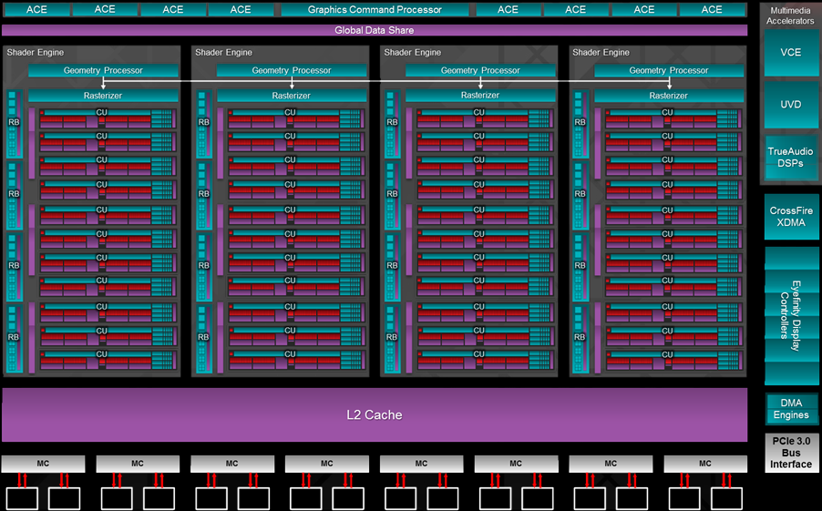
AMD GPU Microarchitecture
Many highly-threaded vector processors
Up to 112,640 work-items in flight
Highly Parallel Memory System
(16 channels, 320 GB/s)

