Slide 1

Sampling Dynamic Dataflow Analyses
Joseph L. Greathouse
Advanced Computer Architecture Laboratory
University of Michigan
University of British Columbia
June 10, 2011
Notes:
This talk was given at the University of British Columbia Computer Science department on June 10, 2011. (This was hosted by Andrew Warfield. http://www.cs.ubc.ca/event/2011/06/talk-joseph-greathouse-hosted-andy-warfield). This is basically a combination of the talks I gave at CGO2011 with a few backup slides brought in, and some slides from my ISCA2011 talk. See those slides for detailed notes of what all the animations mean.

Slide 2
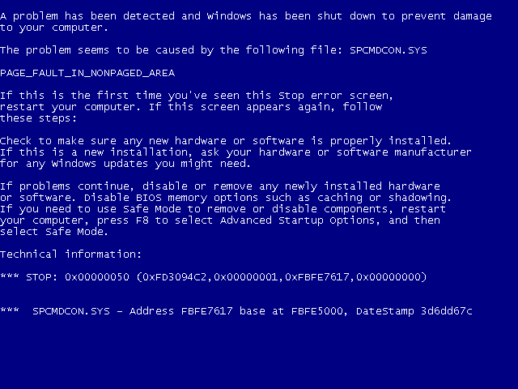
Software Errors Abound
NIST: SW errors cost U.S. ~$60 billion/year as of 2002
FBI CCS: Security Issues $67 billion/year as of 2005
  >⅓ from viruses, network intrusion, etc.
CERT-Cataloged Vulnerabilities

Slide 3
Simple Buffer Overflow Example
Return address
void foo()
{
int local_variables;
int buffer[256];
…
buffer = read_input();
…
return;
}
New Return address
Local variables
Bad Local variables
buffer
Buffer Fill
buffer
If read_input() reads 200 ints
If read_input() reads >256 ints

Slide 4
Concurrency Bugs Also Matter
Thread 1
Thread 2
mylen=small
mylen=large
Nov. 2010 OpenSSL Security Flaw
if(ptr == NULL) {
len=thread_local->mylen;
ptr=malloc(len);
memcpy(ptr, data, len);
}

Slide 5
Concurrency Bugs Also Matter
Thread 1
Thread 2
mylen=small
mylen=large
TIME
if(ptr==NULL)
if(ptr==NULL)
len2=thread_local->mylen;
ptr=malloc(len2);
len1=thread_local->mylen;
ptr=malloc(len1);
memcpy(ptr, data1, len1)
memcpy(ptr, data2, len2)
ptr
LEAKED
∅

Slide 6
One Layer of a Solution
High quality dynamic software analysis
  Find difficult bugs that other analyses miss
Distribute Tests to Large Populations
  Low overhead or users get angry
Accomplished by sampling the analyses
  Each user only tests part of the program

Slide 7
Dynamic Dataflow Analysis
Associate meta-data with program values
Propagate/Clear meta-data while executing
Check meta-data for safety & correctness
Forms dataflows of meta/shadow information

Slide 8
Example Dynamic Dataflow Analysis
Data
Input
Meta-data
Associate
x = read_input()
x = read_input()
validate(x)
Clear
Propagate
y = x * 1024
y = x * 1024
w = x + 42
Check w
Check w
a += y
z = y * 75
Check z
a += y
z = y * 75
Check z
Check a
Check a

Slide 9
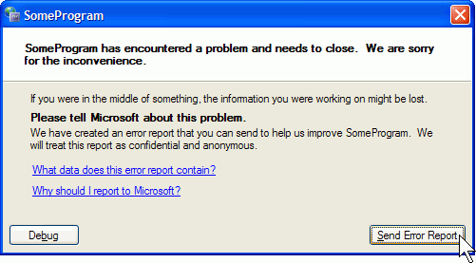





Distributed Dynamic Dataflow Analysis
Split analysis across large populations
  Observe more runtime states
  Report problems developer never thought to test
Instrumented Program
Potential problems

Slide 10
Problem: DDAs are Slow
Symbolic Execution
Data Race Detection
(e.g. Helgrind)
Memory Checking
(e.g. Dr. Memory)
Taint Analysis
(e.g.TaintCheck)
Dynamic Bounds Checking
FP Accuracy Verification
10-200x
2-200x
2-300x
10-80x
100-500x
5-50x

Slide 11
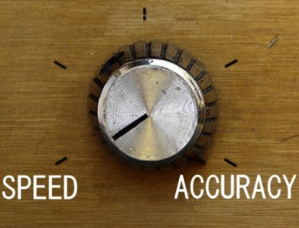
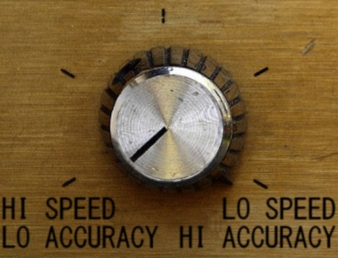
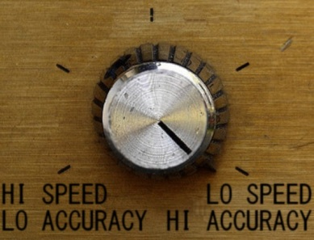
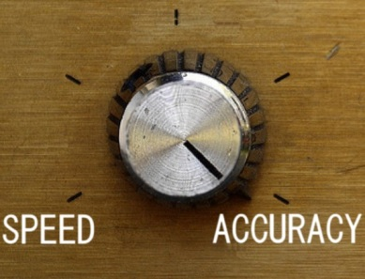
One Solution: Sampling
Lower overheads by skipping some analyses
No
Analysis
Complete
Analysis

Slide 12
Sampling Allows Distribution
End Users
Beta Testers
Many users testing at little overhead see more errors than one user at high overhead.
Developer

Slide 13
Cannot Naïvely Sample Code
Input
x = read_input()
validate(x)
Skip Instr.
x = read_input()
Validate(x)
False Positive
y = x * 1024
w = x + 42
Check w
y = x * 1024
w = x + 42
Check w
a += y
Skip Instr.
a += y
z = y * 75
Check z
Check a
Check z
False Negative
Check a

Slide 14
Sample Data, not Code
Sampling must be aware of meta-data
Remove meta-data from skipped dataflows
  Prevents false positives

Slide 15
Dataflow Sampling Example
Input
x = read_input()
x = read_input()
validate(x)
Skip Dataflow
y = x * 1024
Check w
y = x * 1024
w = x + 42
Check w
Skip Dataflow
a += y
a += y
z = y * 75
Check z
Check a
Check z
False Negative
Check a

Slide 16
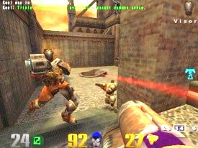

Mechanisms for Dataflow Sampling (1)
Start with demand analysis
Demand Analysis Tool
Instrumented
Application
(e.g. Valgrind)
Instrumented
Application
(e.g. Valgrind)
Native
Application
No meta-data
Meta-data
Shadow Value Detector

Slide 17
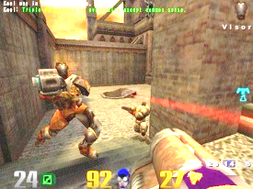

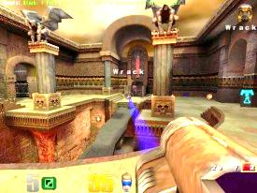

Mechanisms for Dataflow Sampling (2)
Remove dataflows if execution is too slow
Sampling Analysis Tool
Instrumented
Application
Instrumented
Application
Native
Application
OH Threshold
Clear meta-data
Meta-data
Shadow Value Detector

Slide 18
Prototype Setup
Taint analysis sampling system
  Network packets untrusted
Xen-based demand analysis
  Whole-system analysis with modified QEMU
Overhead Manager (OHM) is user-controlled
Xen Hypervisor
ShadowPage Table
Admin VM
OS and Applications
Net Stack
Taint Analysis QEMU
OHM
App
App
…
App
Linux

Slide 19
Benchmarks
Performance – Network Throughput
  Example: ssh_receive
Accuracy of Sampling Analysis
  Real-world Security Exploits
Name | Error Description
Apache | Stack overflow in Apache Tomcat JK Connector
Eggdrop | Stack overflow in Eggdrop IRC bot
Lynx | Stack overflow in Lynx web browser
ProFTPD | Heap smashing attack on ProFTPD Server
Squid | Heap smashing attack on Squid proxy server

Slide 20
Performance of Dataflow Sampling (1)
ssh_receive
Throughput with no analysis

Slide 21
Performance of Dataflow Sampling (2)
netcat_receive
Throughput with no analysis

Slide 22
Performance of Dataflow Sampling (3)
ssh_transmit
Throughput with no analysis

Slide 23
Accuracy at Very Low Overhead
Max time in analysis: 1% every 10 seconds
Always stop analysis after threshold
  Lowest probability of detecting exploits
Name | Chance of Detecting Exploit
Apache | 100%
Eggdrop | 100%
Lynx | 100%
ProFTPD | 100%
Squid | 100%

Slide 24
Accuracy with Background Tasks
netcat_receive running with benchmark

Slide 25
Accuracy with Background Tasks
ssh_receive running in background

Slide 26

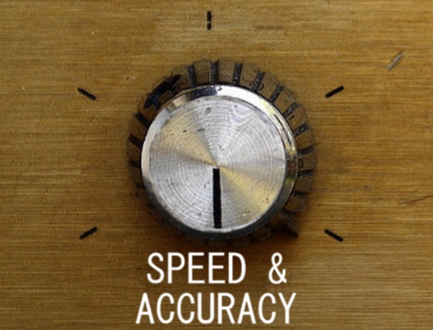
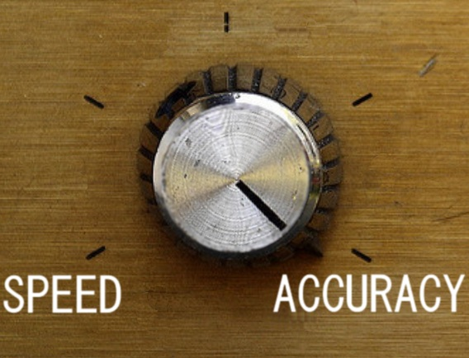
Conclusion & Future Work
Dynamic dataflow sampling gives users a
knob to control accuracy vs. performance
Better methods of sample choices
Combine static information
New types of sampling analysis

Slide 27
BACKUP SLIDES

Slide 28
Outline
Software Errors and Security
Dynamic Dataflow Analysis
Sampling and Distributed Analysis
Prototype System
Performance and Accuracy

Slide 29






Detecting Security Errors
Static Analysis
  Analyze source, formal reasoning
  Find all reachable, defined errors
  Intractable, requires expert input,
  no system state
Dynamic Analysis
  Observe and test runtime state
  Find deep errors as they happen
  Only along traversed path,
  very slow

Slide 30
Width Test
Notes:
In case the projector is clipping.

