Slide 1
Implementing a Leading Loads Performance Predictor on Commodity Processors
Bo Su† Joseph L. Greathouse‡ Junli Gu‡
Michael Boyer‡ Li Shen† Zhiying WAng†
†NUDT ‡AMD Research
June 19, 2014
Notes:
NOTE:These notes panels contain a basic script for what I attempted to say during the talk. This is not guaranteed to be what I said, but is a general description of what each slides is about.
Good afternoon, everyone. As Prof. Lu said, I’m Joe Greathouse from AMD Research. I want to start by mentioning that this work was a collaboration with Bo Su from the National University of Defense Technology in China while he was an AMD Research co-op.
Transition: Let me start with a question *click*

Slide 2
How fast is your application at different CPU frequencies?
Notes:
How does your application’s performance scale with CPU frequency?
For example, if you double your core frequency, do you get twice the performance, or are you limited somehow?
The last talk asked a related question: what’s the right core frequency at which to run and when should you boost? A related question is how your kernel’s frequency governor might your application’s performance?
There are a number of reasons you would want to answer the essential question: if you know your performance at frequency 1, what will happen at frequency 2?
I’m going to describe a method of estimating the answer to this question on existing hardware, since it’s a bit more complicated than you may think.

Slide 3
What happens when you change frequency?
Estimate #1
Nothing. Who cares about frequency?
Estimate #2
Performance difference is equal to frequency change.
Estimate #3
Something in between.
bzip2
milc
Rare
Notes:
In general, what happens to an application’s performance when CPU frequency changes?
The graph I’m showing here shows frequency on the X axis and performance on the Y axis, both normalized to some point at the bottom left.
How does the application’s performance scale? One simple, pessimistic, estimate is *click* that doesn’t. Perhaps your application’s performance has nothing to do with frequency. *click* This is somewhat rare, though.
A more optimistic answer may be that performance directly tracks frequency. *click* If you double frequency, you double performance. Computationally intensive applications (such as *click* bzip2) scale like this.
A more realistic estimate for most applications, though, is that they are somewhere in between *click*. Doubling frequency may result in 50% better performance, for instance. *click* Milc, from the SPEC CPU suite, is an example of this.
This is a pretty wide range, though. Your application *click* lies somewhere in between perfect and no scaling. What affects this? Why don’t all applications scale directly with frequency?

Slide 4
Why don’t naïve estimates always work?
Time
bzip2
CPU
DRAM
Working in the CPU core. Scales with frequency.
milc
CPU
DRAM
Stalled on Memory. Core Frequency doesn’t matter.
Core and memory time both matter
Notes:
Here I’m illustrating a timeline of bzip2 as it may operate on a simple computer. It spends the majority of its time inside the CPU core’s clock domain, and *click* this work is affected by the frequency of the core. If you change the frequency of the core, you affect how much work is done within a particular amount of time *click* and the performance increases or decreases accordingly.
What about those applications that didn’t scale as nicely? *click* This is an illustration of an application like milc. Some amount of its work takes place inside the CPU core. *click* This is why milc’s performance does change when you run at different frequencies.
However, I’ve added a few new lines up here These orange bars *click* are sections of the program where the processor is stalled, waiting for data from memory that can lie hundreds of cycles away. Importantly, the time from the CPU’s request for the data until the time when the DRAM returns it to the core is not affected by CPU core frequency.
This memory time *click* is a major reason why applications like milc won’t scale perfectly with changes in core frequency.
Verbal note: Due to time constraints, we are ignoring the effects of I/O in this work. This potentially be counted by software or the OS – we are focusing on the hardware’s effects on performance.

Slide 5
How do you estimate “memory time”?
Modern Cores Make this Difficult
Count the amount of time with an outstanding load?
Count last-level cache misses?
CPU Work
DRAM
Variable Latencies
Multiple Parallel Accesses
Accesses Overlap Computation
Notes:
How, then, do we estimate memory time?
Because existing hardware performance monitors are relatively simple, there have been proposals for simple memory time estimation mechanisms such as counting the amount of time that there is an outstanding memory access or counting the number of cache misses.
Unfortunately, modern CPU microarchitectures make simple methods like this inadequate.
If we look at an example of execution trace *click* a CPU will do some work in the core and then eventually access memory. However, out-of-order execution allows cores to perform work while waiting for these cache misses to return *click*. And, in fact, that work can create more parallel memory accesses. *click*
The CPU will eventually stall because of program or resource limitations, but *click* these multiple parallel accesses mean that simple cache miss counts don’t directly correlate to memory time. Three misses could be back-to-back or in parallel, for exmaple.
Eventually, when useful data returns from the memory *click* the CPU can continue its work. However *click* that means that computation can overlap with memory accesses – meaning that simply counting the amount of time that a load is outstanding doesn’t match memory time either.
*click* And as a final note, memory accesses can have variable latencies, meaning that it’s even more difficult to use memory access counts to estimate memory time.

Slide 6
“Leading Loads” Memory Time Estimation
Described by 3 separate groups in CF 2010, IEEE TOC, and IGCC 2011
Memory Time
Memory Time
CPU Work
DRAM
Leading Load
Leading Load
Not Leading
Memory time approximately time that a leading loads is active
Simulation: ~0.2% estimation error across 2x change in frequency
Notes:
A few different groups looked into this problem and independently came up with similar solutions at about the same time. We refer to the mechanisms that they proposed as “leading loads” estimation models.
A leading load, in this case, is the first non-prefetch load to leave a core while there is no other active leading load from that core. In other words, *click* the first memory access shown in this timeline is a leading load. These other two parallel accesses *click* are not, because a leading load exists when these requests begin.
After the first leading load completes, the next memory access *click* becomes a leading load, and so on.
The leading load model assumes that the time spent waiting for these leading loads is memory time.
There are limitations to this model (for example, it doesn’t take bandwidth limitations into account), but simulated results showed that this model should be able to predict performance with less than a 1% error across a 2x change in frequency. The authors of these works therefore hoped that hardware companies would add leading loads counters into their processors.
Citations:
“Interval-based Models for Run-time DVFS Orchestration in Superscalar Processors,” Georgios Keramidas, Vasileios Spiliopoulos, Stefanox Kaxiras, In Proc. of the 7th ACM Int’l Conf on Computing Frontiers, May 2010.
“A Counter Architecture for Online DVFS Profitability Estimation,” Stijin Eyerman and Lieven Eeckhout, IEEE Trans. On Computers, Vol 59, No 11, November 2010.
“Practical Performance Prediction under Dynamic Voltage Frequency Scaling,” Barry Rountree, David K. Lowenthal, Martin Schulz, Bronis R. de Supinski, 2011 Int’l Green Computing Conference and Workshops, July 2011.

Slide 7
Leading Loads on AMD Processors
L2 cache misses held in Miss Address Buffer (MAB)
  MAB entries have a static priority (e.g. MAB0 is highest priority)
  Highest priority empty MAB holds the miss until it returns from memory
Performance event 0x69 allows SW to count # of cycles with filled MABs
Core Clock Domain
NB and Memory Clock Domains
Miss Address Buffers
CPU Core
&
L1 Cache
L2 Cache
MAB0
MAB0
L3 Cache & DRAM
MAB1
MAB1
MAB2
MAB2
…
MABn
Notes:
Good news, then: you can approximate a leading loads performance counter on existing AMD hardware.
On AMD processors, CPU cores and their first two levels of cache share a clock domain. Computation and memory accesses that hit in these caches are affected by core frequency.
When an L2 cache miss is sent to memory, the request is stored in a structure referred to as a miss address buffer, or MAB. (This is commonly called a miss status handling register in the literature).
These entries are allocated with a fixed priority. For example, in the latest generation of cores, lower numbered MABs have higher priority (MAB0 has the highest priority). The highest priority entry that does not currently hold a request is then used to hold the newest memory request.
For example: The first L2 cache miss *click* is inserted into MAB0 before being sent to the memory system *click*.
If the next L2 miss happens before that data returns, it’s put into MAB1 *click* and so on *click*.
When a value is returned from memory, its MAB is cleared and the data is sent back into the core *click*. The next request *click* then goes back into MAB0.
This last bit is important, because if you look closely, that’s exactly what we need to count leading loads. So long as MAB0 is full, there is a leading load. Once MAB0 is empty, there is no leading load, and the next load will be a leading load.
In addition, AMD processors have the ability to count the number of core clock cycles that any particular MAB is full. Performance event 69 lets us count the amount of memory time using this leading loads model.
(There are limitations to this model which are discussed into the paper, which I’m glossing over due to time constraints).

Slide 8
Performance Estimation Model: LL-MAB
Measure occupancy time of the highest-priority MAB
  HW event 1: CPU Clocks not Halted (for Execution Time)
    Performance Event 0x76
  HW event 2: MAB Wait Cycles (for Memory Time)
    Performance Event 0x69
    Family 15h Processors: Unit Mask 0
  $Memory Time\left(f1\right)=$ $MAB Wait Cycles(f1)/(f1)$
  $Core Time\left(f1\right)=Execution Time\left(f1\right)$-$Memory Time\left(f1\right)$
  $$Execution Time\left(f2\right)=Core Time\left(f1\right)∗f1/f2+Memory Time(f1)$$
Notes:
We can use this, therefore, to build a performance predictor based on leading loads which requires only two performance counters per core.
In this case, we estimate the memory time as the number of cycles that MAB0 is full divided by the core clock frequency.
The execution time at a new frequency f2 is then the previously measured memory time (which does not change) and a adjusted time spent in the core.

Slide 9
Evaluating Performance Predictors
Run benchmarks at frequency 1, estimate runtime at frequency 2
Run benchmark at frequency 2.
  Difference between observed and estimated is estimation error.
Estimation mechanisms:
  Linear: Performance scales exactly with frequency (like bzip2)
  Green Governor:
    Count L3 cache misses
    Assign delay to each cache miss
    # Cache Misses * delay = “memory time”
  LL-MAB: Count MAB0 cycles at “memory time”
Notes:
How well does this estimation model perform?
We tested this estimation mechanism and a selection of others by first running a program at one frequency and comparing our estimate of performance at another frequency with the actual measured value. The difference between the two is estimation error. Lower is better.
We compared against a few different estimation mechanisms in the paper, but we focus on 3 for this talk.
The first is a linear estimation model, which assumes that performance scales completely with frequency (like bzip2 does) – this is also sometimes called a constant-IPC model.
The second, which we call Green Governor, is based off an IGCC 2011 publication of the same name. In this, we measure last-level cache misses and assign each one an amount of “memory time”. The authors of that paper showed good performance estimates, but setting the correct memory time per miss require a great deal of training. We chose, offline, the value that resulted in the lowest estimation error in order to give this model the benefit of the doubt.
Our final model is the LL-MAB model described in the previous slide.
The Green Governor model is described in greater depth in: “Green Governors: A Framework for Continuously Adaptive DVFS,” Vasileios Spiliopoulos, Stefanos Kaxiras, Georgios Keramidas, in 2011 Int’l Green Computing Conference and Workshops, July 2011.

Slide 10
Experimental Setup
Other Processors Tested in the Paper
AMD Opteron™ 4386 Processor
  2nd Generation Family 15h “Piledriver” CPU
  Minimum Frequency: 1.4 GHz, Maximum non-boost frequency: 3.1 GHz
Fedora® 19 Desktop (kernel version 3.10.6-200)
  Locked benchmarks to single core with numactl
  Used msr-tools to read performance counters around benchmark runs.
  CPUFreq userspace governor to manually control DVFS state. Boosting disabled.
66 Single-threaded benchmarks from:
  SPEC® CPU 2006
  NAS Parallel Benchmarks
  PARSEC
  Rodinia
Notes:
Each of these models was tested on an AMD Opteron 4386 running Fedora 19. The software-controllable frequency limits on this core are 1.4GHz at the low end at 3.1 GHz at the high end.
We used numactl to lock each of our 66 single-threaded benchmarks to a single core when it was running. We measured performance counters using msr-tools, and we used the userspace governor to manually control the frequency of each core.
We also looked at other cores, including a Family 10h Phenom II core in the paper.
“Opteron” trademark of Advanced Micro Devices, Inc.
“Fedora” trademark of Red Hat, Inc.
“SPEC” registered trademark of the Standard Performance Evaluation Corporation.
Benchmarks and input sets used from each suite are listed in the paper. We used the entirety of the SPEC CPU2006, NPB, and PARSEC suites. We used a subset of the Rodinia suite.

Slide 11
Measure at 3.1 GHz, estimate 1.4 GHz Runtime
(Lower is Better)
Notes:
This chart shows estimation errors across the benchmark suites we looked at when first measuring performance at 3.1 GHz and estimating how we would perform at 1.4 GHz.
Compared to both the linear model and the carefully tuned Green Governor model, LL-MAB shows better performance prediction capabilities, leading us to conclude that LL-MAB is a good mechanism that exists on current processors.
This error rate is 10x higher than what was seen in simulation, however. This is a mix of limitations of the MAB counter (for instance, MABs hold prefetches, which should not be counted as leading loads) and limitations of the previous studies (which, for example, optimistically assumed that all memory accesses returned after a constant latency)

Slide 12
Standard Deviation is important for Predictions
(Lower is Still Better)
Notes:
Slush slide in case there’s time.
One other important thing to note when predicting performance is how wrong your estimations are when you are wrong. It may be OK to be somewhat wrong, as long as its consistent. But being correct sometimes and wildly inaccurate in others is probably a bad thing if you want to make good frequency scaling decisions.
This chart shows the standard deviation of the estimation errors in these bnehcmarks, where LL-MAB is generally better.

Slide 13
Disclaimer & Attribution
The information presented in this document is for informational purposes only and may contain technical inaccuracies, omissions and typographical errors.
The information contained herein is subject to change and may be rendered inaccurate for many reasons, including but not limited to product and roadmap changes, component and motherboard version changes, new model and/or product releases, product differences between differing manufacturers, software changes, BIOS flashes, firmware upgrades, or the like. AMD assumes no obligation to update or otherwise correct or revise this information. However, AMD reserves the right to revise this information and to make changes from time to time to the content hereof without obligation of AMD to notify any person of such revisions or changes.
AMD MAKES NO REPRESENTATIONS OR WARRANTIES WITH RESPECT TO THE CONTENTS HEREOF AND ASSUMES NO RESPONSIBILITY FOR ANY INACCURACIES, ERRORS OR OMISSIONS THAT MAY APPEAR IN THIS INFORMATION.
AMD SPECIFICALLY DISCLAIMS ANY IMPLIED WARRANTIES OF MERCHANTABILITY OR FITNESS FOR ANY PARTICULAR PURPOSE. IN NO EVENT WILL AMD BE LIABLE TO ANY PERSON FOR ANY DIRECT, INDIRECT, SPECIAL OR OTHER CONSEQUENTIAL DAMAGES ARISING FROM THE USE OF ANY INFORMATION CONTAINED HEREIN, EVEN IF AMD IS EXPRESSLY ADVISED OF THE POSSIBILITY OF SUCH DAMAGES.
ATTRIBUTION
© 2014 Advanced Micro Devices, Inc. All rights reserved. AMD, the AMD Arrow logo and combinations thereof are trademarks of Advanced Micro Devices, Inc. in the United States and/or other jurisdictions. Other names are for informational purposes only and may be trademarks of their respective owners.

Slide 14
Backup Slides

Slide 15
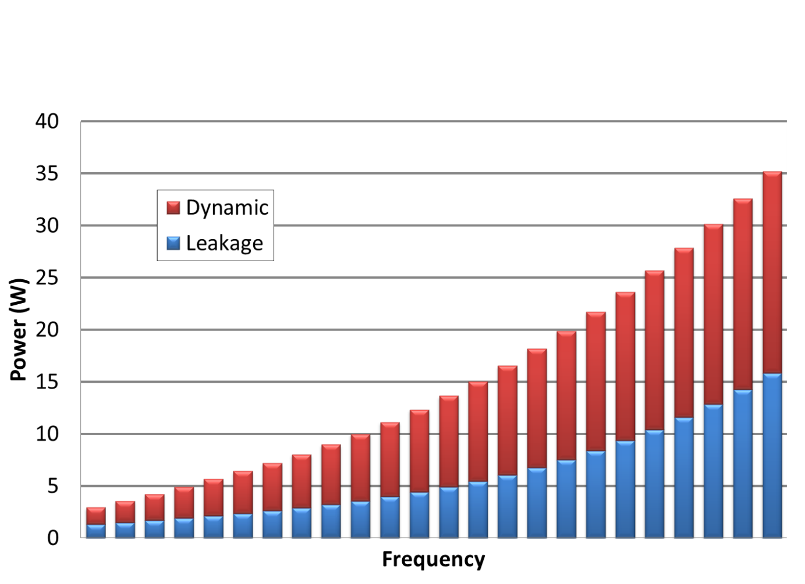
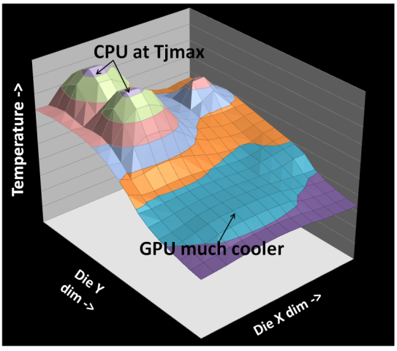


Why is Frequency important?
Courtesy of Oak Ridge National Laboratory,
U.S. Dept. of Energy
Notes:
Why should you care?
CPU frequency has always mattered, of course. Did you need a 66 MHz 486 to run your favorite game, or did 33MHz suffice? Frequency is even more important now, however, because it is tightly related to power *click*. Attainable frequency is related to voltage, and power is related to frequency times voltage^2. So the power your chip burns is related to the cube of frequency. So who pays attention to this?
At a micro level, modern processors carefully watch power across the chip in order to balance thermal hot spots with application performance. If a part of the chip is getting too hot, that core may be underclocked. If a different part of the chip is cool, it may be overclocked. Optimizing performance here quires boosting just enough at the right times.
The battery life of laptops, tablets, and phones is defined by their power usage. A smart operating system will only turn up the frequency when it’s beneficial to do so. Otherwise, the
At a macro level, power is now a first-class design constraint in supercomputers, where power usage is a significant portion of system cost. Suffice it to say, power is important.
And frequency is one of the major knobs that operating systems, hypervisors, firmware, and users can use to tune power usage. Again, as demonstrated in the last talk: if you care about power, you care about frequency.
Image credits:
Power/frequency curve from “Practical Power Gating and Dynamic Voltage/Frequency Scaling” by Stephen Kosonocky, presented at HotChips’11
CPU+GPU temperature chart from “Cooperative Boosting: Needy versus Greedy Power Management,” presented by Indrani Paul at ISCA’13
Tablet photo from http://www.amd.com/en-us/solutions/tablets
Titan picture from https://www.olcf.ornl.gov/titan/ , courtesy of Oak Ridge National Laboratory, U.S. Department of Energy.

Slide 16
How do you estimate “memory time”?
Modern Cores Make this Difficult
Count last-level cache misses?
Count the amount of time with an outstanding load?
Count time that the pipeline is stalled?
Pipeline flushes in core clock domain
CPU Work
DRAM
Can Return Out of Order
Multiple Parallel Accesses
Accesses Overlap Computation

Slide 17
Prediction Accuracy Per Benchmark
Memory Boundedness = Ratio of execution cycles at two frequencies
  1.0 = no change in cycles (completely compute bound, e.g. bzip2)

Slide 18
Conclusion
First leading loads implementation on real processors
Higher accuracy than existing predictors
Lower accuracy than simulation due to HW complexity
Lightweight estimation mechanism (only requires 2 counters)
  Path to better performance and power prediction

