Slide 1
Horton Tables: Fast Hash tables for In-Memory Data-Intensive Computing
Alex D. Breslow, Dong Ping zhang, joseph L. Greathouse, Nuwan Jayasena, and dean M. tullsen
6/23/2016

Slide 2
The Role of hash Tables
In In-memory data-intensive computing
Data stores and caches
Key-value stores (e.g., Memcached, Redis, MongoDB)
Relational databases (e.g., MonetDB, HyPer, IBM DB2 with BLU)
Hash indexes
Join implementation: hash join and variants
Grouping: grouping hash table
Dictionary encoding
Graphics
Accelerate computations by computing on hash tables that store sparse images, textures, or surfaces
General data compression schemes used in common compression utilities
In each of these fields, having a fast hash table is important

Slide 3
Focus of this talk
Optimizing memory accesses in fast in-memory hash tables
We need to aggressively optimize hash tables to be cognizant of this limitation
COMPUTE ELEMENTS
PRIVATE CACHES
Comparatively low bandwidth and high latency per memory transaction leads to memory-boundedness
SHARED
LLCs
MAIN
MEMORY
Hash tables have poor temporal and spatial locality.
In-memory hash tables often have hot working sets that are bigger than LLCs.

Slide 4
Bucketized Cuckoo Hash Tables
0
a | b | c | EMPTY
d | e | f | g
h | EMPTY | EMPTY | EMPTY
i | j | k | l
m | n | o | p
q | r | s | EMPTY
t | u | v | w
H₁
KV₁
1
m
INSERT KV₁
2
KV₁
H₂
3
H₂
4
u
INSERT KV₂
5
e
6
KV₂
H₁
First-fit Evaluate the hash functions in numerical order and insert KV₁ into the first candidate bucket with a free slot
Load balancing Insert KV₁ into the least full candidate bucket
KEY | VALUE
Remap in sequence with alternate hash function
Discover cuckoo chain with breadth-first search
Each bucket is typically sized to one hardware cache line or less.
Overwhelmingly, accesses to the bucket’s cache line hit in the hardware caches during accesses to consecutive cells.
Notes:
Hash tables enjoy wide use throughout all of computer science.
Examples include as indices as part of relational databases and key-value stores, data compression, data visualization, etc.
They enable fast constant time or amortized constant lookups, insertions, and deletions
In this work, we present a revised hash table that meets or exceeds the lookup throughput of the prior state-of-the-art without on compromising on their attractive qualities
First Animation (table pops up)
To understand our contribution, I must first describe bucketized cuckoo hash tables, the prior state-of-the-art for high-throughput, in-memory hash tables
This slide shows a BCHT. Cells are grouped into associative units known as buckets and correspond to rows in the matrix above
Buckets are typically sized to a cache line or less to reduce the demands on the memory subsystem.
Next Animation (KEY | VALUE pops up)
We give buckets a canonical label 0 through 6
Elements such as v consist of a key and value
Next Animation (INSERT KV1 pops up)
When inserting an element KV1, one of two hash functions H1 and H2 is selected to hash KV1 into one of two candidate buckets
Next Animation (Load balancing pops up)
The load balancing approach inserts KV1 into the candidate bucket with the most free slots. In this case bucket 2 has more free slots than bucket 0, so KV1 is inserted into bucket 2 using H2.
Several Animations (Up through when KV1 pops up next to h)
Several Animations (Up until first-fit appears (resets hash table to before insertions))
An alternate approach to insertions is first-fit. First-fit evaluates each hash function in order. It begins with H1. Since bucket 0 has a free slot, KV1 is inserted into bucket 0 and the routine completes. H2 and bucket 2 are not evaluated nor checked.
Several Animations (Up until KV1 is inserted next to c)
Next Animation (KV2 should pop up)
As the table begins to fill, some elements might map exclusively to candidate buckets that are already completely full
When this happens, a technique known as cuckoo hashing is applied
Several Animations (proceed up until the complete red chain appears (chain found with BFS not DFS!!! to deliver minimum length))
A breadth-first search is conducted from each of the candidate buckets to find a series of displacement that produce a path to an empty slot
Because it is BFS, the red path is of minimum length, and therefore requires the minimum number of element displacements
Proceed animation at a time until KV2 appears next to t in bucket 6 using the text below
Each item along the path is then moved in sequence until a free slot is made available in bucket 6 for KV2

Slide 5
Bucketized cuckoo hash tables
Lookups and Load balancing heuristic
0
a | b | c | EMPTY
d | e | f | g
h | EMPTY | EMPTY | EMPTY
i | j | k | l
m | n | o | p
q | r | s | EMPTY
t | u | v | w
H₁
1
INSERT KV₁
2
KV₁
H₂
3
4
5
6
Load balancing Insert KV₁ into the least full candidate bucket
KEY | VALUE
Expected Positive Lookup Cost Per Item in Buckets: 1.5 = (0.5 Hashed by H₁) + 2 * (0.5 Hashed by H₂)
Expected Negative Lookup Cost per Item in Buckets: 2 (also worst-case)
Expected Positive Lookup Cost Per Item in Buckets: (Fraction of Items Hashed by H₁) + 2 * (Fraction of Items Hashed by H₂)
Expected Negative Lookup Cost per Item in Buckets: 2 (also worst-case)

Slide 6
Bucketized cuckoo hash tables
Lookups and First-fit Insertion heuristic
a | b | c | EMPTY
d | e | f | g
h | EMPTY | EMPTY | EMPTY
i | j | k | l
m | n | o | p
q | r | s | EMPTY
t | u | v | w
H₁
0
KV₁
1
INSERT KV₁
2
H₂
3
4
5
6
First-fit Insert KV₁ into the first candidate with a free slot
KEY | VALUE
Expected Positive Lookup Cost Per Item in Buckets: 1 to 1.3ish depending on the table load factor and the slots per bucket
Expected Negative Lookup Cost per Item in Buckets: 2 (also worst-case)
Notes:
Prior work by Erlingsson et al. proposes first-fit, but doesn’t it evaluate its impact on throughput.
Prior work by Ross uses first-fit to accelerate insertions, but doesn’t use it for accelerating lookups. He instead opts to access all candidate buckets to reduce control flow complexity and to reduce stalls induced by branch mispredictions and additional overheads from more complex control flow that can impact latency.

Slide 7
Bucketized cuckoo hash tables
a.key == KV₁.key?
Benefits of First-fit
KV₁
c
b
a | b | c | EMPTY
d | e | f | g
h | EMPTY | EMPTY | EMPTY
i | j | k | l
m | n | o | p
q | r | s | EMPTY
t | u | v | w
H₁
0
KV₁
1
m
LOOKUP KV₁
2
3
H₂
4
u
LOOKUP KV₂
5
e
6
KV₂
H₁
KEY | VALUE
Positive Lookups:
First-fit gets us most of the way to 1.0 on positive lookups because most elements are hashed with H₁
But…
Notes:
Cuckoo eviction chains reduce lookup benefit of first-fit when the table’s load increases. For performance, we would want to select chains that minimally increase the number of elements hashed with H₂, but unfortunately, first-fit doesn’t enforce this property.

Slide 8
Bucketized cuckoo hash tables
Limitations of First-fit
a | b | c | EMPTY
d | e | f | g
h | EMPTY | EMPTY | EMPTY
i | j | k | l
m | n | o | p
q | r | s | EMPTY
t | u | v | w
0
KV₁
1
m
2
H₂
3
LOOKUP KV₃
4
u
5
e
H₁
H₂
6
KV₂
KEY | VALUE
Expected Negative Lookup Cost per Item in Buckets:
First-fit doesn’t address the comparatively expensive negative lookup cost. We still need to check all candidate buckets.
Notes:
First-fit isn’t enough because it doesn’t solve the negative lookup problem and is practically constrained in that it can only use 2 hash functions without adversely affecting the mean and worst-case lookup cost.

Slide 9
Horton Tables
Design GoALS
Positive lookups that typically require accessing only 1 bucket per query
If buckets are at most a cache line in size, then only 1 cache line is accessed as well.
Negative lookups that typically require accessing only 1 bucket per query
If buckets are at most a cache line in size, then only 1 cache line is accessed as well.
Retain a worst-case lookup cost of 2 buckets (i.e., often 2 hardware cache lines)
Achieve a load factor exceeding 0.95 (akin to a bucketized cuckoo hash table that uses 2 hash functions and 4-cell buckets)
Notes:
DMT – should mention the cache lines (ie 1 cache line) for the top two bullet points as well.

Slide 10
Horton Tables
Primary insertions and lookups
8 | 5 | EMPTY | EMPTY
33 | EMPTY | 15 | 2
35 | 18 | 22 | EMPTY
EMPTY | EMPTY | EMPTY | 37
17 | 6 | 21 | EMPTY
9 | 24 | EMPTY | EMPTY
H_{primary}
LOOKUP 13
0
13
INSERT 13
1
2
16
H_{primary}
LOOKUP 16
INSERT 16
3
4
5
Horton tables start off as standard bucketized cuckoo hash tables
Like first-fit, they strongly bias inserts by using a primary hash function called H_{primary}
Most positive lookups therefore only require accessing a single cache line
Notes:
Because bucketized cuckoo hash tables already have a number of desirable traits such as lookups that only require accessing at most 2 cache lines when buckets are sized to a cache line, we retrofit the BCHT
This retrofitting rather than a complete redesign permits maintaining the best properties of BCHTs while improving on them in several key ways
First Animation (two tables pop up)
For sake of comparison, we show a BCHT (left) and a Horton table (right)
A Horton table is almost identical to a BCHT
Next Animation (first bullet)
To enable fast lookups, like first-fit, it uses a single primary hash function to map most items to buckets, which means that most items can be retrieved by accessing a single bucket, and hence cache line
Next Animation (second bullet)
When the primary hash function maps more items to a bucket than that bucket can directly store, the bucket’s last slot is converted into a remap entry array.
Then one of many secondary hash functions is used to remap the item and its identifier is stored in an entry in the remap entry array whose index is determined by a tag hash function.
For example, the tag hash function on the remapped item 7 is 0, 2 for 5, and 3 for 2.
In the example, the bucket containing 35 has 18, 22, 7, 23, 4 initially map to it.
Only 35, 18, and 22 can be directly accommodated and 7, 23 and 4 are remapped using R7, R2, and R5, respectively.
On subsequent lookups 23, 7 and 4 can be found by first accessing the bucket containing 35 and then the bucket specified by the secondary hash. This property maintains the worst-case lookup cost of 2 while permitting many secondary hash functions.
Next bullet
In addition to remapping items, the remap entry array speeds up most negative lookups as well.
Because the remap entry array typically has 21 to 32 free slots and typically only several are full, most queries for items that are not contained in the table can be satisfied with a single lookup
Next bullet
These properties mean that most lookups incur a cost of 1 and only a few require 2.

Slide 11
Horton Tables
Inserts that trigger creation of remap entry array
8 | 5 | EMPTY | EMPTY
33 | EMPTY | 15 | 2
35 | 18 | 22 | REA
EMPTY | EMPTY | EMPTY | 37
17 | 6 | 21 | EMPTY
9 | 24 | EMPTY | EMPTY
0
13
1
2
16
H_{primary}
INSERT 23
3
Evict 16
4
16
5
For buckets that overflow, we remap surplus elements using one of many secondary hash functions and register its numerical identifier (e.g., R₂, R₅, R₇) as an element in a remap entry array (REA), a sparse, in-bucket array that tracks remapped elements.
Notes:
Because bucketized cuckoo hash tables already have a number of desirable traits such as lookups that only require accessing at most 2 cache lines when buckets are sized to a cache line, we retrofit the BCHT
This retrofitting rather than a complete redesign permits maintaining the best properties of BCHTs while improving on them in several key ways
First Animation (two tables pop up)
For sake of comparison, we show a BCHT (left) and a Horton table (right)
A Horton table is almost identical to a BCHT
Next Animation (first bullet)
To enable fast lookups, like first-fit, it uses a single primary hash function to map most items to buckets, which means that most items can be retrieved by accessing a single bucket, and hence cache line
Next Animation (second bullet)
When the primary hash function maps more items to a bucket than that bucket can directly store, the bucket’s last slot is converted into a remap entry array.
Then one of many secondary hash functions is used to remap the item and its identifier is stored in an entry in the remap entry array whose index is determined by a tag hash function.
For example, the tag hash function on the remapped item 7 is 0, 2 for 5, and 3 for 2.
In the example, the bucket containing 35 has 18, 22, 7, 23, 4 initially map to it.
Only 35, 18, and 22 can be directly accommodated and 7, 23 and 4 are remapped using R7, R2, and R5, respectively.
On subsequent lookups 23, 7 and 4 can be found by first accessing the bucket containing 35 and then the bucket specified by the secondary hash. This property maintains the worst-case lookup cost of 2 while permitting many secondary hash functions.
Next bullet
In addition to remapping items, the remap entry array speeds up most negative lookups as well.
Because the remap entry array typically has 21 to 32 free slots and typically only several are full, most queries for items that are not contained in the table can be satisfied with a single lookup
Next bullet
These properties mean that most lookups incur a cost of 1 and only a few require 2.

Slide 12
Horton Tables
Inserts that trigger creation of remap entry array
8 | 5 | EMPTY | EMPTY
33 | EMPTY | 15 | 2
35 | 18 | 22 | REA
EMPTY | EMPTY | EMPTY | 37
17 | 6 | 21 | EMPTY
9 | 24 | EMPTY | EMPTY
R₁
INSERT 23
0
13
1
H_{tag}(23) = 17
0
20
2
2
3
4
R₃
INSERT 23
16
5
23
R₂
INSERT 23
Store 2 at index H_{tag}(23)=17 to indicate that R₂ was used to remap 23
Use R₂ for inserting 23 because it maps 23 to least full secondary bucket candidate.
Compute index into remap entry array using H_{tag} with key as input
For buckets that overflow, we remap surplus elements using one of many secondary hash functions and register its numerical identifier (e.g., R₂, R₅, R₇) as an element in a remap entry array (REA), a sparse, in-bucket array that tracks remapped elements.
Notes:
Because bucketized cuckoo hash tables already have a number of desirable traits such as lookups that only require accessing at most 2 cache lines when buckets are sized to a cache line, we retrofit the BCHT
This retrofitting rather than a complete redesign permits maintaining the best properties of BCHTs while improving on them in several key ways
First Animation (two tables pop up)
For sake of comparison, we show a BCHT (left) and a Horton table (right)
A Horton table is almost identical to a BCHT
Next Animation (first bullet)
To enable fast lookups, like first-fit, it uses a single primary hash function to map most items to buckets, which means that most items can be retrieved by accessing a single bucket, and hence cache line
Next Animation (second bullet)
When the primary hash function maps more items to a bucket than that bucket can directly store, the bucket’s last slot is converted into a remap entry array.
Then one of many secondary hash functions is used to remap the item and its identifier is stored in an entry in the remap entry array whose index is determined by a tag hash function.
For example, the tag hash function on the remapped item 7 is 0, 2 for 5, and 3 for 2.
In the example, the bucket containing 35 has 18, 22, 7, 23, 4 initially map to it.
Only 35, 18, and 22 can be directly accommodated and 7, 23 and 4 are remapped using R7, R2, and R5, respectively.
On subsequent lookups 23, 7 and 4 can be found by first accessing the bucket containing 35 and then the bucket specified by the secondary hash. This property maintains the worst-case lookup cost of 2 while permitting many secondary hash functions.
Next bullet
In addition to remapping items, the remap entry array speeds up most negative lookups as well.
Because the remap entry array typically has 21 to 32 free slots and typically only several are full, most queries for items that are not contained in the table can be satisfied with a single lookup
Next bullet
These properties mean that most lookups incur a cost of 1 and only a few require 2.

Slide 13
Horton Tables
Inserts that trigger creation of remap entry array
8 | 5 | EMPTY | EMPTY
33 | EMPTY | 15 | 2
35 | 18 | 22 | REA
EMPTY | EMPTY | EMPTY | 37
17 | 6 | 21 | EMPTY
9 | 24 | EMPTY | EMPTY
0
13
1
H_{tag}(16) = 1
0
20
2
3
2
3
16
R₃
INSERT 16
4
R₂
INSERT 16
16
5
23
R₁
INSERT 16
16 now also needs to be remapped to a
secondary bucket.
Use R₃ for inserting 16 because it maps 16 to least full secondary bucket candidate.
Compute index into remap entry array using H_{tag} with key as input
Store 3 at index H_{tag}(16)=1 to indicate that R₃ was used to remap 16
For buckets that overflow, we remap surplus elements using one of many secondary hash functions and register its numerical identifier (e.g., R₂, R₅, R₇) as an element in a remap entry array (REA), a sparse, in-bucket array that tracks remapped elements.
Notes:
Because bucketized cuckoo hash tables already have a number of desirable traits such as lookups that only require accessing at most 2 cache lines when buckets are sized to a cache line, we retrofit the BCHT
This retrofitting rather than a complete redesign permits maintaining the best properties of BCHTs while improving on them in several key ways
First Animation (two tables pop up)
For sake of comparison, we show a BCHT (left) and a Horton table (right)
A Horton table is almost identical to a BCHT
Next Animation (first bullet)
To enable fast lookups, like first-fit, it uses a single primary hash function to map most items to buckets, which means that most items can be retrieved by accessing a single bucket, and hence cache line
Next Animation (second bullet)
When the primary hash function maps more items to a bucket than that bucket can directly store, the bucket’s last slot is converted into a remap entry array.
Then one of many secondary hash functions is used to remap the item and its identifier is stored in an entry in the remap entry array whose index is determined by a tag hash function.
For example, the tag hash function on the remapped item 7 is 0, 2 for 5, and 3 for 2.
In the example, the bucket containing 35 has 18, 22, 7, 23, 4 initially map to it.
Only 35, 18, and 22 can be directly accommodated and 7, 23 and 4 are remapped using R7, R2, and R5, respectively.
On subsequent lookups 23, 7 and 4 can be found by first accessing the bucket containing 35 and then the bucket specified by the secondary hash. This property maintains the worst-case lookup cost of 2 while permitting many secondary hash functions.
Next bullet
In addition to remapping items, the remap entry array speeds up most negative lookups as well.
Because the remap entry array typically has 21 to 32 free slots and typically only several are full, most queries for items that are not contained in the table can be satisfied with a single lookup
Next bullet
These properties mean that most lookups incur a cost of 1 and only a few require 2.
DMT – when you get to remapping 16, it is likely they have forgotten about it, so make it very clear why 16 is being remapped.
DMT – In these pictures, REA is hard to distinguish from other entries. Maybe use font or color to better distinguish. Or maybe show some horizontal lines in lower layer that indicate it is an array.

Slide 14
Horton Tables
Retrieving Remapped items
8 | 5 | EMPTY | EMPTY
33 | EMPTY | 15 | 2
35 | 18 | 22 | REA
EMPTY | EMPTY | EMPTY | 37
17 | 6 | 21 | EMPTY
9 | 24 | EMPTY | EMPTY
0
13
1
2
H_{primary}
LOOKUP 16
3
16
4
5
23
Determine 16 is not stored in its primary bucket and proceed to examine REA
Compute primary hash function and examine primary bucket (bucket 2)
Remapped items can always be retrieved by accessing 2 buckets, even when many secondary hash functions are used
e.g., when retrieving 16, we only access buckets 2 (primary bucket) and 3 (secondary bucket). We skip buckets 4 and 5 even though they were previously candidates.
Notes:
Because bucketized cuckoo hash tables already have a number of desirable traits such as lookups that only require accessing at most 2 cache lines when buckets are sized to a cache line, we retrofit the BCHT
This retrofitting rather than a complete redesign permits maintaining the best properties of BCHTs while improving on them in several key ways
First Animation (two tables pop up)
For sake of comparison, we show a BCHT (left) and a Horton table (right)
A Horton table is almost identical to a BCHT
Next Animation (first bullet)
To enable fast lookups, like first-fit, it uses a single primary hash function to map most items to buckets, which means that most items can be retrieved by accessing a single bucket, and hence cache line
Next Animation (second bullet)
When the primary hash function maps more items to a bucket than that bucket can directly store, the bucket’s last slot is converted into a remap entry array.
Then one of many secondary hash functions is used to remap the item and its identifier is stored in an entry in the remap entry array whose index is determined by a tag hash function.
For example, the tag hash function on the remapped item 7 is 0, 2 for 5, and 3 for 2.
In the example, the bucket containing 35 has 18, 22, 7, 23, 4 initially map to it.
Only 35, 18, and 22 can be directly accommodated and 7, 23 and 4 are remapped using R7, R2, and R5, respectively.
On subsequent lookups 23, 7 and 4 can be found by first accessing the bucket containing 35 and then the bucket specified by the secondary hash. This property maintains the worst-case lookup cost of 2 while permitting many secondary hash functions.
Next bullet
In addition to remapping items, the remap entry array speeds up most negative lookups as well.
Because the remap entry array typically has 21 to 32 free slots and typically only several are full, most queries for items that are not contained in the table can be satisfied with a single lookup
Next bullet
These properties mean that most lookups incur a cost of 1 and only a few require 2.

Slide 15
Horton Tables
Retrieving remapped items
8 | 5 | EMPTY | EMPTY
33 | EMPTY | 15 | 2
35 | 18 | 22 | REA
EMPTY | EMPTY | EMPTY | 37
17 | 6 | 21 | EMPTY
9 | 24 | EMPTY | EMPTY
0
13
1
H_{tag}(16) = 1
0
20
2
3
2
3
16
R₃
LOOKUP 16
4
5
23
Retrieve 16 from bucket 3
Determine 16 is not stored in its primary bucket and proceed to examine REA
The remap entry shows R₃ was used to remap 16, so compute R₃(16).
Compute index into remap entry array using H_{tag} with key as input
Remapped items can always be retrieved by accessing 2 buckets, even when many secondary hash functions are used
e.g., when retrieving 16, we only access buckets 2 (primary bucket) and 3 (secondary bucket). We skip buckets 4 and 5 even though they were previously candidates.
Notes:
Because bucketized cuckoo hash tables already have a number of desirable traits such as lookups that only require accessing at most 2 cache lines when buckets are sized to a cache line, we retrofit the BCHT
This retrofitting rather than a complete redesign permits maintaining the best properties of BCHTs while improving on them in several key ways
First Animation (two tables pop up)
For sake of comparison, we show a BCHT (left) and a Horton table (right)
A Horton table is almost identical to a BCHT
Next Animation (first bullet)
To enable fast lookups, like first-fit, it uses a single primary hash function to map most items to buckets, which means that most items can be retrieved by accessing a single bucket, and hence cache line
Next Animation (second bullet)
When the primary hash function maps more items to a bucket than that bucket can directly store, the bucket’s last slot is converted into a remap entry array.
Then one of many secondary hash functions is used to remap the item and its identifier is stored in an entry in the remap entry array whose index is determined by a tag hash function.
For example, the tag hash function on the remapped item 7 is 0, 2 for 5, and 3 for 2.
In the example, the bucket containing 35 has 18, 22, 7, 23, 4 initially map to it.
Only 35, 18, and 22 can be directly accommodated and 7, 23 and 4 are remapped using R7, R2, and R5, respectively.
On subsequent lookups 23, 7 and 4 can be found by first accessing the bucket containing 35 and then the bucket specified by the secondary hash. This property maintains the worst-case lookup cost of 2 while permitting many secondary hash functions.
Next bullet
In addition to remapping items, the remap entry array speeds up most negative lookups as well.
Because the remap entry array typically has 21 to 32 free slots and typically only several are full, most queries for items that are not contained in the table can be satisfied with a single lookup
Next bullet
These properties mean that most lookups incur a cost of 1 and only a few require 2.

Slide 16
Horton Tables
Negative lookups
8 | 5 | EMPTY | EMPTY
33 | EMPTY | 15 | 2
35 | 18 | 22 | REA
EMPTY | EMPTY | EMPTY | 37
17 | 6 | 21 | EMPTY
9 | 24 | EMPTY | EMPTY
0
13
1
2
3
16
H_{primary}
LOOKUP 25
4
5
23
Most negative lookups only require accessing a single bucket
Lookups where the primary bucket is Type A, a conventional BCHT bucket without remap entries, only ever require examining 1 bucket and thus 1 cache line for positive and negative queries alike
Notes:
Because bucketized cuckoo hash tables already have a number of desirable traits such as lookups that only require accessing at most 2 cache lines when buckets are sized to a cache line, we retrofit the BCHT
This retrofitting rather than a complete redesign permits maintaining the best properties of BCHTs while improving on them in several key ways
First Animation (two tables pop up)
For sake of comparison, we show a BCHT (left) and a Horton table (right)
A Horton table is almost identical to a BCHT
Next Animation (first bullet)
To enable fast lookups, like first-fit, it uses a single primary hash function to map most items to buckets, which means that most items can be retrieved by accessing a single bucket, and hence cache line
Next Animation (second bullet)
When the primary hash function maps more items to a bucket than that bucket can directly store, the bucket’s last slot is converted into a remap entry array.
Then one of many secondary hash functions is used to remap the item and its identifier is stored in an entry in the remap entry array whose index is determined by a tag hash function.
For example, the tag hash function on the remapped item 7 is 0, 2 for 5, and 3 for 2.
In the example, the bucket containing 35 has 18, 22, 7, 23, 4 initially map to it.
Only 35, 18, and 22 can be directly accommodated and 7, 23 and 4 are remapped using R7, R2, and R5, respectively.
On subsequent lookups 23, 7 and 4 can be found by first accessing the bucket containing 35 and then the bucket specified by the secondary hash. This property maintains the worst-case lookup cost of 2 while permitting many secondary hash functions.
Next bullet
In addition to remapping items, the remap entry array speeds up most negative lookups as well.
Because the remap entry array typically has 21 to 32 free slots and typically only several are full, most queries for items that are not contained in the table can be satisfied with a single lookup
Next bullet
These properties mean that most lookups incur a cost of 1 and only a few require 2.
DMT – have we introduce the terms “type a” “type b”. Might be better not to introduce them, but just describe “in a bucket without a remap array”?

Slide 17
Horton Tables
Negative lookups
8 | 5 | EMPTY | EMPTY
33 | EMPTY | 15 | 2
35 | 18 | 22 | REA
EMPTY | EMPTY | EMPTY | 37
17 | 6 | 21 | EMPTY
9 | 24 | EMPTY | EMPTY
0
13
1
2
H_{primary}
LOOKUP 28
3
16
4
5
23
Most negative lookups only require accessing a single bucket
Lookups where the primary bucket is Type B, buckets where the final slot is converted into an REA, often only require accessing 1 bucket and at most 2 for positive and negative queries alike
Notes:
Because bucketized cuckoo hash tables already have a number of desirable traits such as lookups that only require accessing at most 2 cache lines when buckets are sized to a cache line, we retrofit the BCHT
This retrofitting rather than a complete redesign permits maintaining the best properties of BCHTs while improving on them in several key ways
First Animation (two tables pop up)
For sake of comparison, we show a BCHT (left) and a Horton table (right)
A Horton table is almost identical to a BCHT
Next Animation (first bullet)
To enable fast lookups, like first-fit, it uses a single primary hash function to map most items to buckets, which means that most items can be retrieved by accessing a single bucket, and hence cache line
Next Animation (second bullet)
When the primary hash function maps more items to a bucket than that bucket can directly store, the bucket’s last slot is converted into a remap entry array.
Then one of many secondary hash functions is used to remap the item and its identifier is stored in an entry in the remap entry array whose index is determined by a tag hash function.
For example, the tag hash function on the remapped item 7 is 0, 2 for 5, and 3 for 2.
In the example, the bucket containing 35 has 18, 22, 7, 23, 4 initially map to it.
Only 35, 18, and 22 can be directly accommodated and 7, 23 and 4 are remapped using R7, R2, and R5, respectively.
On subsequent lookups 23, 7 and 4 can be found by first accessing the bucket containing 35 and then the bucket specified by the secondary hash. This property maintains the worst-case lookup cost of 2 while permitting many secondary hash functions.
Next bullet
In addition to remapping items, the remap entry array speeds up most negative lookups as well.
Because the remap entry array typically has 21 to 32 free slots and typically only several are full, most queries for items that are not contained in the table can be satisfied with a single lookup
Next bullet
These properties mean that most lookups incur a cost of 1 and only a few require 2.

Slide 18
Horton Tables
Negative lookups
8 | 5 | EMPTY | EMPTY
33 | EMPTY | 15 | 2
35 | 18 | 22 | REA
EMPTY | EMPTY | EMPTY | 37
17 | 6 | 21 | EMPTY
9 | 24 | EMPTY | EMPTY
0
13
1
H_{tag}(28) = 10
0
20
2
3
2
3
16
4
Determine 28 is not stored in its primary bucket (2) and proceed to examine REA
Compute index into remap entry array using H_{tag} with key as input
Examine 10th slot of remap entry array and see it is empty. The search can stop.
5
23
Most negative lookups only require accessing a single bucket
Lookups where the primary bucket is Type B, buckets where the final slot is converted into an REA, often only require accessing 1 bucket and at most 2 for positive and negative queries alike
Notes:
Because bucketized cuckoo hash tables already have a number of desirable traits such as lookups that only require accessing at most 2 cache lines when buckets are sized to a cache line, we retrofit the BCHT
This retrofitting rather than a complete redesign permits maintaining the best properties of BCHTs while improving on them in several key ways
First Animation (two tables pop up)
For sake of comparison, we show a BCHT (left) and a Horton table (right)
A Horton table is almost identical to a BCHT
Next Animation (first bullet)
To enable fast lookups, like first-fit, it uses a single primary hash function to map most items to buckets, which means that most items can be retrieved by accessing a single bucket, and hence cache line
Next Animation (second bullet)
When the primary hash function maps more items to a bucket than that bucket can directly store, the bucket’s last slot is converted into a remap entry array.
Then one of many secondary hash functions is used to remap the item and its identifier is stored in an entry in the remap entry array whose index is determined by a tag hash function.
For example, the tag hash function on the remapped item 7 is 0, 2 for 5, and 3 for 2.
In the example, the bucket containing 35 has 18, 22, 7, 23, 4 initially map to it.
Only 35, 18, and 22 can be directly accommodated and 7, 23 and 4 are remapped using R7, R2, and R5, respectively.
On subsequent lookups 23, 7 and 4 can be found by first accessing the bucket containing 35 and then the bucket specified by the secondary hash. This property maintains the worst-case lookup cost of 2 while permitting many secondary hash functions.
Next bullet
In addition to remapping items, the remap entry array speeds up most negative lookups as well.
Because the remap entry array typically has 21 to 32 free slots and typically only several are full, most queries for items that are not contained in the table can be satisfied with a single lookup
Next bullet
These properties mean that most lookups incur a cost of 1 and only a few require 2.

Slide 19
Horton Tables
Negative lookups with tag alias
8 | 5 | EMPTY | EMPTY
33 | EMPTY | 15 | 2
35 | 18 | 22 | REA
EMPTY | EMPTY | EMPTY | 37
17 | 6 | 21 | EMPTY
9 | 24 | EMPTY | EMPTY
0
13
1
2
H_{primary}
LOOKUP 7
3
16
Determine 7 is not stored in its primary bucket (2) and proceed to examine REA
4
5
23
Negative lookups only require accessing 2 buckets on a tag alias
Lookups where the primary bucket is Type B, buckets where the final slot is converted into an REA, often only require accessing 1 bucket and at most 2 for positive and negative queries alike
Notes:
Because bucketized cuckoo hash tables already have a number of desirable traits such as lookups that only require accessing at most 2 cache lines when buckets are sized to a cache line, we retrofit the BCHT
This retrofitting rather than a complete redesign permits maintaining the best properties of BCHTs while improving on them in several key ways
First Animation (two tables pop up)
For sake of comparison, we show a BCHT (left) and a Horton table (right)
A Horton table is almost identical to a BCHT
Next Animation (first bullet)
To enable fast lookups, like first-fit, it uses a single primary hash function to map most items to buckets, which means that most items can be retrieved by accessing a single bucket, and hence cache line
Next Animation (second bullet)
When the primary hash function maps more items to a bucket than that bucket can directly store, the bucket’s last slot is converted into a remap entry array.
Then one of many secondary hash functions is used to remap the item and its identifier is stored in an entry in the remap entry array whose index is determined by a tag hash function.
For example, the tag hash function on the remapped item 7 is 0, 2 for 5, and 3 for 2.
In the example, the bucket containing 35 has 18, 22, 7, 23, 4 initially map to it.
Only 35, 18, and 22 can be directly accommodated and 7, 23 and 4 are remapped using R7, R2, and R5, respectively.
On subsequent lookups 23, 7 and 4 can be found by first accessing the bucket containing 35 and then the bucket specified by the secondary hash. This property maintains the worst-case lookup cost of 2 while permitting many secondary hash functions.
Next bullet
In addition to remapping items, the remap entry array speeds up most negative lookups as well.
Because the remap entry array typically has 21 to 32 free slots and typically only several are full, most queries for items that are not contained in the table can be satisfied with a single lookup
Next bullet
These properties mean that most lookups incur a cost of 1 and only a few require 2.

Slide 20
Horton Tables
Negative lookups with tag alias
8 | 5 | EMPTY | EMPTY
33 | EMPTY | 15 | 2
35 | 18 | 22 | REA
EMPTY | EMPTY | EMPTY | 37
17 | 6 | 21 | EMPTY
9 | 24 | EMPTY | EMPTY
0
13
R₂
LOOKUP 7
1
H_{tag}(7) = 17
0
20
2
3
2
3
16
Determine that no slots of secondary bucket (0) match 7, so stop looking.
Examine 18th slot of remap entry array and see that R₂ was likely used to remap 7.
Compute index into remap entry array using H_{tag} with key as input
4
5
23
Negative lookup with a tag alias (e.g., 7 reads remap entry set by 23)
Lookups where the primary bucket is Type B, buckets where the final slot is converted into an REA, often only require accessing 1 bucket and at most 2 for positive and negative queries alike
Notes:
Because bucketized cuckoo hash tables already have a number of desirable traits such as lookups that only require accessing at most 2 cache lines when buckets are sized to a cache line, we retrofit the BCHT
This retrofitting rather than a complete redesign permits maintaining the best properties of BCHTs while improving on them in several key ways
First Animation (two tables pop up)
For sake of comparison, we show a BCHT (left) and a Horton table (right)
A Horton table is almost identical to a BCHT
Next Animation (first bullet)
To enable fast lookups, like first-fit, it uses a single primary hash function to map most items to buckets, which means that most items can be retrieved by accessing a single bucket, and hence cache line
Next Animation (second bullet)
When the primary hash function maps more items to a bucket than that bucket can directly store, the bucket’s last slot is converted into a remap entry array.
Then one of many secondary hash functions is used to remap the item and its identifier is stored in an entry in the remap entry array whose index is determined by a tag hash function.
For example, the tag hash function on the remapped item 7 is 0, 2 for 5, and 3 for 2.
In the example, the bucket containing 35 has 18, 22, 7, 23, 4 initially map to it.
Only 35, 18, and 22 can be directly accommodated and 7, 23 and 4 are remapped using R7, R2, and R5, respectively.
On subsequent lookups 23, 7 and 4 can be found by first accessing the bucket containing 35 and then the bucket specified by the secondary hash. This property maintains the worst-case lookup cost of 2 while permitting many secondary hash functions.
Next bullet
In addition to remapping items, the remap entry array speeds up most negative lookups as well.
Because the remap entry array typically has 21 to 32 free slots and typically only several are full, most queries for items that are not contained in the table can be satisfied with a single lookup
Next bullet
These properties mean that most lookups incur a cost of 1 and only a few require 2.

Slide 21
Additional content in the Paper
Sharing of remap entries among multiple remapped elements while still permitting their deletion
Further optimizations for improving lookup throughput
Analytical models for lookups, insertions and deletions
More in-depth discussion of prior work and how Horton tables improves over first-fit for positive lookups

Slide 22
Experimental methodology
Conducted a series of analytical studies to determine 8-slots per bucket was a good design point (more details in paper)
Fills a 64-byte cache line with 8-byte entries
High load factors (>95% table can be filled with key-value pairs)
Positive lookups that typically access less than 1.18 buckets per query
Negative lookups that typically access less than 1.06 buckets per query
Further analytical studies demonstrated that 21 entries per REA and 7 secondary functions is often more than sufficient for 8-slot buckets (more details in paper)
Experimental studies conducted on an AMD RadeonTM R9 290X GPU

Slide 23
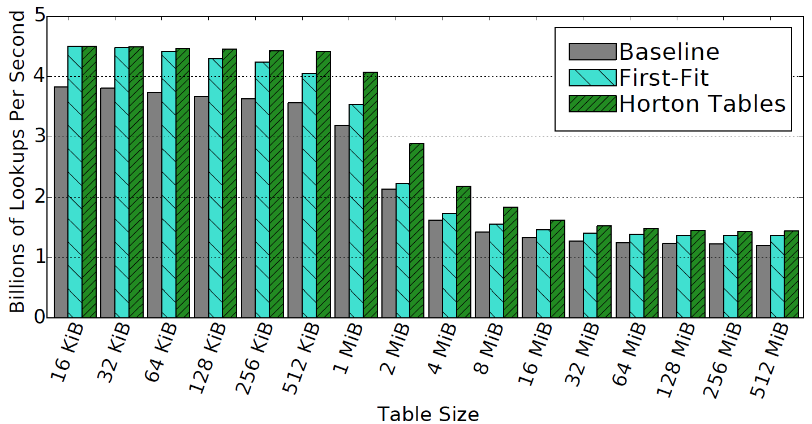
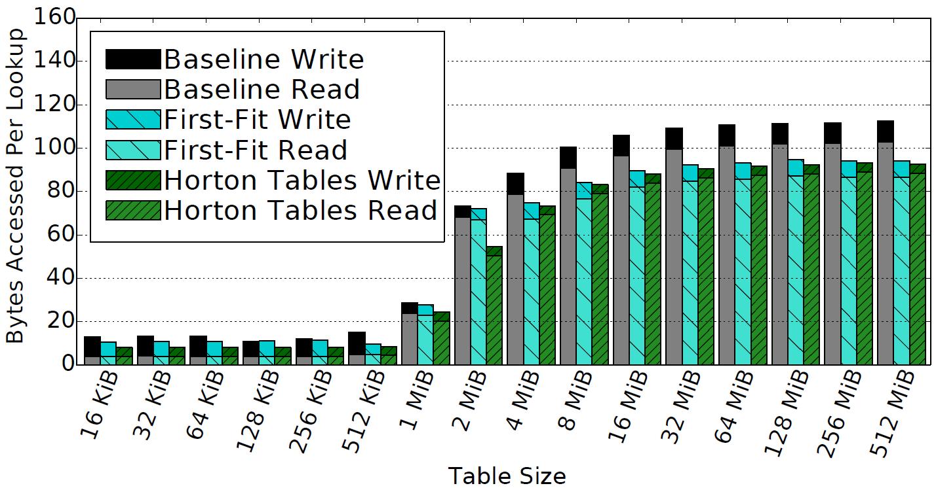
REsults
Positive Lookup Throughput
Positive Lookups
HIGHER IS BETTER
Bytes Transferred from DRAM per Query
LOWER
IS BETTER

Slide 24
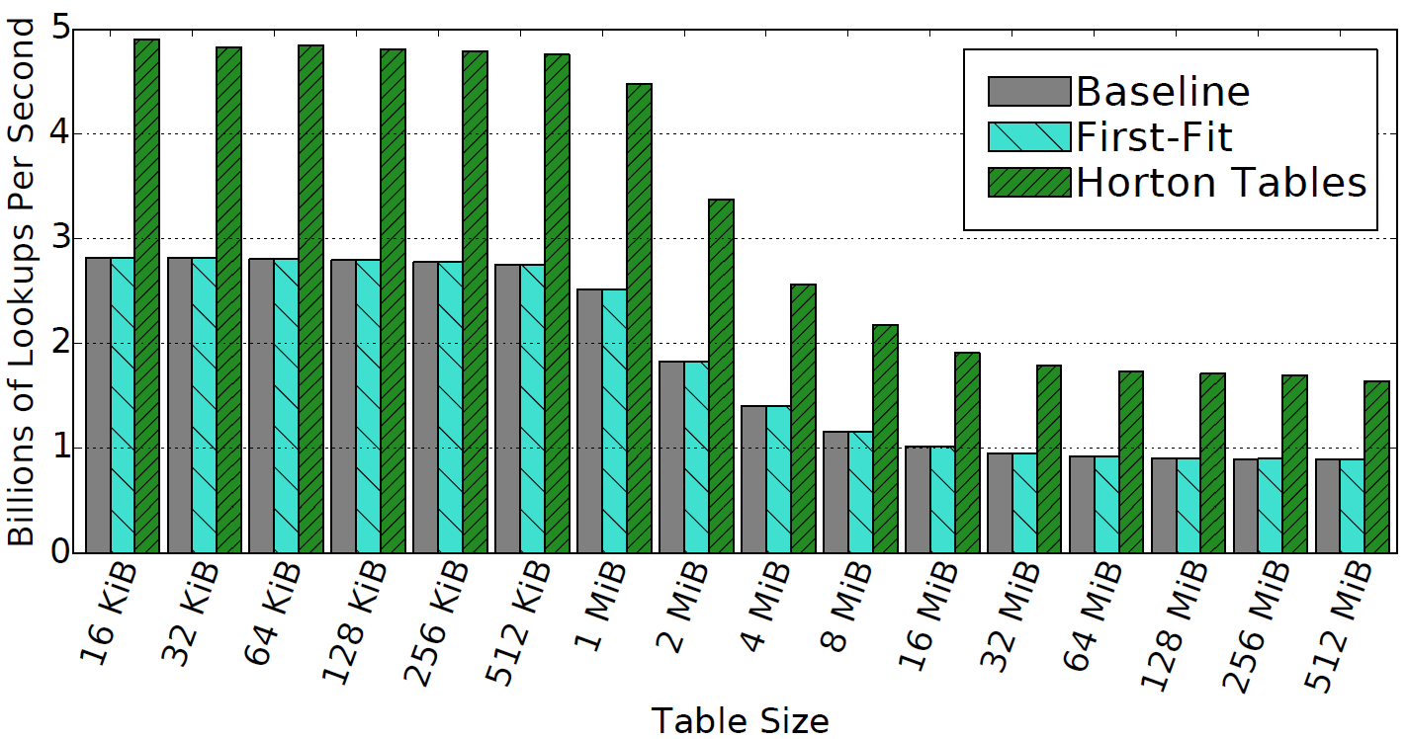
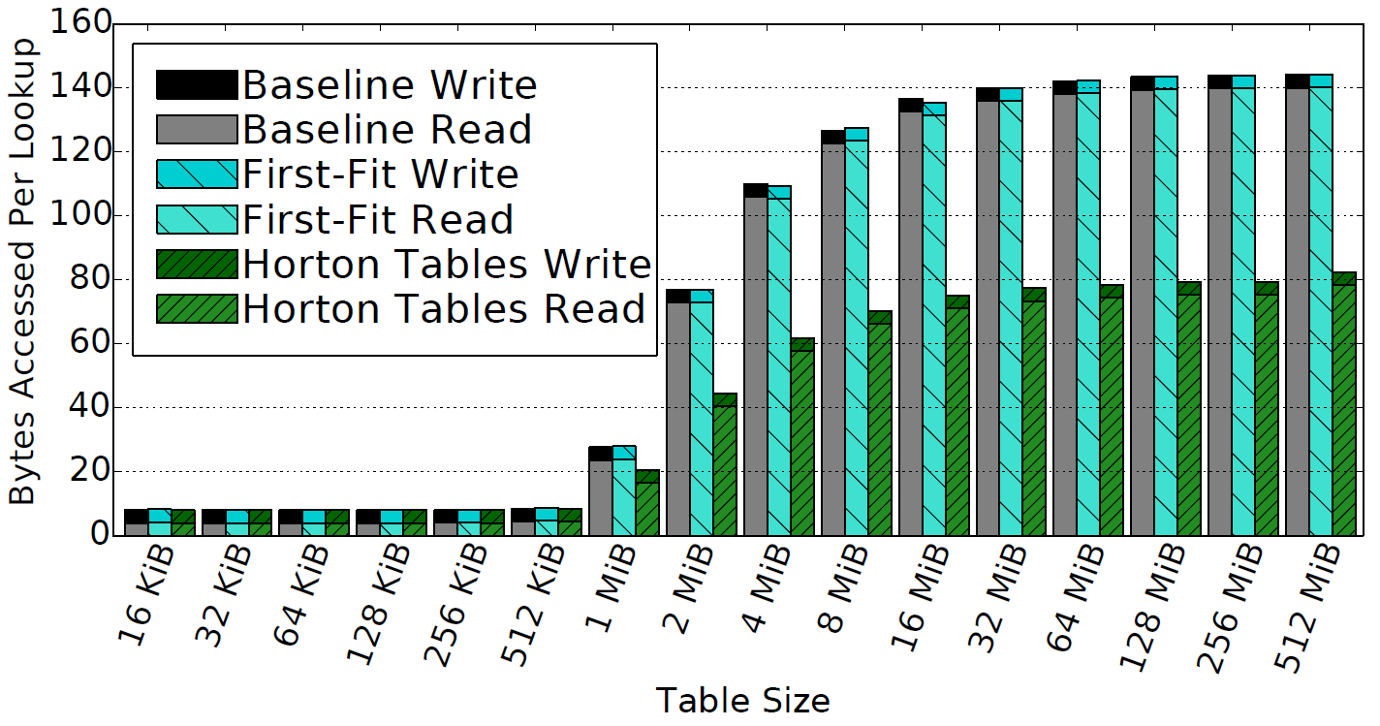
REsults
Negative Lookup Throughput
NEGATIVE Lookups
HIGHER IS BETTER
Bytes Transferred from DRAM per Query
LOWER
IS BETTER

Slide 25
Conclusions from Horton tables
Achieves lookup throughput that meets or exceeds prior approaches
Throughput improvement is achieved by reducing the number of cache lines that need to be accessed per lookup query to at most 1.18 for positive lookups and 1.06 for negative lookups
Reducing cache accesses yields corresponding throughput improvements of 5% to 35% and 73% to 89%, for pos. and neg. lookups, respectively, on a very full table.
Optimizing hash table algorithms is important because of their wide use throughout all segments of computing
e.g., scientific computing and databases, data compression, computer graphics and data visualization

Slide 26
Future Work
Evaluation of insertions and deletions and their optimization
Write- and update-heavy workloads should also benefit from Horton tables approach.
Application of Horton tables to data warehousing and analysis applications
Database operators’ implementations (e.g., hash joins and grouping hash tables)
Key-value stores
Additional indices for speeding up lookups, insertions, and deletions
Evaluation of Horton tables on new and emerging memory subsystems as well as tailoring the technique for persistent storage technologies such as SSDs

Slide 27
Questions?
Thanks for your attention.

Slide 28
Disclaimer & Attribution
The information presented in this document is for informational purposes only and may contain technical inaccuracies, omissions and typographical errors.
The information contained herein is subject to change and may be rendered inaccurate for many reasons, including but not limited to product and roadmap changes, component and motherboard version changes, new model and/or product releases, product differences between differing manufacturers, software changes, BIOS flashes, firmware upgrades, or the like. AMD assumes no obligation to update or otherwise correct or revise this information. However, AMD reserves the right to revise this information and to make changes from time to time to the content hereof without obligation of AMD to notify any person of such revisions or changes.
AMD MAKES NO REPRESENTATIONS OR WARRANTIES WITH RESPECT TO THE CONTENTS HEREOF AND ASSUMES NO RESPONSIBILITY FOR ANY INACCURACIES, ERRORS OR OMISSIONS THAT MAY APPEAR IN THIS INFORMATION.
AMD SPECIFICALLY DISCLAIMS ANY IMPLIED WARRANTIES OF MERCHANTABILITY OR FITNESS FOR ANY PARTICULAR PURPOSE. IN NO EVENT WILL AMD BE LIABLE TO ANY PERSON FOR ANY DIRECT, INDIRECT, SPECIAL OR OTHER CONSEQUENTIAL DAMAGES ARISING FROM THE USE OF ANY INFORMATION CONTAINED HEREIN, EVEN IF AMD IS EXPRESSLY ADVISED OF THE POSSIBILITY OF SUCH DAMAGES.
ATTRIBUTION
© 2016 Advanced Micro Devices, Inc. All rights reserved. AMD, the AMD Arrow logo, AMD Radeon, and combinations thereof are trademarks of Advanced Micro Devices, Inc. in the United States and/or other jurisdictions. Other names are for informational purposes only and may be trademarks of their respective owners.

Slide 29
BACKUP SLIDES

Slide 30
Horton tables
Sharing of remap entries
8 | 5 | EMPTY | EMPTY
33 | EMPTY | 15 | 2
35 | 18 | 22 | REA
EMPTY | EMPTY | EMPTY | 37
17 | 6 | 21 | EMPTY
9 | 24 | EMPTY | EMPTY
0
13
1
2
H_{primary}
INSERT 27
3
16
4
5
23
We conclude that bucket 2 has no free slots, so we need to remap it.
We permit a single remap entry to reference multiple remapped elements.
Deleting remap entries is possible by having elements that share remap entries map to the same secondary bucket (see our paper for details).

Slide 31
Horton tables
Sharing of remap entries
8 | 5 | EMPTY | EMPTY
33 | EMPTY | 15 | 2
35 | 18 | 22 | REA
EMPTY | EMPTY | EMPTY | 37
17 | 6 | 21 | EMPTY
9 | 24 | EMPTY | EMPTY
0
13
H_{tag}(27) = 1
1
0
20
2
3
2
3
27
16
R₃
INSERT 27
4
We see that the remap entry is set,
so we try to use R₃ to insert 27.
5
23
The insertion succeeds because the secondary bucket (3) has a free slot.
Compute the H_{tag} on the key
If bucket 3 had been full, we could have swapped 27 with another item from 27’s primary bucket (2) (e.g., 35) and remapped that item instead.
Alternatively, we could try to remap both 27 and 16 to another shared bucket with a different secondary hash function, but this is more likely to fail.
We permit a single remap entry to reference multiple remapped elements.
Deleting remap entries is possible by having elements that share remap entries map to the same secondary bucket (see our paper for details).

Slide 32
Horton tables
Deleting elements
EMPTY | 5 | EMPTY | EMPTY
33 | EMPTY | 15 | 2
35 | 18 | 22 | REA
EMPTY | EMPTY | EMPTY | 37
17 | 6 | 21 | EMPTY
9 | 24 | EMPTY | EMPTY
0
8
13
H_{primary}
DELETE 8
1
2
H_{primary}
DELETE 27
3
27
16
4
5
23
27 is not found in its primary bucket; we need to access the remap entry array.
Deleting elements that are found in their primary bucket only requires accessing a single bucket
A remapped element can be deleted by performing a secondary lookup followed by a deletion

Slide 33
Horton tables
Deleting elements
EMPTY | 5 | EMPTY | EMPTY
33 | EMPTY | 15 | 2
35 | 18 | 22 | REA
EMPTY | EMPTY | EMPTY | 37
17 | 6 | 21 | EMPTY
9 | 24 | EMPTY | EMPTY
0
8
13
H_{tag}(27) = 1
1
0
20
2
3
2
3
27
16
R₃
DELETE 27
4
Search R₃(27) = 3 and delete it upon discovery.
Compute H_{primary} on 16 and 37 and find that the remap entry is still active.
27 is not found in its primary bucket; we need to access the remap entry array.
5
23
A subsequent deletion of 16 would cause the remap entry to be deleted.
Deleting elements that are found in their primary bucket only requires accessing a single bucket
A remapped element can be deleted by performing a secondary lookup followed by a deletion

Slide 34
END OF BACKUP SLIDES

