Slide 1
Accelerating Dynamic
Software Analyses
Joseph L. Greathouse
Ph.D. Candidate
Advanced Computer Architecture Laboratory
University of Michigan
December 1, 2011
Notes:
This talk was given at VMware on December 1, 2011. (Thanks to Jim Chow). This is basically a mix of my CGO 2011 talk along with my ISCA 2011 talk. See those slides for detailed notes of what all the animations mean.

Slide 2
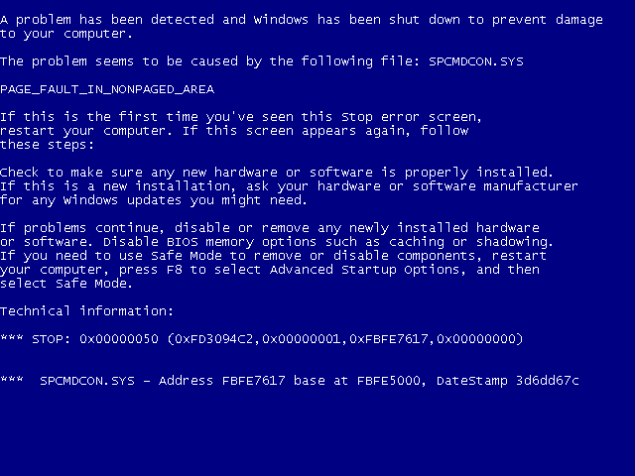
Software Errors Abound
NIST: SW errors cost U.S. ~$60 billion/year as of 2002
FBI CCS: Security Issues $67 billion/year as of 2005
  >⅓ from viruses, network intrusion, etc.
Cataloged Software Vulnerabilities

Slide 3
Example of a Modern Bug
Thread 1
Thread 2
mylen=small
mylen=large
if(ptr == NULL) {
len=thread_local->mylen;
ptr=malloc(len);
memcpy(ptr, data, len);
}
Nov. 2010 OpenSSL Security Flaw
ptr
∅

Slide 4
Example of a Modern Bug
Thread 1
Thread 2
mylen=small
mylen=large
TIME
if(ptr==NULL)
if(ptr==NULL)
len2=thread_local->mylen;
ptr=malloc(len2);
len1=thread_local->mylen;
ptr=malloc(len1);
memcpy(ptr, data1, len1)
memcpy(ptr, data2, len2)
ptr
LEAKED
∅

Slide 5
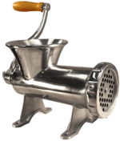



Dynamic Software Analysis
Analyze the program as it runs
  System state, find errors on any executed path
  LARGE runtime overheads, only test one path
Analysis Instrumentation
Program
Instrumented Program
In-House
Test Machine(s)
Developer
Analysis Results
LONG run time

Slide 6
Runtime Overheads: How Large?
Data Race Detection
(e.g. Inspector XE)
Memory Checking
(e.g. MemCheck)
Taint Analysis
(e.g.TaintCheck)
Dynamic Bounds Checking
2-300x
2-200x
5-50x
10-80x
Symbolic Execution
10-200x

Slide 7
Outline
Problem Statement
Background Information
  Demand-Driven Dynamic Dataflow Analysis
Proposed Solutions
  Demand-Driven Data Race Detection
  Sampling to Cap Maximum Overheads

Slide 8
Dynamic Dataflow Analysis
Associate meta-data with program values
Propagate/Clear meta-data while executing
Check meta-data for safety & correctness
Forms dataflows of meta/shadow information

Slide 9
Example: Taint Analysis
Data
Input
Meta-data
Associate
x = read_input()
x = read_input()
validate(x)
Clear
Propagate
y = x * 1024
y = x * 1024
w = x + 42
Check w
Check w
a += y
z = y * 75
Check z
a += y
z = y * 75
Check z
Check a
Check a

Slide 10




Demand-Driven Dataflow Analysis
Only Analyze Shadowed Data
Instrumented
Application
Instrumented
Application
Native
Application
No meta-data
Shadowed Data
Non-Shadowed Data
Meta-Data Detection

Slide 11
Finding Meta-Data
No additional overhead when no meta-data
  Needs hardware support
Take a fault when touching shadowed data
Solution: Virtual Memory Watchpoints
FAULT
V→P
V→P

Slide 12
Results by Ho et al.
lmbench Best Case Results:
Results when everything is tainted:
System | Slowdown (normalized)
Taint Analysis | 101.7x
On-Demand Taint Analysis | 1.98x

Slide 13
Outline
Problem Statement
Background Information
  Demand-Driven Dynamic Dataflow Analysis
Proposed Solutions
  Demand-Driven Data Race Detection
  Sampling to Cap Maximum Overheads

Slide 14
Software Data Race Detection
Add checks around every memory access
Find inter-thread sharing events
Synchronization between write-shared accesses?
  No? Data race.

Slide 15



Example of Data Race Detection
Thread 1
Thread 2
mylen=small
mylen=large
TIME
if(ptr==NULL)
len1=thread_local->mylen;
Interleaved Synchronization?
ptr write-shared?
ptr=malloc(len1);
memcpy(ptr, data1, len1)
if(ptr==NULL)
len2=thread_local->mylen;
ptr=malloc(len2);
memcpy(ptr, data2, len2)

Slide 16
SW Race Detection is Slow
Phoenix
PARSEC

Slide 17
Inter-thread Sharing is What’s Important
“Data races ... are failures in programs that access and update shared data in critical sections” – Netzer & Miller, 1992
Thread-local data
NO SHARING
TIME
if(ptr==NULL)
len1=thread_local->mylen;
ptr=malloc(len1);
Shared data
NO INTER-THREAD SHARING EVENTS
memcpy(ptr, data1, len1)
if(ptr==NULL)
len2=thread_local->mylen;
ptr=malloc(len2);
memcpy(ptr, data2, len2)

Slide 18
Very Little Inter-Thread Sharing
Phoenix
PARSEC

Slide 19



Use Demand-Driven Analysis!
Software
Race Detector
Software
Race Detector
Multi-threaded
Application
Inter-thread sharing
Local Access
Inter-thread Sharing Monitor

Slide 20
Finding Inter-thread Sharing
Virtual Memory Watchpoints?
  ~100% of accesses cause page faults
Granularity Gap
Per-process not per-thread
Inter-Thread Sharing
FAULT
FAULT

Slide 21
Hardware Sharing Detector
Hardware Performance Counters
Intel’s HITM event: W→R Data Sharing
Perf. Ctrs
PEBS
Debug Store
Pipeline
2
1
0
-
EFLAGS
EIP
RegVals
MemInfo
FAULT
0
-1
Armed
-
Cache
0
1
-
Precise
Fault
0
-
Core 1
Core 2
S
S
HITM
M
I

Slide 22
Potential Accuracy & Perf. Problems
Limitations of Performance Counters
  HITM only finds W→R Data Sharing
  Hardware prefetcher events aren’t counted
Limitations of Cache Events
  SMT sharing can’t be counted
  Cache eviction causes missed events
  False sharing, etc…
PEBS events still go through the kernel

Slide 23
Demand-Driven Analysis on Real HW
Execute Instruction
NO
HITM
Interrupt?
NO
Analysis
Enabled?
Disable Analysis
YES
YES
NO
Enable Analysis
SW Race Detection
Sharing Recently?
YES

Slide 24
Performance Increases
Phoenix
PARSEC
51x

Slide 25
Demand-Driven Analysis Accuracy
1/1
2/4
2/4
2/4
3/3
4/4
4/4
3/3
4/4
4/4
4/4
Accuracy vs. Continuous Analysis: 97%

Slide 26
Outline
Problem Statement
Background Information
  Demand-Driven Dynamic Dataflow Analysis
Proposed Solutions
  Demand-Driven Data Race Detection
  Sampling to Cap Maximum Overheads

Slide 27
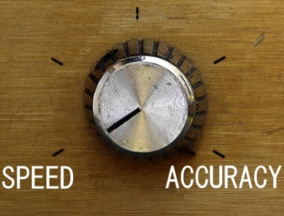
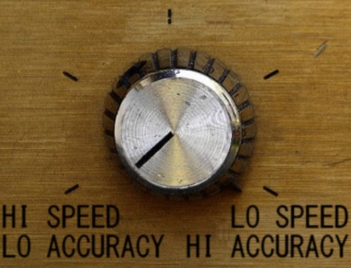
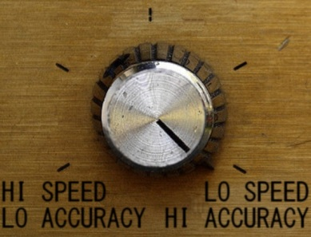
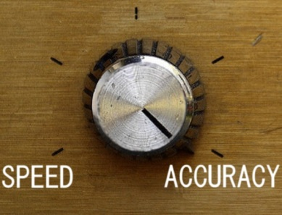
Reducing Overheads Further: Sampling
Lower overheads by skipping some analyses
No
Analysis
Complete
Analysis

Slide 28


Sampling Allows Distribution
End Users
Beta Testers
Many users testing at little overhead see more errors than one user at high overhead.
Developer

Slide 29


Cannot Naïvely Sample Code
Input
x = read_input()
validate(x)
Skip Instr.
x = read_input()
Validate(x)
False Positive
y = x * 1024
w = x + 42
Check w
y = x * 1024
w = x + 42
Check w
a += y
Skip Instr.
a += y
z = y * 75
Check z
Check a
Check z
False Negative
Check a

Slide 30
Solution: Sample Data, not Code
Sampling must be aware of meta-data
Remove meta-data from skipped dataflows
  Prevents false positives

Slide 31
Dataflow Sampling Example
Input
x = read_input()
x = read_input()
validate(x)
Skip Dataflow
y = x * 1024
Check w
y = x * 1024
w = x + 42
Check w
Skip Dataflow
a += y
a += y
z = y * 75
Check z
Check a
Check z
False Negative
Check a

Slide 32


Dataflow Sampling
Remove dataflows if execution is too slow
Sampling Analysis Tool
Instrumented
Application
Instrumented
Application
Native
Application
OH Threshold
Clear meta-data
Meta-data
Meta-Data Detection

Slide 33
Prototype Setup
Taint analysis sampling system
  Network packets untrusted
Xen-based demand analysis
  Whole-system analysis with modified QEMU
Overhead Manager (OHM) is user-controlled
Xen Hypervisor
ShadowPage Table
Admin VM
OS and Applications
Net Stack
Taint Analysis QEMU
OHM
App
App
…
App
Linux

Slide 34
Benchmarks
Performance – Network Throughput
  Example: ssh_receive
Accuracy of Sampling Analysis
  Real-world Security Exploits
Name | Error Description
Apache | Stack overflow in Apache Tomcat JK Connector
Eggdrop | Stack overflow in Eggdrop IRC bot
Lynx | Stack overflow in Lynx web browser
ProFTPD | Heap smashing attack on ProFTPD Server
Squid | Heap smashing attack on Squid proxy server

Slide 35
Performance of Dataflow Sampling
ssh_receive
Throughput with no analysis

Slide 36
Accuracy with Background Tasks
ssh_receive running in background

Slide 37
BACKUP SLIDES

Slide 38
Performance Difference
Phoenix
PARSEC

Slide 39
Width Test
Notes:
In case the projector is clipping.

